Slide 1
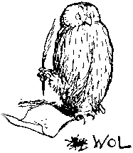
Description Logic Based
Ontology Languages
Ian Horrocks
<ian.horrocks@comlab.ox.ac.uk>
Information Systems Group
Oxford University Computing Laboratory

Slide 2
What Are Description Logics?

Slide 3
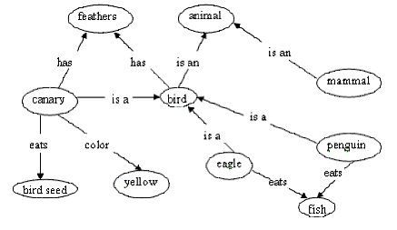
What Are Description Logics?
A family of logic based Knowledge Representation formalisms
  Descendants of semantic networks and KL-ONE
  Describe domain in terms of concepts (classes), roles (properties, relationships) and individuals

Slide 4
What Are Description Logics?
A family of logic based Knowledge Representation formalisms
  Descendants of semantic networks and KL-ONE
  Describe domain in terms of concepts (classes), roles (properties, relationships) and individuals
Modern DLs (after Baader et al) distinguished by:
  Fully fledged logics with formal semantics
    Decidable fragments of FOL (often contained in C₂)
    Closely related to Propositional Modal & Dynamic Logics
    Closely related to Guarded Fragment
  Provision of inference services
    Decision procedures for key problems (satisfiability, subsumption, etc)
    Implemented systems (highly optimised)

Slide 5

DL Basics
Concepts (unary predicates/formulae with one free variable)
  E.g., Person, Doctor, HappyParent, (Doctor t Lawyer)
Roles (binary predicates/formulae with two free variables)
  E.g., hasChild, loves, (hasBrother ± hasDaughter)
Individuals (constants)
  E.g., John, Mary, Italy
Operators (for forming concepts and roles) restricted so that:
  Satisfiability/subsumption is decidable and, if possible, of low complexity
  No need for explicit use of variables
    Restricted form of 9 and 8 (direct correspondence with ◊ and )
  Features such as counting can be succinctly expressed

Slide 6
The DL Family (1)
Smallest propositionally closed DL is ALC (equiv modal K_{(m)})
  Concepts constructed using booleans
  u, t, :,
  plus restricted (guarded) quantifiers
  9, 8
  Only atomic roles
E.g., Person all of whose children are either Doctors or have a child who is a Doctor:
  Person u 8hasChild.(Doctor t 9hasChild.Doctor)

Slide 7
The DL Family (2)
S often used for ALC extended with transitive roles (R₊)
Additional letters indicate further extensions, e.g.:
  H for role hierarchy (e.g., hasDaughter v hasChild)
  R for role box (e.g., hasParent ± hasBrother v hasUncle)
  O for nominals/singleton classes (e.g., {Italy})
  I for inverse roles (e.g., isChildOf ´ hasChild–)
  N for number restrictions (e.g., >2hasChild, 63hasChild)
  Q for qualified number restrictions (e.g., >2hasChild.Doctor)
  F for functional number restrictions (e.g., 61hasMother)

Slide 8
DL Knowledge Base
A TBox is a set of “schema” axioms (sentences), e.g.:
  {Doctor v Person,
  HappyParent ´ Person u 8hasChild.(Doctor t 9hasChild.Doctor)}
An ABox is a set of “data” axioms (ground facts), e.g.:
  {John:HappyParent,
  John hasChild Mary}
A Knowledge Base (KB) is just a TBox plus an Abox

Slide 9
What is an Ontology?
A model of (some aspect of) the world
Introduces vocabulary relevant to domain
Specifies intended meaning of vocabulary
  Typically formalised using a suitable logic
Closely related to schemas in the DB world
  Instantiated by set of individuals and relations
  Defines constraints on possible instantiations

Slide 10
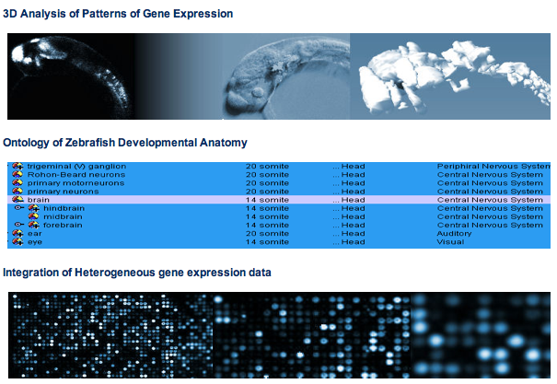
Motivating Applications
In areas such as
Life Sciences

Slide 11
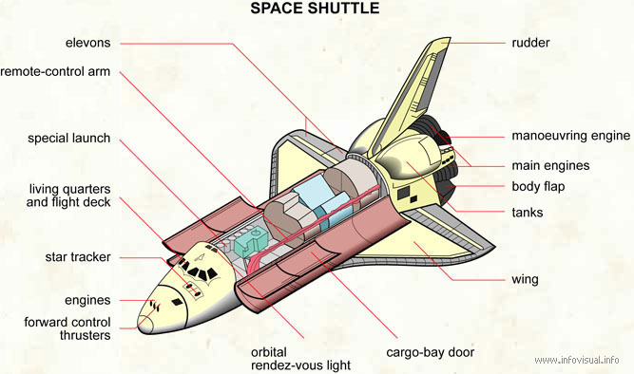
Motivating Applications
In areas such as
Life Sciences
Engineering

Slide 12

Motivating Applications
In areas such as
Life Sciences
Engineering
Semantic Web
…

Slide 13
NHS £6.2 £12 Billion IT Programme
Key component is “Care Records Service”
“Live, interactive patient record service accessible 24/7”
Patient data distributed across local and national DBs
  Diverse applications support radiology, pharmacy, etc
  Applications exchange “semantically rich clinical information”
  Summaries sent to national database
SNOMED-CT ontology provides clinical vocabulary
  Data uses terms drawn from ontology
  New terms with well defined meaning can be added “on the fly”

Slide 14

The Web Ontology Language OWL
Semantic Web led to requirement for a “web ontology language”
set up Web-Ontology (WebOnt) Working Group
  WebOnt developed OWL language
  OWL based on earlier languages OIL and DAML+OIL
  OWL now a W3C recommendation (i.e., a standard)
OIL, DAML+OIL and OWL based on Description Logics
  OWL effectively a “Web-friendly” syntax for SHOIN
  i.e., ALC extended with transitive roles, a role hierarchy
  nominals, inverse roles and number restrictions
  OWL 2 (under development) based on SROIQ
  i.e., OWL extended with a role box, QNRs

Slide 15
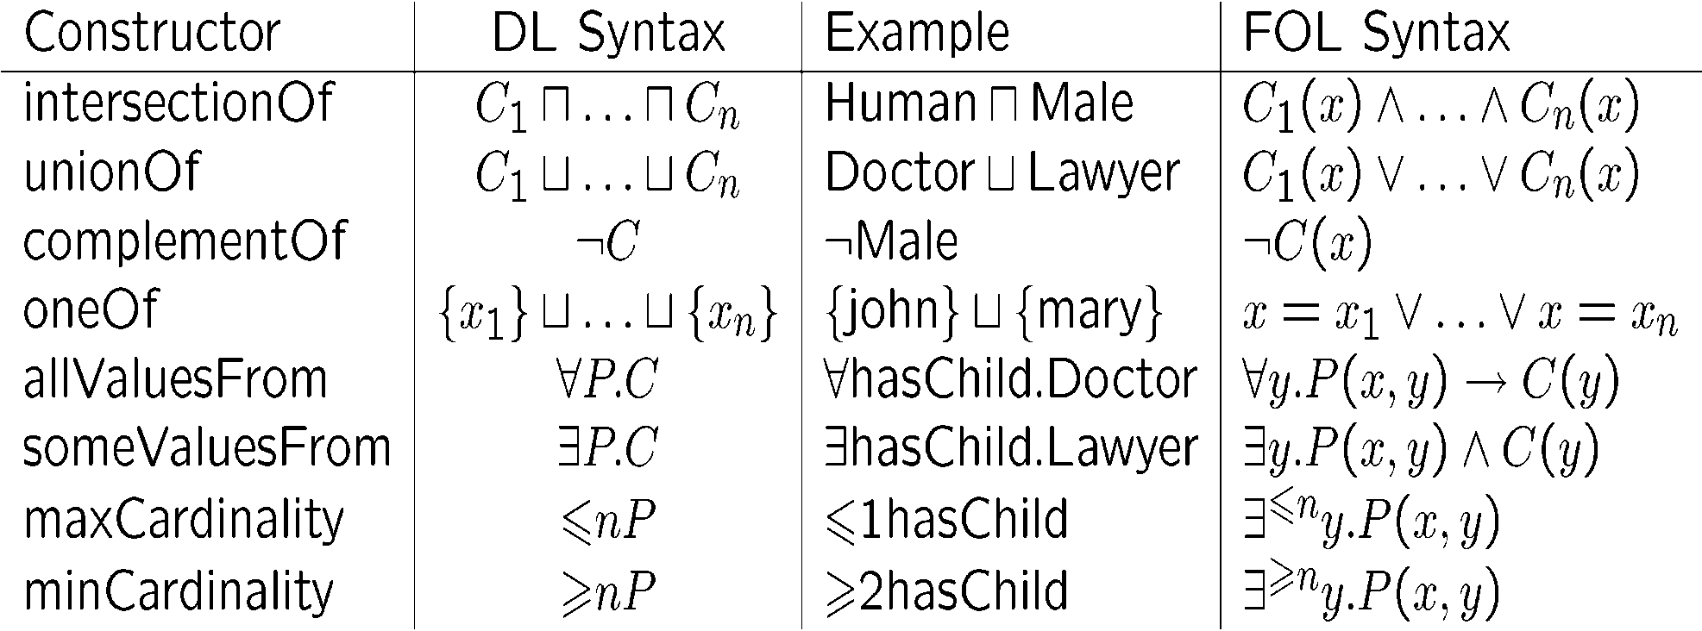
Class/Concept Constructors
for C a concept (class); P a role (property); x an individual name

Slide 16
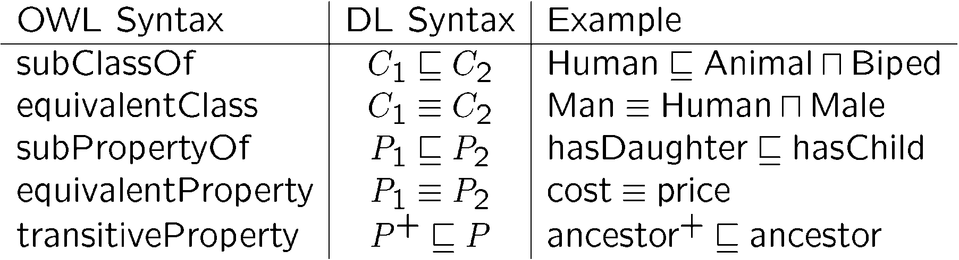
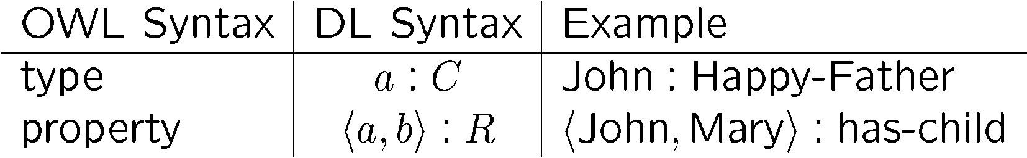
Ontology Axioms
An Ontology is usually considered to be a TBox
  but an OWL ontology is a set of TBox and ABox axioms

Slide 17
Other Features
XSD datatypes, values (OWL) plus facets and ranges (OWL 2)
  integer, real, float, decimal, string, datetime, …
  PropertyAssertion( hasAge Meg "17"^^xsd:integer )
  minExclusive, maxExclusive, length, …
  DatatypeRestriction( xsd:integer xsd:minInclusive "5"^^xsd:integer xsd:maxExclusive "10"^^xsd:integer )
  SomeValuesFrom( a:hasAge DatatypeRestriction( xsd:integer xsd:maxExclusive "20"^^xsd:integer ) )
I.e., (limited form of) DL concrete domains
Keys
  E.g., HasKey(Person SSN)
I.e., DL safe rules

Slide 18
OWL RDF/XML Exchange Syntax
E.g., Person u 8hasChild.(Doctor t 9hasChild.Doctor):
<owl:Class>
<owl:intersectionOf rdf:parseType=" collection">
<owl:Class rdf:about="#Person"/>
<owl:Restriction>
<owl:onProperty rdf:resource="#hasChild"/>
<owl:allValuesFrom>
<owl:unionOf rdf:parseType=" collection">
<owl:Class rdf:about="#Doctor"/>
<owl:Restriction>
<owl:onProperty rdf:resource="#hasChild"/>
<owl:someValuesFrom rdf:resource="#Doctor"/>
</owl:Restriction>
</owl:unionOf>
</owl:allValuesFrom>
</owl:Restriction>
</owl:intersectionOf>
</owl:Class>

Slide 19
Description Logic Reasoning

Slide 20
Deciding KB Satisfiability
Key reasoning tasks reducible to KB (un)satisfiability
  E.g., C v D w.r.t. KB K iff K [ {x:(C u :D)} is not satisfiable
State of the art DL systems typically use (highly optimised) tableaux algorithms to decide satisfiability (consistency) of KB
Tableaux algorithms try to find (abstraction of) model of K:
  Start from ground facts (ABox axioms)
  Explicate structure implied by complex concepts and TBox axioms
    Syntactic decomposition using tableaux expansion rules
    Infer constraints on (elements of) model

Slide 21
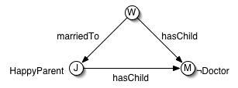
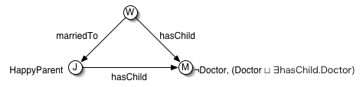
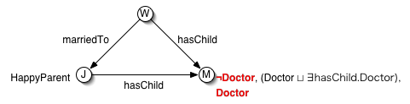
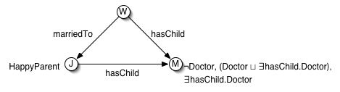
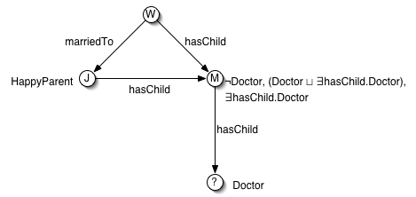
Tableaux Reasoning (1)
E.g., KB:
  {HappyParent ´ Person u 8hasChild.(Doctor t 9hasChild.Doctor),
  John:HappyParent, John hasChild Mary, Mary:: Doctor
  Wendy hasChild Mary, Wendy marriedTo John}
Person
8hasChild.(Doctor t 9hasChild.Doctor)

Slide 22
Decision Procedures
KB is satisfiable iff rules can be applied such that fully expanded clash free abstraction is constructed:
Sound
  Given fully expanded clash-free abstraction, can trivially construct model
Complete
  Given a model, can use it to guide application of non-deterministic rules
Terminating
  Bounds on number of “root” individuals, out-degree of trees (rule applications per individual), and depth of trees (blocking)
Crucially depends on (some form of) forest model property

Slide 23
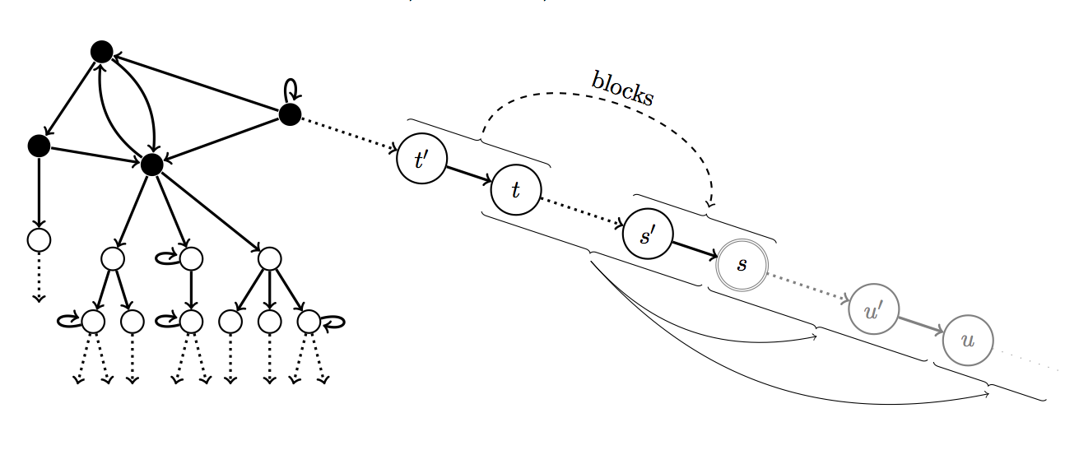
Forest Model Property
Search can be limited to forest-like models

Slide 24

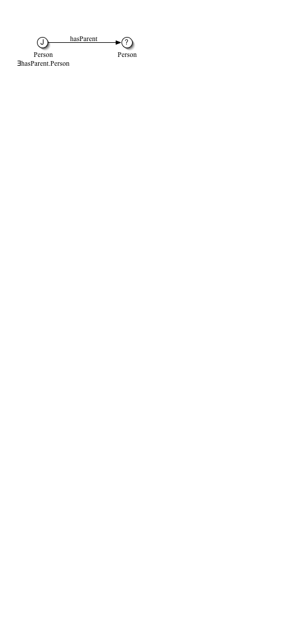

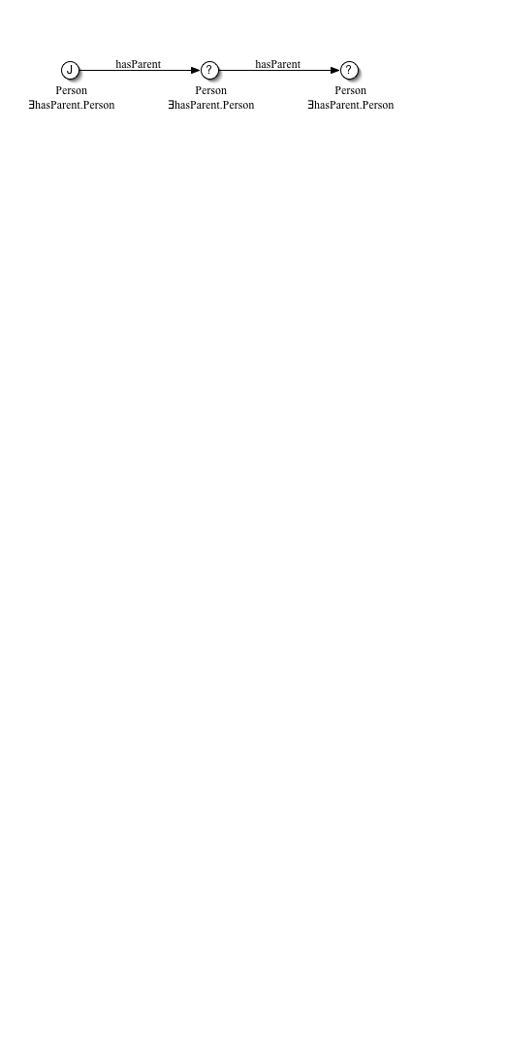

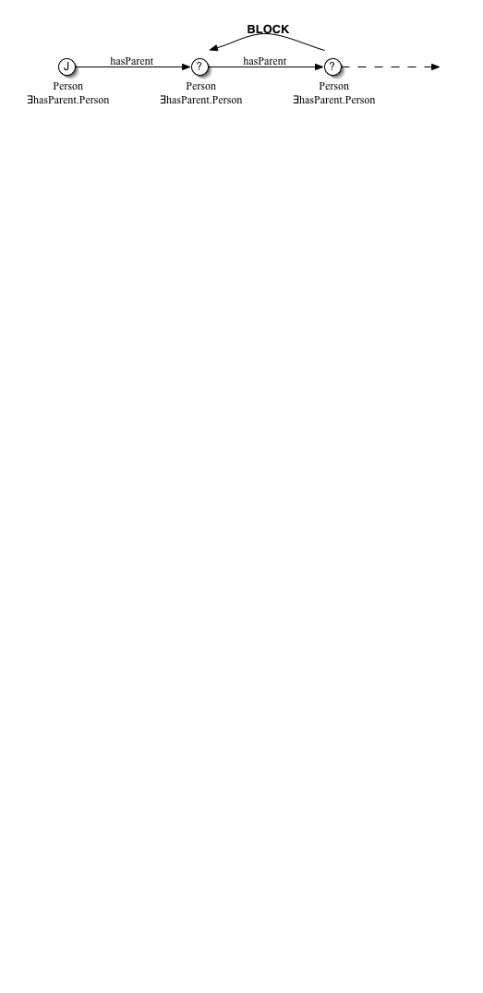

Termination
Simplest DLs are naturally terminating
  ALC with definitorial TBox
  Rules produce strictly smaller concepts
Most DLs require some form of blocking
  ALC with general Tbox -- single blocking ensures termination
  E.g., {Person v 9hasParent.Person, John:Person}

Slide 25
Termination
Simplest DLs are naturally terminating
  ALC with definitorial TBox
  Rules produce strictly smaller concepts
Most DLs require some form of blocking
  ALC with general Tbox -- single blocking ensures termination
  E.g., {Person v 9hasParent.Person, John:Person}
More expressive DLs require more complex blocking
  E.g., SHIQ -- no longer has finite model property
  Double blocking ensures that “unravelling” produces a non-finite model

Slide 26
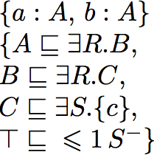
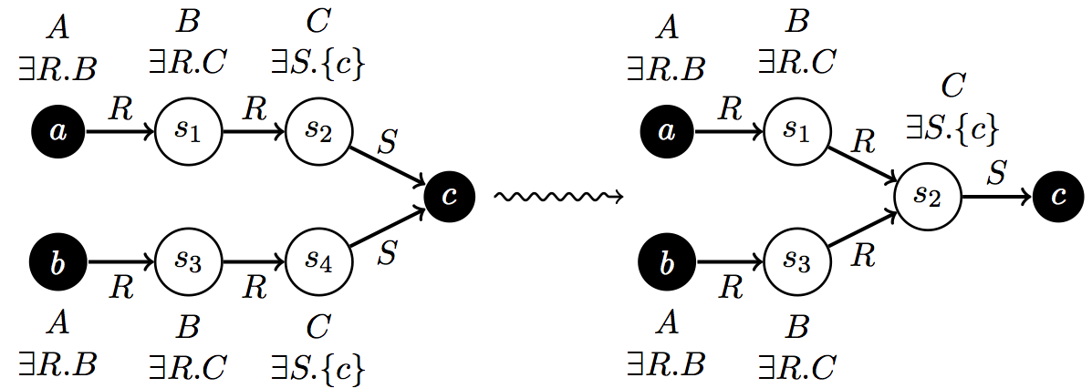
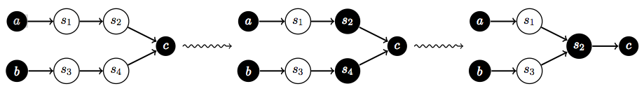
Termination
Nominals + inverse + number restrictions lead to non forest-like models
Solution is to introduce new root nodes

Slide 27
Practical Reasoning Services

Slide 28
Complexity
ALC already ExpTime-complete in size of KB
SHOIQ is NExpTime-complete
So how can it work in practice?
  “Only hopelessly intractable problems are interesting any more”
Ontologies typically don’t contain pathological cases
  Number restrictions typically use only small values
    Often only functionality
  “Nasty” interactions between constructors are rare
  Many ontologies are similar in structure
    Optimisation techniques are often broadly effective

Slide 29
Highly Optimised Implementations
Lazy unfolding
Simplification and rewriting
  Absorption:
Detection of tractable fragments (EL)
Fast semi-decision procedures
  Told subsumer, model merging, …
Search optimisations
  Dependency directed backtracking
Reuse of previous computations
  Of (un)satisfiable sets of concepts (conjunctions)
Heuristics
  Ordering don’t know and don’t care non-determinism

Slide 30
Recent and Future Work

Slide 31
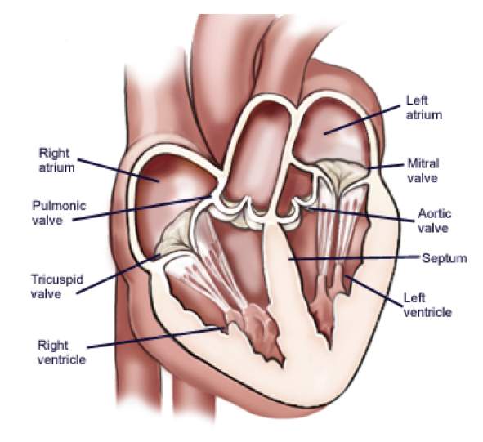
Ontology Languages & Formalisms
DLs poor for modelling non-tree structures
  E.g., physically structured objects

Slide 32
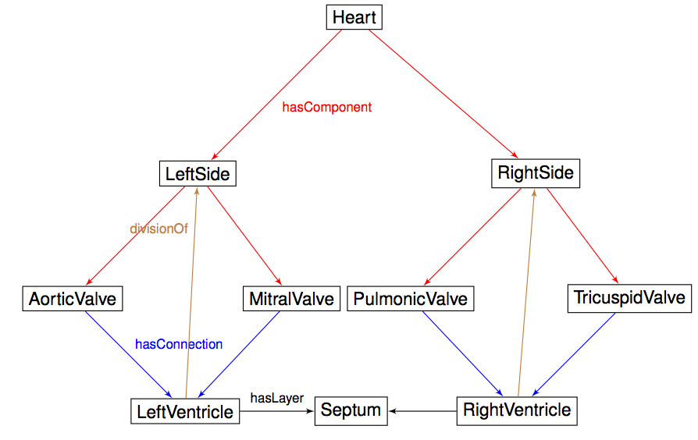
Ontology Languages & Formalisms
DLs poor for modelling non-tree structures
  E.g., physically structured objects

Slide 33
Ontology Languages & Formalisms
DLs poor for modelling non-tree structures
  E.g., physically structured objects
Description graphs [1] allow for modelling of prototypical structures
  Prototypes resemble small ABoxes
  Reasoning performance may also be significantly improved
  Some restrictions needed for decidability
    E.g., on roles used in TBox and in prototypes
[1] Motik, Cuenca Grau, Horrocks, and Sattler. Representing Structured Objects using Description Graphs. In Proc. of KR 2008.

Slide 34
Ontology Languages & Formalisms
Integration of DLs with DBs
  Open world semantics can be complex & unintuitive
    Users may want integrity constraints as well as axioms
  Reasoning with data can be problematical
    Scalability & persistence are both issues
  Solution could be closer integration with DBs [1]
    Challenge is to find a coherent yet practical semantics
[1] Boris Motik, Ian Horrocks, and Ulrike Sattler. Bridging the Gap Between OWL and Relational Databases. In Proc. of WWW 2007.

Slide 35
New Reasoning Techniques
New hypertableau calculus [1]
  Uses more complex hyper-resolution style expansion rules
    Reduces non-determinism
  Uses more sophisticated blocking technique
    Reduces model size
New HermiT DL reasoner
  Implements optimised hypertableau algorithm [2]
  Already outperforms SOTA tableau reasoners
[1] Boris Motik, Rob Shearer, and Ian Horrocks. Optimized Reasoning in Description Logics using Hypertableaux. In Proc. of CADE 2007.
[2] Boris Motik and Ian Horrocks. Individual Reuse in Description Logic Reasoning. In Proc. of IJCAR 2008.

Slide 36
New Reasoning Techniques
Saturation-based decision procedures [1]
  Uses proof search rather than model search
  Crucial “trick” is to use tableau like techniques to guide and restrict derivations
  Reasoning time for SNOMED reduced by 2 orders of magnitude
[1] Yevgeny Kazakov, Boris Motik. A Resolution-Based Decision Procedure for SHOIQ. Journal of Automated Reasoning, 40(2-3):89-116, 2008.

Slide 37
New Reasoning Services
Support for ontology re-use
  Integrate multiple ontologies [1] and/or Extract (small) modules [2]
  New reasoning problems arise
    Conservative extension, safety, ..
[1] Bernardo Cuenca Grau, Yevgeny Kazakov, Ian Horrocks, and Ulrike Sattler. A Logical Framework for Modular Integration of Ontologies. In Proc. of IJCAI 2007.
[2] Bernardo Cuenca Grau, Ian Horrocks, Yevgeny Kazakov, and Ulrike Sattler. Modular Reuse of Ontologies: Theory and Practice. JAIR, 31:273-318, 2008.
Notes:
Renders obsolete most/all earlier research!

Slide 38
New Reasoning Services
Conjunctive query answering
  Expressive query language for ontologies [1, 2]
  Long-standing open problems
    E.g., decidability of SHOIQ conjunctive query answering
[1] Birte Glimm, Ian Horrocks, Carsten Lutz, and Uli Sattler. Conjunctive Query Answering for the Description Logic SHIQ. JAIR, 31:157-204, 2008.
[2] Birte Glimm, Ian Horrocks, and Ulrike Sattler. Unions of Conjunctive Queries in SHOQ. In Proc. of KR 2008.

Slide 39
Summary
DLs are a family of logic based KR formalisms
DLs are basis for ontology languages such as OWL
Motivating applications in, e.g., life sciences and semantic web
Automated reasoning supports ontology engineering/deployment
“Discouraging” worst case complexity
  But highly optimised implementations (typically) work well in practice
Very active research area with many open problems
  New logics
  New reasoning tasks
  New algorithms and implementations
  …

