Slide 1
𝐴[3,2,6,5,1]
6
5
3
2
0
1
2
3
4
0
1
2
3
4
theLargest()
A
A
3
2
6
5
1
3
2
1
5
6
1
4
7
largest
k
4
last

Slide 2
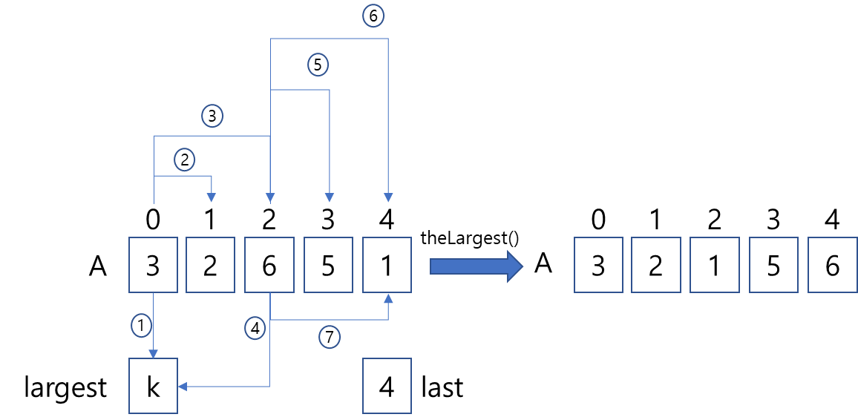

Slide 3
6
5
5
3
3
3
2
2
2
0
1
2
3
4
0
1
2
3
4
0
1
2
3
4
theLargest()
A
theLargest()
A
A
3
2
6
5
1
3
2
1
5
6
3
2
1
5
6
1
4
1
6
1
7
4
largest
k
4
largest
k
4
3
largest
k
2
last
last
last
theLargest()
2
0
1
2
3
4
0
1
2
3
4
theLargest()
0
1
2
3
4
A
1
2
3
5
6
A
1
2
3
5
6
A
1
2
3
5
6
1
4
largest
k
3
1
last

Slide 4
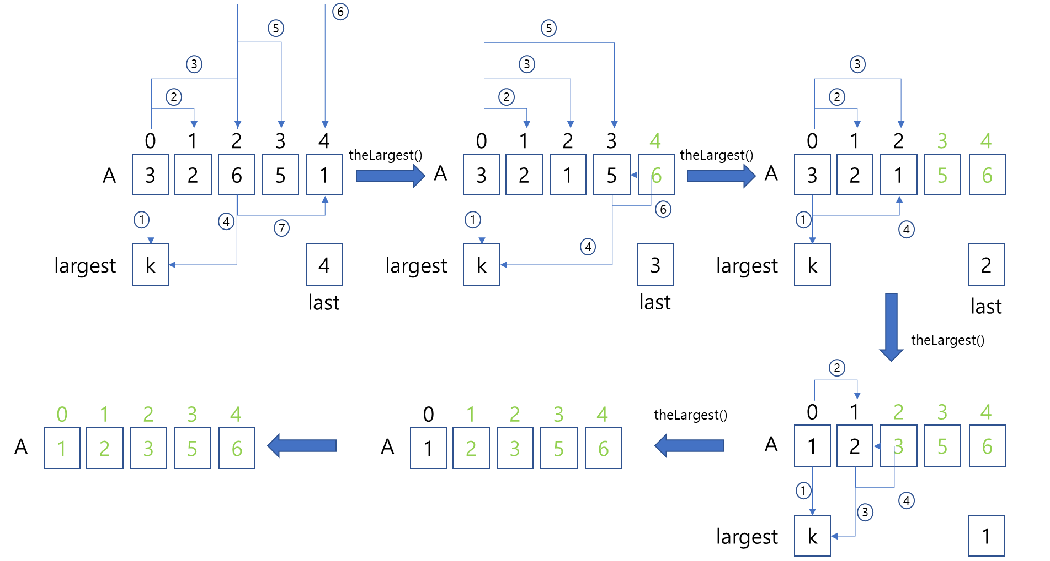

Slide 5
0
1
2
3
4
A
3
2
1
5
6
A
2
3
1
5
6
A
2
1
3
5
6
A
2
1
3
5
6
A
2
1
3
5
6

Slide 6
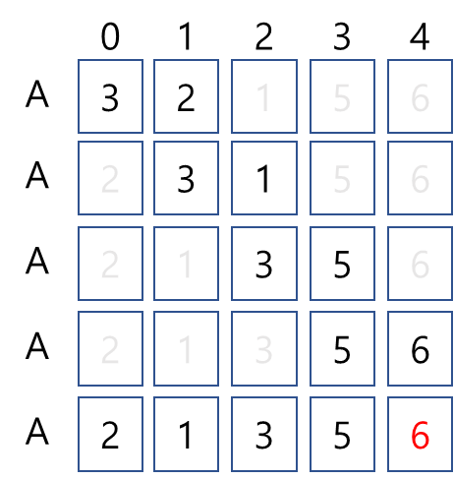

Slide 7
4 round
3 round
2 round
1 round
0
0
1
0
1
2
0
1
2
3
0
1
2
3
4
A
1
A
1
2
A
1
2
3
A
2
1
3
5
A
3
2
1
5
6
A
1
2
A
1
2
3
A
1
2
3
5
A
2
3
1
5
6
A
1
2
3
A
1
2
3
5
A
2
1
3
5
6
A
1
2
3
5
A
2
1
3
5
6
A
2
1
3
5
6
0
1
2
3
4
A
1
2
3
5
6

Slide 8
