Slide 1
MINISQL
文本关系型数据库系统实现
课程:算法设计与分析 导师:宫秀军
李佳麒 2509218031
2009-12-14

Slide 2
问题描述
来源:POJ 3699 并予以扩充,形成一个RDBMS
输入(Input)
输出(Output)

Slide 3
基本概念
RDBMS(Relational Database Management System)
DML(Data Manipulation Language)
DDL(Data Definition Language)
Syntax Analysis
Regular Expression

Slide 4
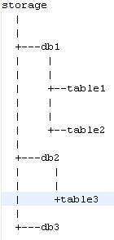
存储方式
存储目录结构
private File databasefile ; //数据库目录
private File storge; //存储引擎目录
private File currenttable; //当前表文件
private static Connection connection; //连接
//单例模式保存数据库连接
public static Connection getInstance() throws InstantiationException, IllegalAccessException, ClassNotFoundException{
if(connection==null){
connection = new Connection();
}
return connection;
}

Slide 5
支持数据类型
net.fly78.miniSQL.datatype.DataType接口
  INT
  STR
  DATE
  FLOAT
public interface DataType {
  public String getStringValue();
  public int getLength();
  public Class<?> getType();
  public DataType getValue();
  public int compare(String r);
}

Slide 6
命令集
use $db
create database $name
show database
show tables
create table $name ($filed $type $length , $filed $type $length)
select * from $table where $field=$cond
describe $table;
insert into $table value($value);

Slide 7
命令集(续)
接口Command
Command适配器CommandAdpter
实现命令多态
通过正则表达式,反射
try{
Command rc = Ref2Class.getCommand(res.toLowerCase().split(" ")[0]);
res = res.substring(0, res.length()-1);
rc.excuse(res);
}catch(Exception e){
System.out.println("unknow command");
}

Slide 8
测试用例
4 10
SID INT 8
NAME STR 20
SEX STR 2
AGE INT 8
1000 Potion F 22
1001 Phoenix_Down M 34
1002 Remedy M 52
1003 Dagger F 31
1004 Rod M 42
1005 Flame_Staff M 72
1006 Broad_Sword F 47
1007 Fork M 10
1008 Javelin M 85
1009 Cats_Claws F 37
1010 Dafei M 25
1011 Maliwen M 25

Slide 9
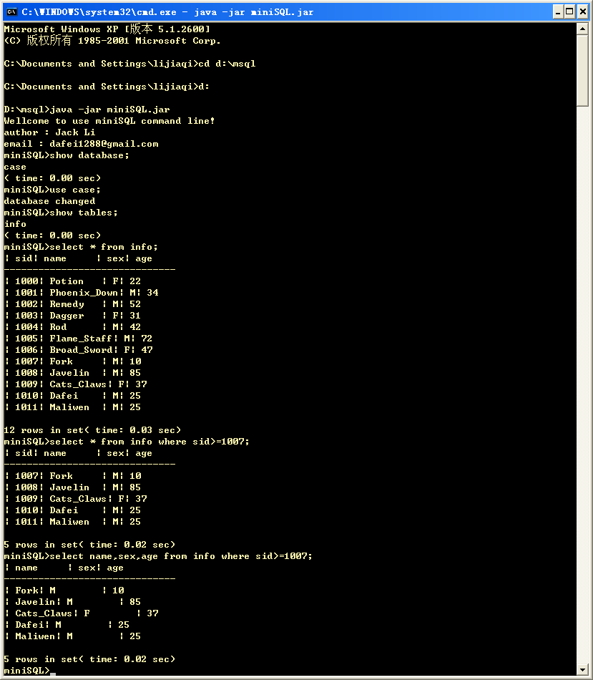

Slide 10


