Slide 1
JIMSQL : JIM ISN’T MYSQL
李佳麒 Jack Li
Sunday, March 07, 2010

Slide 2
概要
问题描述
基本概念
特性
  架构图
  存储方式
  支持数据类型
  命令集
  其他特性
  Road map
测试
目前还处于玩具级阶段

Slide 3
问题描述
来源:POJ (北大ACM月赛) 3699并予以扩充
  http://acm.pku.edu.cn/JudgeOnline/problem?id=3699
输入(Input)
输出(Output)
Notes:
miniSQL
Time Limit: 1000MS Memory Limit: 65536K
Total Submissions: 1510 Accepted: 463
Description
Joan is taking an internship at a company these days. Every day she is assigned tons of dull statistical jobs such as counting how many products made by the company values more than $100. In order to have more time to chat with the handsome intern nearby, she asks you to program a clever software that helps her get released from the onerous work.
The software should take as input a table of records together with several queries and for each query output all the records respectively.
Input
The first part of the input is a single line consisting of three integers, m(1 ≤ m ≤ 10), n(1 ≤ n ≤ 10000), k(1 ≤ k ≤ 100) indicating the number of columns in the table, the number of records and the number of queries.
The second part of the input is the description of the table, which consists of m lines. The i-th line of this part consists two strings in the format Column_Name Type which describes the i-th column of the table.
Column_Name contains only letters(a-zA-Z), digits(0-9) and underline(_).
Type is either "STR" or "INT" indicating the type of this column.
The third part of the input shows the content of the table which contains n lines. The i-th line of this part shows the i-th record in the table which consists of m items.
if the type of the i-th column is "INT", the i-th item will be a 32-bit integer.
if the type of the i-th column is "STR" , the i-th item will be a string containing only letters(a-zA-Z), digits(0-9) and underline(_).
The last part of the input gives the k queries which are similar to SQL select statements. The query is in the format select Column_List where Condition
Column_List contains a list of column names which are separated by a single comma. All the names occured in the description of the table.
Condition is in the format Column_Name Op Value
Column_Name is one of the column name in the description of the table.
if the column's type is "STR", Op is "=". Otherwise it may be "=", "<" or ">".
if the column's type is "STR", Value will be a quoted string containing only letters(a-zA-Z), digits(0-9) and underline(_). Otherwise it will be a 32-bit integer.
The size of the input will not exceed 1M bytes.
Output
For each query output a table and a blank line as Sample Output shows.
Sample Input
3 10 4
SID INT
NAME STR
PRIZE INT
1000 Potion 50
1001 Phoenix_Down 150
1002 Remedy 300
1003 Dagger 320
1004 Rod 260
1005 Flame_Staff 1100
1006 Broad_Sword 330
1007 Fork 1100
1008 Javelin 880
1009 Cats_Claws 4000
select SID,NAME,PRIZE where PRIZE>100
select SID,SID where NAME="Dagger"
select PRIZE where NAME="Rod"
select SID,NAME,PRIZE where NAME="Excalibur"
Sample Output
+-----------------------------+
| SID | NAME | PRIZE |
|------|--------------|-------|
| 1001 | Phoenix_Down | 150 |
| 1002 | Remedy | 300 |
| 1003 | Dagger | 320 |
| 1004 | Rod | 260 |
| 1005 | Flame_Staff | 1100 |
| 1006 | Broad_Sword | 330 |
| 1007 | Fork | 1100 |
| 1008 | Javelin | 880 |
| 1009 | Cats_Claws | 4000 |
+-----------------------------+
+-------------+
| SID | SID |
|------|------|
| 1003 | 1003 |
+-------------+
+-------+
| PRIZE |
|-------|
| 260 |
+-------+
+--------------------+
| SID | NAME | PRIZE |
|-----|------|-------|
+--------------------+
Source
POJ Founder Monthly Contest – 2008.10.05, Dagger

Slide 4
基本概念
RDBMS(Relational Database Management System)
DML(Data Manipulation Language)
DDL(Data Definition Language)
Syntax Analysis
Regular Expression

Slide 5
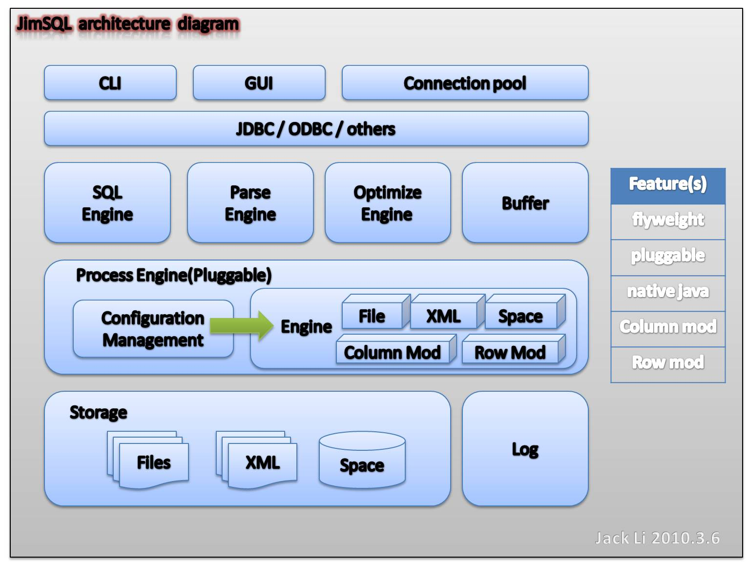
架构图

Slide 6
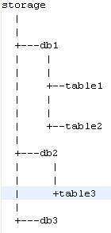
存储方式（目前文本存储，没实现索引）
存储目录结构
private File databasefile ; //数据库目录
private File storge; //存储引擎目录
private File currenttable; //当前表文件
private static Connection connection; //连接
//单例模式保存数据库连接
public static Connection getInstance() throws InstantiationException, IllegalAccessException, ClassNotFoundException{
if(connection==null){
connection = new Connection();
}
return connection;
}

Slide 7
支持数据类型
net.fly78.miniSQL.datatype.DataType接口
  INT
  STR
  DATE
  FLOAT
public interface DataType {
  public String getStringValue();
  public int getLength();
  public Class<?> getType();
  public DataType getValue();
  public int compare(String r);
}

Slide 8
命令集（模拟MYSQL命令行风格）
use $db
create database $name
show database
show tables
create table $name ($filed $type $length , $filed $type $length)
select * from $table where $field=$cond
describe $table;
insert into $table value($value);

Slide 9
命令集(续)
接口Command
Command适配器CommandAdpter
实现命令多态
通过正则表达式,反射
try{
Command rc = Ref2Class.getCommand(res.toLowerCase().split(" ")[0]);
res = res.substring(0, res.length()-1);
rc.excuse(res);
}catch(Exception e){
System.out.println("unknow command");
}

Slide 10
其他特性
纯JAVA实现
开放架构
  支持配置解析器引擎方式
  支持配置存储引擎
扩展基本数据类型
支持日志

Slide 11
Road map
改进存储方式
增加列存模式
SQL标准的支持
语法解释器优化
增加索引
增加锁

Slide 12
测试用例
4 10
SID INT 8
NAME STR 20
SEX STR 2
AGE INT 8
1000 Potion F 22
1001 Phoenix_Down M 34
1002 Remedy M 52
1003 Dagger F 31
1004 Rod M 42
1005 Flame_Staff M 72
1006 Broad_Sword F 47
1007 Fork M 10
1008 Javelin M 85
1009 Cats_Claws F 37
1010 Dafei M 25
1011 Maliwen M 25

Slide 13
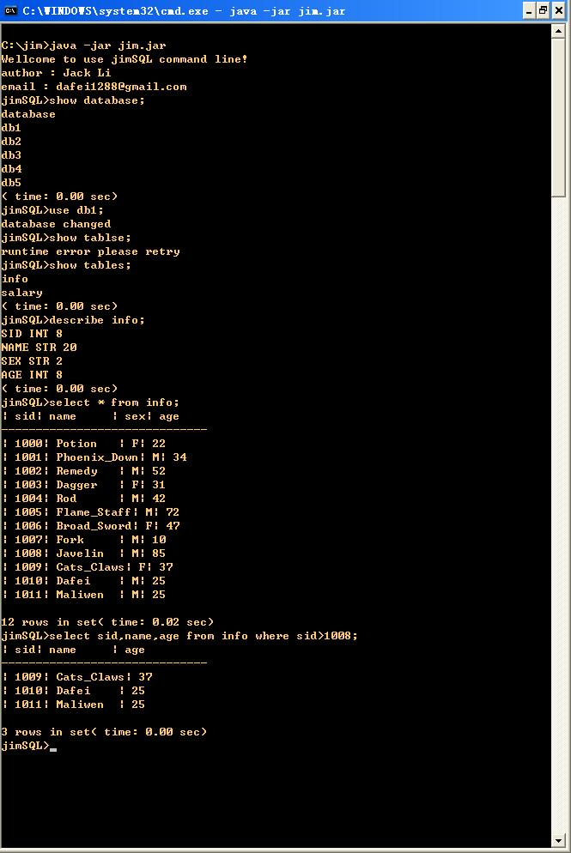
测试用例
java –jar jim.jar
show database;
use db1;
show tables;
describe info;
select * from info;
Select * from info where sid>1008

Slide 14
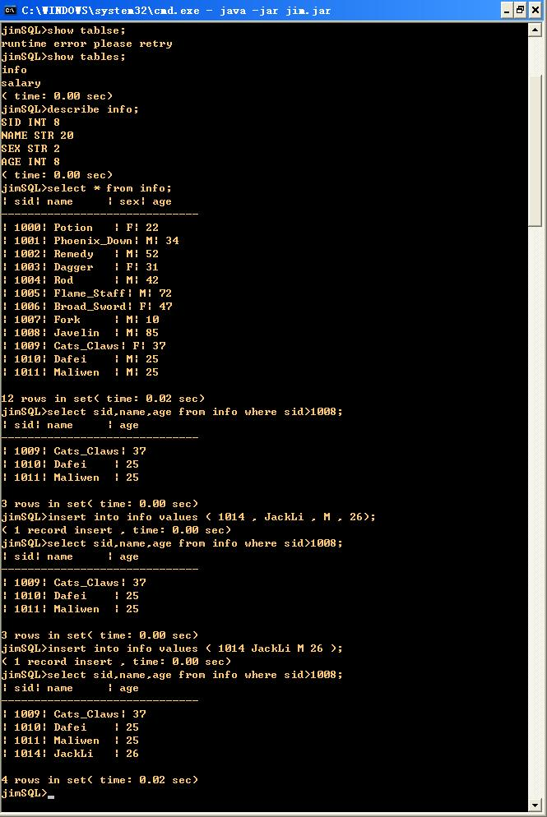
测试用例
insert into info values( 1012 JackLi M 26 );
SQL 语句还不完全支持标准

Slide 15


