Slide 1

YOUTH BREAK THE BOUNDARIES
Neurodivergent
Inclusion in Japan
A Pathway to Equity
Project Team
Presentation
Faiz Abdillah, Mert Bian, Malika
2026

Slide 2
THE URGENCY
Why Neurodivergent Inclusion Matters in Japan
Rising Prevalence
Mental Health Crisis
Exceeding Global Averages
Suicidal Ideation Risk
3.26%
56%
ASD prevalence for 2014 birth cohort in Japan, significantly higher than global averages. The burden continues to rise, with projections showing sustained increase through 2050.
Lifetime suicidal ideation among young adults with both ASD and ADHD traits. 33.9% across all neurodivergent youth - a silent epidemic requiring urgent intervention.
Cultural Barriers
Implementation Gap
The Meiwaku Factor
Law vs. Reality
「迷惑」
2024
The cultural value of "not burdening others" prevents neurodivergent individuals from requesting accommodations. Stigma remains significantly higher than in Western contexts even after awareness interventions.
Japan's amended law mandating reasonable accommodation took effect April 2024, yet practical implementation remains limited. The disconnect between legal protection and workplace reality creates invisible barriers.

Slide 3
PROBLEM DEFINITION
Problem Background & Target Beneficiary
The Core Problem
Target Beneficiary
Neurodivergent individuals in Japan face systemic barriers in education, employment, and social participation due to persistent stigma, lack of public awareness, and inadequate practical accommodations.
Demographics
Neurodivergent youth and young adults, ages 16-30
Despite legal protections under the 2016 Act (amended 2024), the implementation gap between policy and practice leaves many without support. Cultural factors compound these challenges, making Japan's neurodivergent inclusion landscape uniquely complex.
Conditions
ASD, ADHD, and related neurodevelopmental conditions
Problem Scope
Location
Urban Japan, primarily Tokyo and surrounding prefectures
Education
Employment
Social Life
Focus
Inadequate support in schools and universities
Workplace discrimination and lack of accommodations
Social isolation and communication barriers
High-functioning individuals navigating education-to-work transitions
Key Challenge
Gap between legal protections and practical implementation

Slide 4
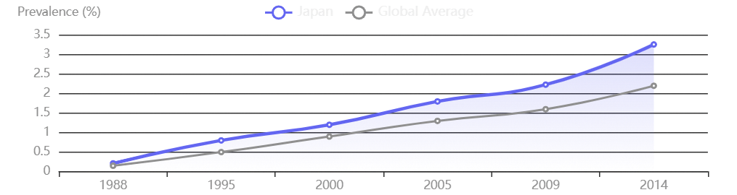
EVIDENCE BASE
Japan-Specific Evidence & Current Context
ASD Prevalence Trends in Japan (GBD 2021)
Key Statistics
1
56% lifetime suicidal ideation (ASD+ADHD traits)
2
33.9% lifetime suicidal ideation across all neurodivergent youth
3
3.26% ASD prevalence (2014 birth cohort)
4
2.23% cumulative incidence (2009 birth cohort)
Legal Framework
Regional Variations
Gender Disparity
The Act for Eliminating Discrimination against Persons with Disabilities was enacted in 2016 and amended in April 2024 to mandate reasonable accommodation for all business operators.
Higher ASD burden in Tokyo, Aomori, Fukuoka, Nagano . Urban areas show greater prevalence due to diagnostic access and awareness, not solely environmental factors.
Male-to-female ratio 4:1 , with significant underdiagnosis in females who employ masking strategies. This gap suggests many women remain unsupported.
Sources: GBD 2021, Frontiers Psychiatry 2025, Japanese Law Translation

Slide 5
ROOT CAUSE ANALYSIS
Root Causes & Systemic Barriers
Cultural Stigma
Lack of Awareness
Inadequate Accommodation
Limited Infrastructure
Communication Barriers
The proverb "the nail that sticks out gets hammered down" reflects intense conformity pressure. Standing out risks mockery and bullying, especially in classrooms.
Studies show autism is significantly more stigmatized in Japan than the US. Even after intervention, Japanese students stigmatize autism at high rates unlike US students.
Insufficient specialized educational and workplace support services. Existing support focuses on children or severe disabilities, leaving youth and high-functioning adults underserved.
Meiwaku culture makes it difficult to express needs. Lack of constructive dialogue frameworks means many suffer in silence rather than request help.
Despite the 2024 legal mandate, practical implementation remains limited. Many businesses lack knowledge or resources to provide meaningful accommodations.
Impact: Social exclusion
Impact: Underdiagnosis
Impact: Workplace barriers
Impact: Service gaps
Impact: Silent suffering
These interconnected barriers create a cycle: Stigma prevents disclosure → Non-disclosure limits accommodation → Lack of accommodation reinforces stigma

Slide 6
SDG ALIGNMENT
SDG Alignment & Project Logic
Reduced Inequalities
Project Logic Model
10
Primary SDG
If we address...
Target 10.2
The awareness gap, cultural barriers, and lack of practical resources preventing neurodivergent inclusion in Japan
Empower and promote the social, economic and political inclusion of all
By creating...
Target 10.3
Ensure equal opportunity and reduce inequalities of outcome
Culturally-sensitive awareness toolkits, peer support workshops, and digital resources that empower both neurodivergent youth and institutions
Then we achieve...
4
Quality Education
8
Decent Work
Increased institutional awareness, improved self-advocacy skills, successful accommodation requests, and greater social participation
Target 4.5: Eliminate gender disparities and ensure equal access to all levels of education for persons with disabilities
Target 8.5: Achieve full and productive employment and decent work for all, including persons with disabilities
Contributing to...
SDG 10 (Reduced Inequalities) by promoting social and economic inclusion of neurodivergent individuals in Japanese society

Slide 7
LANDSCAPE ANALYSIS
Existing Support & Remaining Gap
Existing Efforts
The Critical Gap
Legal Framework
Age Gap
Act for Eliminating Discrimination (2016, amended 2024)
Most support focuses on children or severe disabilities. Limited youth-specific resources for high-functioning neurodivergent individuals.
NPO Children's Trees
Early intervention programs for children with autism
HandsOn Tokyo
Institutional Gap
Volunteer support for autism organizations
No comprehensive awareness toolkit exists for educational institutions and SMEs. The 2024 law mandate lacks practical implementation guidance.
Hello Work Centers
Vocational support for persons with disabilities
Peer Support Gap
TELL Japan
Lack of peer-led, youth-focused support programs that address the unique challenges of transitioning to adulthood in Japan.
Workplace neurodiversity counseling services
Our Unique Position
NeuroBridge Japan fills these gaps by being youth-led, culturally-adapted, and practical - creating resources that existing organizations don't provide.

Slide 8

SOLUTION
Project Solution Overview
NeuroBridge Japan
Bridging Neurodivergence & Inclusion
A youth-led awareness and peer support initiative that creates culturally-sensitive toolkits, workshops, and digital resources to bridge the gap between neurodivergent young adults and inclusive educational/workplace environments in urban Japan.
Core Concept
Target Settings
Key Innovation
Build understanding from both sides - educating institutions while empowering neurodivergent youth to self-advocate
Universities, vocational schools, and SMEs in Tokyo and surrounding prefectures
Culturally-adapted approach that respects meiwaku culture while promoting constructive dialogue
3
50+
12
Core Deliverables
Pilot Beneficiaries
Week Timeline

Slide 9
IMPLEMENTATION
Activities & Deliverables
Deliverable 1
Deliverable 2
Deliverable 3
Awareness Toolkit
Peer Support Workshops
Digital Resource Platform
A culturally-adapted guide for educators and employers covering:
A 3-session program designed for neurodivergent youth:
A curated online hub providing:
Local support directory (NPOs, clinics, support groups)
Understanding neurodivergence in Japanese context
Session 1: Self-Advocacy Skills
Understanding rights, preparing accommodation requests
Success stories from Japanese neurodivergent individuals
Reasonable accommodation examples (sensory-friendly spaces, flexible communication, task restructuring)
Practical accommodation request templates
Session 2: Navigating Disclosure
FAQ and resource library
Constructive dialogue frameworks respecting meiwaku culture
When, how, and to whom to disclose neurodivergence
Visual guides and practical checklists
Session 3: Building Networks
Creating peer support groups and finding allies
Format: Digital + Print
Format: In-person + Online
Format: Website + Mobile-friendly

Slide 10
USER EXPERIENCE
Beneficiary Journey & User Scenario
Meet Yuki
1
Current State: Struggling
Yuki faces sensory overload in crowded classrooms, anxiety during group presentations, and fear of being seen as a burden if requesting help.
Profile
22-year-old university student with ASD, majoring in Computer Science
2
Discovery: NeuroBridge
Discovers NeuroBridge through university disability services. Downloads the toolkit and registers for the peer workshop series.
Current Challenge
Struggles with group work, sensory overload in classrooms, anxiety about requesting accommodations
3
Intervention: Support & Tools
Emotional State
Attends peer workshops on self-advocacy, uses the accommodation request template, and joins a peer support group.
Feels like a burden (meiwaku), considering dropping out, isolated from peers
4
Outcome: Thriving
Goal
Successfully requests and receives note-taking support and sensory accommodations. Completes degree and confidently navigates workplace.
Complete degree and transition to workplace with confidence and support

Slide 11
COLLABORATION
Partners & Stakeholder Access
Strategic Partners
Beneficiary Access Strategy
University Disability Services
Primary Channel
Direct access to beneficiaries, workshop venues, credibility
University disability services offices and student support centers
NPO Children's Trees
Established autism support network, early intervention expertise
Secondary Channel
Social media outreach (Twitter, Instagram), NPO referrals
HandsOn Tokyo
Volunteer base, community connections, event coordination
Peer Advocates
TELL Japan
Lived experience voices for authentic community trust and program design
Mental health expertise, workplace counseling, professional network
Chambers of Commerce
Ethical Considerations
Access to SMEs for toolkit distribution, workplace partnerships
Voluntary participation - no disclosure required
Anonymized stories with informed consent
Cultural sensitivity in all materials and interactions
Privacy protection - no identifiable information shared

Slide 12
EXECUTION
Implementation Timeline & Team Roles
12-Week Implementation Plan
Team Roles
Phase 1
Research & Design
Faiz Abdillah
Weeks 1-4
F
Research Lead
Conduct needs assessment, design toolkit content, develop workshop curriculum, establish partnerships
Japan-specific needs assessment, stakeholder interviews, evidence collection
Phase 2
Pilot & Refine
Weeks 5-8
Deliver 2 pilot workshops, gather feedback, refine toolkit, launch digital platform prototype
Mert Bian
M
Content Designer
Toolkit content design, workshop curriculum development, digital platform
Phase 3
Scale & Evaluate
Weeks 9-12
Expand to 2 additional locations, deliver final workshops, collect impact data, prepare sustainability handover
M
Malika
Partnership Coordinator
Partnership agreements, workshop logistics, beneficiary outreach, evaluation
Key Milestones
Collaboration Model
Week 2
Week 4
Week 6
Week 12
All team members participate in weekly sync meetings, contribute to workshop delivery, and share responsibility for project success.
Partnerships signed
Toolkit v1 complete
First pilot workshop
Impact report

Slide 13
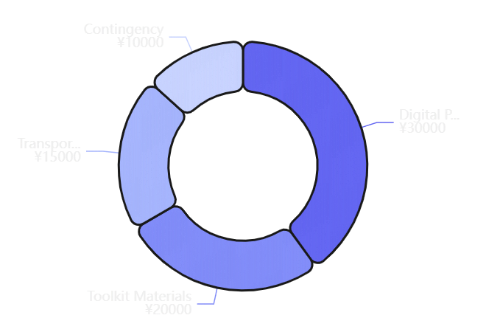
FEASIBILITY
Budget & Resource Feasibility
Budget Breakdown
Resource Requirements
Digital Platform
Toolkit Materials
¥30,000
¥20,000
Hosting & design tools (Notion, Canva)
Printing for pilot phase distribution
Transportation
Contingency
¥15,000
¥10,000
Travel & communication costs
Emergency & unexpected costs
Feasibility Assessment
High Feasibility
Primarily volunteer-driven with minimal financial requirements
Digital-First Approach
Minimizes costs through free/low-cost digital tools
In-Kind Contributions
Total Pilot Budget
Approximately
University venues, NPO expertise, volunteer time
¥75,000
$500 USD
Scalable Model
Digital resources can reach unlimited users at near-zero marginal cost

Slide 14
IMPACT
Expected Impact & Evaluation Indicators
Outputs (What We Produce)
Evaluation Indicators
Participation Metrics
1
3
Workshop attendance
Target: 15-20/session
Awareness Toolkit
Workshops Delivered
Toolkit downloads
Target: 100+
Platform visits
Target: 200+
Feedback Scores
1
50+
Pre/post self-efficacy surveys
+20% improvement
Digital Platform
Direct Beneficiaries
Satisfaction ratings
Target: 4.2/5+
Behavioral Change
Outcomes (What Changes)
Accommodation request rates
Track 3-month post
Retention in education/work
6-month follow-up
Self-Advocacy Confidence
80%
of workshop participants report increased confidence
Partner Engagement
Partnership agreements signed
Target: 3+
Successful Accommodation Requests
60%
Referral numbers
Track monthly
of toolkit users successfully request accommodations
Institutional Partnerships
3+
partners commit to ongoing collaboration

Slide 15
LONG-TERM VIABILITY
Sustainability & Risk Management
Sustainability Plan
Risk Management
1
Digital Permanence
Privacy & Sensitivity
Resources remain accessible online indefinitely at no cost
2
Open Licensing
Risk: Participant privacy concerns, stigma exposure
Toolkit under Creative Commons for free distribution and adaptation
Mitigation: All stories anonymized with consent, no identifiable information, voluntary participation only
3
Train-the-Trainer Model
Peer advocates trained to continue workshop delivery independently
4
Institutional Integration
Partner Withdrawal
University partners integrate toolkit into existing disability services
Risk: University or NPO partners unable to continue
5
Future Funding
Mitigation: Maintain multiple partnerships, have backup venues identified, diversify partner types
Seek Japan Foundation for Disability Promotion or corporate CSR programs
Low Participation
Risk: Difficulty reaching beneficiaries due to stigma
Mitigation: Leverage NPO networks for outreach, offer flexible formats (online + in-person), peer advocate referrals
Funding Constraints
Risk: Limited budget for expansion beyond pilot
Mitigation: Low-cost digital-first model, in-kind contributions, grant applications for Phase 2

Slide 16
CONCLUSION
Conclusion & Call to Action
Project Summary
Call to Action
Neurodivergent individuals in Japan face significant barriers to inclusion despite legal protections. Cultural stigma, lack of awareness, and inadequate practical accommodations create a cycle of exclusion.
We Invite Your Feedback
We welcome mentors and evaluators to provide feedback on our approach, evidence quality, and feasibility assessment. Your insights will strengthen our project.
NeuroBridge Japan addresses this gap through culturally-sensitive awareness toolkits, peer support workshops, and digital resources that empower both neurodivergent youth and the institutions that serve them.
We Seek Connections
We are looking for connections to university disability offices and NPO partners in Tokyo who could support our pilot phase and provide beneficiary access.
The project is feasible, scalable, and directly contributes to SDG 10 (Reduced Inequalities) by promoting social and economic inclusion of neurodivergent individuals in Japanese society.
We Welcome Guidance
We seek guidance on measuring long-term impact and securing sustainable funding for project expansion beyond the pilot phase.
Clear Problem
Practical Solution
SDG Aligned
Together, we can build a more inclusive Japan
Evidence-based
Measurable impact
where neurodivergence is understood, accommodated, and valued.
Youth-led

