Slide 1
Pemrograman jaringan
Prodi s1 Teknik informatika
Institut teknologi sepuluh nopember

Slide 2
outline
Thread di Python
Penerapan Thread di Socket
Satu server
Banyak server thread
Async Server

Slide 3
Thread
Berbeda dengan proses
Lightweight process
Proses sebagai induk, thread sebagai anak
Bisa berbagi state, memori, dan sumber daya
Bisa berkomunikasi antar thread
Ada beberapa cara untuk menjalankan thread di Python

Slide 4
Contoh thread 1: class inheritance
import threading
import datetime
class ThreadClass(threading.Thread):
def run(self):
now = datetime.datetime.now()
print("%s says Hello World at time: %s\n" % (self.getName(), now))
for i in range(5):
t = ThreadClass()
t.start()
Class inheritance
Method overriding
Method start untuk memanggil
method run pada thread

Slide 5
Contoh thread 2: target function
import threading
def worker():
print('Worker')
threads = []
for i in range(5):
t = threading.Thread(target=worker)
threads.append(t)
t.start()

Slide 6
Contoh thread 3: target function with args
import threading
def worker(num):
print('Worker: %s' % num)
threads = []
for i in range(5):
t = threading.Thread(target=worker, args=(i,))
threads.append(t)
t.start()

Slide 7
Contoh thread 4: thread with logging
import threading
import logging
logging.basicConfig(level=logging.DEBUG, format='(%(threadName)-10s) %(message)s', )
class MyThread(threading.Thread):
def run(self):
logging.debug('running')
for i in range(5):
t = MyThread()
t.start()

Slide 8
Contoh thread 5: class inheritance + args
logging.basicConfig(level=logging.DEBUG, format='(%(threadName)-10s) %(message)s', )
class MyThread(threading.Thread):
def __init__(self, num):
threading.Thread.__init__(self)
self.num = num
def run(self):
logging.debug(str(self.num) + ' running')
for i in range(5):
t = MyThread(i)
t.start()

Slide 9
Thread dan socket
Agar setiap klien bisa berjalan secara bersamaan, digunakan thread
Setiap klien yang terkoneksi ke server, akan dibuatkan satu thread

Slide 10
arsitektur thread dan socket
Satu server
Satu proses utama server, banyak thread untuk banyak klien yang terkoneksi
Banyak server
Beberapa thread untuk server, masing-masing thread server bisa membuat satu atau banyak thread untuk banyak klien yang terkoneksi
Satu proses utama

Slide 11
arsitektur thread dan socket
Satu proses,
banyak server thread,
banyak client thread
Satu proses, satu server,
banyak client thread
Satu proses,
banyak server thread

Slide 12
Contoh thread dan socket: satu server
import select
import socket
import sys
import threading
class Server:
def __init__(self):
self.host = 'localhost'
self.port = 5000
self.backlog = 5
self.size = 1024
self.server = None
self.threads = []
Inisialisasi variabel

Slide 13
def open_socket(self):
self.server = socket.socket(socket.AF_INET, socket.SOCK_STREAM)
self.server.setsockopt(socket.SOL_SOCKET, socket.SO_REUSEADDR, 1)
self.server.bind((self.host, self.port))
self.server.listen(self.backlog)
Membuat socket, bind, listen

Slide 14
def run(self):
self.open_socket()
input_list = [self.server, sys.stdin] # Linux can have non-socket item
running = 1
while running:
input_ready, _, _ = select.select(input_list, [], [])
for s in input_ready:
if s == self.server:
# handle the server socket
client_socket, client_address = self.server.accept()
c = Client(client_socket, client_address)
c.start()
self.threads.append(c)
elif s == sys.stdin:
# handle standard input
_ = sys.stdin.readline()
running = 0
Pengecekan oleh
modul select
Jika ada klien terkoneksi,
buat instance kelas Client yang dibuat
dari parent kelas thread
(class Client di slide berikutnya)

Slide 15
# close all threads
self.server.close()
for c in self.threads:
c.join()
Memastikan semua thread klien
sudah selesai menjalankan tugasnya

Slide 16
Kelas Client diturunkan dari kelas threading.Thread
class Client(threading.Thread):
def __init__(self, client, address):
threading.Thread.__init__(self)
self.client = client
self.address = address
self.size = 1024
def run(self):
running = 1
while running:
data = self.client.recv(self.size)
print('received: ', self.address, data)
if data:
self.client.send(data)
else:
self.client.close()
running = 0
Proses mengirim dan
menerima data

Slide 17
Kode program yang dipanggil pertama di mode script
if __name__ == "__main__":
server = Server()
server.run()

Slide 18
Contoh thread dan socket: banyak server thread
Utils: https://github.com/brandon-rhodes/fopnp/blob/m/py3/chapter07/zen_utils.py
Klien: https://github.com/brandon-rhodes/fopnp/blob/m/py3/chapter07/client.py
Satu server: https://github.com/brandon-rhodes/fopnp/blob/m/py3/chapter07/srv_single.py
Banyak server thread: https://github.com/brandon-rhodes/fopnp/blob/m/py3/chapter07/srv_threaded.py

Slide 19
Zen_utils.py
def get_answer(aphorism):
def parse_command_line(description):
def create_srv_socket(address):
def accept_connections_forever(listener):
def handle_conversation(sock, address):
def handle_request(sock):
def recv_until(sock, suffix):

Slide 20
Banyak server thread
import zen_utils
from threading import Thread
def start_threads(listener, workers=4):
t = (listener,)
for i in range(workers):
Thread(target=zen_utils.accept_connections_forever, args=t).start()
if __name__ == '__main__':
address = zen_utils.parse_command_line('multi-threaded server')
listener = zen_utils.create_srv_socket(address)
start_threads(listener)
Satu accept() satu thread,
Didefinisikan ada 4 server worker

Slide 21
def accept_connections_forever(listener):
"""Forever answer incoming connections on a listening socket."""
while True:
sock, address = listener.accept()
print('Accepted connection from {}'.format(address))
handle_conversation(sock, address)

Slide 22

asynchronous server
The code is willing to hear from a whole list of waiting client sockets and respond whenever one of those clients is ready for more interaction,
Instead of blocking and waiting for data to arrive or depart from one particular client

Slide 23
asynchronous server
The name asynchronous means that the server code never stops to wait for a particular client
The thread of control running the code is not synchronized
Instead, it switches freely among all connected clients to do the work of serving.

Slide 24
Why is it possible?
OS offers a feature that lets a process block waiting on a whole list of client sockets, instead of on only a single client socket
A socket can be configured as nonblocking, where it does not make a call to a thread block in a send() or recv() call,
But will always return from the send() or recv() system call immediately whether or not further progress can be made in the conversation.

Slide 25
poll for async server
The poll() system call, supported on most Unix systems
It provides better scalability for network servers that service many clients at the same time
poll() scales better because the system call only requires listing the file descriptors of interest
while select() builds a bitmap, turns on bits for the file descriptors of interest, and then afterward the whole bitmap has to be linearly scanned again

Slide 26
poll for async server
import select, zen_utils
def all_events_forever(poll_object):
while True:
for fd, event in poll_object.poll():
yield fd, event
yield: return a generator. Generator is a function that returns an iterator object with a sequence of values
return: return a value

Slide 27
Poll system call
fileno() returns the socket’s file descriptor
(a small integer), or -1 on failure.
def serve(listener):
sockets = {listener.fileno(): listener}
addresses = {}
bytes_received = {}
bytes_to_send = {}
poll_object = select.poll()
poll_object.register(listener, select.POLLIN)
Using poll instead of select,
Listener is a socket,
select.POLLIN: a constant → no data to read

Slide 28
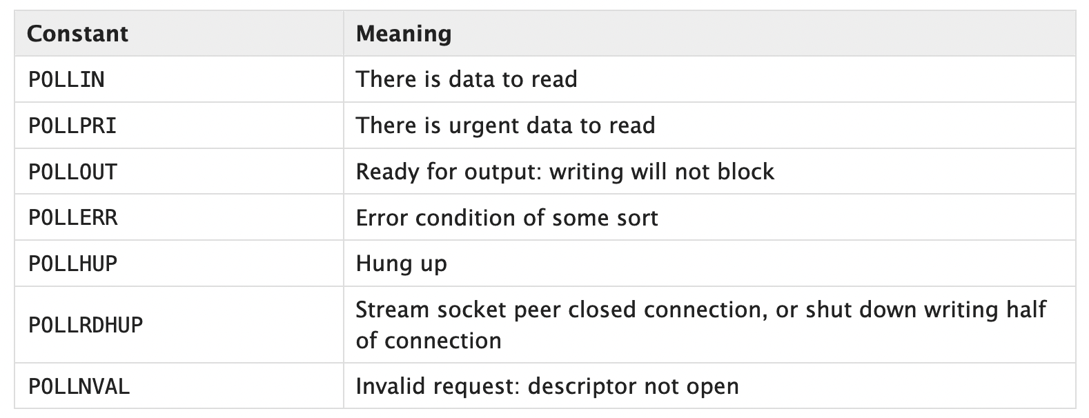
Poll constant

Slide 29
When a client socket finally gives an error or closing status,
we dispose of it and any outgoing or incoming buffers.
for fd, event in all_events_forever(poll_object):
sock = sockets[fd]
# Socket closed: remove it from our data structures.
if event & (select.POLLHUP | select.POLLERR | select.POLLNVAL):
address = addresses.pop(sock)
rb = bytes_received.pop(sock, b'')
sb = bytes_to_send.pop(sock, b'')
if rb:
print('Client {} sent {} but then closed'.format(address, rb))
elif sb:
print('Client {} closed before we sent {}'.format(address, sb))
else:
print('Client {} closed socket normally'.format(address))
poll_object.unregister(fd)
del sockets[fd]

Slide 30
Accept a connection
# New socket: add it to our data structures.
elif sock is listener:
sock, address = sock.accept()
print('Accepted connection from {}'.format(address))
sock.setblocking(False)
sockets[sock.fileno()] = sock
addresses[sock] = address
poll_object.register(sock, select.POLLIN)
setblocking to False
Add new socket file descriptor to sockets dictionary
Add new socket to addresses dictionary
Register socket to poll_object

Slide 31
Receive data
# Incoming data: keep receiving until we see the suffix.
elif event & select.POLLIN:
more_data = sock.recv(4096)
if not more_data: # end-of-file
sock.close() # next poll() will POLLNVAL, and thus clean up
continue
data = bytes_received.pop(sock, b'') + more_data
if data.endswith(b'?'):
bytes_to_send[sock] = zen_utils.get_answer(data)
poll_object.modify(sock, select.POLLOUT)
else:
bytes_received[sock] = data
Prepare data to send

Slide 32
Send data
# Socket ready to send: keep sending until all bytes are delivered.
elif event & select.POLLOUT:
data = bytes_to_send.pop(sock)
n = sock.send(data)
if n < len(data):
bytes_to_send[sock] = data[n:]
else:
poll_object.modify(sock, select.POLLIN)

Slide 33
Main
if __name__ == '__main__':
address = zen_utils.parse_command_line('low-level async server')
listener = zen_utils.create_srv_socket(address)
serve(listener)

