Slide 1

CS250 Sprint Review & Retrospective
Presentation Work: David Foutch

Slide 2
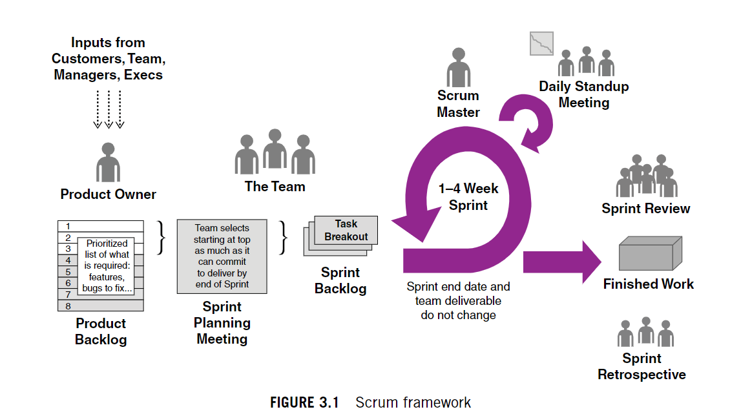
SNHU Travel Project Scrum-Agile Team
(Cobb, 2015)
Notes:
To make sure that the projects objectives were in line with business objectives, the Product Owner served as the conduit between the development team and the stakeholders. As a servant leader, the Scrum Master led the team in embracing and putting Agile practices into place. The task of converting the Product Owner’s specifications into a usable product iteration fell to the Development Team members which included software developers and testers. The stakeholders were essential to the project’s success even if they did not have a formal function inside the Scrum team. The seamless coordination and communication across all roles played a key factor in the SNHU Travel Project’s success.

Slide 3
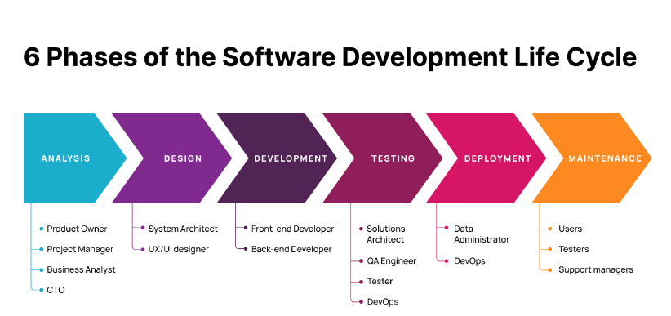
Glamazdina, Y. (2021)
Notes:
According to Charles G. Cobb, from the Project Manager’s Guide to Mastering Agile : Principles and Practices, “Scrum is adaptive in two ways…in the sense of progressively defining the solution…”. This allows for development to begin quickly and flush out the details as the work progresses. Also, “A Scrum project is broken up into short, fixed-length sprints.” (Cobb, 2015) At the start of each sprint the team would analyze the user stories from the backlog and decide on the work based on factors such as importance and complexity. The team engaged with the Product Owner to clarify requests to ensure a shared understanding before the work was done. The design and development phase would start with basic functionality and work through iterations of development through one-to-two-week sprints. By holding daily Scrum meetings, the team was able to collaborate by communicating with each other on the status of development and testing. This way upcoming sprints could be adjusted and refined based on feedback from the stakeholders.

Slide 4
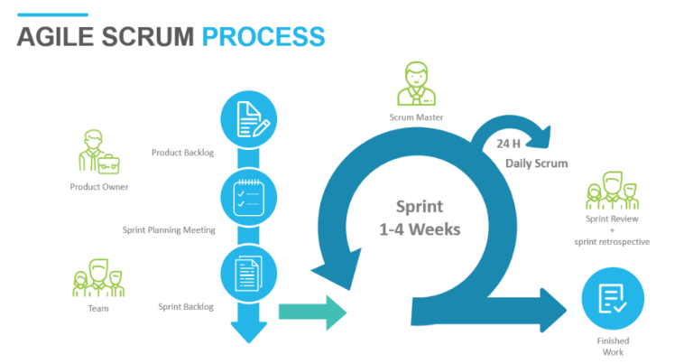
The Agile Software Development Life Cycle: All You Need to Know. (Ihor, 2022)
Notes:
The team did a retrospective following each sprint to evaluate its procedures and pinpoint areas of improvement. Through this method, the team was able to improve communication and efficiency while continuously fine-tuning its development process. According to Pereira and Russo from an academic journal on computer science, “enforcing ASD (Agile Software Development) allows an organization to have quick answers to the constant changes in the business scenario, with focus on the adaptability when faced with uncertainties and frequent changes”. (Pereira & Russo, 2018)

Slide 5
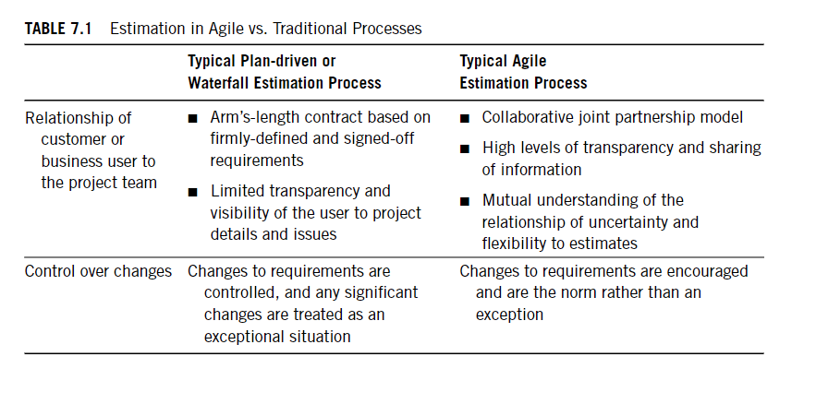
(Cobb, 2015)
Notes:
When the SNHU travel project needed to change course, the Scrum-Agile methodology proved to be very flexible and efficient. The structure allowed the teams to quickly pivot, change priorities, and keep providing value to stakeholders in the face of unexpected challenges. The team was able to adapt by adjusting the backlog priorities when the direction of the interface and content priority changed due to external factors. The Product Owner was able to quickly revise the backlog to include the updated features and changes in priority. The team used the sprint planning meetings to reevaluate priorities and adjust plans when the project was interrupted. The Scrum Team and Product Owner worked together to keep its focus on the new objectives while keeping the project's scope manageable.

Slide 6
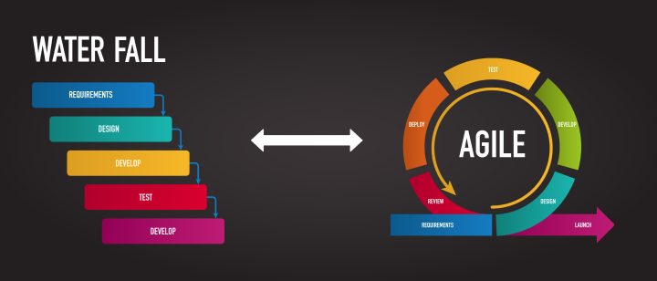
(Costea, V. 2021)
Notes:
There was a particular problem the team faced when a change request came in from the Product Owner late in the development process. By incorporating Agile methodology, we were able to apply the flexibility to pivot quickly and change direction with the website layout and changes in popular vacation trends. This would not have been an easy adjustment in a Waterfall project method since it does not use sprint iterations with design. In conclusion, the SNHU Travel project was successfully directed by the Scrum-Agile methodology because it encourages iterative development, adaptation, and cooperation. Delivering incremental value and developing a collaborative culture were advantages that overcame the drawbacks, which included resource limitations and difficulties with stakeholder availability and documentation. Overall, the approach's capabilities enabled the team to manage changes, stay customer-centric, and provide a product that matched stakeholder expectations. I believe this was the best approach for the SNHU Travel development project.

Slide 7
References
Pereira, J. C., & Russo, R. de. (2018). Design thinking integrated in agile software development: A systematic literature review. Procedia Computer Science, 138, 775–782. https://doi.org/10.1016/j.procs.2018.10.101
Charles G. Cobb. (2015). The Project Manager’s Guide to Mastering Agile : Principles and Practices for an Adaptive Approach. Wiley.
Jim Reed, L. K. (2019). A Path to Employment for Veterans With Disabilities. A path to employment for veterans with disabilities. Retrieved February 13, 2022, from https://www.ncsl.org/research/military-and-veterans-affairs/a-path-to-employment-for-veterans-with-disabilities.aspx
Glamazdina, Y. (2021). Phases of Agile SDLC: The Brocoders Approach. A Guide to the Agile Software Development Life Cycle (SDLC). Retrieved August 13, 2023, from https://brocoders.com/blog/agile-software-development-life-cycle/.
Ihor. (2022). The Agile Software Development Life Cycle: All You Need to Know. Retrieved August 13, 2023, from https://distantjob.com/blog/agile-software-development-life-cycle/.
Costea, V. (2021). Agile vs. Waterfall: what’s better for your business (pros, cons, and the hybrid approach). Retrieved August 13, 2023, from https://www.roweb.ro/blog/agile-vs-waterfall/.

