Slide 1
AI Bubble Unwind Stress Model
Theory construction for senior management
Core idea: separate broad-market stress from AI/TMT-excess stress, then add targeted overlays for single stocks and market cap.
Output: implementable stress vectors by country × industry × market-cap bucket, plus single-stock overrides.
July 2026
AI unwind stress model | theory section

Slide 2
What management needs to understand
The theory is a linked chain, not a collection of ad hoc shocks.
The model first separates the market shock from the AI-specific excess shock.
It then measures which countries, industries, and stocks are exposed to each leg.
Dot-com history calibrates the shock size by horizon and scenario.
Market-cap and single-stock layers make the output usable on actual positions.
Final stress = market leg + AI/TMT-excess leg + targeted overlays
How the presentation builds
1 = define the two factors
2 = orthogonalize AI from the market
3 = estimate exposures
4 = calibrate scenarios from dot-com
5 = add market-cap and single-stock overlays
6 = produce stress vectors
Takeaway: Every later component only exists because the previous step created a clean quantity to shock.
AI unwind stress model | theory section

Slide 3
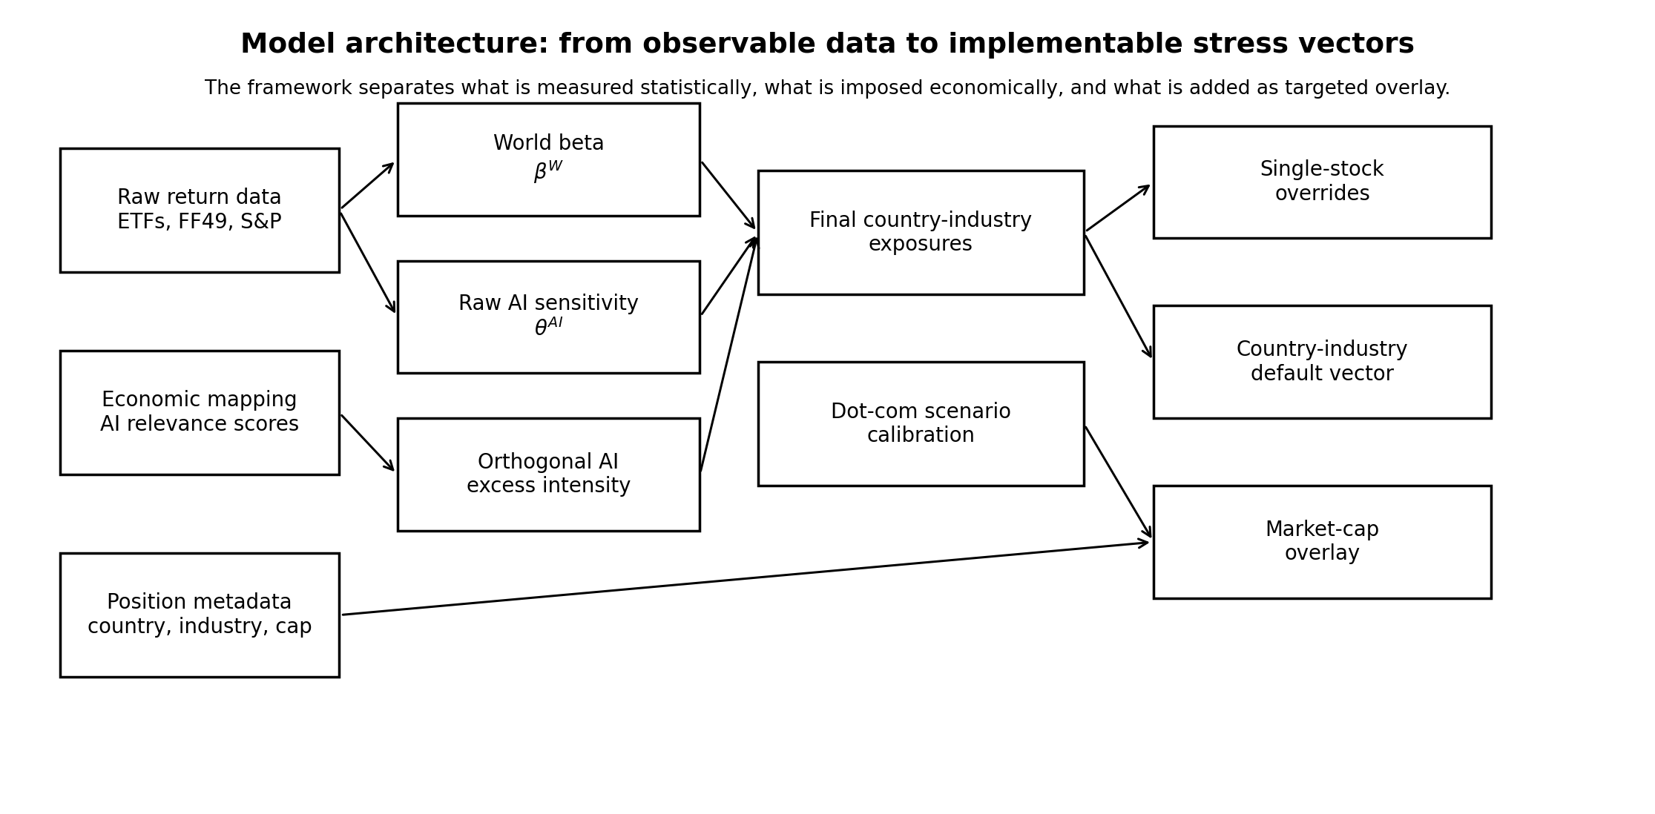
Model architecture
The framework keeps data, exposure estimation, calibration, and overlays separate.
Takeaway: This separation is what makes the model explainable and auditable.
AI unwind stress model | theory section

Slide 4
Variable map for the full model
Every later formula uses these labels.
S[j,m,h,s] = betaW[j] · M[h,s] + IAI[j] · A[h,s] + Psize[m,h,s]
Variable labels
j = country-industry bucket
b = country bucket
g = industry bucket
i = single stock
m = market-cap bucket
h = stress horizon: 1w, 2w, 1m, 2m
s = scenario: mild, base, severe, extreme, worst
S[j,m,h,s] = final log stress return
betaW[j] = broad-market beta of bucket j
M[h,s] = broad-market scenario shock
IAI[j] = final AI-excess intensity of bucket j
A[h,s] = AI/TMT-excess scenario shock
Psize[m,h,s] = market-cap overlay penalty
Takeaway: The model is additive in log-return space, so each risk component has a clear interpretation.
AI unwind stress model | theory section

Slide 5
Data map: what each dataset does
The model does not ask one data source to answer every question.
Data block
Examples
Model role
Current AI ETFs
SMH, SOXX, IGV, SKYY, AIQ, IXN
Build AI basket; estimate current AI factor
Broad market
S&P 500, world / broad ETF proxies
Define market leg and world beta
Country / industry data
Country ETFs; FF49 / sector proxies
Estimate country-industry exposures
Dot-com history
NASDAQ / TMT returns around 2000
Calibrate shock magnitude and timing
Size portfolios
Fama-French market-equity buckets
Calibrate market-cap overlay
Position metadata
country, industry, ticker, market cap
Choose correct stress row
Takeaway: Data is organized by function: measurement, calibration, overlay, and implementation.
AI unwind stress model | theory section

Slide 6
Step 1: define the two forces in an AI unwind
An AI bubble burst is an equity selloff plus an AI-specific re-rating.
STEP 1
Split raw AI movement into market-driven and AI-excess pieces
rAI[t] = alphaAI + thetaWAI · rW[t] + xAI[t]
Why this matters:
Raw AI returns include general market moves. The model only wants the part of AI movement that remains after removing the broad market.
Variable labels
rAI[t] = return of AI basket at time t
rW[t] = broad world market return at time t
thetaWAI = AI basket loading on the world market
xAI[t] = residual AI-excess return
alphaAI = intercept of the AI-on-world regression
Financial interpretation:
• Market leg = normal equity selloff
• AI-excess leg = additional TMT / AI de-rating
Takeaway: The model starts by isolating the AI-specific component before any country or industry shock is estimated.
AI unwind stress model | theory section

Slide 7
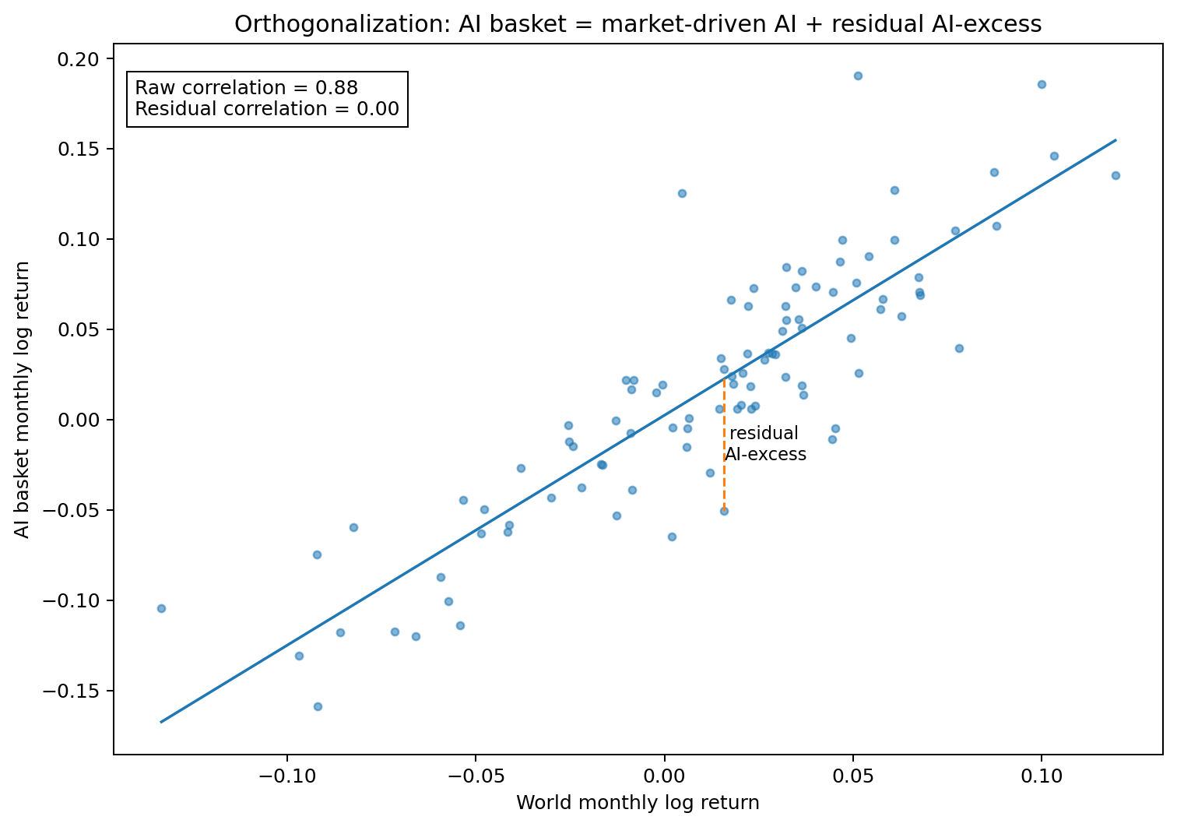
Step 2: orthogonalization is the core theory
The residual AI factor is what remains after the market-driven component is removed.
How to read the chart
fitted line = AI movement explained by market returns
vertical residual = AI-excess return for that month
raw correlation = AI basket still moves with broad market
residual correlation = near zero after orthogonalization
Statistical result:
Cov(xAI[t], rW[t]) ≈ 0
Business result:
AI-excess is now a cleaner shock leg, not another broad market shock.
Takeaway: Orthogonalization is the step that prevents double-counting the market selloff.
AI unwind stress model | theory section

Slide 8
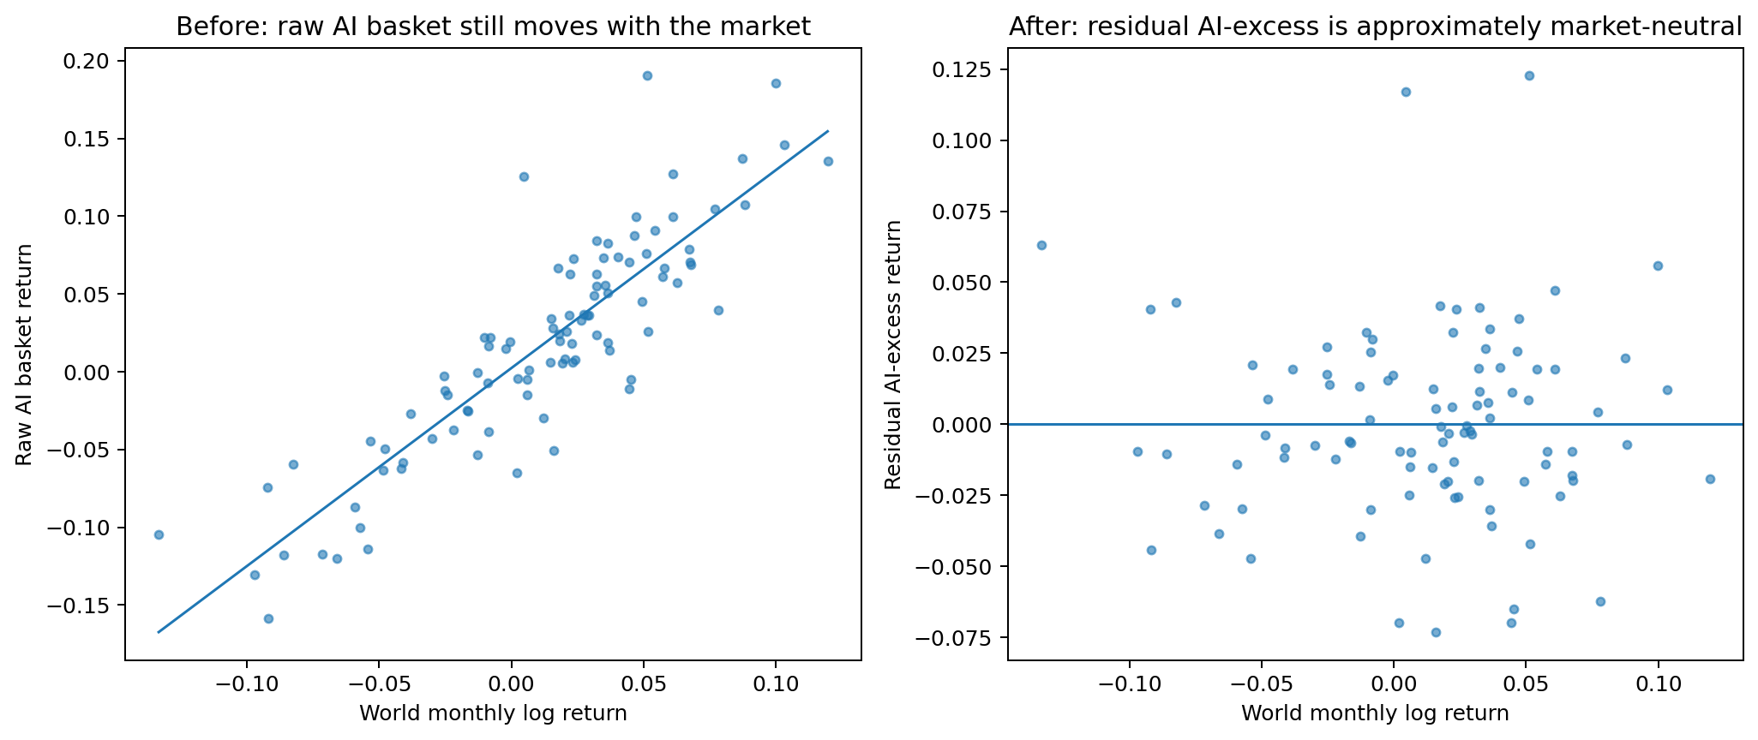
Why orthogonalization works
It forces the AI factor to explain only what the market cannot explain.
xAI[t] = rAI[t] − (alphaAI + thetaWAI · rW[t])
Definitions
xAI[t] = residual AI-excess return
rAI[t] = raw AI basket return
rW[t] = world market return
thetaWAI · rW[t] = market-driven part of AI return
alphaAI = average residual offset
Plain English:
First remove what AI would have done just because the market moved. Then stress only the leftover AI-specific movement.
Takeaway: After this step, the AI-excess shock has a distinct economic meaning.
AI unwind stress model | theory section

Slide 9
Step 3: estimate exposure of each bucket to the two factors
Each country-industry bucket receives a market beta and an AI-excess loading.
rj[t] = alphaj + betaW[j] · rW[t] + gammaAI[j] · xAI[t] + epsj[t]
Variable labels
Interpretation of betaW[j]:
How much the bucket should move when broad equities sell off.
rj[t] = return of country-industry bucket j at time t
j = specific country-industry bucket
betaW[j] = bucket j broad-market beta
gammaAI[j] = bucket j sensitivity to residual AI-excess factor
xAI[t] = orthogonal AI-excess factor
epsj[t] = unexplained idiosyncratic residual
alphaj = bucket-specific intercept
Interpretation of gammaAI[j]:
How much extra the bucket moves when AI / TMT de-rates beyond the market.
Because xAI[t] is orthogonal to rW[t], gammaAI[j] is not just another market beta.
Takeaway: The exposure model converts return history into two interpretable loadings.
AI unwind stress model | theory section

Slide 10
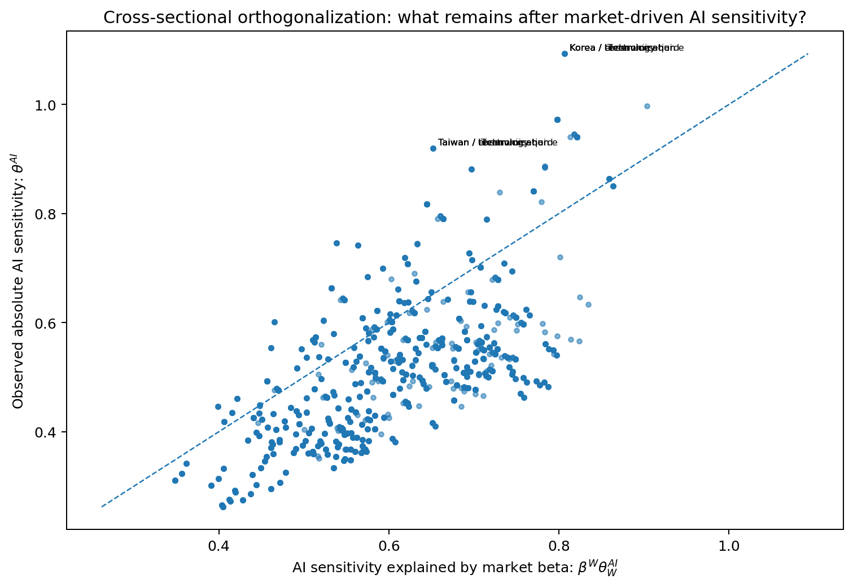
Step 4: convert raw sensitivity into AI-excess intensity
A second residualization removes AI sensitivity that is merely explained by market beta.
EAI[j] = thetaAI[j] − betaW[j] · thetaWAI
Istat[j] = EAI[j] / (1 − thetaWAI)
Variable labels
thetaAI[j] = observed absolute AI sensitivity of bucket j
betaW[j] · thetaWAI = AI sensitivity expected from market beta alone
EAI[j] = residual AI-excess sensitivity
Istat[j] = scaled statistical AI intensity
Takeaway: A bucket is treated as AI-exposed only when it has AI sensitivity beyond what its market beta already explains.
AI unwind stress model | theory section

Slide 11
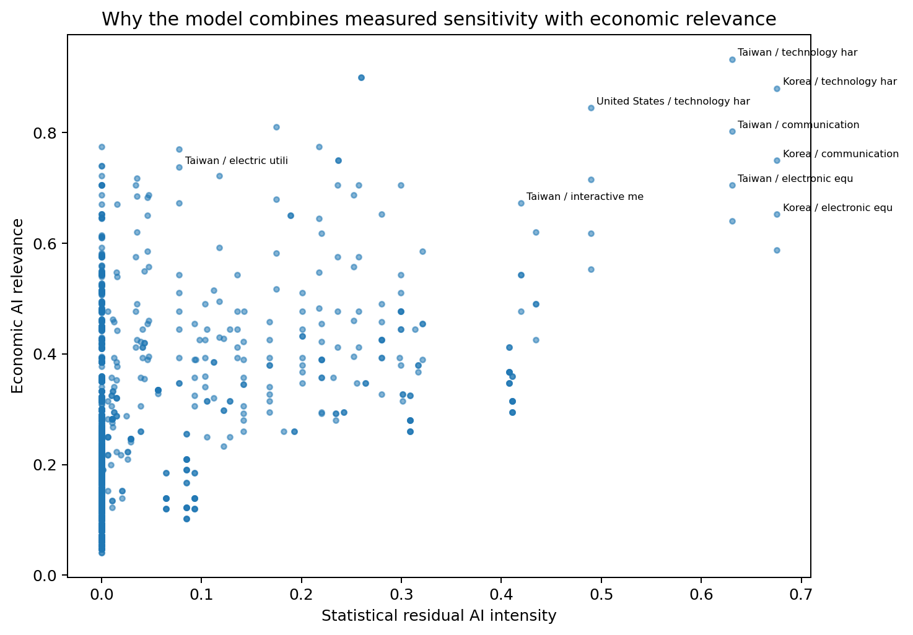
Step 5: combine measured sensitivity with economic relevance
The final AI intensity is both data-driven and economically sensible.
IAI[j] = wstat · Istat[j] + wecon · Iecon[j]
Variable labels
IAI[j] = final AI-excess intensity used in shocks
Istat[j] = statistical residual AI intensity
Iecon[j] = economic AI relevance score
wstat = weight on statistical estimate
wecon = weight on economic relevance
Why blend?
Return data can be noisy; economic mappings prevent obvious AI-linked sectors from being missed.
Takeaway: The final intensity is not a black-box regression coefficient; it is a governed exposure score.
AI unwind stress model | theory section

Slide 12
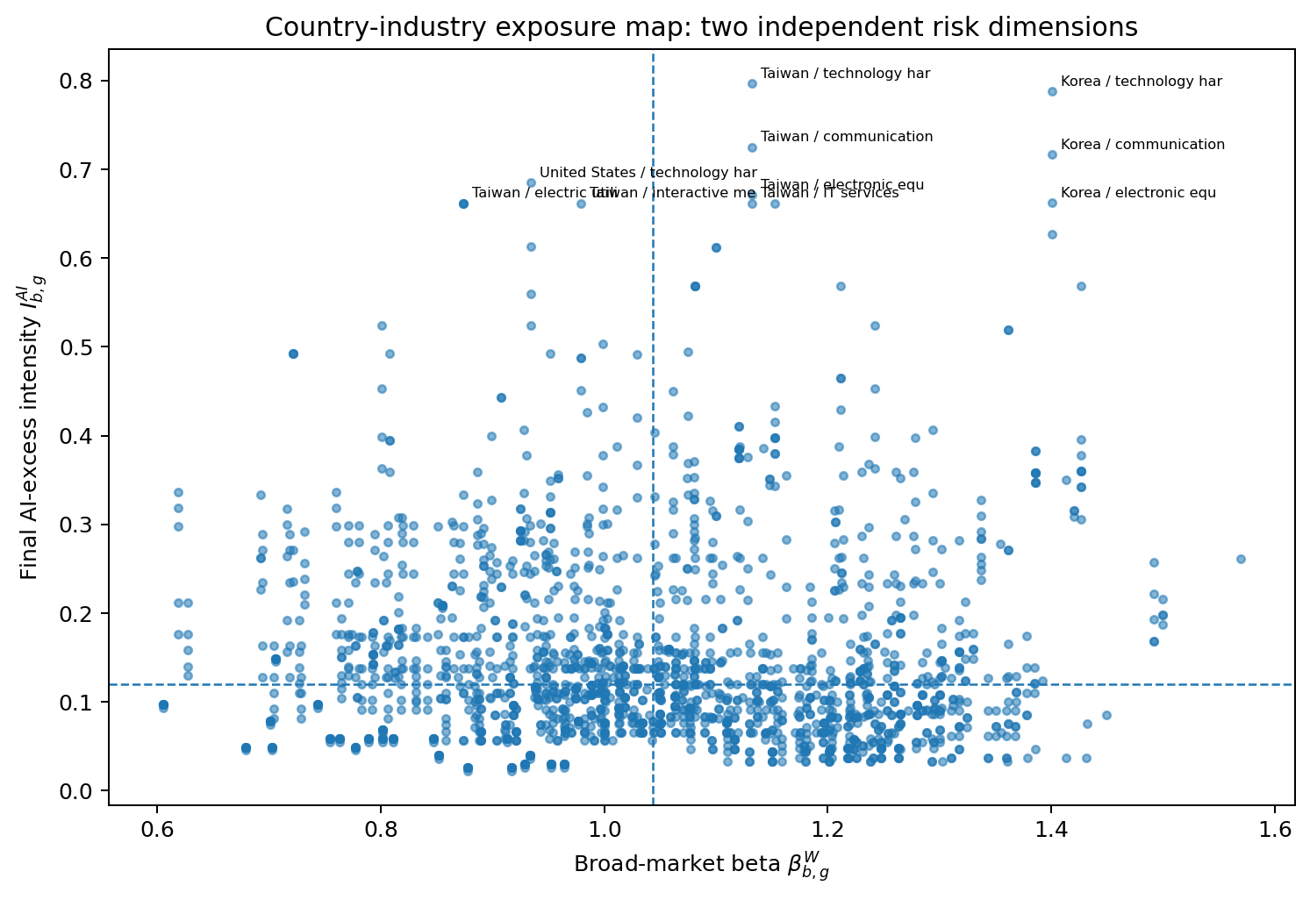
Step 6: extend exposure globally through country-industry cells
The same theory produces shocks for non-U.S. AI supply chains.
Each row is a country-industry cell, e.g., Korea technology hardware or Taiwan semiconductors.
Country effects capture local market concentration and macro equity sensitivity.
Industry effects capture sector exposure to AI infrastructure, software, and data-center demand.
The final cell exposure combines both, then applies the same market + AI-excess shock structure.
cell j = country b × industry g
Takeaway: This is why Korea and Taiwan can receive more AI-sensitive shocks than a generic global equity bucket.
AI unwind stress model | theory section

Slide 13
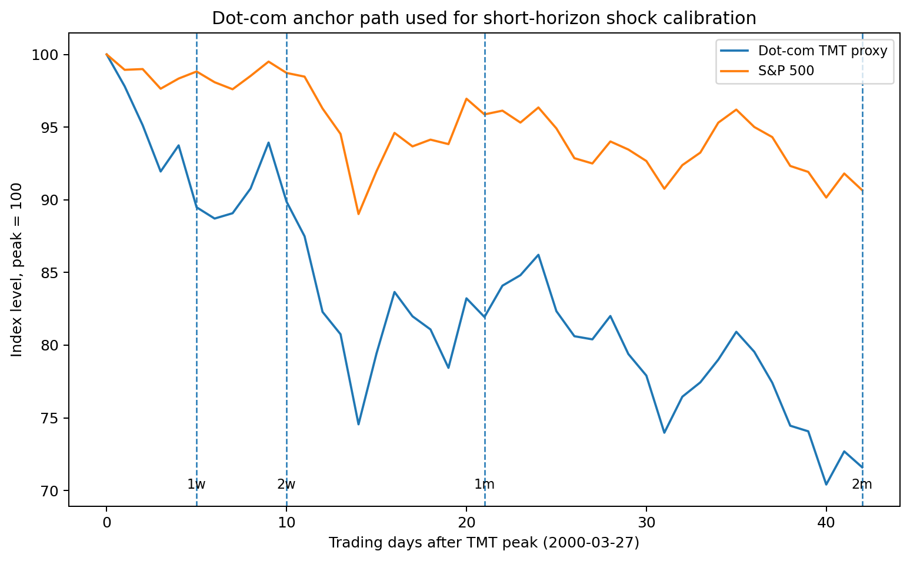
Step 7: use dot-com to calibrate the shock size
Dot-com gives a historical technology-bubble anchor, not a mechanical forecast.
M[h] = log(PW[t0+h] / PW[t0])
A[h] = log(PTMT[t0+h] / PTMT[t0]) − M[h]
Variable labels
t0 = dot-com TMT peak date
h = horizon: 1w, 2w, 1m, 2m
PW = broad market price index
PTMT = dot-com TMT / technology proxy
M[h] = market shock over horizon h
A[h] = TMT excess shock beyond market
Takeaway: The dot-com analogy enters only after the model has already separated the market leg from the AI-excess leg.
AI unwind stress model | theory section

Slide 14
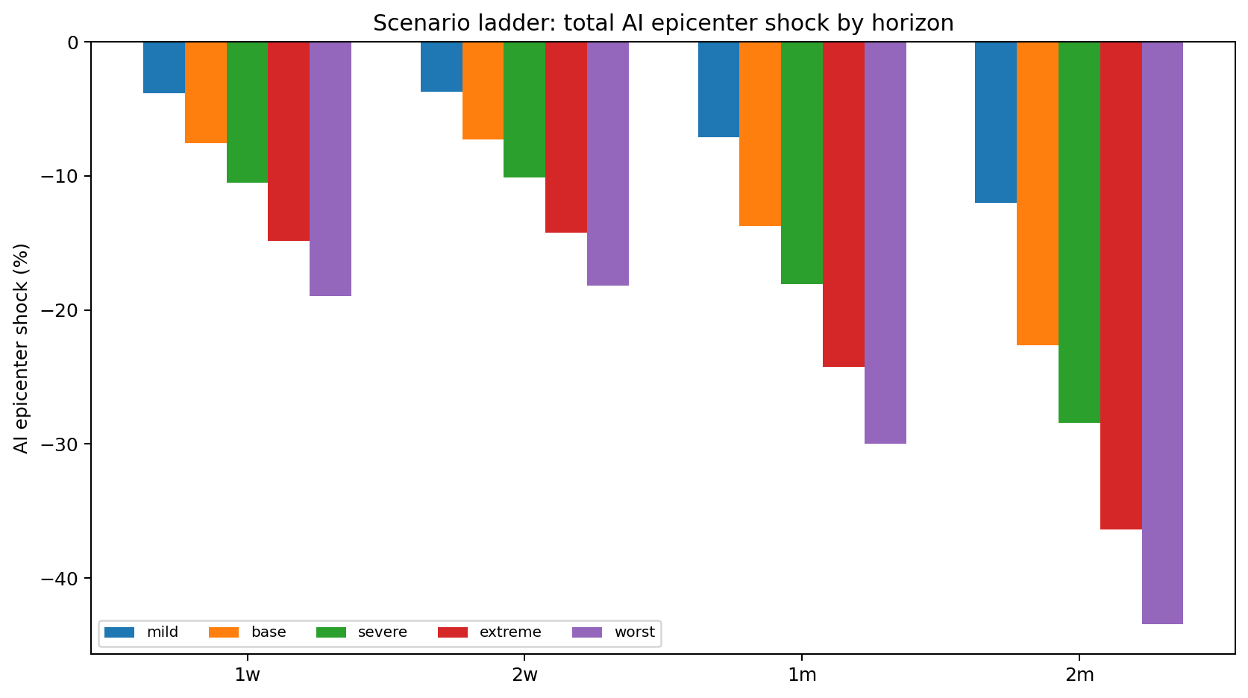
Step 8: turn dot-com anchors into a scenario ladder
The same historical shock can be scaled into mild, base, severe, extreme, and worst cases.
M[h,s] = lambda[s] · M[h]
A[h,s] = kappa[s] · A[h]
Scenario labels
M[h,s] = market shock for horizon h and scenario s
A[h,s] = AI/TMT-excess shock for horizon h and scenario s
lambda[s] = market-leg severity scalar
kappa[s] = AI-excess severity scalar
extreme = kappa = 1.5 in revised ladder
worst = kappa = 2.0 in revised ladder
Takeaway: The scenario ladder changes shock severity without changing the model structure.
AI unwind stress model | theory section

Slide 15
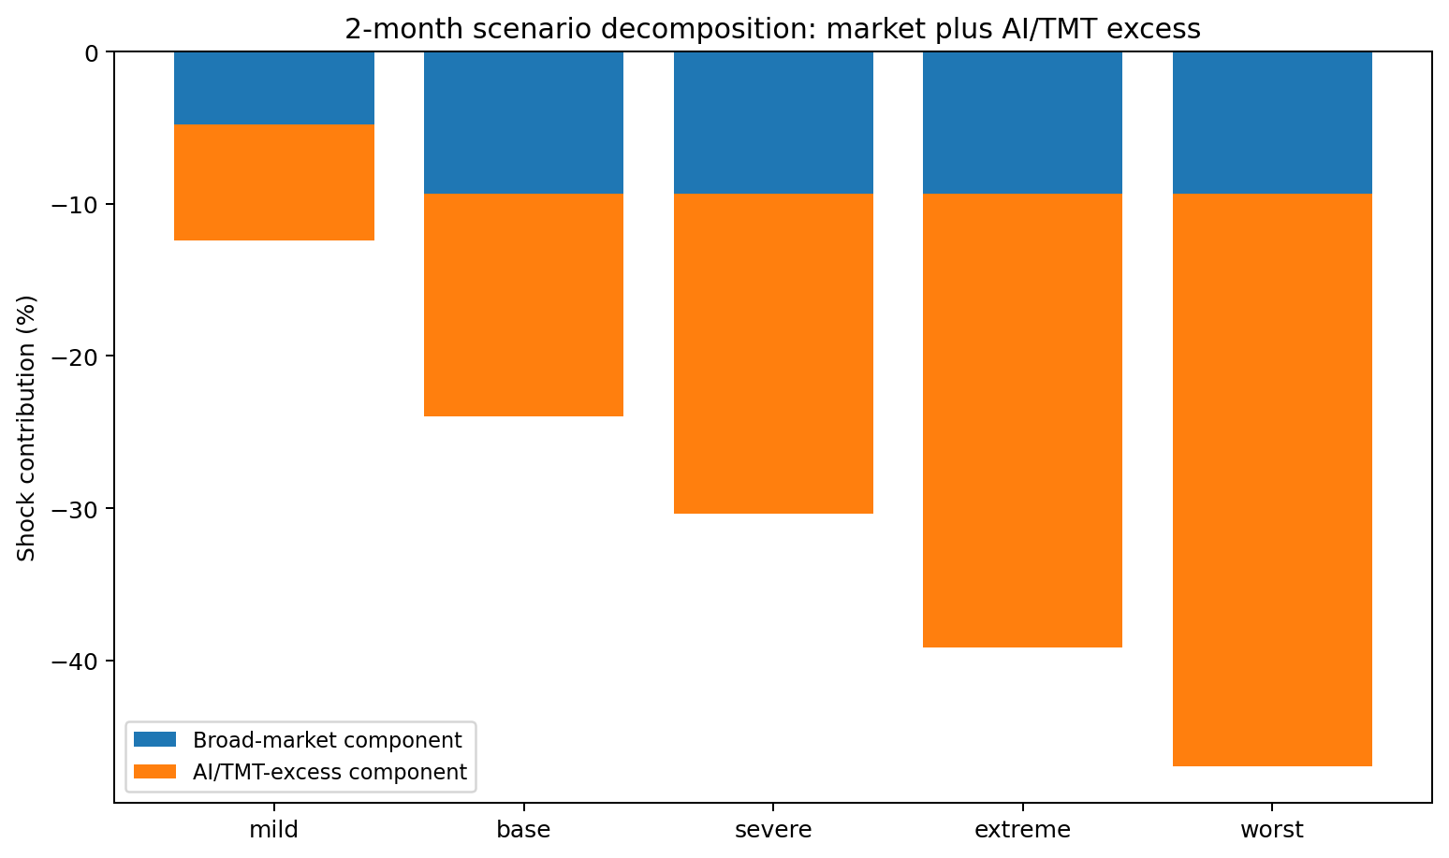
Step 9: production formula for country-industry shocks
This formula links exposure estimates to scenario calibration.
SCI[j,h,s] = betaW[j] · M[h,s] + IAI[j] · A[h,s]
Variable labels
SCI[j,h,s] = country-industry log stress before cap overlay
j = country-industry bucket
h = horizon: 1w, 2w, 1m, 2m
s = scenario: mild/base/severe/extreme/worst
betaW[j] = broad-market beta for bucket j
M[h,s] = broad-market scenario shock
IAI[j] = final AI-excess intensity for bucket j
A[h,s] = AI/TMT-excess scenario shock
Reading the formula:
• market leg = betaW × M
• AI leg = IAI × A
• total = sum in log space
Takeaway: The shock is not arbitrary: it is exposure × calibrated scenario, component by component.
AI unwind stress model | theory section

Slide 16
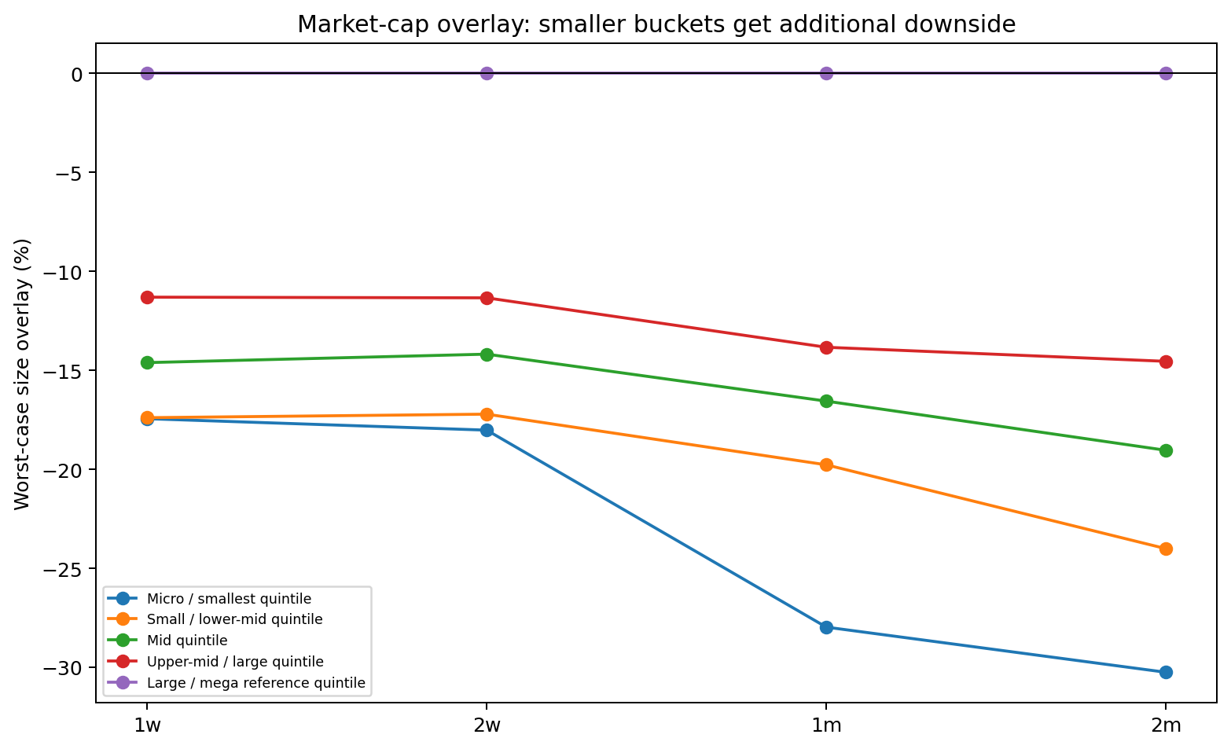
Step 10: market-cap penalty is an overlay, not a replacement
Small-cap names are penalized for fragility and liquidity risk on top of factor stress.
S[j,m,h,s] = SCI[j,h,s] + Psize[m,h,s]
Variable labels
S[j,m,h,s] = final log stress after market-cap overlay
SCI[j,h,s] = country-industry shock before cap overlay
m = market-cap bucket
Psize[m,h,s] = size overlay penalty
large/mega bucket = reference bucket, no overlay
smaller buckets = receive additional downside
Takeaway: Large caps are unchanged; smaller names become more severe because the overlay is added after the factor shock.
AI unwind stress model | theory section

Slide 17
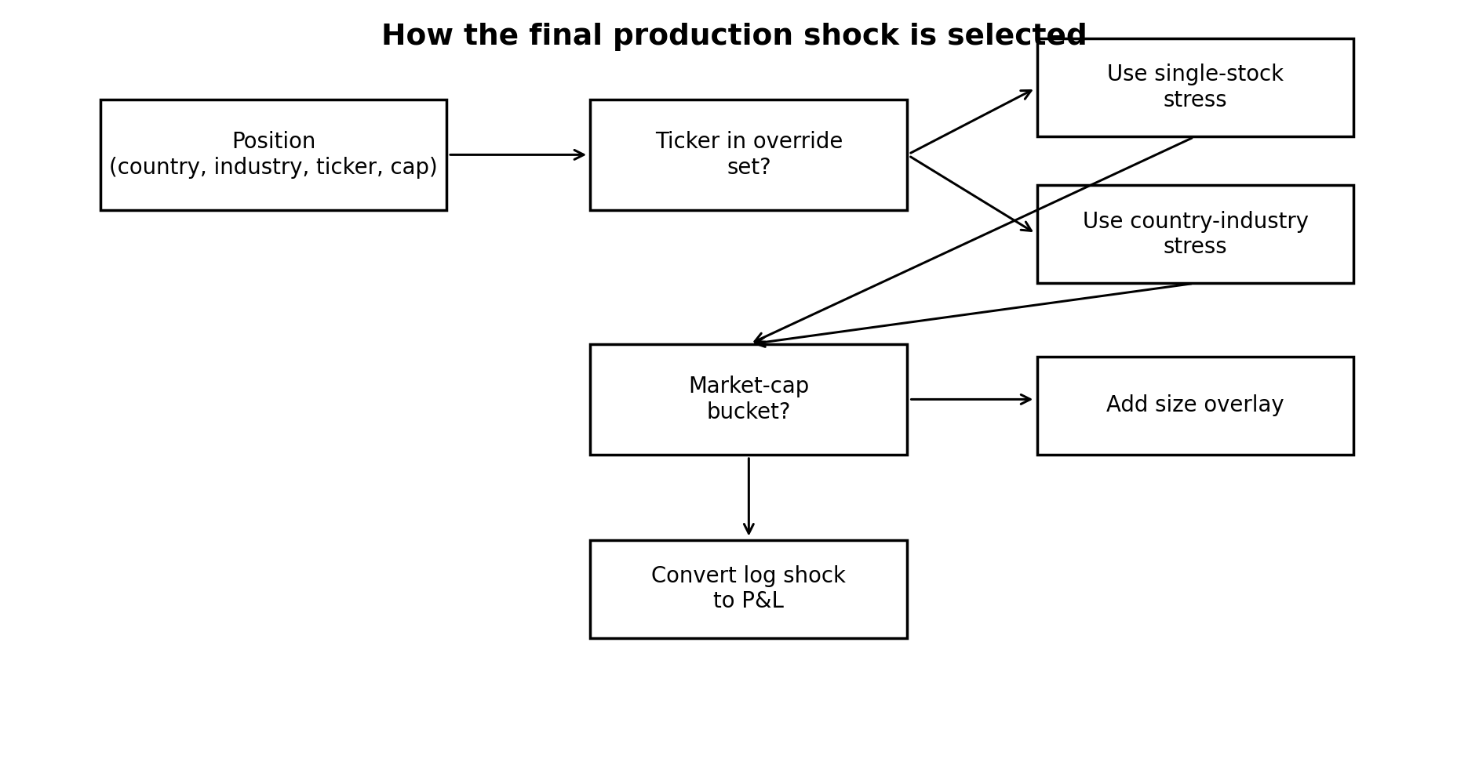
Step 11: single-stock override layer
Selected AI epicentre names should not be averaged away inside broad industry buckets.
SS[i,h,s] = betaWstock[i] · M[h,s] + IAIstock[i] · A[h,s]
Variable labels
SS[i,h,s] = single-stock log stress
i = specific stock ticker
betaWstock[i] = stock-level world beta
IAIstock[i] = stock-level AI-excess intensity
M[h,s] = market shock
A[h,s] = AI/TMT-excess shock
Rule = use override when ticker matches; otherwise use bucket row
Takeaway: The override layer improves precision without changing the underlying theory.
AI unwind stress model | theory section

Slide 18
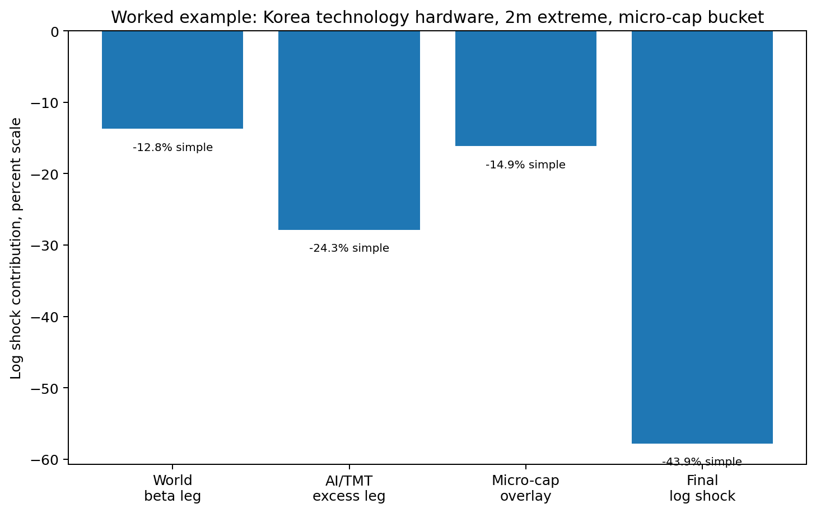
Worked example: how the pieces add up
The final stress is transparent: market leg + AI leg + size overlay.
Example variables
bucket j = Korea technology hardware
scenario s = 2m extreme
market-cap m = micro-cap bucket
final shock = sum of log components, then converted to simple return
Takeaway: This is the easiest way to explain the model verbally: three additive pieces create the final shock.
AI unwind stress model | theory section

Slide 19
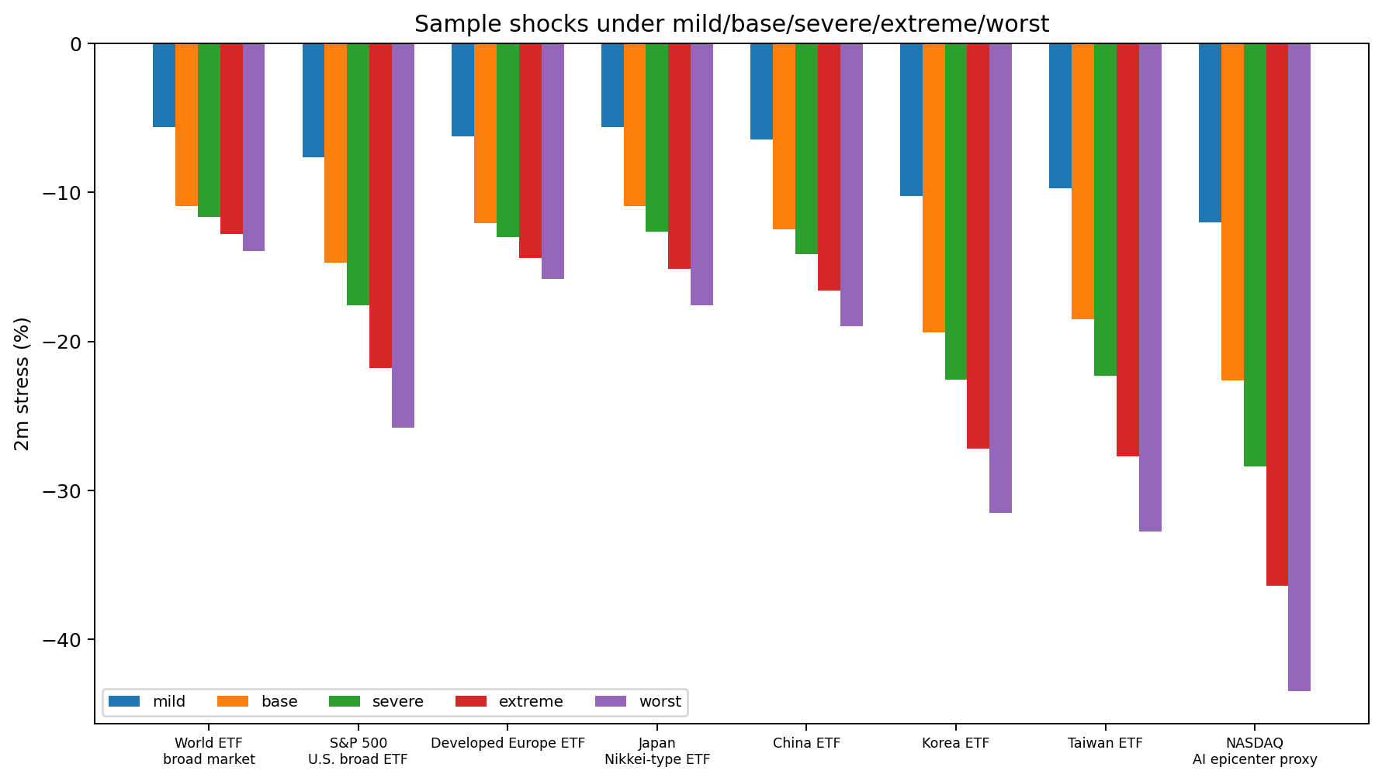
Sample shocks: scenario severity is intuitive
NASDAQ and AI-linked regions receive larger shocks than broad world equity.
Takeaway: The output hierarchy is intuitive: broad market < international AI-linked regions < AI epicentre proxy.
AI unwind stress model | theory section

Slide 20
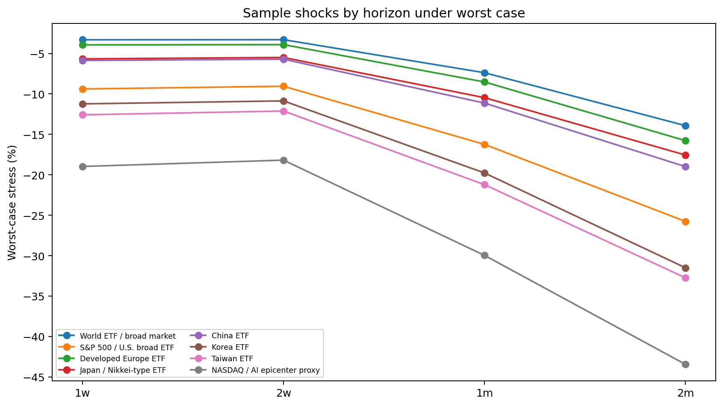
Sample shocks: horizon scaling is also intuitive
Worst-case shocks grow as the horizon extends from 1w to 2m.
Takeaway: The model supports margin-relevant short horizons while preserving a longer-horizon stress view.
AI unwind stress model | theory section

Slide 21
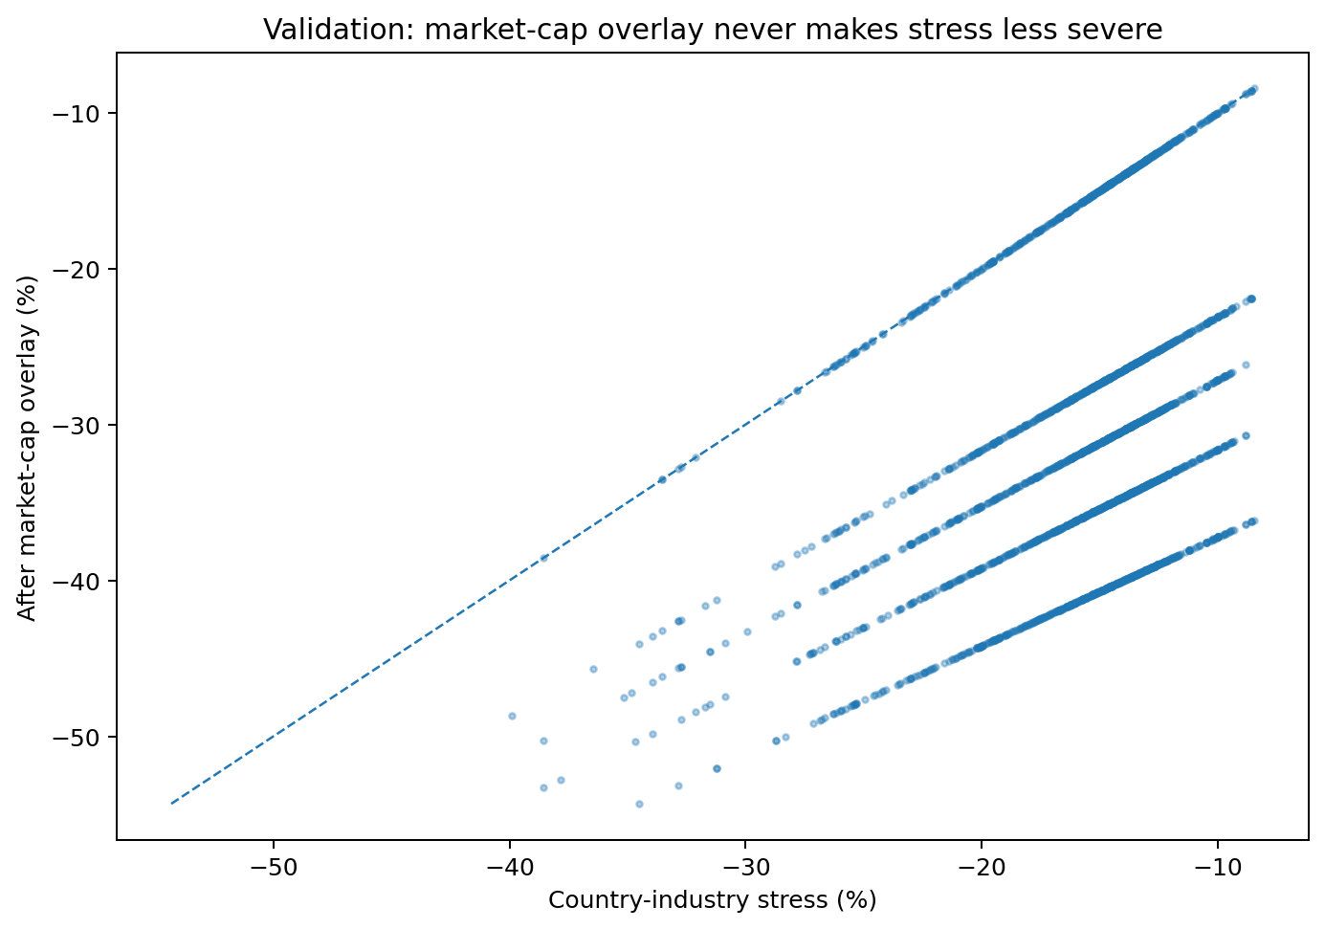
Validation checks that make the theory operationally safe
The stress engine is built to avoid obvious incoherence.
Orthogonal AI factor has near-zero market correlation after residualization.
Market-cap overlay never makes stress less severe.
Large / mega-cap reference bucket stays unchanged by cap overlay.
Single-stock overrides use the same factor structure as country-industry rows.
Scenarios are ordered: mild < base < severe < extreme < worst.
Takeaway: The model is explainable, but also mechanically constrained to behave sensibly.
AI unwind stress model | theory section

Slide 22
Final production formula
This is the complete theory in one line, with every variable labelled.
S[j,m,h,s] = betaW[j] · M[h,s] + IAI[j] · A[h,s] + Psize[m,h,s]
Variable labels
S[j,m,h,s] = final log stress return applied to a position
j = country-industry bucket, j = (country b, industry g)
m = market-cap bucket for the position
h = stress horizon: 1w / 2w / 1m / 2m
s = scenario: mild / base / severe / extreme / worst
betaW[j] = world market beta of country-industry bucket j
M[h,s] = broad-market shock from dot-com calibration
IAI[j] = final AI-excess intensity after orthogonalization and economic blending
A[h,s] = AI/TMT-excess shock from dot-com calibration
Psize[m,h,s] = market-cap overlay penalty from size-portfolio calibration
Takeaway: All pieces are linked: exposure estimates decide sensitivity, dot-com calibrates shock size, overlays refine application.
AI unwind stress model | theory section

Slide 23
How the theory maps to actual use
The output hierarchy avoids ambiguity when applying shocks.
Application rule
1 = If ticker is in the override file, use single-stock override.
2 = Otherwise map position to country-industry bucket j.
3 = Assign market-cap bucket m from position market cap.
4 = Select horizon h and scenario s.
5 = Use S[j,m,h,s] as the log stress return.
6 = Convert to simple return: exp(S) − 1.
stress simple return = exp(S[j,m,h,s]) − 1
Takeaway: The theory ends in a concrete, auditable stress-return lookup.
AI unwind stress model | theory section

Slide 24
Management takeaways
The theory is coherent because each step creates the input needed by the next step.
The model starts with a clean decomposition: market selloff plus AI/TMT-excess selloff.
Orthogonalization is the key theoretical step: it removes market contamination from AI exposure.
Country-industry shocks are exposure times scenario, not hand-selected percentages.
Dot-com history anchors the shock magnitude; severity scalars create the scenario ladder.
Market-cap penalties and single-stock overrides improve real-book applicability without changing the core theory.
market leg + AI-excess leg + targeted overlays → implementable stress vector
Takeaway: The framework is designed to be rigorous enough for model discussion and simple enough for management use.
AI unwind stress model | theory section

