Slide 1
CST 336 Internet programming
Monday Practice: PHP, MySQL, AJAX, HighCharts.js

Slide 2
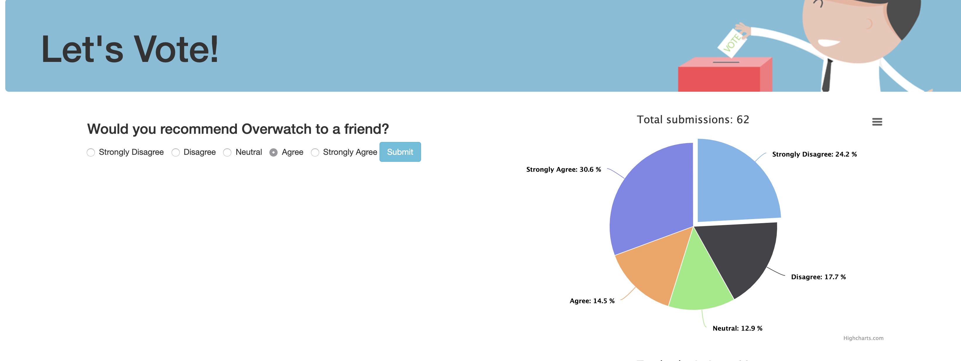
Task: Create a polling system

Slide 3
Directions:
Download the project files and unzip them to c9
2) Set up the database with the included SQL file. Look at and understand the schema.
3) “poll.html” contains the HTML template as well a function to display poll chart.
4) Start by connecting the button on click to the displayPollChart function.
5) Implement functions.php that will update the poll database. Note: You should be updating the table, not inserting new records.

Slide 4
Directions:
6) When page loads, use Ajax to check session variable to see if form has been submitted already.
7) Hide the radio buttons and submit boxes if the form has already been submitted, but display the chart with latest data.
Partial sample: (it doesn’t prevent multiple submissions)
http://cst336.herokuapp.com/projects/poll/

Slide 5
Rubric:
3 Points
1) Send poll data through Ajax Call to functions.php and update database
2) Chart properly displays poll data from database.
3) Session variable is used so form is only submitted once
+2 Points
4) Display loading animation while charts are updating
5) Add CSS to make it look nicer

