Slide 1









Computing Laboratory · Fakultas Informatika · Telkom University
Advance Study Group
Belajar AI
Lewat Paper
Pertemuan 0
Notes:
BEFORE 0:00. On screen while students arrive. Hand out the pretest at the door.
Theme of Week 0: in AI, knowledge lives in papers. Books teach the foundations, papers show where the field is today.

Slide 2
Pretest
8 menit
12 soal pendek, tanpa perangkat
Tanpa nilai. Pakai nama samaran
Kosongkan soal yang tidak kamu tahu
Hasilnya hanya untuk merencanakan kelas
Notes:
0:00 to 0:08 (8 min). Pretest on paper (fasilitator/pretest.html). Collect face-down. Say: 'Tanpa nilai. Kosongkan yang tidak tahu.' Latecomers join in.
Same items return in Week 16 as a post-test, so ask them to remember their code name.

Slide 3
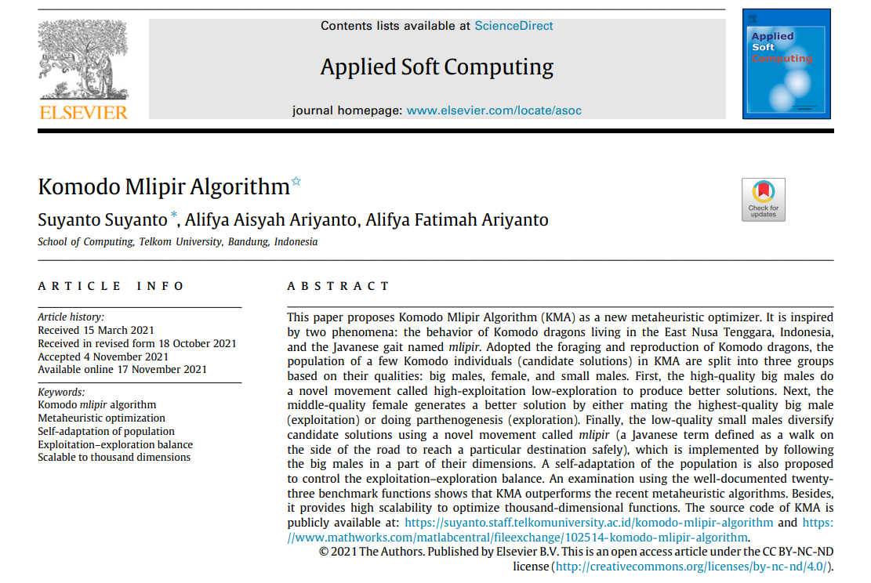
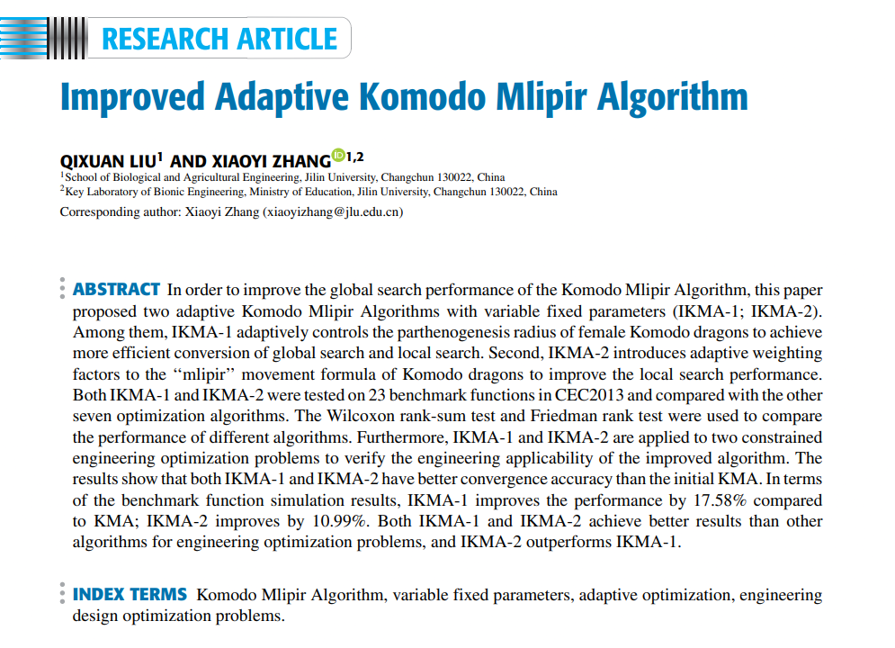
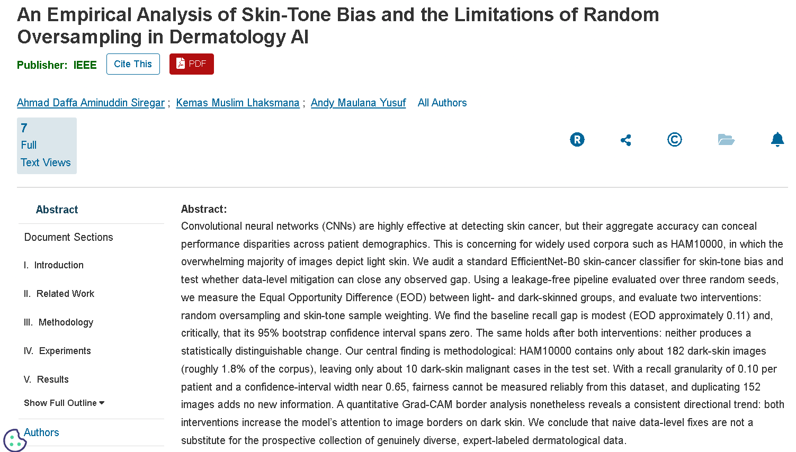
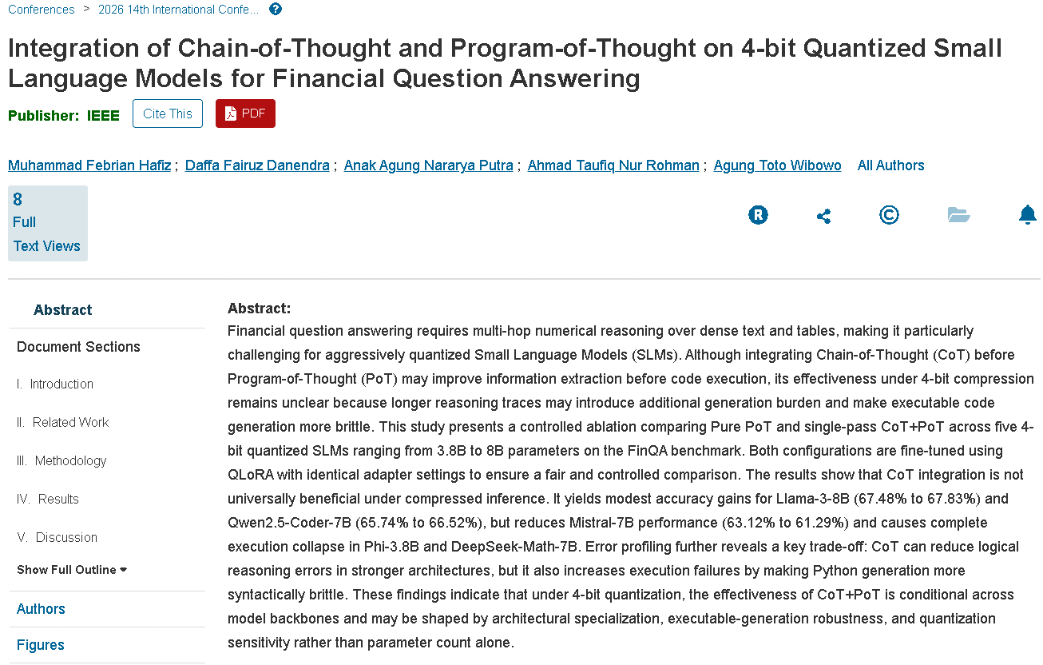
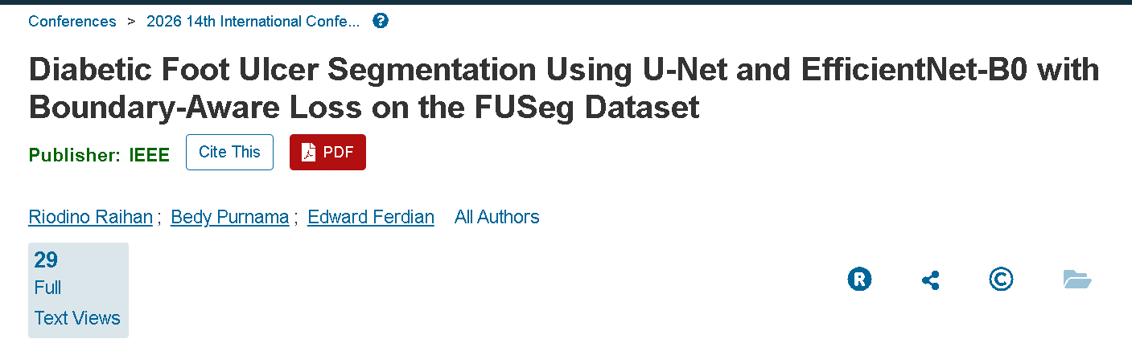
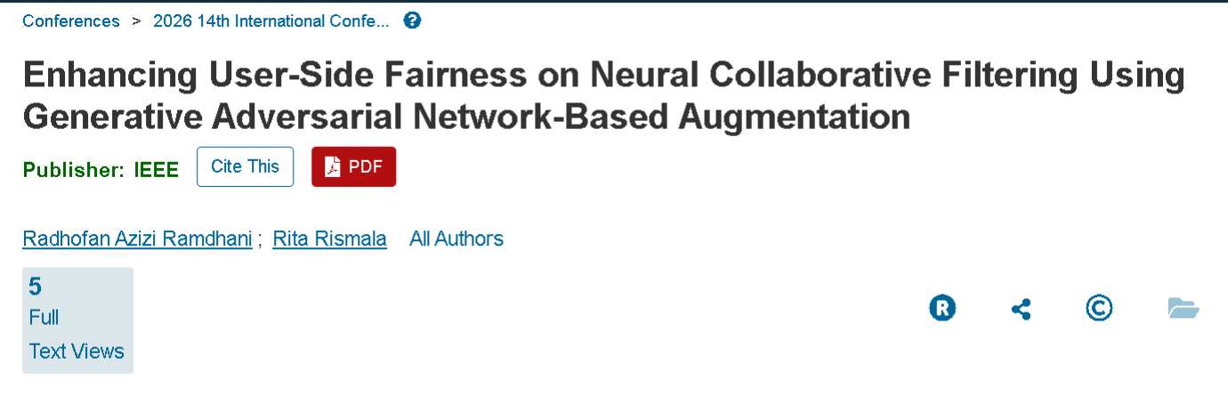
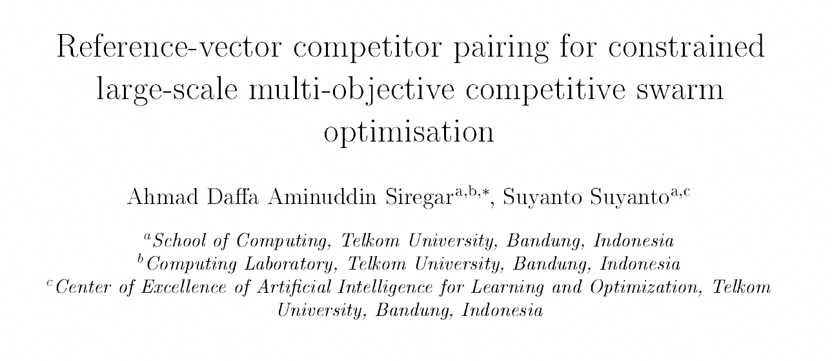
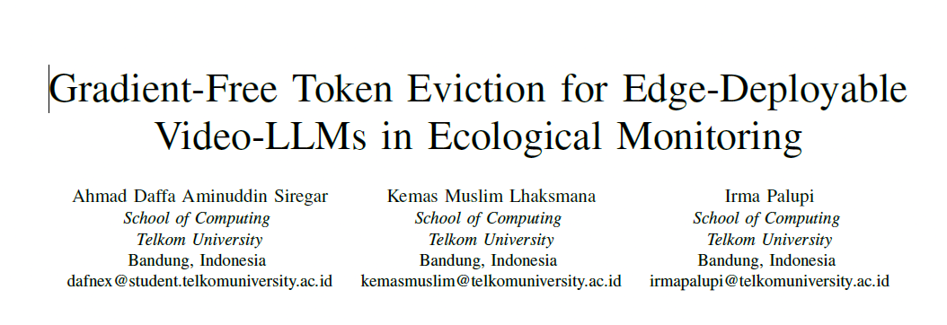
Semua AI bermula dari paper
Hari ini kita belajar membaca dunia ini
Notes:
0:08 to 0:11 (3 min). The wall of papers. Hook: 'Model yang kamu pakai tiap hari, deteksi kanker kulit, rekomendasi, chatbot, semuanya bermula sebagai paper seperti ini.'
Point out: several are from our own campus and our own lab. 'Satu dekade lagi, nama di paper seperti ini bisa jadi namamu.' Do not read titles; they come back one by one.

Slide 4
Agenda Hari Ini
0:00
0:08
0:13
0:43
0:53
1:18
1:23
1:31
1:46
1:56
Pretest (8 menit)
Dinding paper dan agenda (5)
Empat jenis paper (30)
Cara membaca paper (10)
Detektif Paper (25)
Istirahat (5)
Dari paper ke kelas ini (8)
Cara kerja kelas (15)
Stasiun persiapan (10)
Tiket keluar (4)
Notes:
0:11 to 0:13 (2 min). Read the agenda in one breath. 'Dua jam: kita jalan-jalan di dunia paper, belajar membacanya, lalu praktik.'
Note for mentors: the Python worksheet and the Optimizer game moved to pre-work and the Week 1 opener (see fasilitator guide).

Slide 5
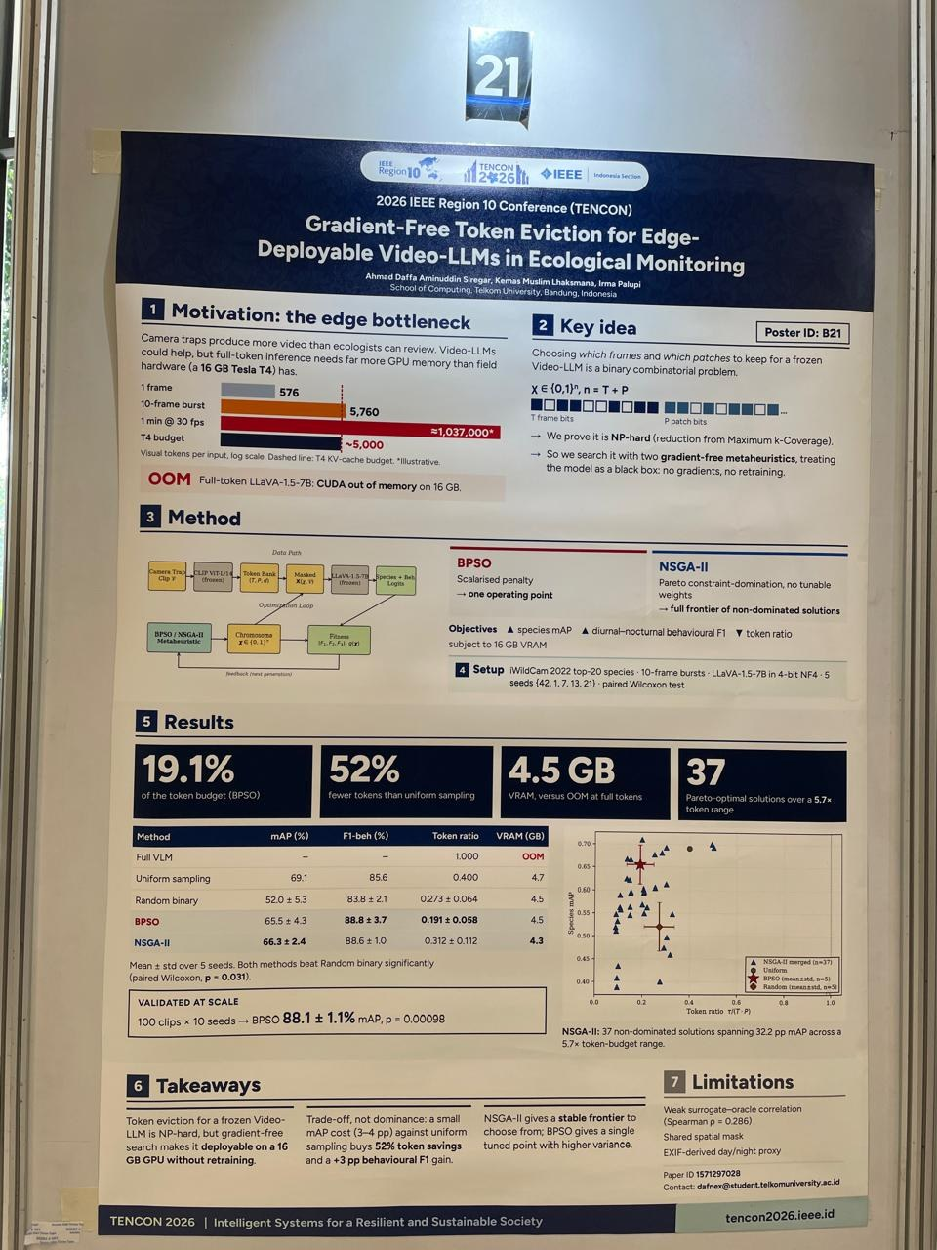
Empat Jenis Paper
Riset murni
Riset terapan
Bidang berkembang
Dari paper ke poster
Ide atau algoritma baru, diuji pada soal standar
AI dipakai atau diaudit pada masalah nyata
Satu ide diperbaiki dan dipakai orang lain
Hasil riset dikomunikasikan di konferensi
Notes:
0:13 to 0:15 (2 min). Four kinds, each with a real example. 1 = riset murni (ide baru), 2 = riset terapan (masalah nyata), 3 = bidang yang berkembang (garis keturunan sebuah ide), 4 = dari paper ke poster.
Say: 'Empat contoh ini semua ditulis di kampus kita atau memakai karya kampus kita.' Check: KMA, KomoTrip, reference-vector, skin-tone, token eviction all have Telkom University authors (visible in the screenshots).

Slide 6
RISET MURNI
Ide baru untuk sebuah algoritma
Bedah judulnya
Reference-vector competitor pairing
ide barunya
constrained
ada batasan
large-scale
variabel sangat banyak
multi-objective
beberapa tujuan sekaligus
Siregar dan Suyanto, Telkom University
Computing Laboratory, Telkom University
Pusat Keunggulan AI untuk Pembelajaran dan Optimasi
competitive swarm optimisation
algoritma dasar yang diperbaiki
Notes:
0:15 to 0:19 (4 min). RISET MURNI. The screenshot shows only the title page, so read the title, not results.
Teach: a pure-research title usually carries the new idea plus the problem class. Reference-vector competitor pairing = the new idea. Constrained, large-scale, multi-objective = the problem class. Competitive swarm optimisation = the base algorithm. Typically judged on standard benchmark problems, not on patient or customer data (the KMA abstract shows this: 23 benchmark functions).
Affiliations on the page: School of Computing, Computing Laboratory (our lab), and the Center of Excellence of AI for Learning and Optimization, Telkom University.

Slide 7
RISET TERAPAN
Mengaudit AI pada masalah nyata
Model: EfficientNet-B0 untuk kanker kulit
Data HAM10000: hanya sekitar 182 gambar kulit gelap (1,8%)
Selisih recall (EOD) sekitar 0,11, tetapi selang kepercayaan 95% mencakup nol
Kesimpulan: perbaikan data saja tidak cukup
Notes:
0:19 to 0:23 (4 min). RISET TERAPAN. This paper does not propose a new algorithm; it audits an existing model on a real problem (skin cancer). Authors: Siregar, Lhaksmana, Yusuf (IEEE conference, 2026).
Read the abstract with them: problem (CNNs hide demographic gaps), method (EfficientNet-B0, leakage-free pipeline, 3 seeds, Equal Opportunity Difference), result (EOD about 0.11, 95% bootstrap CI spans zero, about 182 dark-skin images, about 10 dark-skin malignant cases in the test set), conclusion (naive data-level fixes are not a substitute for diverse data).
Say: 'Paper yang bagus berani bilang apa yang TIDAK bisa disimpulkan.' This is exactly the evaluation habit of Week 7.

Slide 8
RISET TERAPAN
Satu pola, banyak bidang
Citra medis
Segmentasi luka kaki diabetik dengan U-Net dan EfficientNet-B0
Sistem rekomendasi
Keadilan pada rekomendasi, dengan augmentasi berbasis GAN
Model bahasa
Penalaran soal keuangan pada model kecil 4-bit
Hasil campuran pun layak terbit: CoT menaikkan Llama-3-8B, tetapi menurunkan Mistral-7B
Notes:
0:23 to 0:26 (3 min). Same pattern in three fields: a real problem, a model, an honest evaluation.
Left: diabetic foot ulcer segmentation (U-Net + EfficientNet-B0 with a boundary-aware loss on FUSeg). Middle: user-side fairness in neural collaborative filtering with GAN-based augmentation. Right: Chain-of-Thought plus Program-of-Thought on 4-bit quantized small language models, FinQA benchmark.
Mixed results (from the CoT/PoT abstract): Llama-3-8B 67.48 to 67.83, Qwen2.5-Coder-7B 65.74 to 66.52, Mistral-7B 63.12 to 61.29, complete execution collapse in Phi-3.8B and DeepSeek-Math-7B. Say: 'Hasil yang tidak seragam tetap diterbitkan karena dilaporkan dengan jujur.'

Slide 9
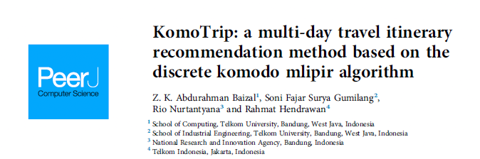
BIDANG BERKEMBANG
Satu ide, tiga paper
2021
2022
2025
Paper asli
Applied Soft Computing
Telkom University
Diperbaiki orang lain
IEEE Access
Jilin University, Tiongkok
Dipakai untuk masalah nyata
PeerJ Computer Science
Telkom University dan mitra
Notes:
0:26 to 0:29 (3 min). A field improves through a chain of papers.
2021: Komodo Mlipir Algorithm, Suyanto et al., Applied Soft Computing (vol. 114, 2022; online 17 Nov 2021), written at Telkom University. 2022: Improved Adaptive KMA, Liu and Zhang (Jilin University), IEEE Access vol. 10, 2022. 2025: KomoTrip, Baizal et al., PeerJ Computer Science, 12 Nov 2025: a discrete KMA for multi-day travel itineraries.
Say: 'Algoritma dari kampus kita diperbaiki peneliti di Tiongkok, lalu dipakai untuk menyusun rute wisata. Begitulah bidang ini maju: orang membaca paper orang lain.'

Slide 10
BIDANG BERKEMBANG
Paper asli: Komodo Mlipir Algorithm
Terinspirasi komodo di NTT dan gaya jalan mlipir
Populasi dibagi tiga: jantan besar, betina, jantan kecil
Diuji pada 23 fungsi benchmark
Kode sumber dibuka untuk umum
Open access, lahir di School of Computing, Telkom University
Notes:
0:29 to 0:32 (3 min). The original paper. Authors Suyanto, A. A. Ariyanto, A. F. Ariyanto, School of Computing, Telkom University. Received 15 March 2021, accepted 4 Nov 2021, online 17 Nov 2021. Open access, CC BY-NC-ND.
Mlipir: a Javanese term for walking at the side of the road to reach a destination safely (stated in the abstract). Three groups: high-quality big males (high exploitation, low exploration), middle-quality females (mate with the best male or parthenogenesis), low-quality small males (mlipir, following the big males in some dimensions).
Tie to the course: this is a population metaheuristic like the GA and PSO of Weeks 10 to 11. Source code is public, so students can run it.

Slide 11
BIDANG BERKEMBANG
Diperbaiki: Improved Adaptive KMA
Dua varian: IKMA-1 dan IKMA-2
Diklaim memperbaiki KMA: 17,58% (IKMA-1) dan 10,99% (IKMA-2)
Diuji pada 23 fungsi CEC2013 dan dua masalah rekayasa
Dibandingkan dengan tujuh algoritma lain, dengan uji Wilcoxon dan Friedman
Ditulis oleh peneliti Jilin University, Tiongkok
Notes:
0:32 to 0:35 (3 min). Someone else read the KMA paper and improved it. IKMA-1 adapts the parthenogenesis radius of the females; IKMA-2 adds adaptive weighting factors to the mlipir movement. Published in IEEE Access 2022 (vol. 10).
Teach the reading skill: 'diklaim' means these are the authors' numbers. A good reader asks: improved on which benchmark, against which baselines, tested how (Wilcoxon, Friedman)?
Tie to the course: statistical tests and many runs appear in the final project protocol (10 or more runs).

Slide 12
BIDANG BERKEMBANG
Dipakai: KomoTrip
Masalah nyata
Menyusun itinerari wisata beberapa hari
Metode
KMA versi diskret
Judul sudah memberi tahu keduanya
Telkom University, BRIN, dan Telkom Indonesia
PeerJ Computer Science, 12 November 2025
Notes:
0:35 to 0:38 (3 min). From benchmark functions (KMA) to travel routes (KomoTrip). Authors Baizal, Gumilang, Nurtantyana, Hendrawan. Published 12 Nov 2025 in PeerJ Computer Science (DOI 10.7717/peerj-cs.3350).
The abstract (not on the slide, from the journal page) frames it as a team orienteering problem with time windows and combines the discrete KMA with Multi-Attribute Utility Theory; I did not open the full text, so stay with what the title says: problem = multi-day itinerary recommendation, method = discrete komodo mlipir algorithm.
Connect to Week 11 (representation, TSP-like problems): a route is a permutation, not a real vector, so the algorithm had to be made discrete.

Slide 13
DARI PAPER KE POSTER
Hasil riset di konferensi
Satu paper, satu poster di IEEE TENCON 2026
Tujuh kotak: Motivasi, Ide kunci, Metode, Setup, Hasil, Takeaways, Limitations
Angka utama dibuat besar: 19,1% budget token, 52% lebih sedikit token, 4,5 GB VRAM
Notes:
0:38 to 0:41 (3 min). A paper becomes a poster. This is the TENCON 2026 poster (B21) of 'Gradient-Free Token Eviction for Edge-Deployable Video-LLMs in Ecological Monitoring' (Siregar, Lhaksmana, Palupi, Telkom University). Photo taken at the conference.
Show how a poster compresses a paper into seven boxes. Numbers from the poster: 19.1% of the token budget (BPSO), 52% fewer tokens than uniform sampling, 4.5 GB VRAM versus out-of-memory with full tokens, 37 Pareto-optimal solutions.
Plant the idea: our Demo Day (Week 16) will be a mini poster session, and the technical note is a mini paper.

Slide 14
DARI PAPER KE KELAS
Poster ini memakai isi kelas kita
Di poster | Di kelas ini
Pilih frame dan patch mana yang disimpan: soal biner | Representasi solusi (Pekan 11)
BPSO: binary particle swarm | Metaheuristik populasi, PSO (Pekan 10)
NSGA-II: banyak tujuan, solusi Pareto | Multi-objektif (topik lanjutan, opsional)
Gradient-free: model dianggap kotak hitam | Optimasi tanpa gradien (Pekan 9 sampai 12)
5 seed, rata-rata ± simpangan baku, uji Wilcoxon | Protokol eksperimen (Pekan 9 dan proyek akhir)
Video-LLM beku, LLaVA-1.5-7B 4-bit | Transformer dan LLM (Pekan 14)
Kotak Limitations | Catatan teknis dengan satu kasus gagal
Notes:
1:23 to 1:26 (3 min), after the break. The bridge from papers to this course: every element of a real, recent paper from our lab is something students will learn by Week 16.
Be honest about scope: NSGA-II (multi-objective) is not in the 16-week plan; it is an optional extension (Luke chapter 7).
Say: 'Di akhir 16 pekan kamu bisa membaca paper seperti ini, dan menulis versi mini-nya sendiri.'

Slide 15
CARA MEMBACA
Satu abstrak, empat bagian
Baca abstrak seperti ini
Masalah
Apa yang bermasalah?
Metode
Apa yang dikerjakan?
Hasil
Apa temuannya? Angkanya?
Kesimpulan
Apa artinya, dan batasnya?
Bagian paper: Pendahuluan, Related Work, Metodologi, Eksperimen, Hasil
Notes:
0:43 to 0:48 (5 min). The same skin-tone abstract, now coloured: red = problem, gold = method, teal = results, violet = conclusion. The colour bands are drawn over the screenshot and are approximate at line edges.
Say: 'Abstrak selalu mengikuti urutan ini. Setelah dua atau tiga paper, kamu bisa menemukannya dalam hitungan detik.'
The IEEE page's own outline (visible in the screenshot) lists: I. Introduction, II. Related Work, III. Methodology, IV. Experiments, V. Results.

Slide 16
Membaca Paper dalam 10 Menit
Urutan membaca
Judul
Abstrak
Gambar dan tabel
Kesimpulan dan keterbatasan
Metode, hanya jika perlu
Lima pertanyaan
Masalah apa yang dikerjakan?
Apa yang diusulkan atau dilakukan?
Bagaimana diuji?
Apa angka kuncinya?
Apa keterbatasannya?
Notes:
0:48 to 0:53 (5 min). Reading order for beginners: title, abstract, figures and tables, conclusion and limitations, and only then the method. The five questions are exactly what the Detective Card asks.
Say: 'Kamu tidak membaca paper dari kata pertama sampai terakhir. Kamu menginterogasinya.' AI assistants can help summarize, but the numbers must be checked against the paper.

Slide 17
Detektif Paper
25 menit · berpasangan
Ambil satu kartu paper (A sampai E)
Jawab lima pertanyaan di kartu, 12 menit
Tandai angka kunci dan satu keterbatasan
Bagikan hasilnya: satu menit per paper
A
B
C
D
E
Notes:
0:53 to 1:18 (25 min). Printed cards: fasilitator/kartu-detektif.pdf. 5 papers x 3 pairs = 15 cards (A skin-tone abstract, B CoT+PoT abstract, C KMA abstract, D IKMA abstract, E the TENCON poster).
Timing: 3 min explain, 12 min pairs fill the card, 10 min share-out (5 papers x about 2 minutes, one pair per paper). Answer keys are in fasilitator/panduan-fasilitator.md section 6.
AI is allowed, but ask for the number first: 'Di bagian mana angka itu tertulis di paper?'

Slide 18
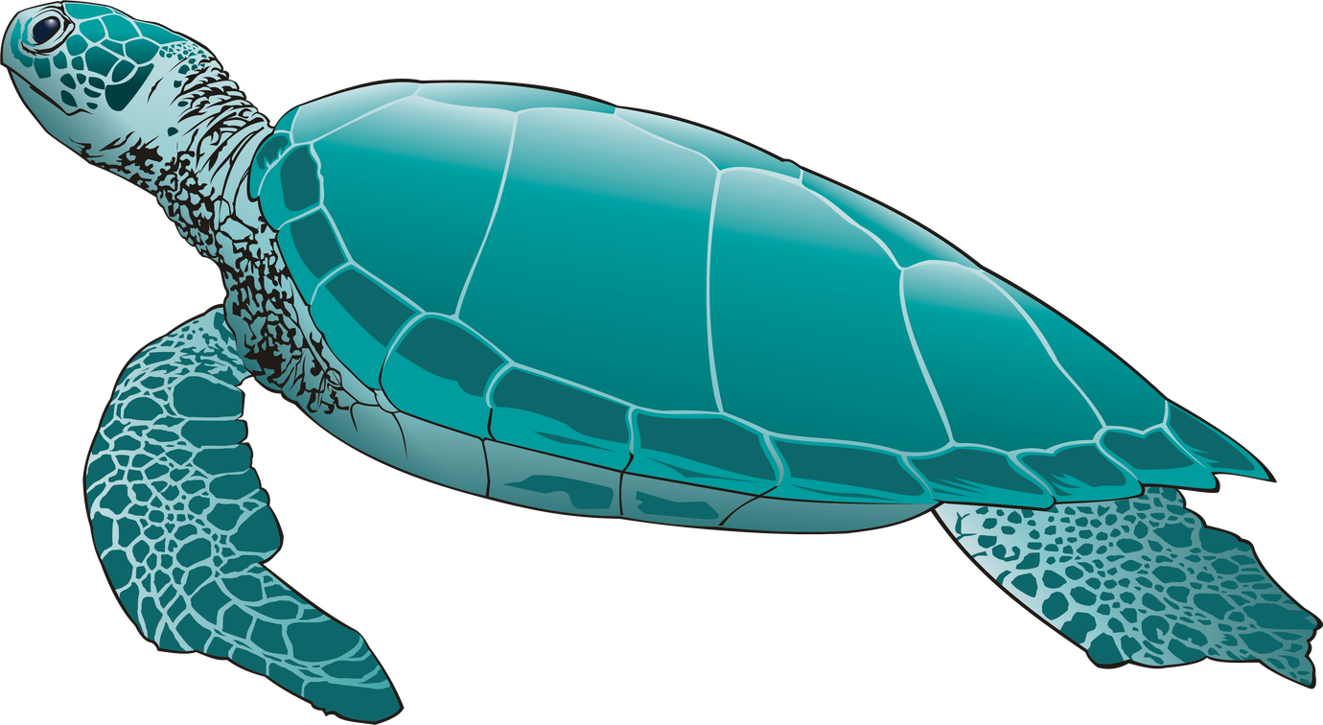
Lalu: dari paper ke kelas
Istirahat
5 menit
Notes:
1:18 to 1:23 (5 min). Break. Collect the detective cards if you want to read them later.

Slide 19
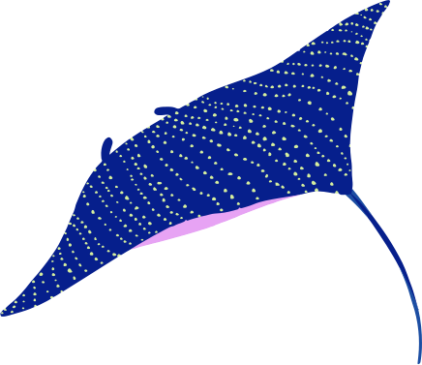


ML dan Optimasi
Fungsi tujuan
Apa yang ingin diperkecil atau diperbesar.
Ruang pencarian
Anggaran
Pilihan apa saja yang boleh kita coba.
Berapa kali kita boleh mencoba.
Notes:
1:23 to 1:26 (3 min). Back to the course. Every paper you saw has three parts: an objective, a search space, and a budget.
KMA: the objective is a benchmark function, the search space its variables, the budget the number of evaluations. KomoTrip: the objective is itinerary quality, the search space is all possible routes. Training a model is the same: find parameters with the lowest loss.
Slide 14 (poster versus course) can be shown here if there is time; it is the bridge.

Slide 20


Evolusi Gambar
Satu aturan
Ubah sedikit. Simpan jika lebih mirip target, buang jika tidak.
Perhatikan
Kapan kurva turun cepat? Kapan melambat?
Notes:
1:26 to 1:31 (5 min). LIVE DEMO (demo.html, speed Cepat, press Mulai before you talk). It is a tiny hill-climbing optimizer drawing a picture with 40 triangles.
Ask: 'Kapan kurvanya turun cepat? Kapan melambat?' Then: 'Kurva seperti ini ada di hampir setiap paper optimasi, itu grafik konvergensi.' Hill climbing is formalized in Week 9.

Slide 21

Ritme Mingguan
2. Kelas
2 jam tatap muka: kuis tanpa perangkat, contoh, latihan berpasangan.
Sekitar 5 sampai 6 jam per pekan
1. Baca
Bab buku dan satu paper, dengan panduan baca.
3. Latihan
Notebook Colab dan satu pertanyaan pemahaman.
Notes:
1:31 to 1:33 (2 min). Each week: read the book chapter and one paper (guided), class, practice. The 5 to 6 hour figure is an estimate. The paper-per-week idea is a proposal; see the next slide and the fasilitator guide.

Slide 22
Buku untuk Dasar, Paper untuk Garis Depan
Dua buku, gratis dan sah
Understanding Deep Learning
Simon J. D. Prince, MIT Press 2023
Essentials of Metaheuristics
Sean Luke, edisi kedua, versi 2.4
Unduh dari situs penulis (Panduan Peserta)
Paper yang kita baca bersama
Pekan 7: audit bias warna kulit
Pekan 9 sampai 11: KMA dan penerusnya
Pekan 12: token eviction dengan BPSO
Pekan 14: CoT dan PoT pada model kecil
Notes:
1:33 to 1:36 (3 min). Books give the foundations; papers show the frontier. Both books are free from the authors; licenses forbid modification and translation, so mentors publish Indonesian reading guides as original commentary.
PROPOSAL, confirm before class: the four anchor papers per week. They come from the papers shown today and match the course topics (evaluation, KMA lineage with metaheuristics, hybrid optimization, LLMs). Remove the right column if you have not decided.

Slide 23
Penilaian
40%
10%
50%
Latihan
mingguan: kelengkapan dan satu pertanyaan pemahaman
Cek lisan
Pekan 8 individu, Pekan 12 tim
Proyek akhir
tim 30%, cek lisan individu 20%
Kehadiran menjadi syarat: minimal 13 dari 16 pertemuan.
Notes:
1:36 to 1:38 (2 min). 40 / 10 / 50. Oral checks are about 7 minutes: explain your own code and predict the effect of a small change.
CONFIRM BEFORE CLASS: the attendance threshold (13 of 16) is a proposal. If not confirmed say 'ambang kehadiran diumumkan minggu depan' and edit this slide.

Slide 24
Proyek Akhir
Tim 3 orang: model ML dengan lapisan optimasi yang menentukan hasil
Dibandingkan dengan pembanding pada anggaran sama, minimal 10 percobaan
Catatan teknis 2 sampai 3 halaman: paper mini dengan satu kasus gagal
Hari demo: sesi poster seperti konferensi
Proposal Pekan 9 · Baseline Pekan 11 · Demo Pekan 16
Notes:
1:38 to 1:42 (4 min). The final project mirrors what they saw today: the technical note is a mini paper (problem, method, evaluation, key number, limitation) and Demo Day is a mini poster session like the TENCON poster.
Rules: teams of 3 formed by mentors in Week 8; the optimization layer must change the result and be compared with a baseline at the same budget over 10 or more runs; open or synthetic data only.

Slide 25
Alat AI
Pakai AI apa pun, kapan pun. Tidak ada yang mencatatnya.
Tiga hal tetap berlaku:
Kuis pembuka dan cek lisan: tanpa perangkat
Angka yang kamu kutip dari paper dicek ke paper aslinya
Kamu yang bertanggung jawab dan harus bisa menjelaskannya
Notes:
1:42 to 1:46 (4 min). Say: 'Pakai AI sesukamu. Tidak ada yang mencatat. AI sangat membantu merangkum paper, tapi ia bisa salah mengutip angka, jadi angkanya kamu cek ke paper.'
Also: seven weeks carry a 'verify the assistant' task (weeks 2, 5, 7, 9, 10, 11, 14); oral checks are closed-device.

Slide 26
Stasiun Persiapan
A · Google dan Colab
Akun Google masuk. Colab terbuka dan print("halo") berjalan.
B · GitHub
Akun GitHub dibuat. Username diberikan ke mentor.
C · Buku
Kedua buku terunduh dan terbuka di perangkatmu.
10 menit. Yang belum selesai dikerjakan di rumah.
Notes:
1:46 to 1:56 (10 min). Mentor 2 = A (Colab first), mentor 3 = B, mentor 1 = C. Fixes in fasilitator/panduan-fasilitator.md. Never cut this block.

Slide 27
Untuk Pertemuan 1
Baca UDL bagian 1.1 (halaman 1 sampai 6) dan bab 2 (halaman 17 sampai 22)
Kerjakan lembar kerja Python untuk programmer Go (latihan 1 sampai 10)
Bawa laptop yang sudah bisa membuka Colab
Tiket keluar (2 menit)
Tulis satu pertanyaan dan satu hal yang kamu khawatirkan.
Notes:
1:56 to 2:00 (4 min). Page numbers are printed numbers (UDL printed 17 = PDF 31). The Python worksheet is now homework; Week 1 opens with the 'Optimizer 20 baris' game. Hand out slips, collect on the way out, read them the same evening.

Slide 28
Advance Study Group
Terima
Kasih
Sampai jumpa
Notes:
2:00. End. See you in Week 1.

