Slide 1
Extended version of talk at the Dan Everett Festival
Cohesive Rhythms
Choral Narrative in Ega
http://wwwhomes.uni-bielefeld.de/gibbon/EGA/
Dafydd Gibbon
Bielefeld University
Göttingen University, 22 June 2023

Slide 2
Overview
Methods for analysing rhythms
  Inducing rhythm from speech
  Deducing rhythm from grammar
The ubiquity of rhythms
  Rhythms, melodies and the modulation of speech
  AM and FM modulation
Ega
  Geographically and typologically
  Phonology, tonology: does Ega have downstep? Maybe!
Rhythms in Ega choral narrative
  Rhythms in the time domain and the frequency domain
  Demodulation of long-term speech events
Conclusion

Slide 3
Why rhythms of orature?
Beyond ‘linguistic rhythms’ derived from grammar:
Partially reversible numerical tree encodings
Qualitative empical + formal methodology
Deductive, just one rhythm:
    Either non-relational binary categories, e.g. [+/- stress]
    Or iambic, trochaic metaphors:
      Where are the dactyls, anapaests, spondees, pyrrhics?
      How about amphibrachs and Jassem’s anacrusis theory?
Phonetic correlates of rhythms remain undefined
Induction of ‘realtime rhythms’ from real speech registers:
Quantitative, physical signal measurement and processing
Rhythm as beats/cycles with frequencies, magnitudes, ...
    Plenty of boom-de-boom-boom!
Variability of rhythm patterns, parallel ‘rhythms of rhythm’
Variability of linguistic correlates
Depends on contextual style, register, not only grammar:
    e.g. reading → formal → orature → informal spontaneous

Slide 4
Deduction of ‘linguistic rhythms’ from grammar?
Data:
    normative ‘educated registers’, not extempore speech
    metalinguistic quoted (written, transcribed) data
Method:
    Individual expert opinion, hermeneutic interpretation
    qualitative judgment and analysis
    data comparison with algebraic and set-theoretic models
Modelling conventions:
    rhythm as relations between nodes in structures:
        (partly reversible) numerical tree encodings
    binarity constraints on
        categories and relations: [+/- stress], [s, w] / [w, s]
        sequences: ‘iambic’, ‘trochaic’, ‘metrical’ metaphors
    physical grounding (correlates) not essential

Slide 5
Induction of ‘real rhythms’ from recorded orature
Data:
    well-defined speech registers
    reproducible realtime recordings
Method:
    quantitative, physical measurement
    signal processing
    data comparison with hierarchical clustering
Modelling conventions:
    rhythm as beats/cycles with frequencies, magnitudes, ...
    systematic variability of rhythm patterns
    multiple parallel ‘rhythms of rhythm’
    physical grounding for linguistic correlates
    dependence on contextual style, register:
          reading → orature → ...

Slide 6
Deduction of ‘linguistic rhythms’ from grammar?
Very successful ‘clear case’ methodology, but ...
Too much reliance on metaphors rather than models:
  Where are the dactyls, anapaests, spondees, pyrrhics?
  How about amphibrachs and Jassem’s anacrusis theory?
  Mutual citation bubbles (aka paradigms) prevail.
  Individual intuitive judgments are opinions rather than facts.
Timing, including ‘real rhythms’, involve many factors, e.g.:
  Phonotactics: syllable structure
  Morphotactics: word structure
  Phrase and sentence structure
  Information structure
  Dialogue structure
And, to misquote a line by Fred Cummins:
  Where’s the ‘boom-de-boom-boom’ in numerical tree encodings?

Slide 7
Why induce rhythms from orature?
Data:
    well-defined speech registers
    reproducible realtime recordings
Method:
    quantitative, physical measurement
    signal processing
    data comparison with hierarchical clustering
Modelling conventions:
    rhythm as beats/cycles with frequencies, magnitudes, ...
    systematic variability of rhythm patterns
    multiple parallel ‘rhythms of rhythm’
    physical grounding for linguistic correlates
    dependence on contextual style, register:
          reading → orature → ...
So let’s take a look at ‘realtime rhythms’.
And where better to start than West Africa?
After all, that’s where prosodic, autosegmental, metrical phonologies came from –
Firth, …, Leben, Goldsmith, Clements, ...

Slide 8
Rhythms are ubiquitous...
Phonetician
Phonologian
Radio engineer
Musician

Slide 9
Rhythms are ubiquitous...
Phonetician
Phonologian
Radio engineer
...
Prosody
intonation
pitch accent
tone
sonority curve etc.
Musician

Slide 10
Rhythms are ubiquitous...
Phonetician
Phonologian
Radio engineer
...
Prosody
intonation
pitch accent
tone
Melody
(cf. also vibrato)
sonority curve etc.
Rhythm
(cf. also tremolo)
Musician

Slide 11
Rhythms are ubiquitous...
Phonetician
Phonologian
Radio engineer
...
Prosody
Information signals, IS (low frequency)
Carrier signal, CS
(high frequency)
Modulation
intonation
pitch accent
tone
Melody
(cf. also vibrato)
sonority curve etc.
Rhythm
(cf. also tremolo)
Musician

Slide 12
Rhythms are ubiquitous...
Phonetician
Phonologian
Radio engineer
...
Prosody
Information signals, IS (low frequency)
Carrier signal, CS
(high frequency)
Modulation
intonation
pitch accent
tone
Melody
(cf. also vibrato)
sonority curve etc.
Rhythm
(cf. also tremolo)
Musician

Slide 13
Rhythms are ubiquitous...
Phonetician
Phonologian
Radio engineer
...
Prosody
Information signals, IS (low frequency)
Carrier signal, CS
(high frequency)
Modulation
intonation
pitch accent
tone
Frequency (FM)
F0(CS) + IS
Melody
(cf. also vibrato)
sonority curve etc.
Rhythm
(cf. also tremolo)
Amplitude (AM)
Amp(CS) × IS
Musician

Slide 14
Rhythms are ubiquitous...
Phonetician
Phonologian
Radio engineer
...
Prosody
Information signals, IS (low frequency)
Carrier signal, CS
(high frequency)
Modulation
intonation
pitch accent
tone
Frequency (FM)
F0(CS) + IS
Melody
(cf. also vibrato)
sonority curve etc.
Rhythm
(cf. also tremolo)
Amplitude (AM)
Amp(CS) × IS
Musician

Slide 15
Rhythms are ubiquitous...
Phonetician
Phonologian
Radio engineer
...
Prosody
Information signals, IS (low frequency)
Carrier signal, CS
(high frequency)
Modulation
intonation
pitch accent
tone
Frequency (FM)
F0(CS) + IS
Melody
(cf. also vibrato)
sonority curve etc.
Rhythm
(cf. also tremolo)
Amplitude (AM)
Amp(CS) × IS
Musician

Slide 16
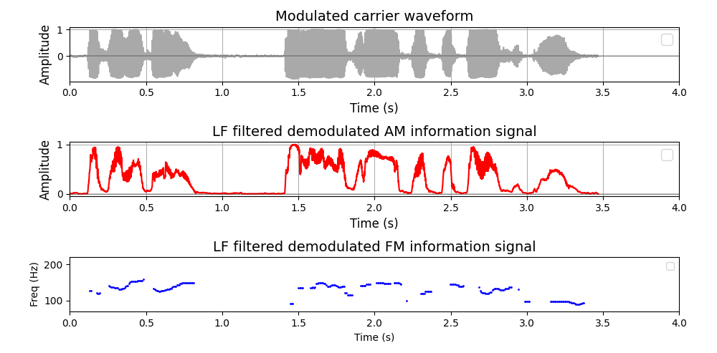
AM and FM demodulation: an Ega example
Ega: | Nufli mUkanU | inOn mUglU | Oko Towe Cyprien
French: | bonjour | je m´appelle | Oko Towe Cyprien
NUfli mukanu
good morning
InOn ma muglu
my name is
Oku towe siyprie
Oko Towe Cyprien
Note:
L raising and H lowering on “Òkú tòwé siprìè”

Slide 17
AM and FM demodulation: an Ega example
1. Amplitude and frequency modulated carrier waveform
2. AM demodulation (absolute values, low frequency filter)
3. FM demodulation (frequencies of carrier cycles)
Ega: | Nufli mUkanU | inOn mUglU | Oko Towe Cyprien
French: | bonjour | je m´appelle | Oko Towe Cyprien
NUfli mukanu
good morning
InOn ma muglu
my name is
Oku towe siyprie
Oko Towe Cyprien
Note:
L raising and H lowering on “Òkú tòwé siprìè”

Slide 18
Where are we geographically?

Slide 19
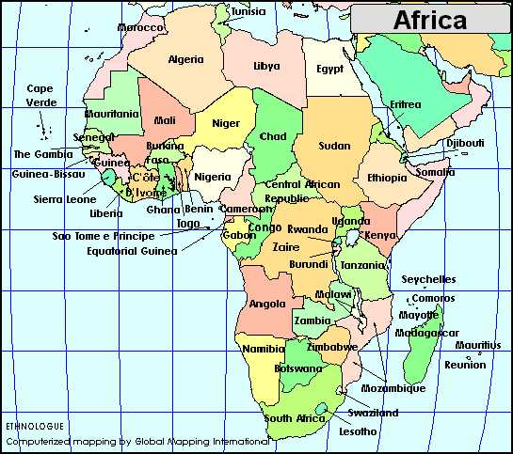
Where are we geographically?
Côte d’Ivoire

Slide 20
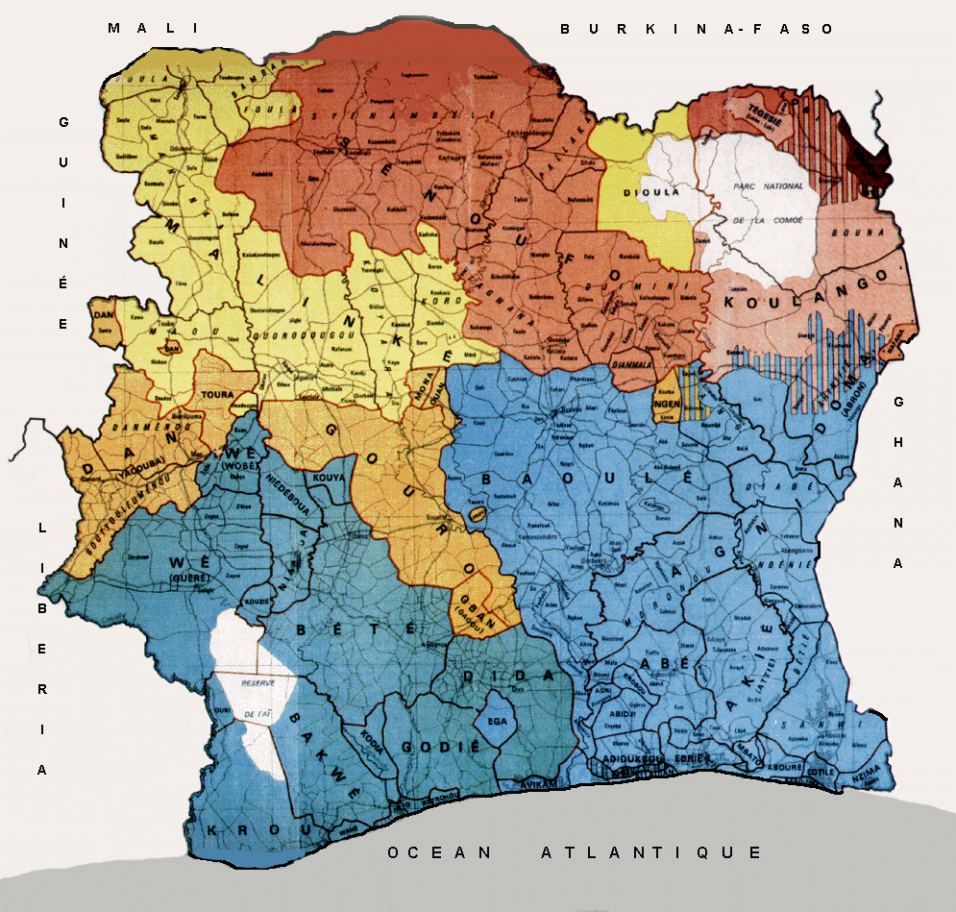
Where are we geographically?
Ega
(ISO 639-3 ega)
enclave

Slide 21
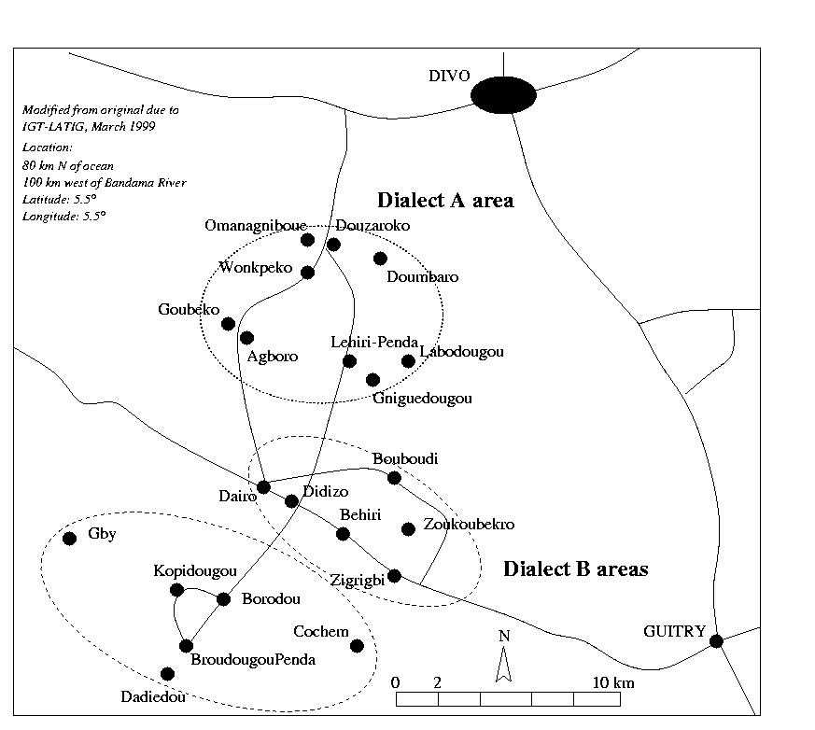
Where are we geographically?
DIDA
(Kru)
EGA
(Kwa?)
Gniguedougou
fieldwork

Slide 22
Where are we typologically?,

Slide 23
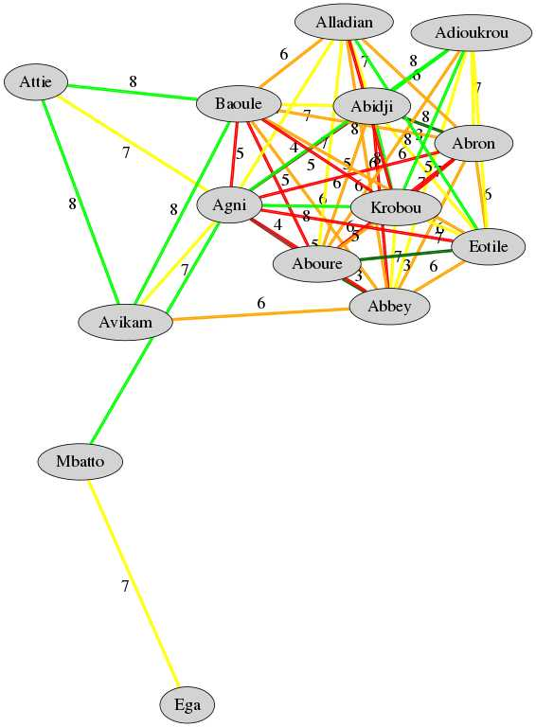
Where are we typologically?
Better-known Ivory Coast Kwa languages
Kwa languages of Ivory Coast
Levenshtein Distance mapping
of phoneme inventories:
    Distance range: 0-8
    Ega distance >7
Source of phoneme inventories:
Hérault, Georges. Atlas Linguistique des Langues Kwa. Abidjan: Institut de Linguistique Appliquée, Agence de Coopération Culturelle et Technique. 1983.
Ega
ISO 639-3 ega

Slide 24
Outline of Ega phonetics, phonology, tonology

Slide 25
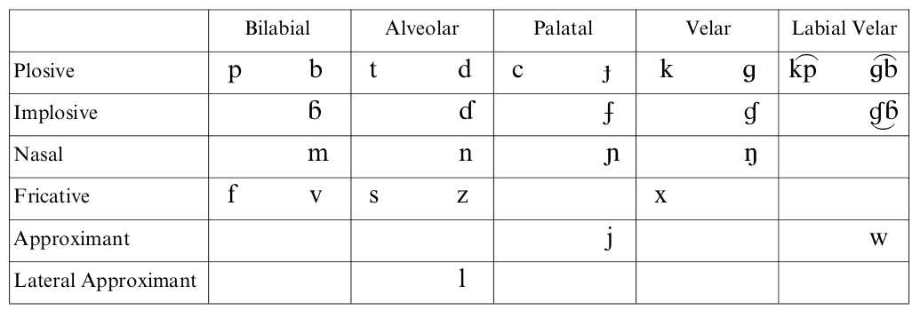
Ega Phonetics: Consonants
Extensive set of implosives
Depressor consonants:
    The voiced obstruent series /b, d, K, g, gb , v, z/
    Lowering of following tone (lowering effect on following M and H tones is a salient perceptual cue in distinguishing these from implosives )

Slide 26
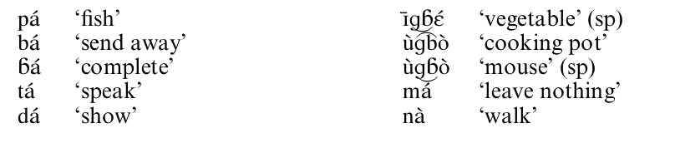
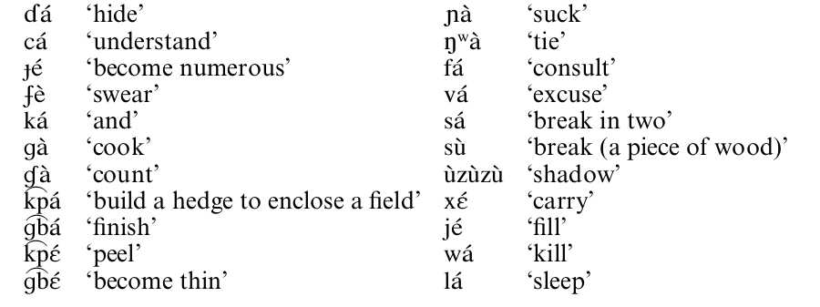
Ega Phonetics: Consonants

Slide 27
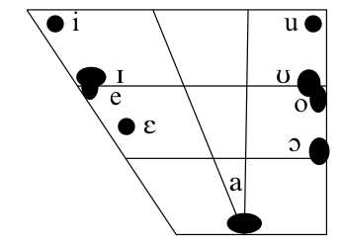
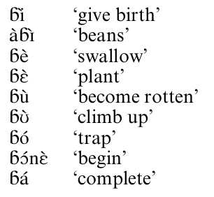
Ega Phonetics: Vowels
ATR vowel harmony within NPs and within VPs
Frequency of vowel hiatus phenomena, regularly resulting in elision, coalescence or assimilation of one of the two vowels

Slide 28

Ega Phonetics: Tone
H
M
L
Depressor consonants
  The voiced obstruent series /b, d, K, g, gb , v, z/
  Lowering of following tone (lowering effect on following M and H tones is a salient perceptual cue in distinguishing these from implosives )
Tone sequences:
  Diachronic vowel deletion may leave two tones on one syllable
Downtrend:
  Possibly, not investigated.

Slide 29
Tones in sequence
A cyclical linear model for downstep
(Note: there are only borderline cases of downstep in Ega)

Slide 30
Generic downstep model: Finite State Automaton
Tone strings of languages with downstep are often represented as terminal strings of right-branching trees.
The set of such terminal strings is a regular language, which can be generated by a regular grammar.
The same set of strings can be accepted by a Finite State Automaton or Finite Transition Network.
The FSA or FTN for tonal downstep sequences is cyclical.

Slide 31
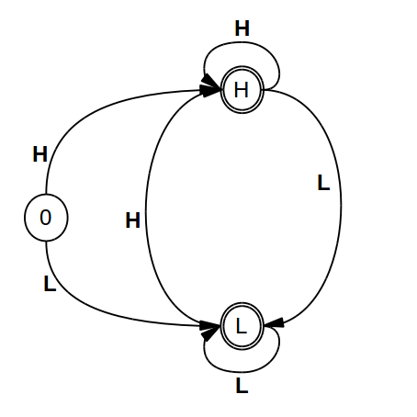
Generic downstep model: Finite State Automaton
Tone strings of languages with downstep are often represented as terminal strings of right-branching trees.
The set of such terminal strings is a regular language, which can be generated by a regular grammar.
The same set of strings can be accepted by a Finite State Automaton or Finite Transition Network.
The FSA or FTN for tonal downstep sequences is cyclical.

Slide 32
Generic downstep model: Finite State Automaton
Tone strings of languages with downstep are often represented as terminal strings of right-branching trees.
The set of such terminal strings is a regular language, which can be generated by a regular grammar.
The same set of strings can be accepted by a Finite State Automaton or Finite Transition Network.
The FSA or FTN for tonal downstep sequences is cyclical.
This FTN defines constraints on tone sequences, e.g. tonal terraces, as
a sequence of H tones
followed by a sequence of L tones
modelled as cycles around the two main nodes of the FTN.
If terraces are not needed, e.g. there is no downstep, the cyclical tones can be collapsed into a single node.

Slide 33
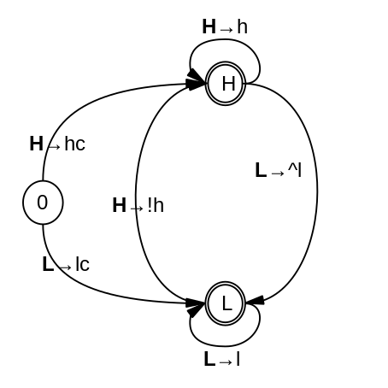
Generic downstep model: Finite State Automaton
The FSA or FTN for tonal downstep sequences can be extended into a Finite State Transducer for mapping one set of strings on to a second set of strings, e.g.
    phonological categories (lexical tones)
      mapped to
    phonetic categories (phonetic tones)
In other words, contexts for phonological rules are provided by a Finite Transition Network.

Slide 34
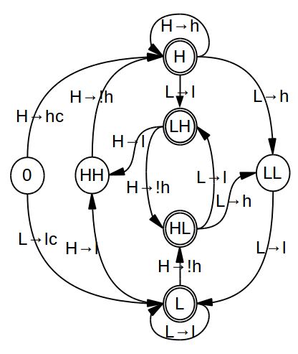
Baule downstep model: Finite State Automaton
Source:
Ahoua, Firmin. 1996. Prosodic Aspects of Baule. Cologne: Rüdiger Koppe Verlag.

Slide 35
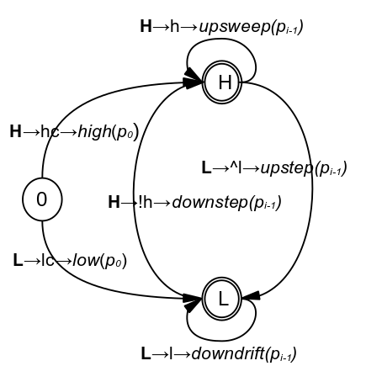
Ega Phonetics: Tone
The Finite State Transducer for mapping two sets of strings can be extended by a mapping on to a third set of strings, e.g.
    phonological categories (lexical tones) to
    phonetic categories (phonetic tones)
    physical phonetic functions, e.g. downstep, upstep, downdrift, upsweep

Slide 36
AM and FM demodulation: an Ega example
Ega: | Nufli mUkanU | inOn mUglU | Oko Towe Cyprien
French: | bonjour | je m´appelle | Oko Towe Cyprien
NUfli mukanu
good morning
InOn ma muglu
my name is
Oku towe siyprie
Oko Towe Cyprien
Note:
L raising and H lowering on “Òkú tòwé siprìè”

Slide 37
AM and FM demodulation: an Ega example
1. Amplitude and frequency modulated carrier waveform
2. AM demodulation (absolute values, low frequency filter)
3. FM demodulation (frequencies of carrier cycles)
Ega: | Nufli mUkanU | inOn mUglU | Oko Towe Cyprien
French: | bonjour | je m´appelle | Oko Towe Cyprien
NUfli mukanu
good morning
InOn ma muglu
my name is
Oku towe siyprie
Oko Towe Cyprien
Note:
L raising and H lowering on “Òkú tòwé siprìè”

Slide 38
Ega rhythms: annotation as a useful starting point

Slide 39
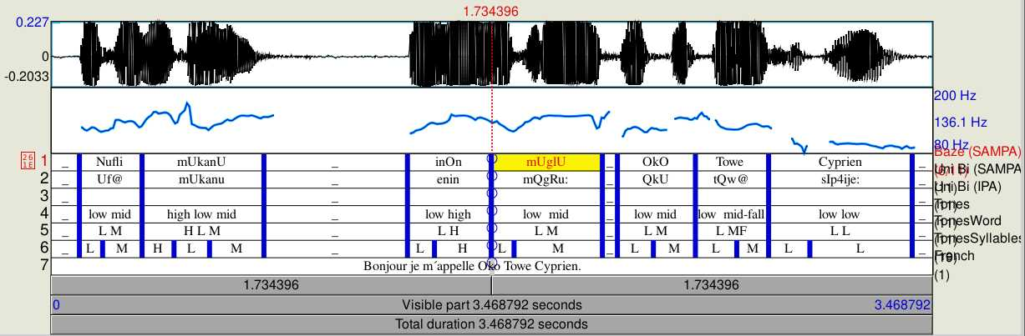
Ega Phonetics: Praat Annotation
Ega: | Nufli mUkanU | inOn mUglU | Oko Towe Cyprien
French: | bonjour | je m´appelle | Oko Towe Cyprien
Pause distribution:
Nufli mUkanU _
inOn mUglU _
OkO Towe Cyprien
Note:
L – M/H alternation

Slide 40
Ega Phonetics: Syllable and Word Duration
Syllable duration measures |  |  |  | Word duration measures
Attribute | Value | Attribute | Value | Attribute | Value | Attribute | Value
n | 15 | intercept | 117.7 | n | 7 | intercept | 319.714
min (ms) | 90 | slope | 8.443 | min (ms) | 246 | slope | 19.714
max (ms) | 403 | SD | 86.544 | max (ms) | 565 | SD | 107.912
range (ms) | 313 | coeff var | 48.95 | range (ms) | 319 | coeff var | 28.484
mean (ms) | 176.8 | nPVI | 50 | mean (ms) | 378.86 | nPVI | 39
mean rate | 5.66 | rPVI | 96 | mean rate | 2.64 | rPVI | 153
total (ms) | 2652 |  |  | total (ms) | 2652
Two points to note:
nPVI (next-door-neighbour distance) is higher for syllables, indicating either influence of final lengthening or, perhaps, the presence of stress/accent.
The rate values are potential rhythm frequencies (but note the influence of final lengthening).

Slide 41
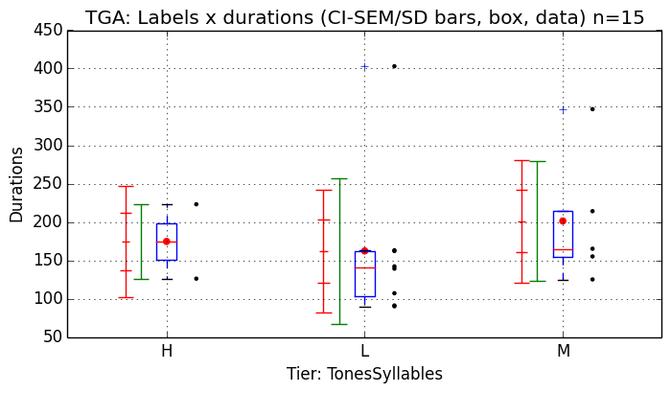
Ega Phonetics: Tone X Syllable Duration
Note:
Statistically, the diagram is meaningless (data sample too small).
However, a sources of hypotheses on dependencies.
The syllable type would also need to be taken into consideration.

Slide 42
Choral narrative in the village

Slide 43
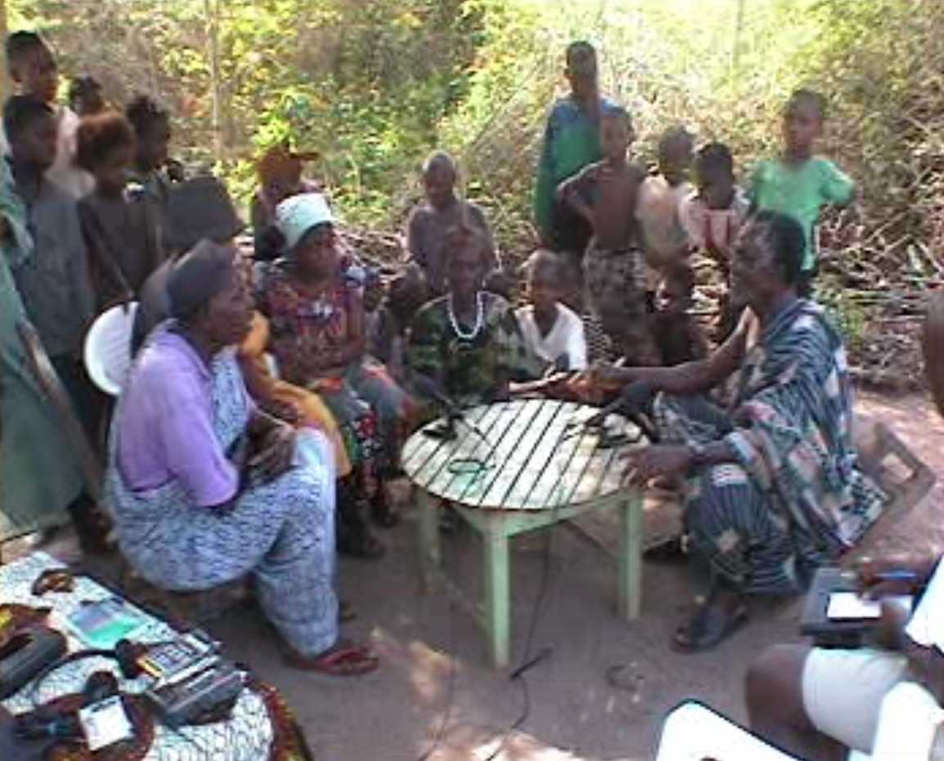
The parable
Audience + Choir
Narrator
+
Caller
Backchannel
Responder
Fieldworkers: notes, audio, camera

Slide 44
The parable

Slide 45
The parable
A faithless young bride-to-be left her promised bridegroom
  and is on her way to the next village
  to marry her new-found future husband (exogamy)
She is fruitlessly warned by a twittering bird
  with a prophecy about her impending end
  at the hands of her formerly betrothed suitor
  who had worked for free for her father to win her hand.
Alas, the girl did not understand
The bride and the jilted suitor met along the way ...
  he reproached and threatened her, she spat at him
  whereupon the prophecy came true
Moral: one should learn other languages like the fieldworkers
Punchline: the birdsong is in Dida
  the enclaving Eastern Kru language
  not in endangered Ega.

Slide 46
A cyclical model of the dialogue turns (e.g. narrative sequences) adjacency pairs (e.g. call-response)

Slide 47
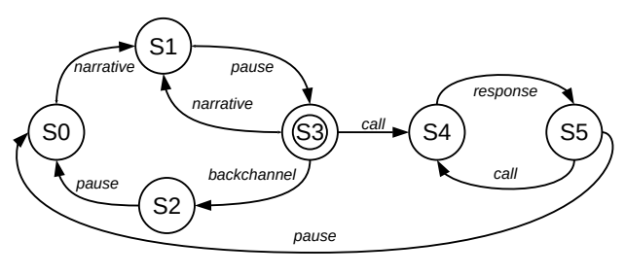
A cyclical dialogue model
Form:
There are multiple parallel speech rhythms, not a single rhythm
Speech rhythms relate to linguistic units in cycles
Multiple speech rhythm beat levels / cycles can be modelled as regular languages by cyclical (iterative) FTNs, FSTs, etc.
Function
Semantics: Speech rhythms are metalocutions which denote units at temporal points and intervals in locutions
Pragmatics: Domains of speech rhythms depend on register, style and discourse (at least as much as lexical and phrasal grammar)

Slide 48
A cyclical dialogue model
Form:
There are multiple parallel speech rhythms, not a single rhythm
Speech rhythms relate to linguistic units in cycles
Multiple speech rhythm beat levels / cycles can be modelled as regular languages by cyclical FTNs, FSTs, etc.

Slide 49
A cyclical dialogue model
Form:
There are multiple parallel speech rhythms, not a single rhythm
Speech rhythms relate to linguistic units in cycles
Multiple speech rhythm beat levels / cycles can be modelled as regular languages by cyclical FTNs, FSTs, etc.
Function
Semantics: Speech rhythms are metalocutions which denote units at temporal points and intervals in locutions
Pragmatics: Domains of speech rhythms depend on register, style and discourse (at least as much as lexical and phrasal grammar)

Slide 50
A cyclical dialogue model
Form:
There are multiple parallel speech rhythms, not a single rhythm
Speech rhythms relate to linguistic units in cycles
Multiple speech rhythm beat levels / cycles can be modelled as regular languages by cyclical FTNs, FSTs, etc.
Recursive computation is unnecessary
whether right, left or centre branching grammar
(unrealistic: requires nonfinite memory)
Only iteration is required
through the multiple cycles of
turns, exchange adjacency pairs
(realistic: finite constant working memory)
Recursion is delegated to function not form.
Function
Semantics: Speech rhythms are metalocutions which denote units at temporal points and intervals in locutions
Pragmatics: Domains of speech rhythms depend on register, style and discourse (at least as much as lexical and phrasal grammar)

Slide 51
Rhythms are ubiquitous ...
An inheritance hierarchy:
Physiological rhythms: breathing, heartbeat, brain ...
  Behavioural rhythms: walking, chewing, ...
    Bonding rhythms: dance, music, waving, nods, handshakes, …
      Speech rhythms: syllable, word, phrase, turn, exchange, ...
Characterisation:
  A rhythm is perceived, and can be measured, when a series of similarly structured events occurs with a specific frequency at approximately equal intervals in time and motivates a prediction of a further similarly structured event after a similar interval.
Attributes:
  frequency, magnitude, bandwidth, persistence, resonance
  attack, decay, staccato, legato, ...

Slide 52
Rhythms are ubiquitous ...
An inheritance hierarchy:
Physiological rhythms: breathing, heartbeat, brain ...
  Behavioural rhythms: walking, chewing, ...
    Bonding rhythms: dance, music, waving, nods, handshakes, …
      Speech rhythms: syllable, word, phrase, turn, exchange, ...
Characterisation:
  A rhythm is perceived, and can be measured, when a series of similarly structured events occurs with a specific frequency at approximately equal intervals in time and motivates a prediction of a further similarly structured event after a similar interval.
Attributes:
  frequency, magnitude, bandwidth, persistence, resonance
  attack, decay, staccato, legato, ...
Physiological, behavioural, communication, speech: Low Frequency rhythms in the range
0.1 Hz … 1Hz … 10Hz

Slide 53
Rhythms are ubiquitous ...
An inheritance hierarchy:
Physiological rhythms: breathing, heartbeat, brain ...
  Behavioural rhythms: walking, chewing, ...
    Bonding rhythms: dance, music, waving, nods, handshakes, …
      Speech rhythms: syllable, word, phrase, turn, exchange, ...
Characterisation:
  A rhythm is perceived, and can be measured, when a series of similarly structured events occurs with a specific frequency at approximately equal intervals in time and motivates a prediction of a further similarly structured event after a similar interval.
Attributes:
  frequency, magnitude, bandwidth, persistence, resonance
  attack, decay, staccato, legato, ...

Slide 54
Rhythms are ubiquitous ...
An inheritance hierarchy:
Physiological rhythms: breathing, heartbeat, brain ...
  Behavioural rhythms: walking, chewing, ...
    Bonding rhythms: dance, music, waving, nods, handshakes, …
      Speech rhythms: syllable, word, phrase, turn, exchange, ...
Characterisation:
  A rhythm is perceived, and can be measured, when a series of similarly structured events occurs with a specific frequency at approximately equal intervals in time and motivates a prediction of a further similarly structured event after a similar interval.
Attributes:
  frequency, magnitude, bandwidth, persistence, resonance
  attack, decay, staccato, legato, ...
In Econometrics, Granger-Causality
(thanks, Alex!)
A time series X is said to Granger-cause Y if it can be shown [...] that those X values provide statistically significant information about future values of Y.
Cf. the rhetorical role of timing (X) in ‘predicting’ turn-taking points in locutions (Y).

Slide 55
Rhythms
An inheritance hierarchy:
Physiological rhythms: breathing, heartbeat, brain ...
  Behavioural rhythms: walking, chewing, ...
    Bonding rhythms: dance, music, waving, nods, handshakes, …
      Speech rhythms: syllable, word, phrase, turn, exchange, ...
Characterisation:
  A rhythm is perceived, and can be measured, when a series of similarly structured events occurs with a specific frequency at approximately equal intervals in time and motivates a prediction of a further similarly structured event after a similar interval.
Attributes:
  frequency, magnitude, bandwidth, persistence, resonance
  attack, decay; staccato, legato, ...

Slide 56
Rhythms
An inheritance hierarchy:
Physiological rhythms: breathing, heartbeat, brain ...
  Behavioural rhythms: walking, chewing, ...
    Bonding rhythms: dance, music, waving, nods, handshakes, …
      Speech rhythms: syllable, word, phrase, turn, exchange, ...
Characterisation:
  A rhythm is perceived, and can be measured, when a series of similarly structured events occurs with a specific frequency at approximately equal intervals in time and motivates a prediction of a further similarly structured event after a similar interval.
Attributes:
  frequency, magnitude, bandwidth, persistence, resonance
  attack, decay; staccato, legato, ...

Slide 57
Ega choral narrative:
Rhythms in the time and frequency domains

Slide 58
Phonetic Methods
Time domain dialogue annotation (e.g. with Praat, …)
  Use case:
    Heuristic exploration, validation
  Time-stamped labels for linguistically defined units
            Phone, Syllable, Word, Phrase
            Turn, Exchange, Episode, Encounter
Frequency domain LF signal analysis of entire event
  Speech Modulation Theory
  → Rhythm Formant Theory and Rhythm Formant Analysis
    → Demodulation of AM and FM information signals
      → Fourier Analysis
        → Spectral magnitude peaks: vector extraction
          → Distance network calculation, hierarchical clustering
‘Rhythm Formants’

Slide 59
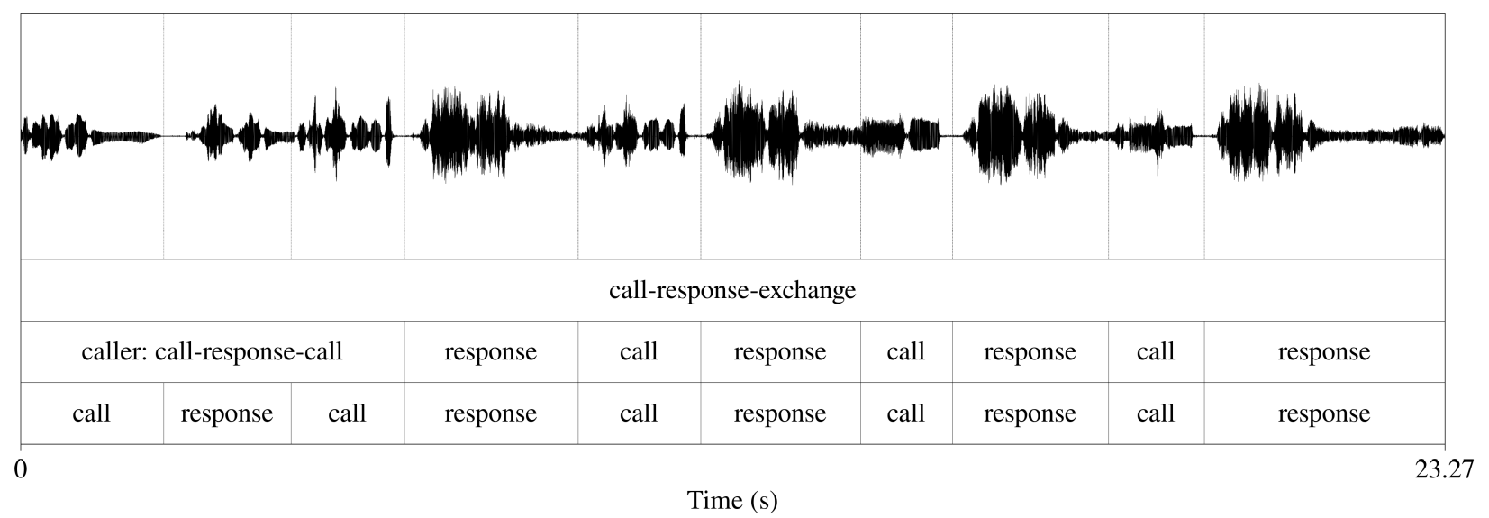
Rhythms in the time domain – turn annotation
Typical use cases for annotation triples (e.g. with Praat):
      Use case in speech recognition: train label recognition
      Use case in linguistics: illustrate phonetic observations
      Use case in phonetics: calculate duration regularity indices:
    Variance, SD, Coefficient of Variation, other dispersion measures
    Next-door-neighbour distances: rPVI, nPVI
Again… Where’s the “Boom-de-boom-boom” in ‘65’ or ‘33’?

Slide 60
Speech rhythm in the frequency domain
We need to
    demodulate the AM to recover the information signal (rhythm)
    analyse the information signal
And speech rhythms have...
  frequencies, so let’s apply an FFT to get the LF spectrum
  magnitudes, so let’s apply a peak detector to get the salient spectral frequencies (functionally: ‘rhythm formants’)
  persistence, so let’s make an LF spectrogram to see the persistence/variability of frequencies in time
  resonance, so let’s check the stability of persistent frequencies in time

Slide 61
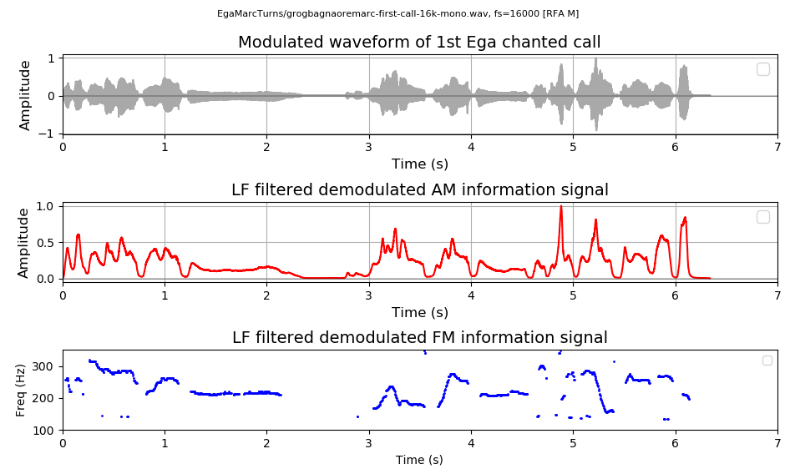
Method 2: Rhythms in the Frequency Domain
Methods:
  Extract AM (amplitude demodulation), the ‘sonority curve’
  Extract FM (frequency demodulation), the ‘pitch curve’
First call by the narrator-caller
Carrier
signal
Information
signals

Slide 62
Rhythm Formant Analysis: AM demodulation

Slide 63
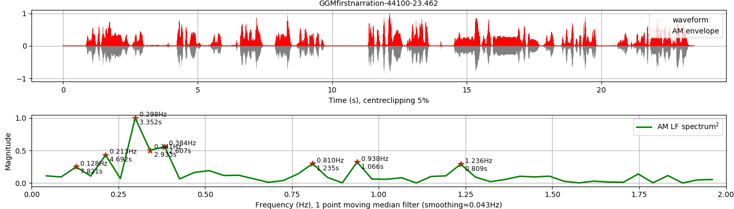
Rhythm Formant Analysis: global AM spectrum
First narrative turn
Time domain (waveform and demodulated AM envelope)
FFT
Frequency domain (Long term Low Frequency Spectrum < 2 Hz)

Slide 64
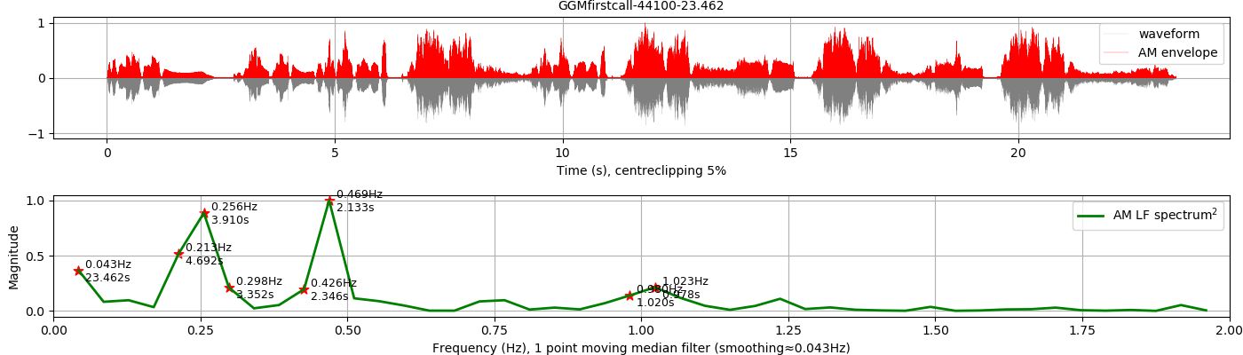
Rhythm Formant Analysis: global AM spectrum
First caller-choir exchange
Time domain (waveform and demodulated AM envelope)
FFT
Frequency domain (Long term low frequency Spectrum < 2 Hz)

Slide 65
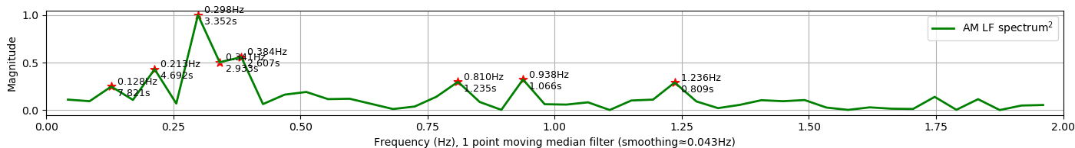
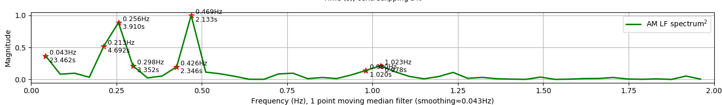
Rhythm Formant Analysis: global AM spectrum
Comparison of narrative turn cycles and choral turn cycles
Narrative turns
Phrases
Words
Syllables
Caller-Choir exchanges,
‘stanzas’
Phrases,
‘lines’
Words ...
Cyclical rhythm hierarchy as partial correlate of ‘Prosodic Hierarchy’

Slide 66
Different dialogue cycles – different rhythms
Narrative turn: single dominant rhythm formant
Call-response exchange: two dominant rhythm formants
Note the different cyclical structures:
    Low frequency for narrative cycles
    Lower frequency for exchange (adjacency pair) cycles
    Higher frequency (octave higher) for exchange constituents

Slide 67
Different dialogue cycles – different rhythms
Narrative turn cycles
Call-response exchange cycles
Note the different cyclical structures:
    Low frequency for narrative cycles
    Lower frequency for exchange (adjacency pair) cycles
    Higher frequency (octave higher) for exchange constituents

Slide 68
Restoring the time domain: LF AM spectrograms

Slide 69
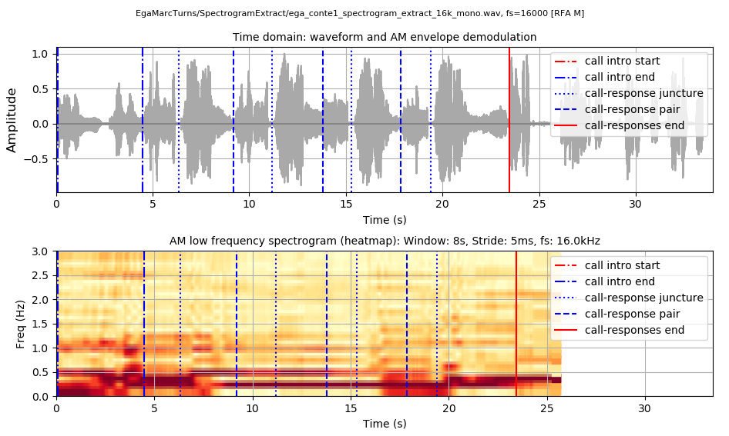
Restoring the time domain: AM spectrograms
First Caller-Choir exchange
Iterative rhythm ‘comb’ patterns in the Time Domain
Rhythm bars in the Time X Frequency Domain

Slide 70
Restoring the time domain: AM spectrograms
First Caller-Choir exchange
The rhythm bars demonstrate the rhythm attributes of
persistence in time
resonance in frequency

Slide 71
How can the insights from demodulation be generalised?
From Analysis to Comparison of Rhythms with spectrum and spectrogram differences using distance metrics and clustering

Slide 72
From Analysis to Comparison
Extraction of attribute vectors from
  Low Frequency global spectrum
    LF spectrum as vector
    N highest magnitude frequencies
      Magnitudes of these frequencies
    N highest magnitude frequency peaks
      Magnitudes of these frequencies
  Low Frequency global spectrogram
    Trajectory of highest magnitude peak frequencin each spectral slice
      Trajectory of magnitudes of these peaks

Slide 73
Method 4: Vectors, distances, clusters
Comparisons of different languages and styles
  Orature:
    Ega (ISO 639-3 ega), putative Kwa, …, Niger-Congo
    Anyi (ISO 639-3 ani), Kwa, …, Niger-Congo
  Readings:
    Ibibio (ISO 639-3 ibb), Lower Cross, …, Niger-Congo
    News in Ivory Coast French, Anyi reader
Method:
  Input:
    Spectrum and spectrogram vectors
  Procedure:
    Demodulation → FFT → spectral vectors
    Pairwise distances: Cosine, Manhattan
  Output:
    Distance networks → hierarchical clustering
Opportunistic corpus:
Fieldwork was cut short by civil war In the Ivory Coast

Slide 74
Method 3: Vectors, distances, clusters
Comparisons of different languages and styles
  Orature:
    Ega (ISO 639-3 ega), putative Kwa, …, Niger-Congo
    Anyi (ISO 639-3 ani), Kwa, …, Niger-Congo
  Readings:
    Ibibio (ISO 639-3 ibb), Lower Cross, …, Niger-Congo
    News in Ivory Coast French, Anyi reader
Method:
  Input:
    Spectrum and spectrogram vectors
  Procedure:
    Pairwise distances: Cosine, Manhattan
  Output:
    Distance networks → hierarchical clusters (dendrograms)

Slide 75
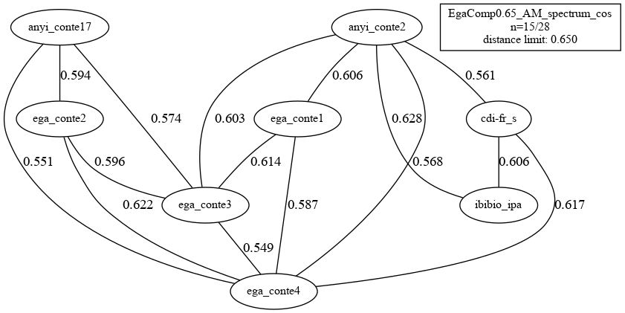
Rhythm Formant Analysis of related registers
Cosine Distance Network, distances < 0.65 (scale: 0...1)

Slide 76
Rhythm Formant Analysis of related registers
Cosine Distance Network, distances < 0.65 (scale: 0...1)

Slide 77
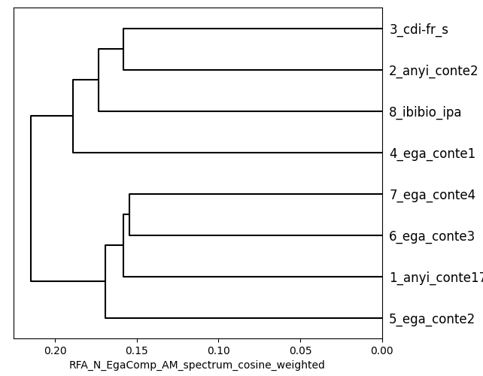
Rhythm Formant Analysis of related oral registers
Hierarchical clustering
Cosine Distance & Weighted Mean

Slide 78
Rhythm Formant Analysis of related oral registers
Hierarchical clustering
Cosine Distance & Weighted Mean
Anyi speakers (3, 2)
Readings (3, 8)
Orature

Slide 79
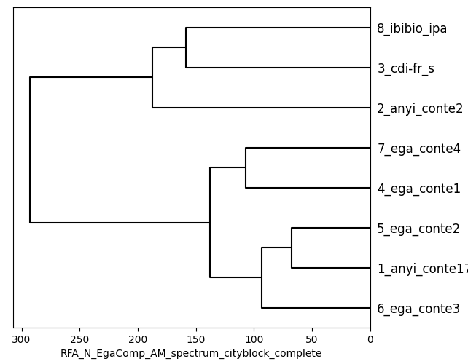
Rhythm Formant Analysis of related oral registers
Hierarchical clustering
Manhattan Distance & Farthest Neighbour

Slide 80
Rhythm Formant Analysis of related oral registers
Hierarchical clustering
Manhattan Distance & Farthest Neighbour
Readings
V. short, formal style
Orature

Slide 81
Rhythm Formant Analysis of related oral registers
Hierarchical clustering
Manhattan Distance & Farthest Neighbour
Readings
Interpretation
Reading and formal styles tend to cluster, even in different (though typologically related) languages.
Orature tends to cluster, with influence of formal-informal style levels.
V. short, formal style
Orature

Slide 82
Conclusion
Form:
There are multiple parallel speech rhythms, not a single rhythm
Speech rhythms relate to linguistic units in cycles
Multiple speech rhythm beat levels / cycles can be modelled as regular languages by cyclical FTNs, FSTs, etc.
Function
Semantics: Speech rhythms are metalocutions which denote units in the locution at temporal points and intervals
Pragmatics: Speech rhythms depend on register, style and discourse (as well as the lexical and phrasal grammar)

Slide 83
Thanks!
The moral of the story:
Combine fieldwork with music and engineering!

