Slide 1
EDES 301 Digital Stethoscope Proposal
Daniel Gutierrez
10/04/2025

Slide 2
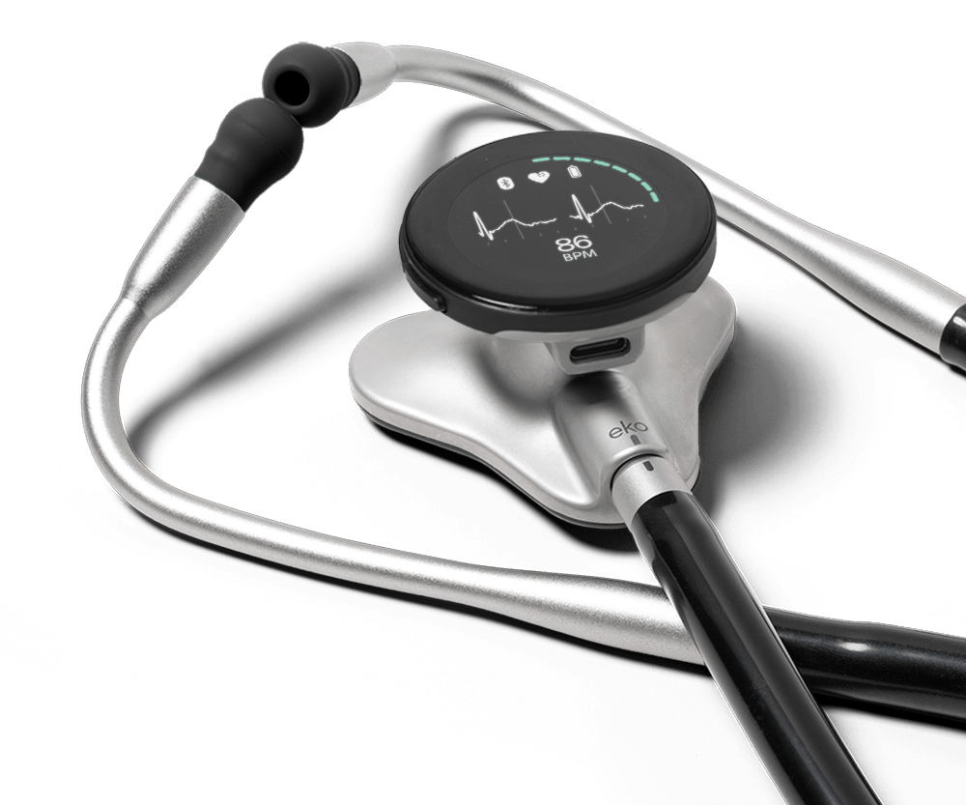
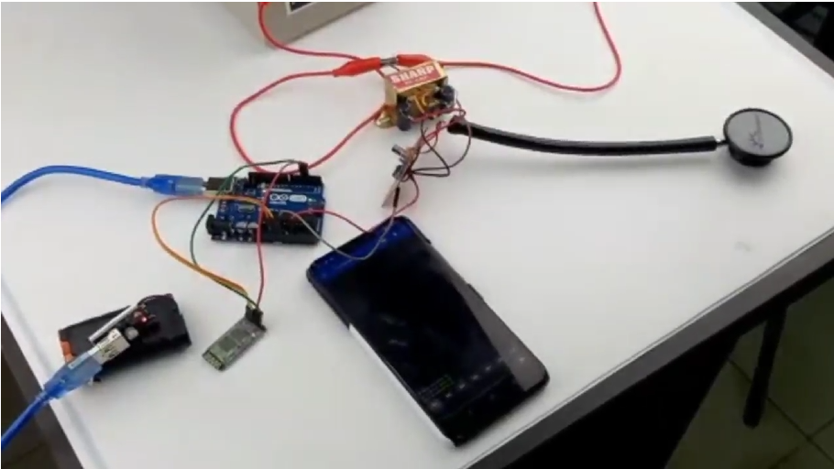
Background Information
This project aims to develop an electronic stethoscope capable of digitally capturing and analyzing heart sounds. A condenser microphone will be integrated into the stethoscope to record auscultation signals, which are transmitted wirelessly via a Bluetooth interface and displayed in a serial terminal window for analysis. The system will incorporate physiologically relevant metrics, including frequency thresholds associated with normal and abnormal heart sounds, to automatically flag potential outliers that may indicate underlying health complications. Beyond diagnostic support, this project seeks to provide users with an accessible means to understand and interpret their own cardiac sounds, bridging traditional auscultation techniques with modern digital health monitoring
Link to Existing Project
While this project establishes a solid foundation for the circuitry behind an electronic stethoscope, additional noise filtering and signal amplification will likely be required to achieve the desired resolution for accurate data analysis. Furthermore, rather than simply displaying the recorded data, the project aims to provide users with meaningful insights by identifying and flagging outlier heart sounds based on established physiological reference values.

Slide 3
System Block Diagram
Required Audio Range (20Hz-1300Hz) is only passed.
Analog
Analog
Microphone + Stethoscope
Band Pass Filter
Audio Amplifier
Capacitor Filter
Analog
Output to the device
(speaker / PC / Bluetooth Module)
I^2C/SPI
Micro Controller
ADC
Display LED Indicator
(GPIO)
Digital via SPI / I^2C

Slide 4
Power Block Diagram
Battery / USB Power
Peripherals & Display
V=3.3V
I=1-100 mA
Power Regulation
(5V → 3.3V)
Analog Section (Mic, Filters, Amplifiers)
V=3.3V
I= 0.5-0.35 mA
Digital Section
(ADC & MCU)
V=3.3V
I=0.6-25 mA

Slide 5
Audio Acquisition
Interfaces with ADC to capture and condition audio signals from the condenser microphone
Signal Processor
Perform digital signal processing to extract frequency-domain information and flag abnormalities
Compute Fast Fourier Transform (FFT)
Data Handler
Manages local data storage and formatting for output
Store Data
USB Interface
Handles serial communication over USB between Pocket Beagle and the host PC
- Initialize port
- Send data
- Receive command
User Interface
Provides visualization and alerts through the serial terminal or GUI on the host computer
- Display waveform
- Display alerts
- Get user input
Apply gain
Filter noise
Capture signal
Extract features
Detect abnormalities
Retrieve Data
Format for output

Slide 6
User Input via Terminal/Gui
User Interface (Host PC Application)
Audio Acquisition
Audio Acquisition
Data Handler
USB Interface
PocketBeagle Embedded Software
Microphone
Filtering/FFT
Format Data
Send via USB
Hardware Output/Storage

Slide 7
Components / Budget
Component | EDES301 to Buy? | Cost
1- USB Bluetooth | Yes | $9.99
1- Op-Amp | No
1- Adjustable voltage adapter (1A) | Yes | $11.99
1- Breadboard | No
2 - 1K resistor | No
1 - 3.3K Resistor | No
3 – 10K Resistor | No
1 – 100K Resistor | No
1 - 470nF Capacitor | No
1 – 2.2μF Capacitor | No
1- ADC | Yes | $11.88
1- Stethoscope | No
1- MEMS microphone | No

