Slide 1
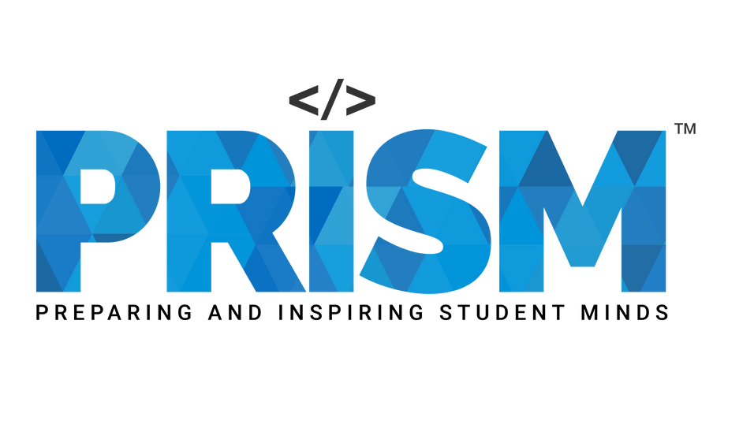
Team: Astro Bugs,
SRM Institute of Science and Technology, KTR
SAMSUNG PRISM | GEN AI HACKATHON PHASE 2
(PROTOTYPE SUBMISSION)
Theme: Multimodal AI
AuraFit: Your On-Device AI Fitness Coach
Ayush Daga - RA2311003010222
Pavithra CP - RA2311003010234
Nikhil CP - RA2311030010168
Dhruv Gupta- RA2311030010175
ABSTRACT
AuraFit transforms any smartphone into a privacy-first, on-device AI workout coach, delivering real-time form correction, rep counting, and gamified feedback- without sending data to the cloud. By fusing computer vision via MediaPipe with live biometrics from a Samsung Galaxy Watch, AuraFit provides context-aware coaching that is accurate, responsive, and fully private. This report details the system’s architecture, dual-AI innovation, and technical implementation, demonstrating a next-generation platform for personalized fitness.

Slide 2



The Disconnect in Digital Fitness
Today's fitness apps fail because they see the body in pieces.
Movement apps can't see your effort.
Wearable apps can't see your form.
Cloud AI compromises your privacy.
The result? An incomplete, disconnected, and insecure workout.
https://github.com/dagaayush1205/Samsung-GENAI-Hackathon
The Fusion: Introducing AuraFit
AuraFit bridges this gap. It's a revolutionary platform that fuses two real-time data streams into one intelligent brain.
VISION (The Phone): What your body is doing.
BIOMETRICS (The Watch): How your body is reacting.
The result? A complete, holistic, and 100% private AI coach.

Slide 3







IMPLEMENTED FEATURES
VISION BASED ANALYSIS
GENERATIVE FEEDBACK
WEARABLE INTEGRATION
ON-DEVICE AND PRIVACY
Use on-device pose estimation using Mediapipe. A model flags errors and outputs
An on-device LLM converts those error signals with NLP to coaching tips and encouragement.
Incorporate Galaxy Watch/Ring data. Using the data, AI could suggest rest or modify the workout.
All AI runs locally and ON-DEVICE ensuring privacy
MediaPipe – Real-time pose estimation (Pose Landmarker)
Custom ML Pipeline – Form correction & performance insights
ML Algorithms and Python Libraries
Count-Click:
During intensive workouts, people often lose track of their repetitions as they focus on maintaining proper form and effort.
Weight-lifter:
Some users are unsure if they are to take heavier weights, this is a dilemma that many people face and a big safety issue especially over-enthusiastic beginners.
Score:
Workout score, brings motivation to the user and increases the overall user experience.

Slide 4
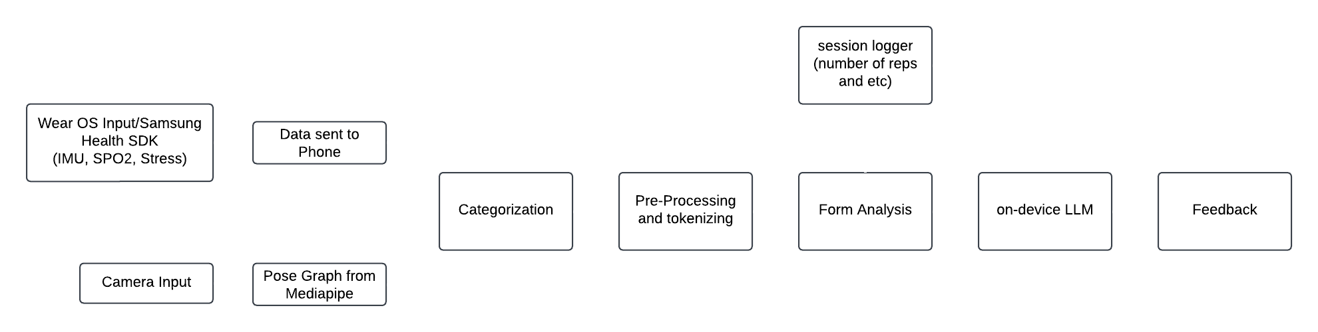
WORKFLOW
TECH STACK
USP
Platform: Android (Kotlin-first)
Computer Vision Engine: Google MediaPipe Pose Landmarker for real-time, 33-point body tracking.
On-Device AI Engine #1 (Reflex Model): A custom-built, hyper-efficient rules engine for instantaneous rep counting and critical error detection.
Wearable Integration: Samsung Health Data SDK & Samsung Sensor SDK providing a live, low-latency data stream from connected Galaxy Watch sensors.
On-Device AI Engine #2 (Cognitive Model): Google Gemma 2B, a powerful 1.3GB on-device Large Language Model for generating nuanced, human-like coaching feedback.
Data Persistence: Android Room Database for secure, on-device storage of all user workout history.
UI & Architecture: Android Architecture Components, including Fragment navigation, RecyclerViews, and a reactive UI built with View Binding.
Expert-level, biometric-aware coaching with absolute privacy, powered by a future-proof, on-device AI.

Slide 5
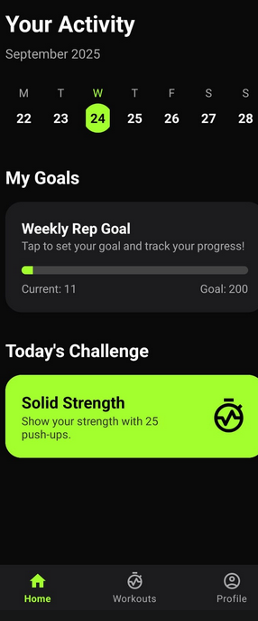
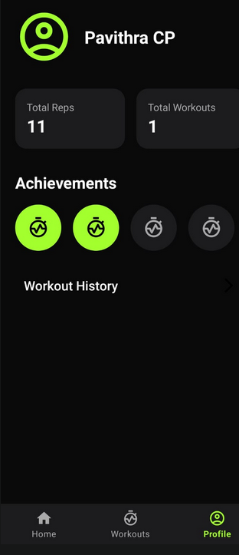
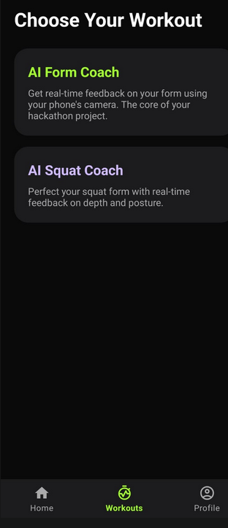
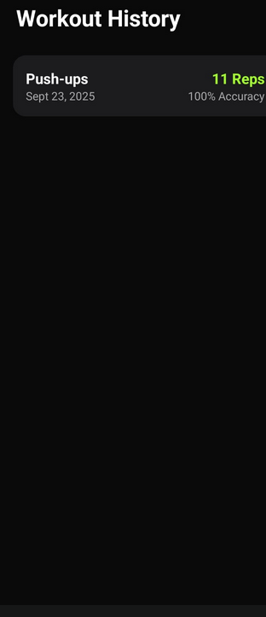
UI- THE APP- SCREENSHOTS
1.DASHBOARD
2.PROFILE SECTION
3.WORKOUT HISTORY
4. WORKOUTS

Slide 6
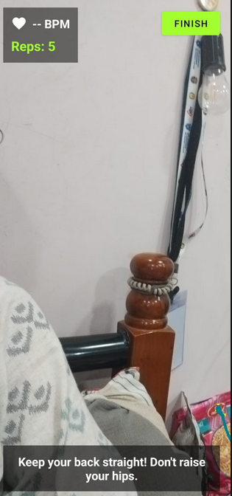
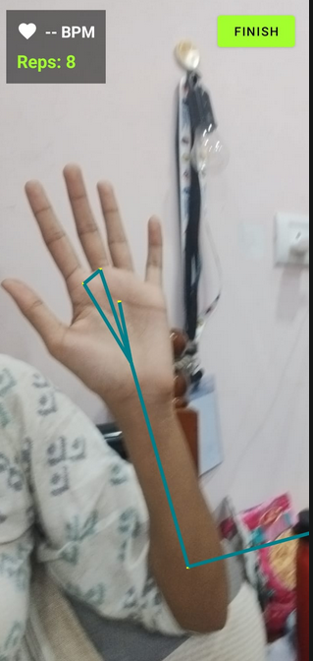
CORE FEATURES
-> Mediapipe Pose Landmarkers- Calculates pose and feeds it to LLM
-> On device LLM- Plug & play LLM (Gemma 3B) with fallback model for generative feedback.
-> Voice Feedback using TTS (Android’s Native)
-> Workout History- Using Android Room Persistence Library- every workout session is logged here.
-> DataDriven Personalized Dashboard- using Samsung Health SDK and Android Room.
-> Daily updates- The date and workout history is updated AUTOMATICALLY
-> Personalized Goal- Set personal goals which will be tracked daily
-> Achievement Records- Achievements recorded for users to improve UI.
-> ON-DEVICE LLM Feedback
MediaPipe Pose Landmarkers
-> Voice feedback- using TTS

Slide 7
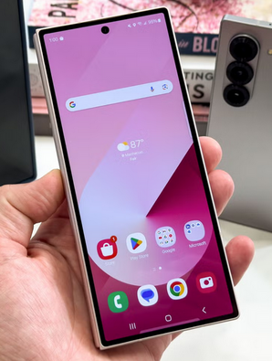
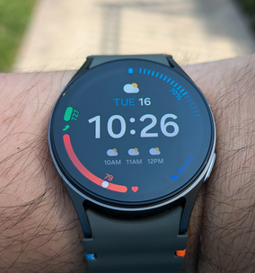
The Brain: Our "Plug-and-Play" AI Module
This is our core innovation. We engineered a dual-model AI system to solve the on-device memory crash problem.
The Reflex Engine (Rules AI): A hyper-efficient system for instant rep counting and critical error detection. It's our "always-on" AI.
The Cognitive Engine (The "Plug-in"): A slot for powerful generative models. For this demo, it runs a "Simulated Generative AI" that provides varied, human-like feedback from a curated expert library.
The Breakthrough: Our architecture is LLM-ready. We successfully integrated a 1.3GB Gemma model using a pioneering pause/resume protocol- freezing the camera to free memory for the LLM. This makes our platform future-proof.
THE SAMSUNG ECOSYSTEM
AuraFit is not just an app; it's a killer feature for Samsung hardware.
Drives Hardware Value: It transforms the Galaxy Watch from a passive tracker into an active, indispensable coaching tool.
Showcases SDK Power: It is a real-world demonstration of the low-latency power of the Samsung Health Data SDK.
Reinforces Privacy: It champions Samsung's commitment to user privacy by keeping all sensitive data on-device.
Tried
and
Tested.

Slide 8
Target Market & Stakeholders
Our vision extends beyond the user to a complete fitness ecosystem.
1.
2.
1. End Users (Consumers)
Problem: Lack of affordable, real-time coaching at home.
Solution: AuraFit delivers expert-level feedback, rep tracking, and motivation - no subscription, no privacy compromise.
Impact: Safer, more effective workouts, higher fitness engagement, and improved long-term health outcomes.
2. Samsung (Strategic Partner)
Problem: Differentiation in the crowded fitness app and wearable markets.
Solution: AuraFit fuses Galaxy smartphones + Galaxy Watch + Samsung Health.
Impact: Boosts Galaxy Watch sales, drives Samsung Health adoption, and positions Samsung as a leader in on-device AI health coaching.
3.
4.
3. Fitness & Wellness Industry
Problem: Trainers and generic fitness apps are costly and inaccessible.
Solution: AuraFit offers a scalable, low-cost coaching platform for gyms, wellness programs, and digital fitness startups.
Impact: Expands coaching access to millions, enabling hybrid digital-physical wellness models.
4. Researchers & Developers
Problem: Few real-world implementations of multi-modal AI fusion on mobile.
Solution: AuraFit is a technical case study in hybrid inference, wearable integration, and privacy-first design.
Impact: Inspires research, accelerates Samsung developer adoption, and strengthens the AI fitness ecosystem.

Slide 9
The Future is On-Device
We believe the future of personal technology is intelligent, synergistic, and fundamentally private
Our Github Repo- https://github.com/dagaayush1205/Samsung-GENAI-Hackathon

