Slide 1
People counting example setup guide

Slide 2
Hardware and software requirements
Hardware requirements:
Nucleo F401RE
X-NUCLEO-53L1A1
VL53L1X-SATEL
Windows PC
SW requirements
STSW-XXX
X-NUCLEO-53L1A1
Nucleo F401RE
Left satellite connector
VL53L1X-SATEL

Slide 3
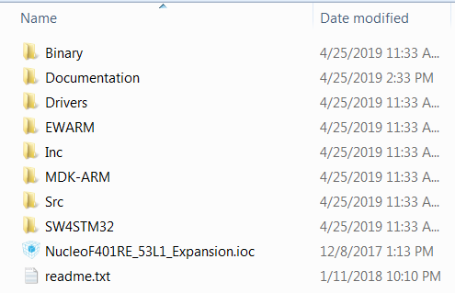
STSW-XXX content
Search for STSW-IMG010 on st.com, download and unzip the file in your hard drive C:\
It is strongly recommended to unzip the file in short path like C:\ because KEIL doesn’t support a long path and you may find the error “file not found” when compiling the KEIL example project.
Contains binary application file
VL53L1X ULD API and other STM32 drivers
Precompiled IAR project
Precompiled KEIL project
Precompiled Eclipse project

Slide 4

Run the example
Plug the satellite board on the expansion board using the Left connector
Plug the expansion board on the F401RE Nucleo board
Connect the F401RE Nucleo board to a PC USB port
Flash the demo application by drag and drop the binary file located in the Binary directory, the demo will start immediately once the FW is loaded
Open a Tera-Term to monitor the people counting (460800 Baud-rate)
Wave your hand from left to right to simulate the people going in and out (figure 1)
Range status
Distance
Zone #
People counter

Slide 5
Modifying, compiling and running the example code
The example code is precompiled for the most popular professional IDEs
(KEIL,IAR and Eclipse)
I suppose that you already have your favourite IDE and familiar with.

Slide 6
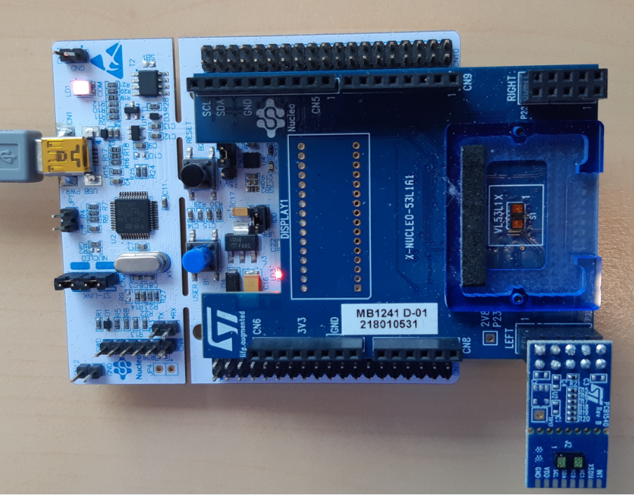
Figures
Figure1
Move the hand to simulate people in and out

