Slide 1
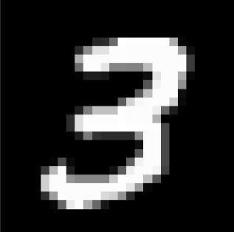
MNIST Digit Classification
Using a Neural Network
Naviotech Artificial Intelligence Internship
Project 1 • Ankit Dagar
Sample prediction
3 → 3
Naviotech • Artificial Intelligence Internship • Project 1

Slide 2
Project at a Glance
02
From raw pixels to a working handwritten-digit classifier
60,000
10,000
28 × 28
10
Training images
Test images
Image size
Digit classes
What the project does
End-to-end workflow
Loads the MNIST handwritten-digit dataset.
Normalizes pixel values and prepares the images.
Builds and trains a feed-forward neural network.
Evaluates the model and predicts a separate handwritten image.
Dataset → preprocessing → neural network → training
→ evaluation → confusion matrix → single-image prediction
Naviotech • Artificial Intelligence Internship • Project 1

Slide 3
Objective & Methodology
03
A compact supervised-learning workflow for image classification
Objective
Recognize handwritten digits from 0 to 9.
Train a neural network on labeled MNIST images.
Measure performance on unseen test data.
Validate the pipeline using an external handwritten digit.
Input
Prep
Model
Output
28×28 pixels
Scale 0–1
2× Dense 50
10 classes
Validation
The notebook also performs a single-image prediction after training.
Naviotech • Artificial Intelligence Internship • Project 1

Slide 4
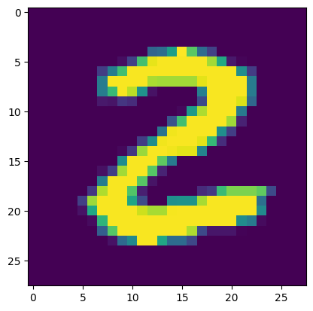
MNIST Dataset
04
The visual foundation of the classifier
Dataset scale
Target classes
60,000 training images
10,000 test images
28 × 28 grayscale
0 1 2 3 4
5 6 7 8 9
Why MNIST?
It is a standard benchmark for handwritten-digit classification.
The fixed 28 × 28 format makes it ideal for a compact neural-network demonstration.
Each image is paired with a digit label, enabling supervised learning.
Actual notebook sample • true label: 2
Naviotech • Artificial Intelligence Internship • Project 1

Slide 5
Data Preprocessing
05
Preparing image pixels for stable neural-network training
0–255
0–1
28×28
1
Original pixel range
Normalized range
Image shape
Grayscale channel
Preprocessing sequence
1. Load image arrays → 2. Convert pixel values to floating-point scale → 3. Divide by 255 → 4. Feed normalized arrays into the model.
For the external handwritten image: OpenCV loads it, converts it to grayscale, resizes it to 28 × 28, normalizes it, and reshapes it for prediction.
Naviotech • Artificial Intelligence Internship • Project 1

Slide 6
Neural Network Architecture
06
The exact architecture implemented in the cleaned notebook
Implemented layers
Input shape: (28, 28)
Flatten: 28×28 → 784 features
Dense: 50 neurons, ReLU
Dense: 50 neurons, ReLU
Output: 10 neurons, Softmax
Input
Flatten
Dense
Dense
Output
28×28
784
50 • ReLU
50 • ReLU
10 • Softmax
Naviotech • Artificial Intelligence Internship • Project 1

Slide 7
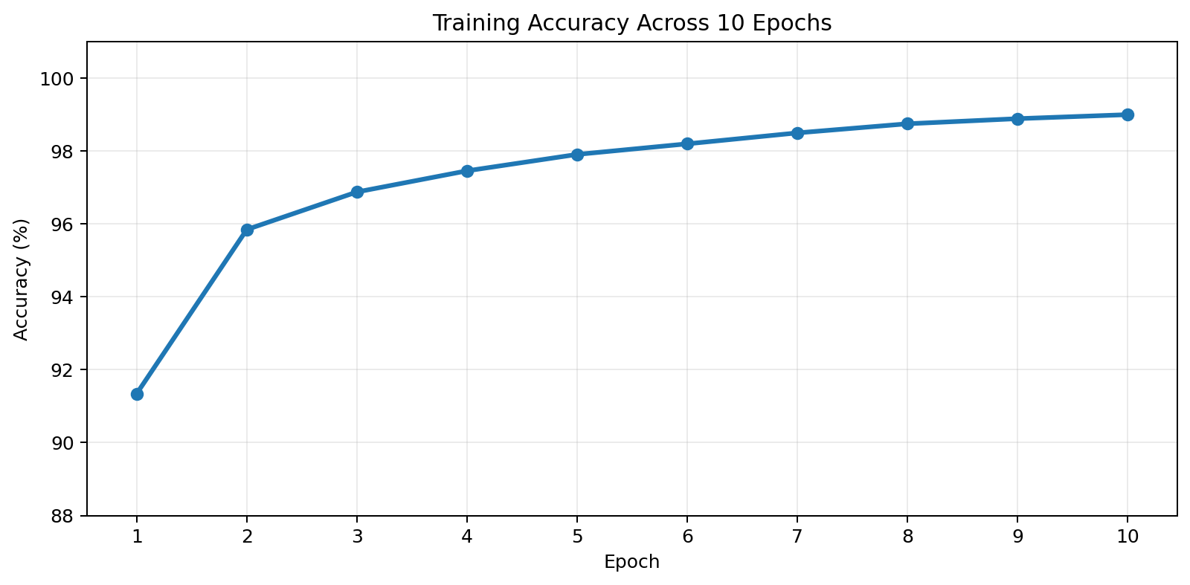
Model Compilation & Training
07
Optimization settings and the learning trajectory recorded in the notebook
Compilation settings
Optimizer: Adam
Loss: Sparse Categorical Crossentropy
Metric: Accuracy
Epochs: 10
98.99%
0.0321
Recorded final training accuracy
Recorded final training loss
Naviotech • Artificial Intelligence Internship • Project 1

Slide 8
Model Evaluation
08
Performance on the 10,000-image test set
97.09%
0.1182
10,000
Test accuracy
Test loss
Test images
Interpretation
The test accuracy is lower than training accuracy, which is expected when evaluating on unseen data.
A 97.09% test accuracy indicates that the trained network generalizes well to the MNIST test set.
Naviotech • Artificial Intelligence Internship • Project 1

Slide 9
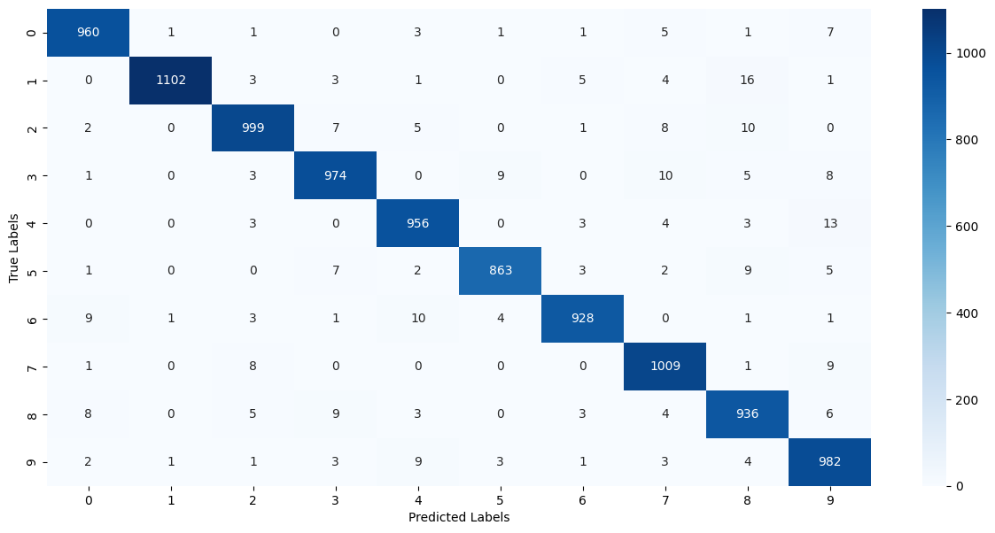
Predictions & Confusion Matrix
09
Where the model succeeds—and where classes are occasionally confused
How to read it
Rows = true labels
Columns = predicted labels
Dark diagonal cells = correct classifications
Observed result
Most predictions lie on the diagonal.
Some visually similar digits are occasionally confused.
This supports the strong overall test accuracy.
Naviotech • Artificial Intelligence Internship • Project 1

Slide 10

Single-Image Prediction Pipeline
10
The notebook moves beyond the benchmark dataset to classify a separate handwritten image
Loaded input
28×28 processed
Prediction input
Processing steps
OpenCV load → grayscale → resize to 28×28 → normalize → reshape → model.predict() → argmax → predicted class
Naviotech • Artificial Intelligence Internship • Project 1

Slide 11
Real-World Check: Handwritten “3”
11
The external sample used in the notebook was recognized correctly
3
3
Input digit
Predicted digit
Result
The model correctly recognized the handwritten sample.
Prediction: 3
This demonstrates the complete inference pipeline on an external image.
Naviotech • Artificial Intelligence Internship • Project 1

Slide 12
Conclusion & Key Findings
12
Project 1 delivers a complete, reproducible MNIST classification workflow
98.99%
97.09%
0.1182
3 → 3
Final training accuracy
Test accuracy
Test loss
External prediction
Key findings
The neural network learned to classify all ten MNIST digit classes with strong test performance.
The confusion matrix shows a strong diagonal, indicating that most test examples are correctly classified.
The external handwritten “3” was correctly recognized as digit 3.
The notebook contains the full workflow: data preparation, model construction, training, evaluation, prediction, and documentation.
Naviotech • Artificial Intelligence Internship • Project 1 • Thank you

