Slide 1
New Design
Erkwagh Dagba

Slide 2
 | Var1 | Var2 | Var3 | Var4 | Var5 | Var6 | Var7 | Var8 | Var9 | Var10 | Var11 | Var12 | Var13 | Var14 | Var15 | Var16 | Var17 | Var18 | Var19 | Var20 | Var21 | Var22 | Var23 | Var24 | Var25 | Var26
0 | Abia | 0 | 2023-2024 DHS | SE | 25.4 | 0.4 | 13.3 | 20.0 | 57.6 | 12.1 | 0.0 | 87.4 | 72.0 | 25.7 | 26.0 | 60.6 | 6.6 | 82.4 | 42.9 | 66.7 | 81.3 | 74.7 | 65.8 | 100.0 | 69 | 89.1
1 | Adamawa | 0 | 2023-2024 DHS | NE | 78.6 | 2.0 | 48.9 | 47.9 | 60.7 | 42.6 | 54.3 | 72.3 | 56.7 | 34.4 | 9.5 | 70.3 | 21.0 | 44.1 | 66.5 | 79.3 | 89.1 | 97.8 | 99.1 | 96.5 | 144 | 76.1
2 | Akwa Ibom | 1 | 2023-2024 DHS | SS | 70.9 | 1.9 | 59.9 | 25.4 | 33.4 | 29.2 | 41.9 | 81.4 | 51.9 | 25.2 | 41.4 | 70.1 | 16.3 | 90.5 | 68.9 | 78.7 | 86.9 | 89.5 | 83.0 | 94.4 | 80 | 46.2
3 | Anambra | 0 | 2023-2024 DHS | SE | 56.8 | 1.3 | 35.2 | 36.9 | 52.9 | 38.3 | 59.0 | 93.2 | 70.4 | 26.0 | 12.5 | 88.4 | 6.5 | 71.5 | 40.7 | 61.0 | 97.3 | 99.3 | 82.0 | 97.6 | 72 | 84.9
4 | Bauchi | 1 | 2023-2024 DHS | NE | 76.4 | 2.1 | 44.8 | 50.5 | 62.4 | 53.5 | 68.9 | 63.3 | 55.0 | 35.9 | 11.7 | 38.6 | 33.9 | 0.0 | 49.0 | 37.1 | 80.1 | 83.8 | 97.9 | 97.8 | 125 | 67.3
... | ... | ... | ... | ... | ... | ... | ... | ... | ... | ... | ... | ... | ... | ... | ... | ... | ... | ... | ... | ... | ... | ... | ... | ... | ... | ...
180 | Rivers | 0 | 2013 DHS | SS | 27.0 | 0.5 | 15.9 | 17.5 | 48.4 | 12.3 | 0.0 | 12.4 | 5.2 | 1.2 | 28.3 | 81.1 | 19.3 | 19.7 | 0.0 | 0.0 | 0.0 | 0.0 | 0.0 | 0.0 | 98 | 79.1
181 | Sokoto | 1 | 2013 DHS | NW | 56.0 | 1.2 | 20.2 | 12.3 | 19.5 | 9.1 | 14.0 | 9.8 | 5.7 | 0.7 | 6.2 | 62.6 | 3.0 | 8.2 | 0.0 | 0.0 | 0.0 | 0.0 | 0.0 | 0.0 | 210 | 77.5
182 | Taraba | 0 | 2013 DHS | NE | 59.4 | 1.2 | 21.3 | 14.5 | 23.6 | 11.7 | 20.4 | 21.8 | 11.9 | 2.8 | 21.1 | 69.6 | 15.7 | 1.6 | 0.0 | 0.0 | 0.0 | 0.0 | 0.0 | 0.0 | 152 | 87.7
183 | Yobe | 0 | 2013 DHS | NE | 56.9 | 1.2 | 24.3 | 19.1 | 30.9 | 18.7 | 30.8 | 25.3 | 11.2 | 4.9 | 33.7 | 73.6 | 6.5 | 8.9 | 0.0 | 0.0 | 0.0 | 0.0 | 0.0 | 0.0 | 143 | 72.3
184 | Zamfara | 1 | 2013 DHS | NW | 82.3 | 1.8 | 34.6 | 9.1 | 10.6 | 10.6 | 12.7 | 17.9 | 10.7 | 4.7 | 7.3 | 70.8 | 0.9 | 1.0 | 0.0 | 0.0 | 0.0 | 0.0 | 0.0 | 0.0 | 256 | 75.1

Slide 3
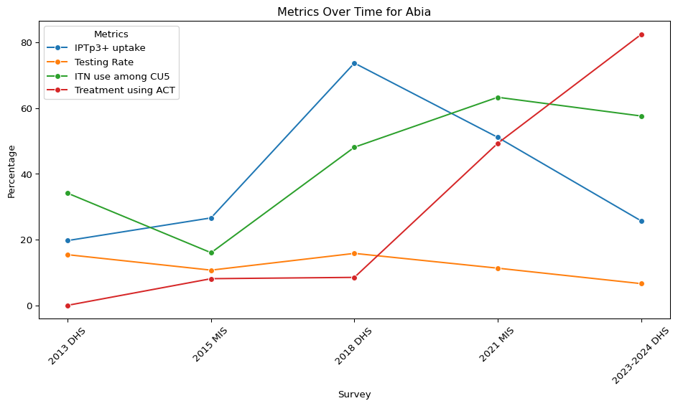
37
Original legend labels: ['Var14', 'Var17', 'Var9', 'Var18']

Slide 4
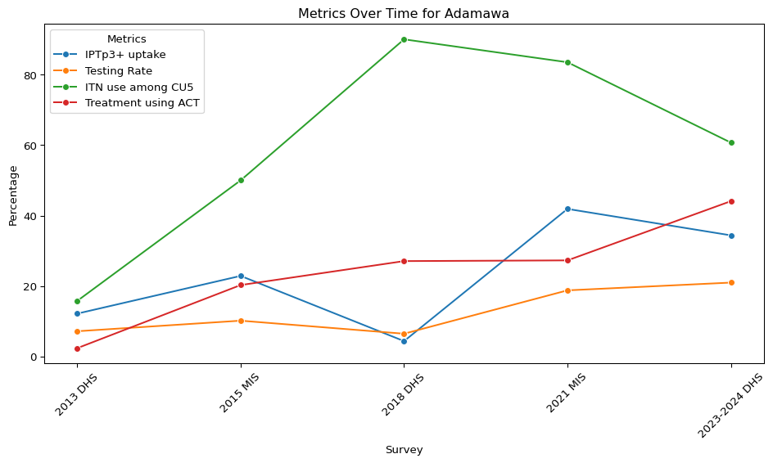
Original legend labels: ['Var14', 'Var17', 'Var9', 'Var18']

Slide 5
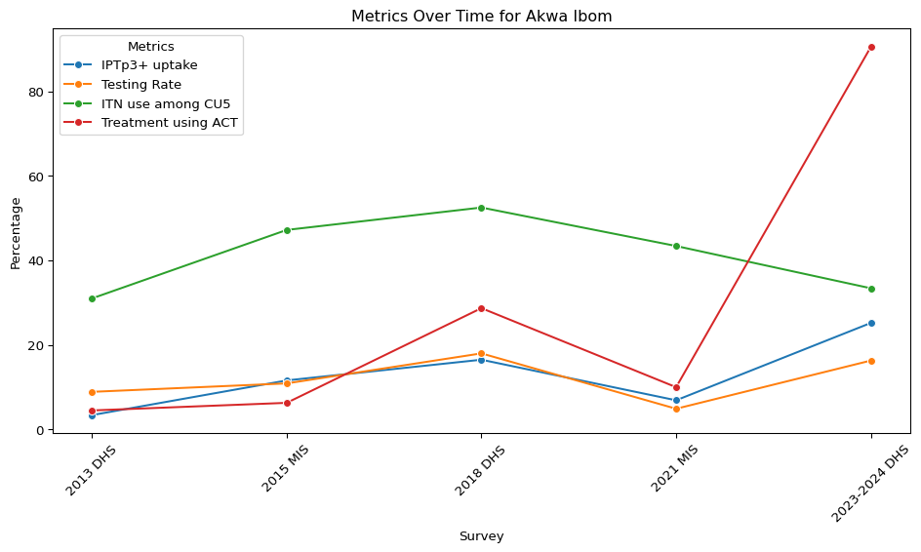
Original legend labels: ['Var14', 'Var17', 'Var9', 'Var18']

Slide 6
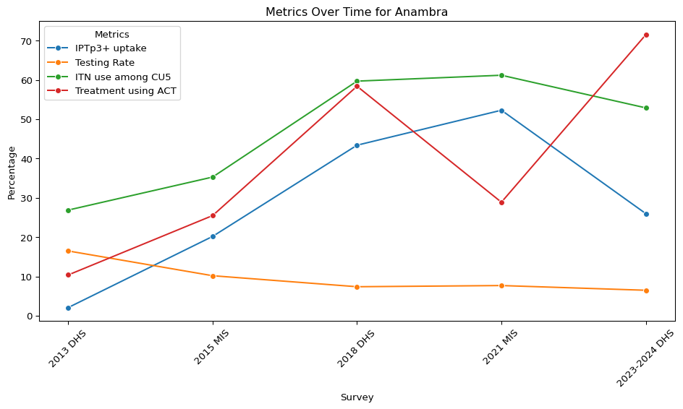
Original legend labels: ['Var14', 'Var17', 'Var9', 'Var18']

Slide 7
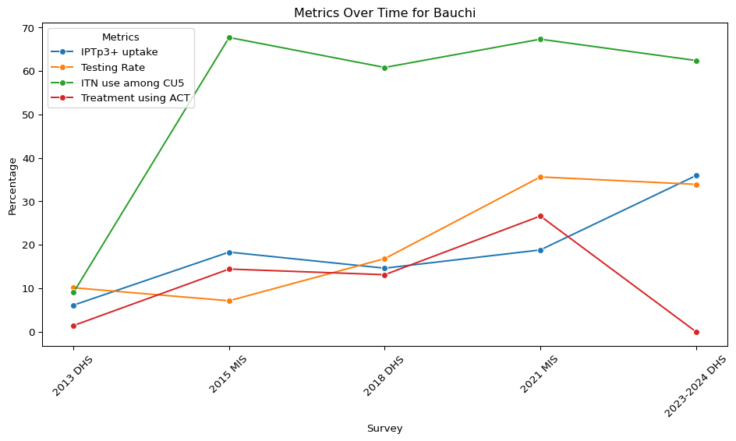
Original legend labels: ['Var14', 'Var17', 'Var9', 'Var18']

Slide 8
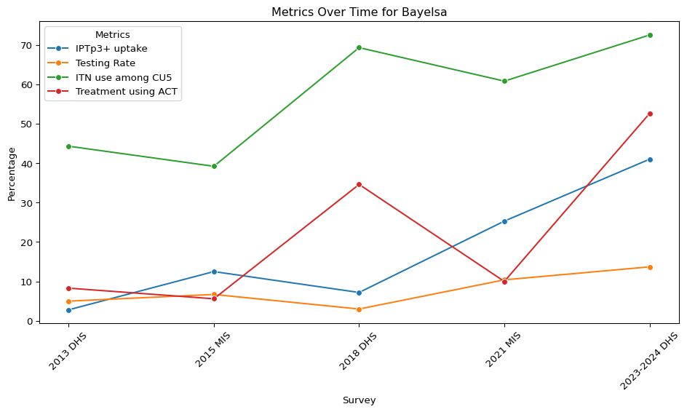
Original legend labels: ['Var14', 'Var17', 'Var9', 'Var18']

Slide 9
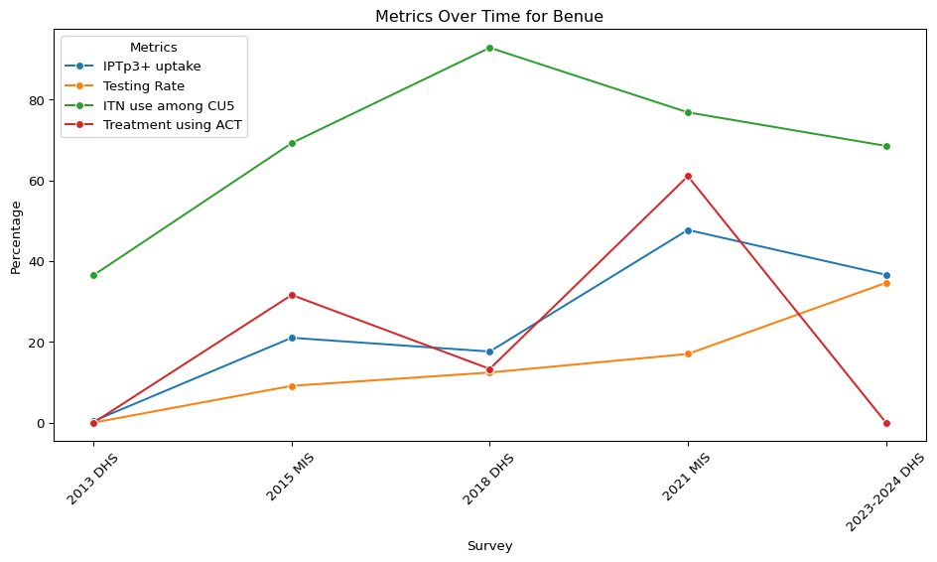
Original legend labels: ['Var14', 'Var17', 'Var9', 'Var18']

Slide 10
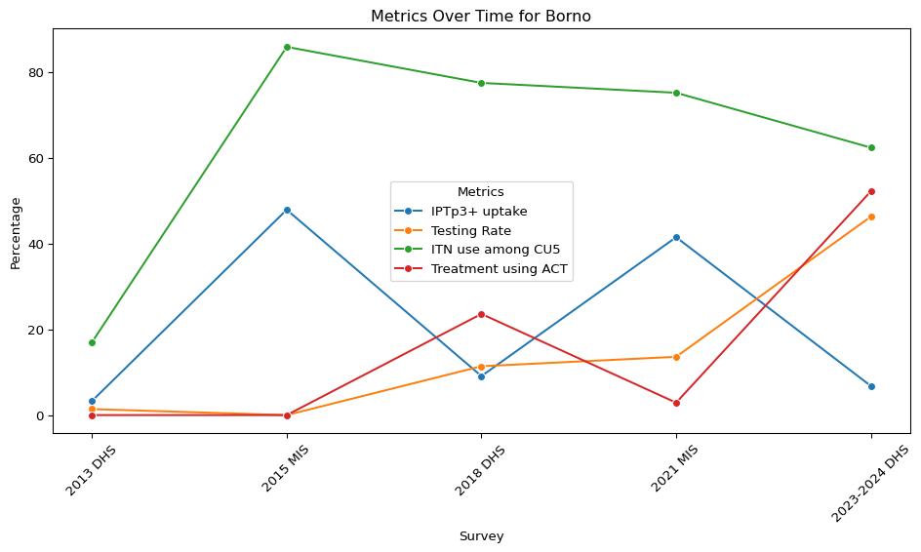
Original legend labels: ['Var14', 'Var17', 'Var9', 'Var18']

Slide 11
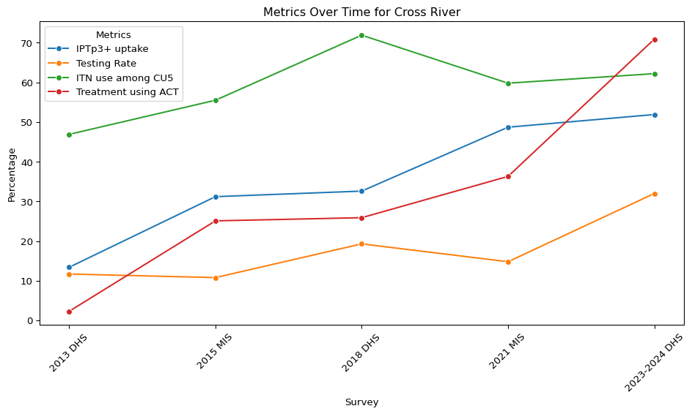
Original legend labels: ['Var14', 'Var17', 'Var9', 'Var18']

Slide 12
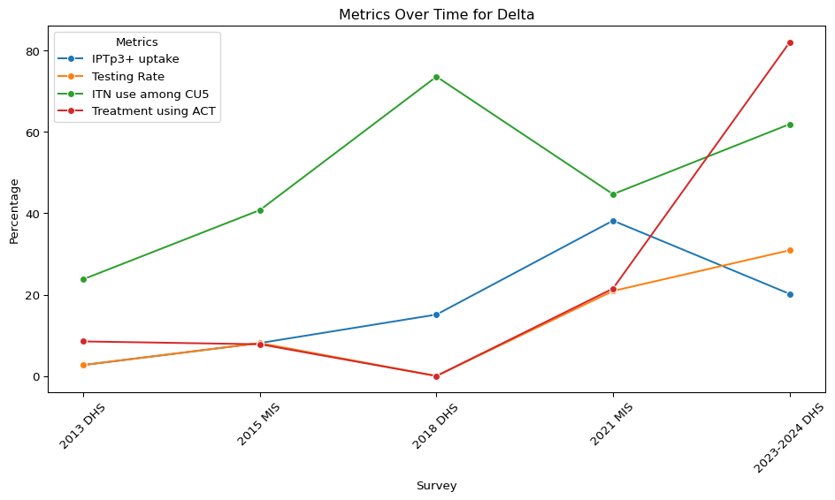
Original legend labels: ['Var14', 'Var17', 'Var9', 'Var18']

Slide 13
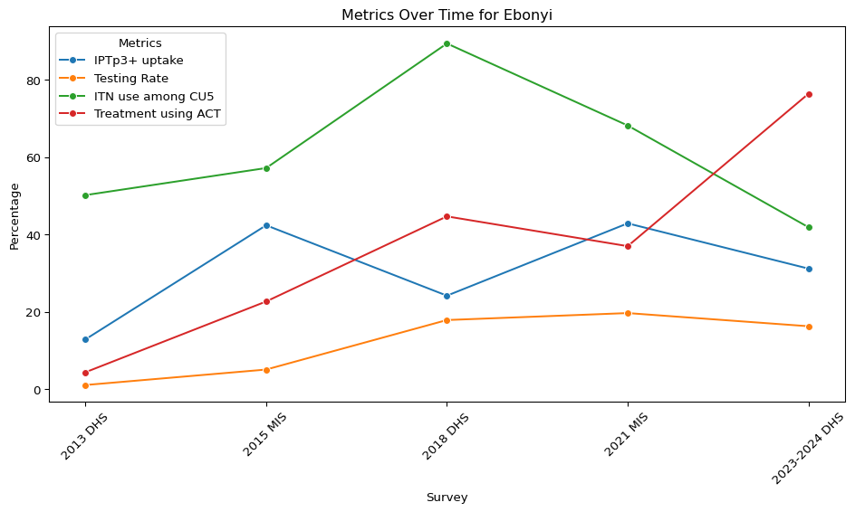
Original legend labels: ['Var14', 'Var17', 'Var9', 'Var18']

Slide 14
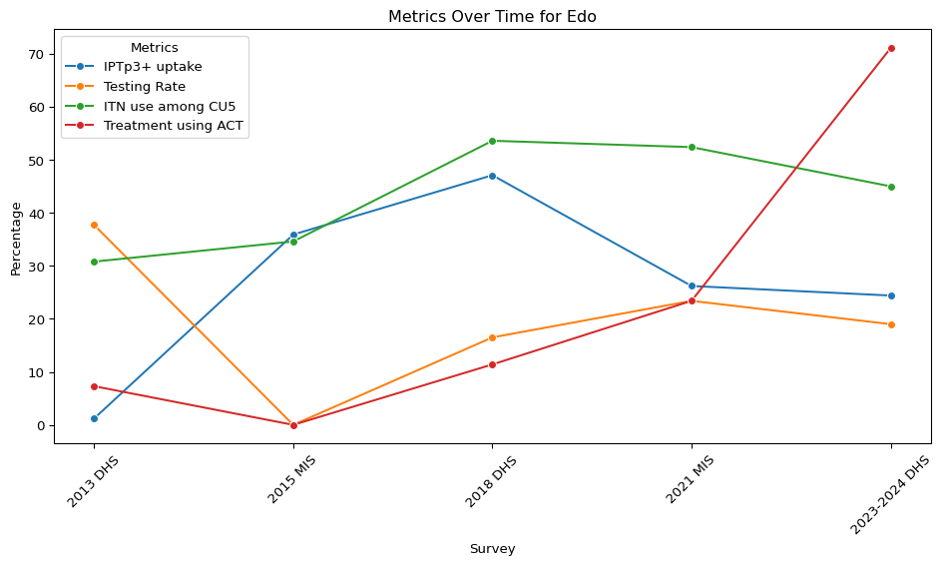
Original legend labels: ['Var14', 'Var17', 'Var9', 'Var18']

Slide 15
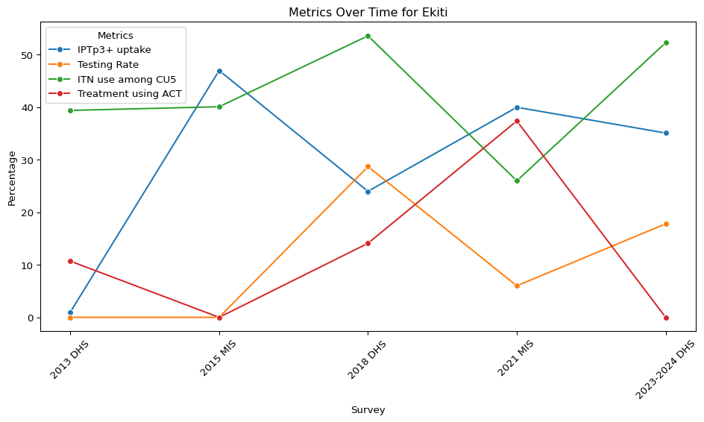
Original legend labels: ['Var14', 'Var17', 'Var9', 'Var18']

Slide 16
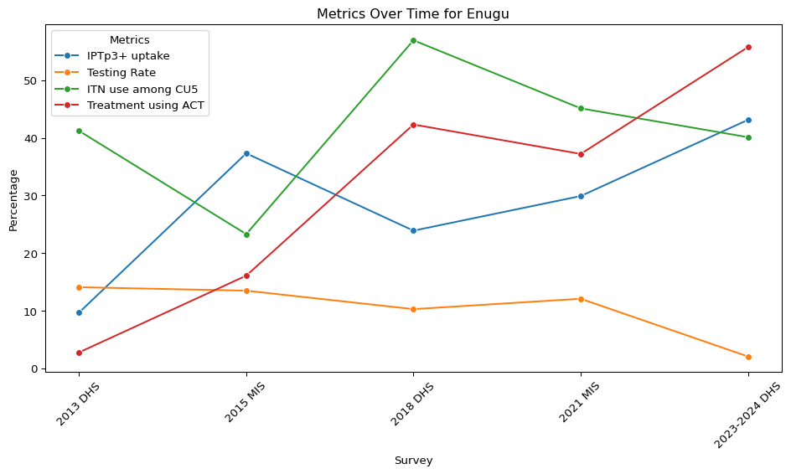
Original legend labels: ['Var14', 'Var17', 'Var9', 'Var18']

Slide 17
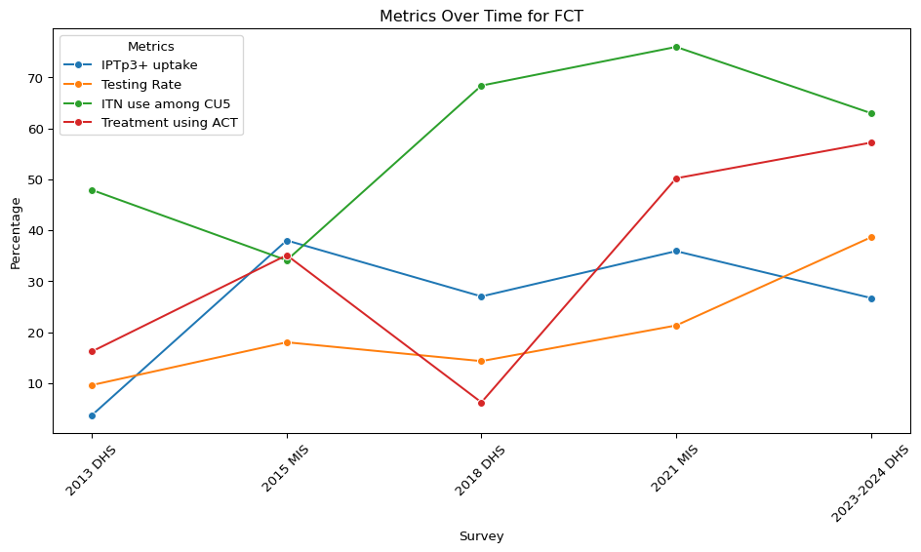
Original legend labels: ['Var14', 'Var17', 'Var9', 'Var18']

Slide 18
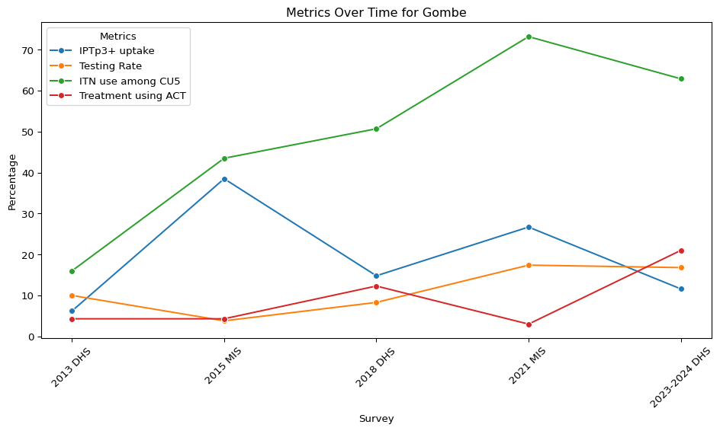
Original legend labels: ['Var14', 'Var17', 'Var9', 'Var18']

Slide 19
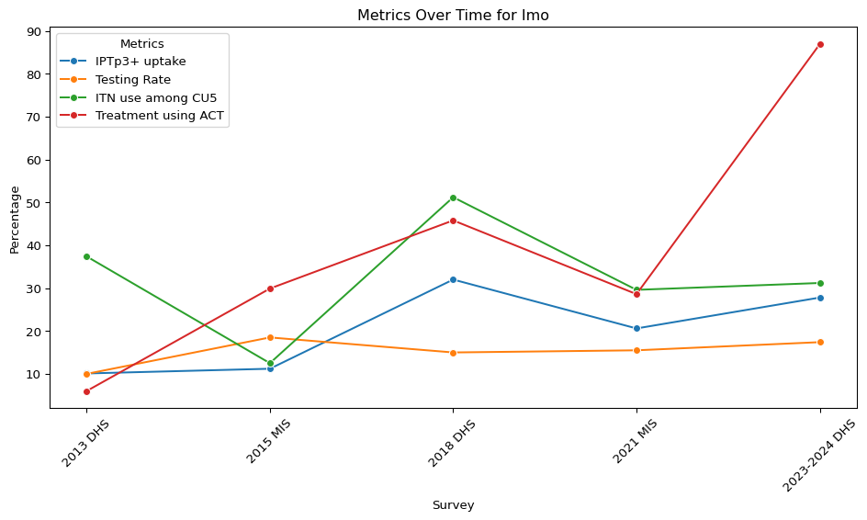
Original legend labels: ['Var14', 'Var17', 'Var9', 'Var18']

Slide 20
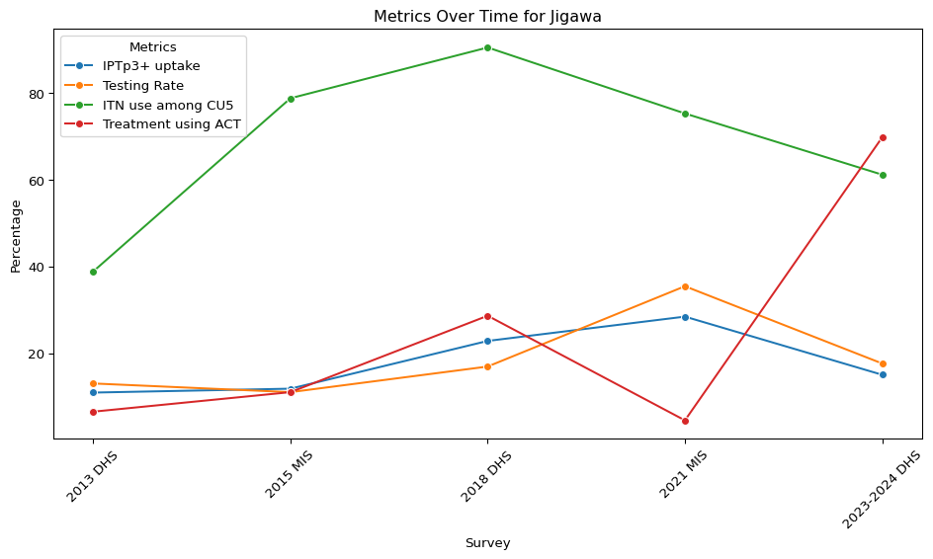
Original legend labels: ['Var14', 'Var17', 'Var9', 'Var18']

Slide 21
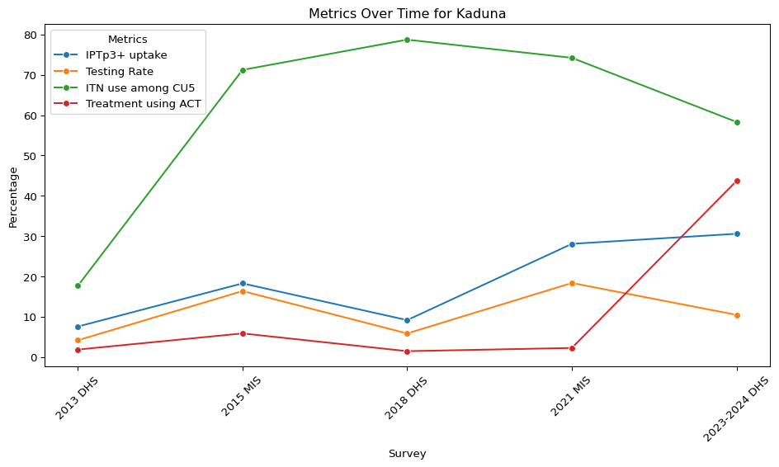
Original legend labels: ['Var14', 'Var17', 'Var9', 'Var18']

Slide 22
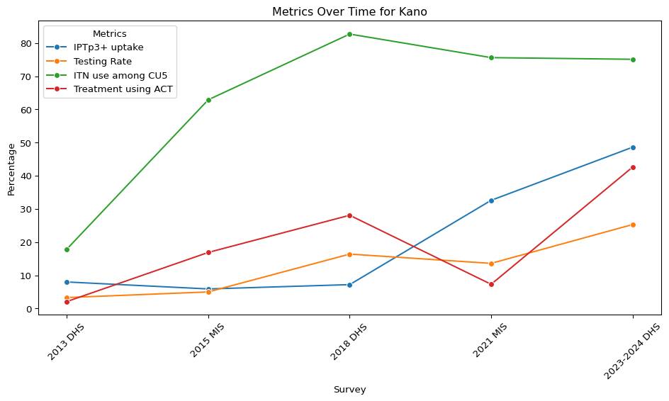
Original legend labels: ['Var14', 'Var17', 'Var9', 'Var18']

Slide 23
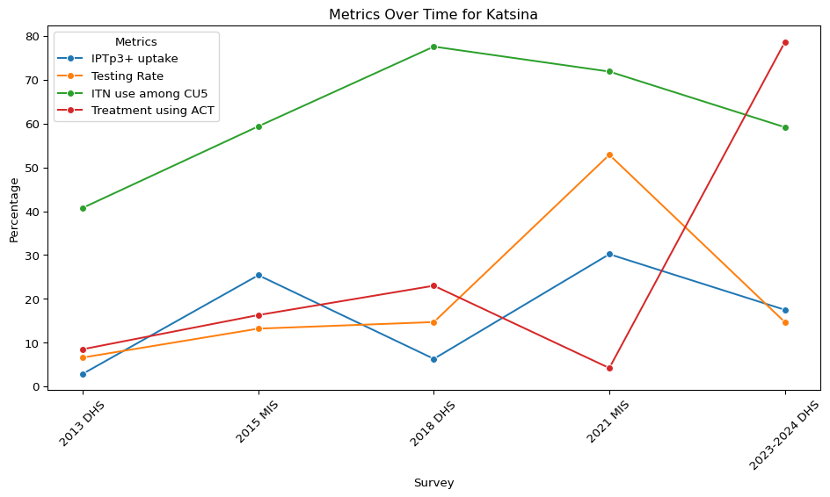
Original legend labels: ['Var14', 'Var17', 'Var9', 'Var18']

Slide 24
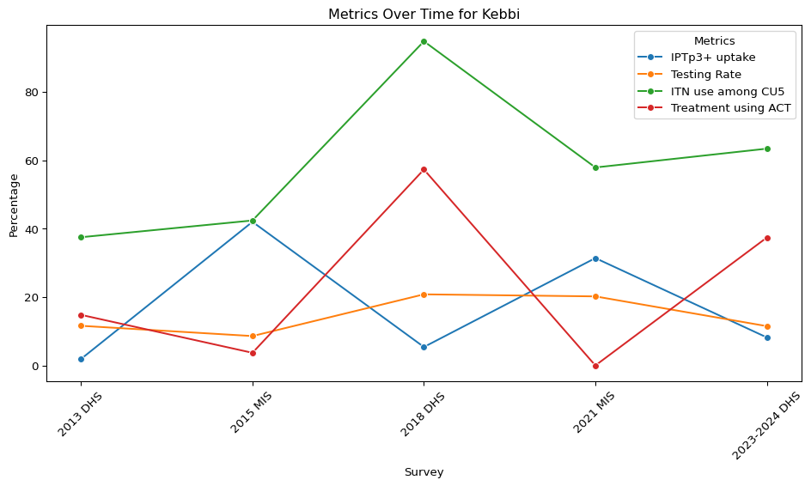
Original legend labels: ['Var14', 'Var17', 'Var9', 'Var18']

Slide 25
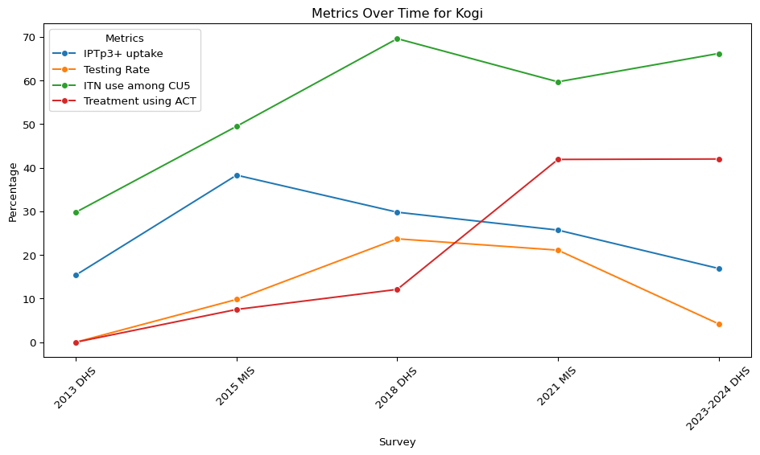
Original legend labels: ['Var14', 'Var17', 'Var9', 'Var18']

Slide 26
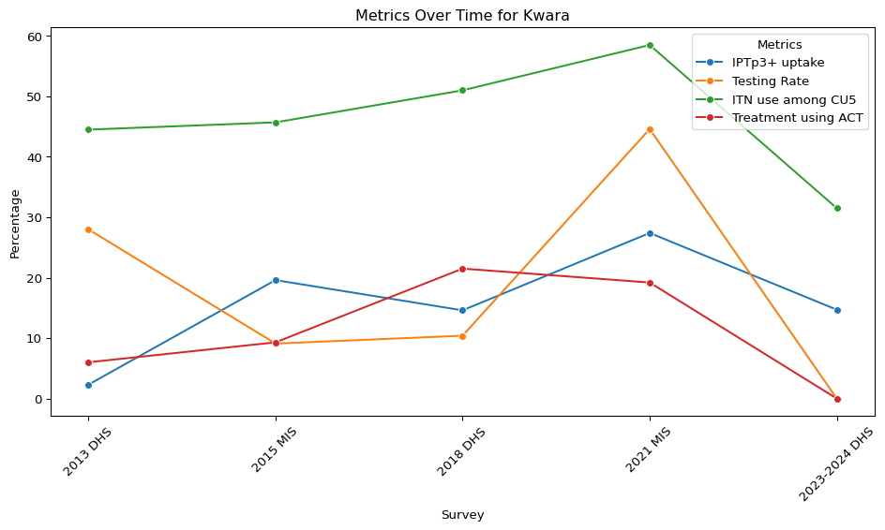
Original legend labels: ['Var14', 'Var17', 'Var9', 'Var18']

Slide 27
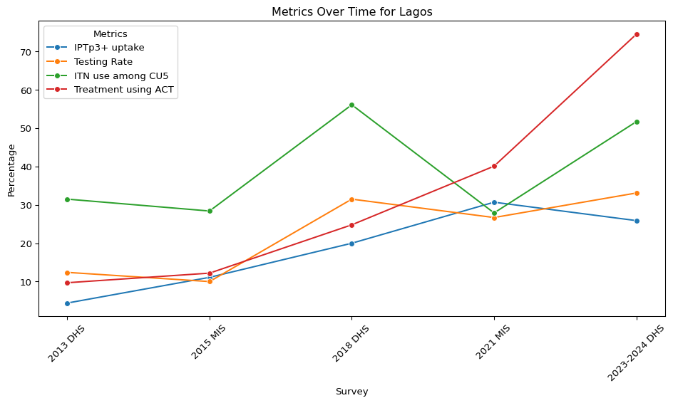
Original legend labels: ['Var14', 'Var17', 'Var9', 'Var18']

Slide 28
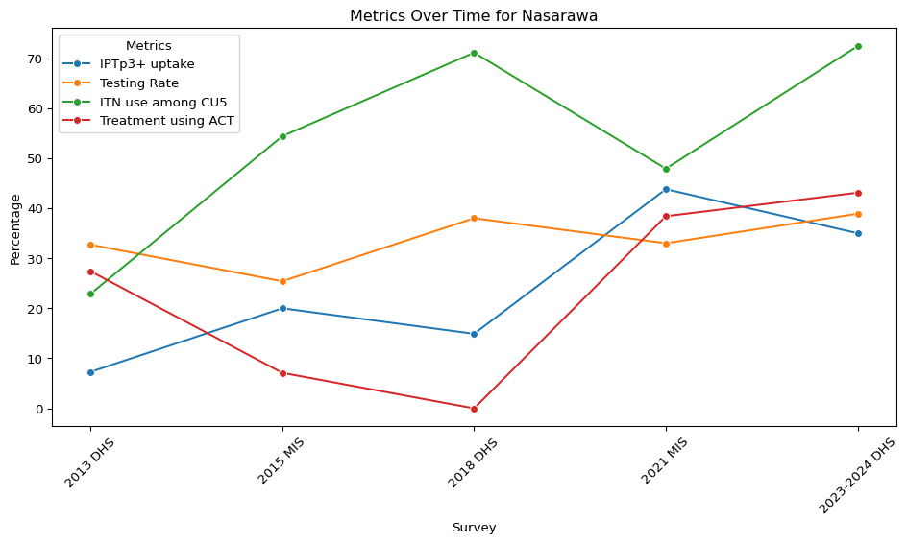
Original legend labels: ['Var14', 'Var17', 'Var9', 'Var18']

Slide 29
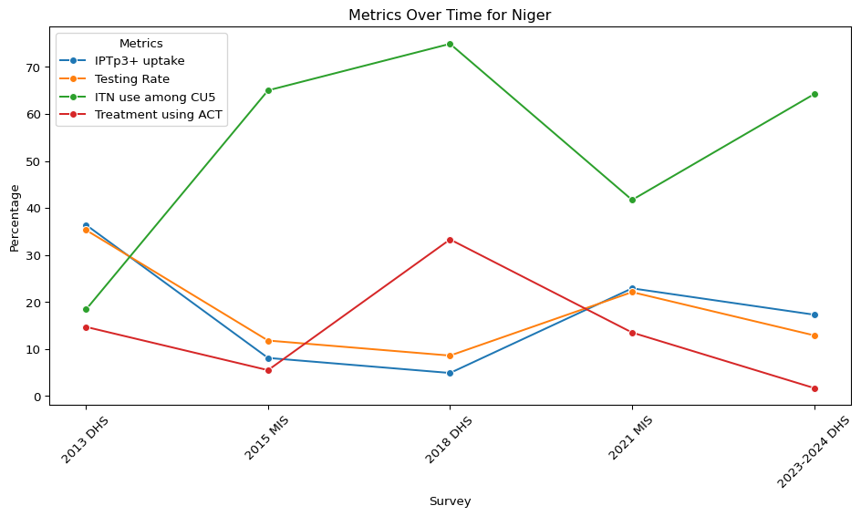
Original legend labels: ['Var14', 'Var17', 'Var9', 'Var18']

Slide 30
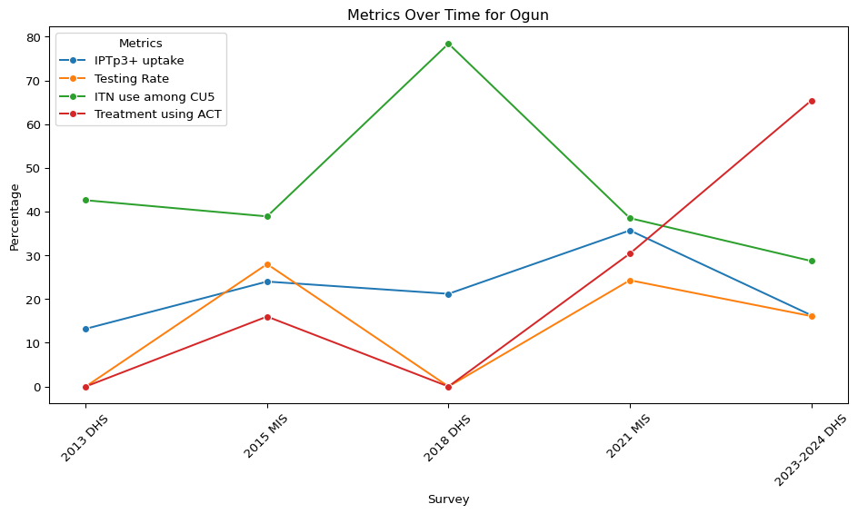
Original legend labels: ['Var14', 'Var17', 'Var9', 'Var18']

Slide 31
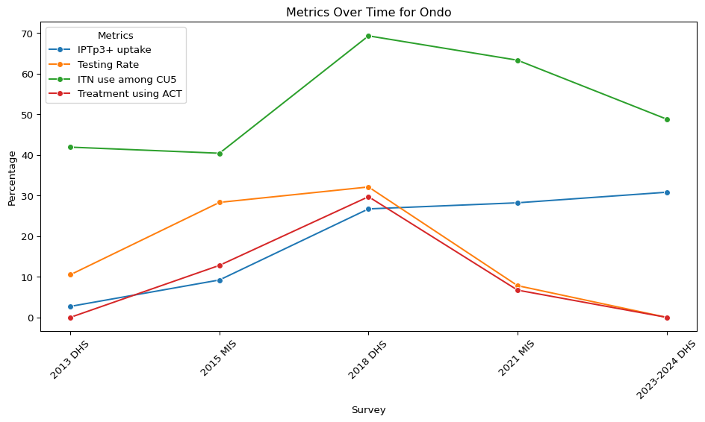
Original legend labels: ['Var14', 'Var17', 'Var9', 'Var18']

Slide 32
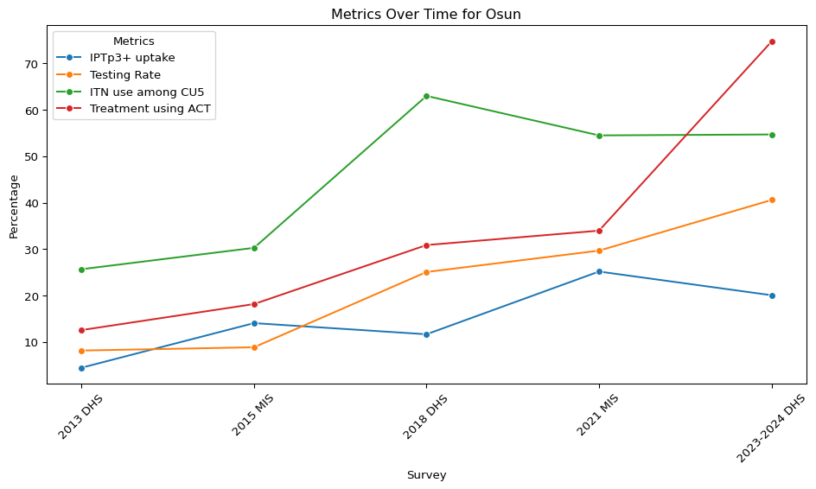
Original legend labels: ['Var14', 'Var17', 'Var9', 'Var18']

Slide 33
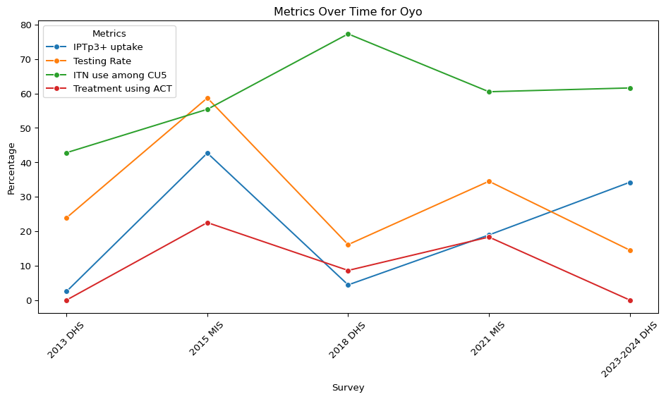
Original legend labels: ['Var14', 'Var17', 'Var9', 'Var18']

Slide 34
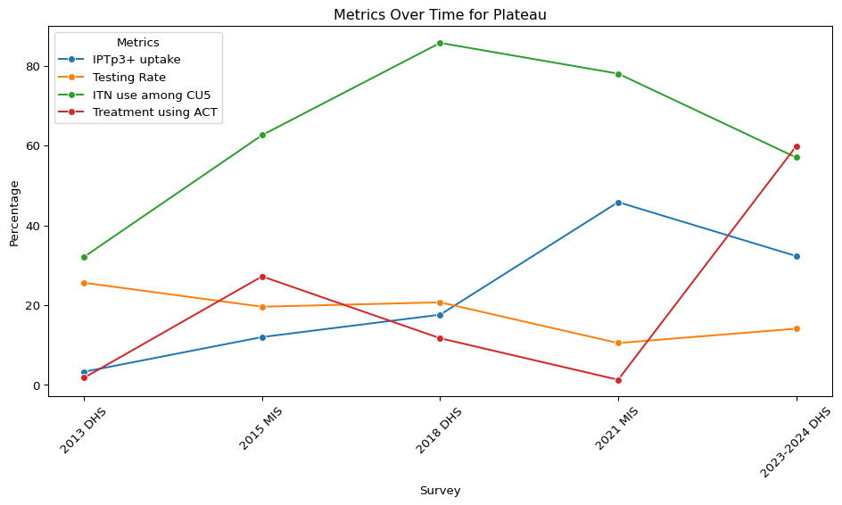
Original legend labels: ['Var14', 'Var17', 'Var9', 'Var18']

Slide 35
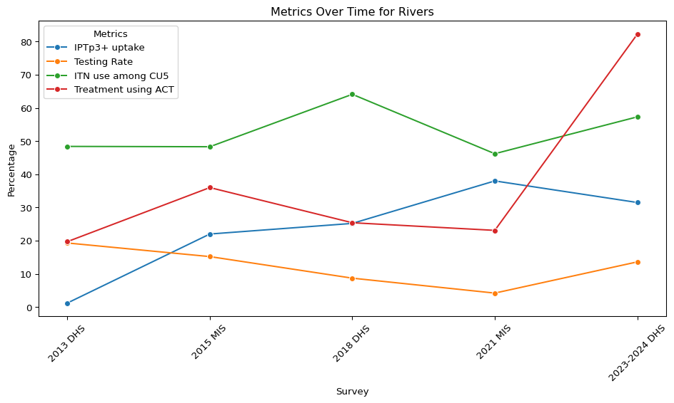
Original legend labels: ['Var14', 'Var17', 'Var9', 'Var18']

Slide 36
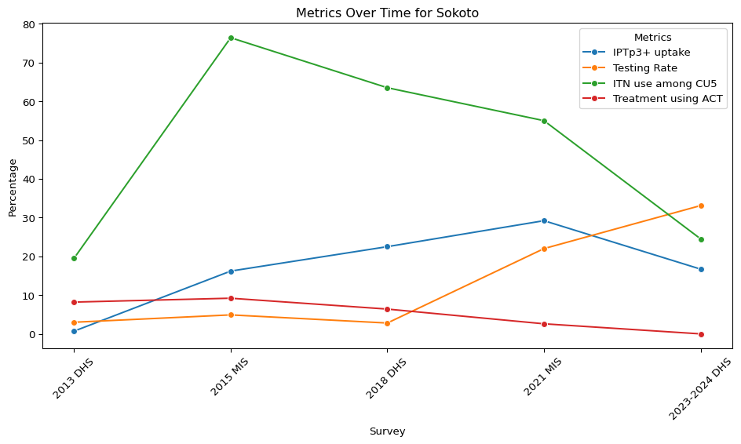
Original legend labels: ['Var14', 'Var17', 'Var9', 'Var18']

Slide 37
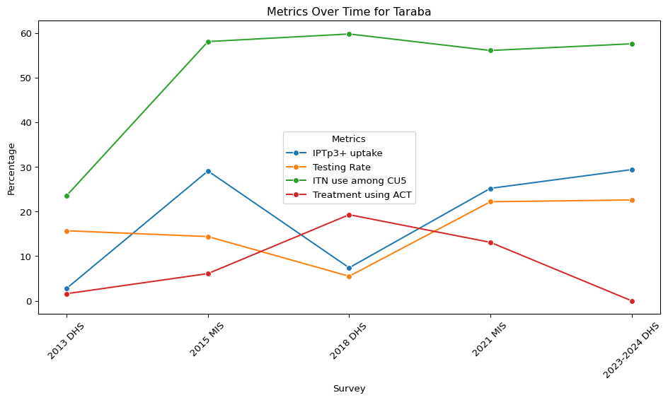
Original legend labels: ['Var14', 'Var17', 'Var9', 'Var18']

Slide 38
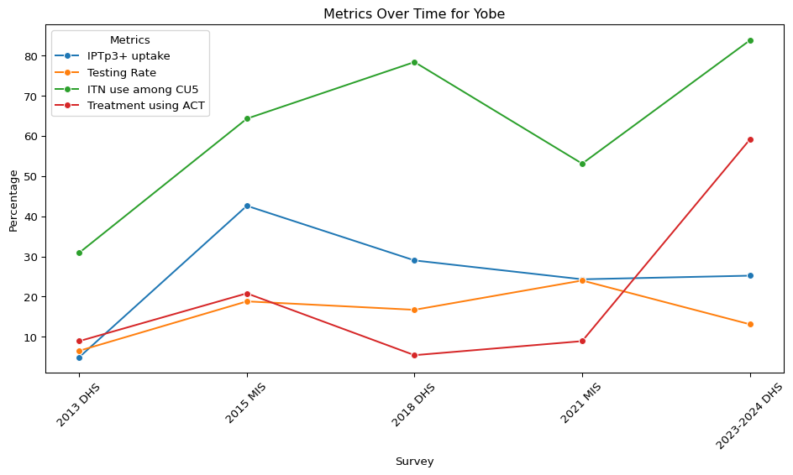
Original legend labels: ['Var14', 'Var17', 'Var9', 'Var18']

Slide 39
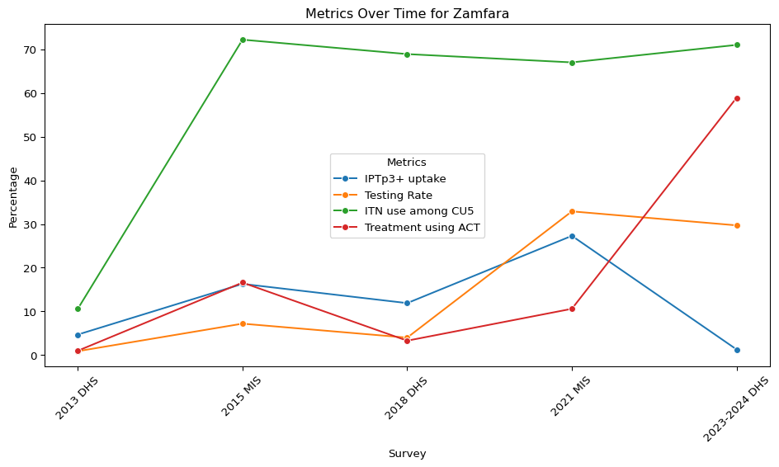
Original legend labels: ['Var14', 'Var17', 'Var9', 'Var18']

