Slide 1

Bayesian-learning and GLM-based hybrid model for NMDAR-modulating drug prediction.
Translational Neuromodeling
Damola Abglese
Clara Kümpel
Yitong

Slide 2
Agenda
Introduction
Methods and Models
MMN
HGF
Generalized Linear Model
Classification Results
Discussion
Conclusion and Future Work

Slide 3
Introduction

Slide 4
Idea/Hypothesis

Slide 5
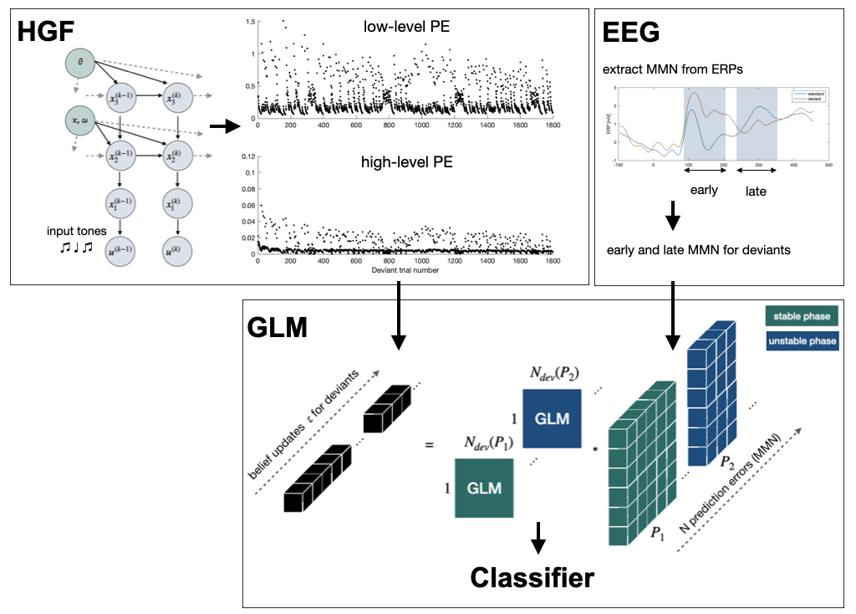
Project Pipeline

Slide 6
Methods and Models

Slide 7
MMN

Slide 8
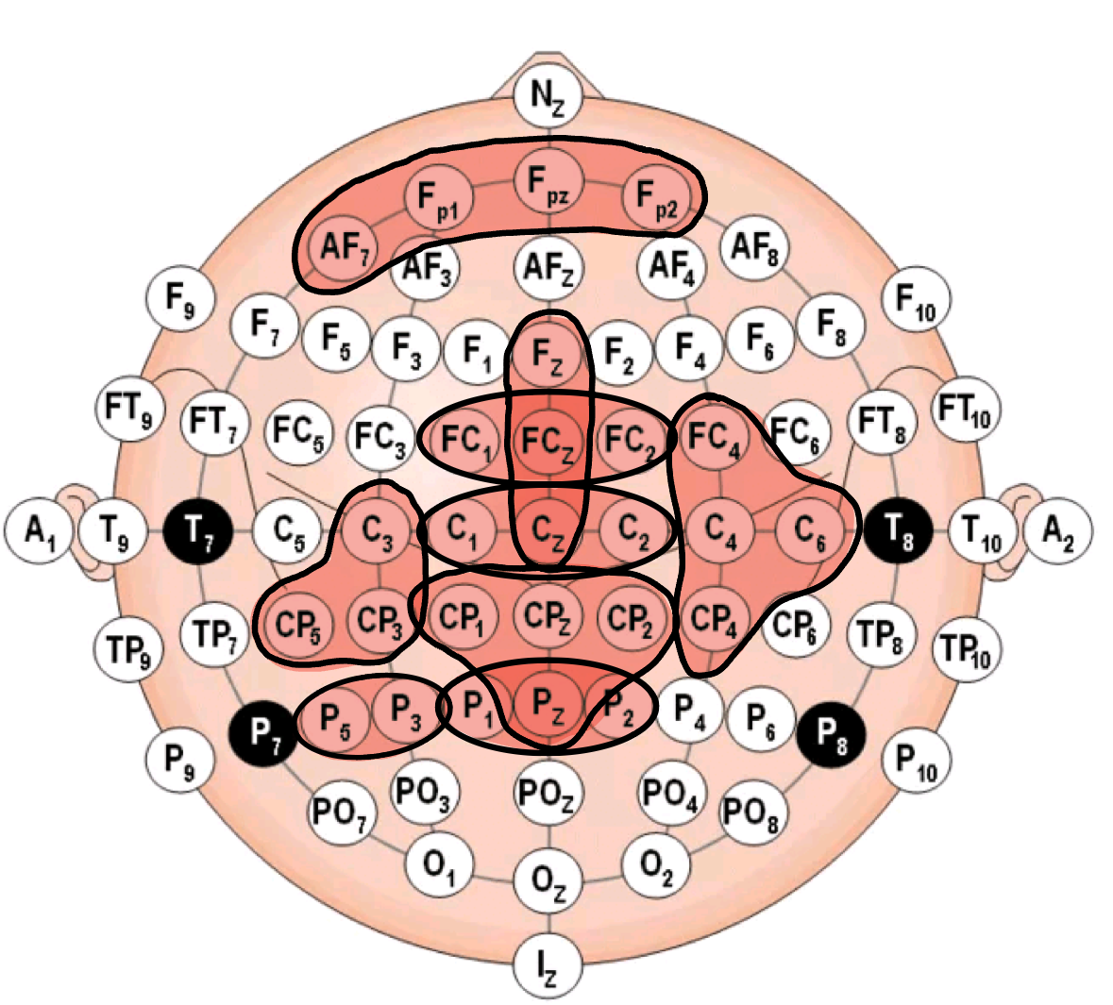
MMN

Slide 9
HGF

Slide 10
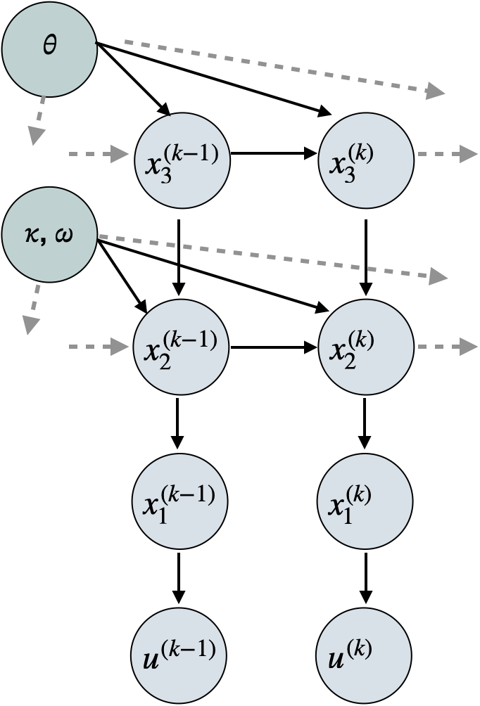
HGF

Slide 11
GLM

Slide 12
Classification Results

Slide 13
Classification Results
Labels | All Channels | Selected Channels | Clusters
Uni-Phase Accuracy | Uni-Phase Accuracy
All drugs | 43.8% | 34.4% | 43.8%
Anta Study | 50.0% | 35.7% | 57.1%
Agon Study | 50.0% | 72.2% | 44.4%
Bi-Phase Accuracy | Bi-Phase Accuracy
All drugs | 12.5% | 50.0% | 43.8%
Anta study | 21.4% | 50.0% | 64.3%
Agon study | 33.3% | 50.0% | 38.9%
Quad-Phase Accuracy | Quad-Phase Accuracy
All drugs | 43.8% | 34.4% | 46.9%
Anta study | 28.6% | 50.0% | 42.9%
Agon study | 50.0% | 33.3% | 55.6%

Slide 14
Discussion

Slide 15
Strengths and Weaknesses

Slide 16
Conclusion and Future Work

Slide 17
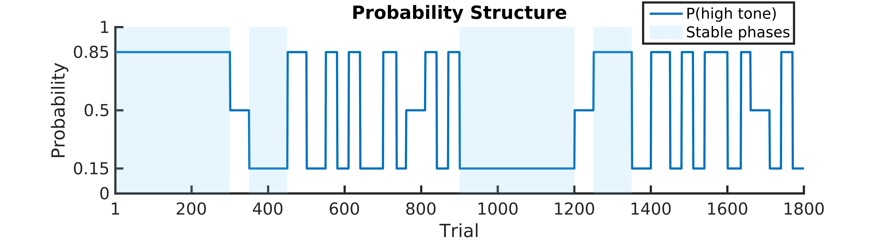
Idea / hypothesis

Slide 18
Detailed Model architecture

Slide 19
Model overview

Slide 20
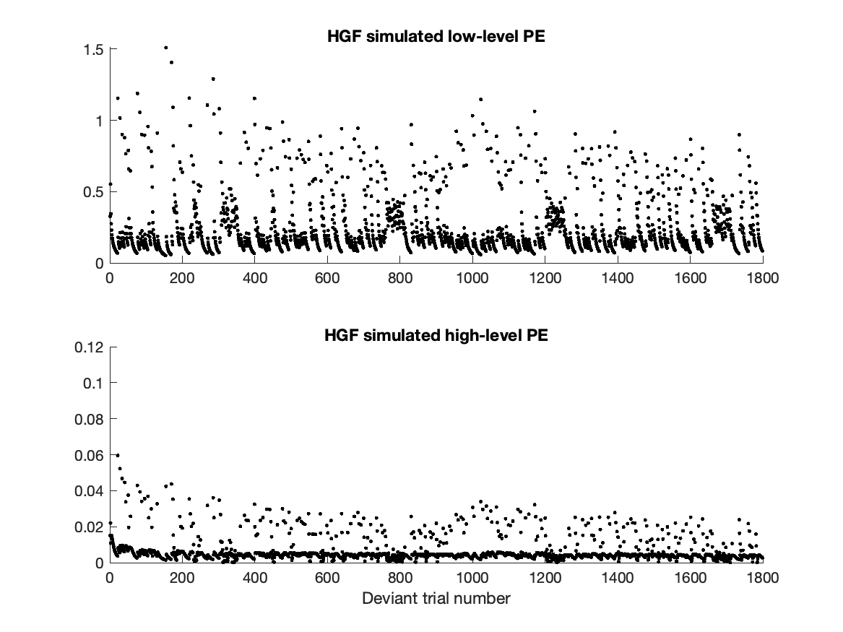
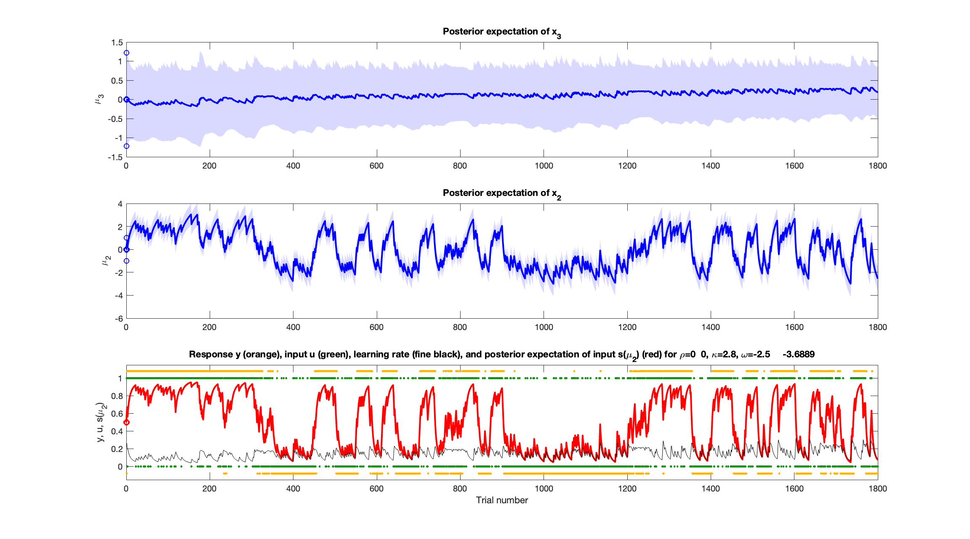
HGF
UPDATE!!

Slide 21
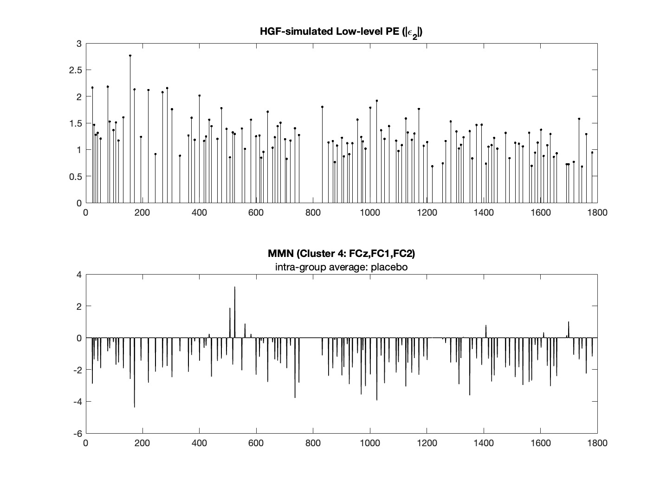
HGF

Slide 22
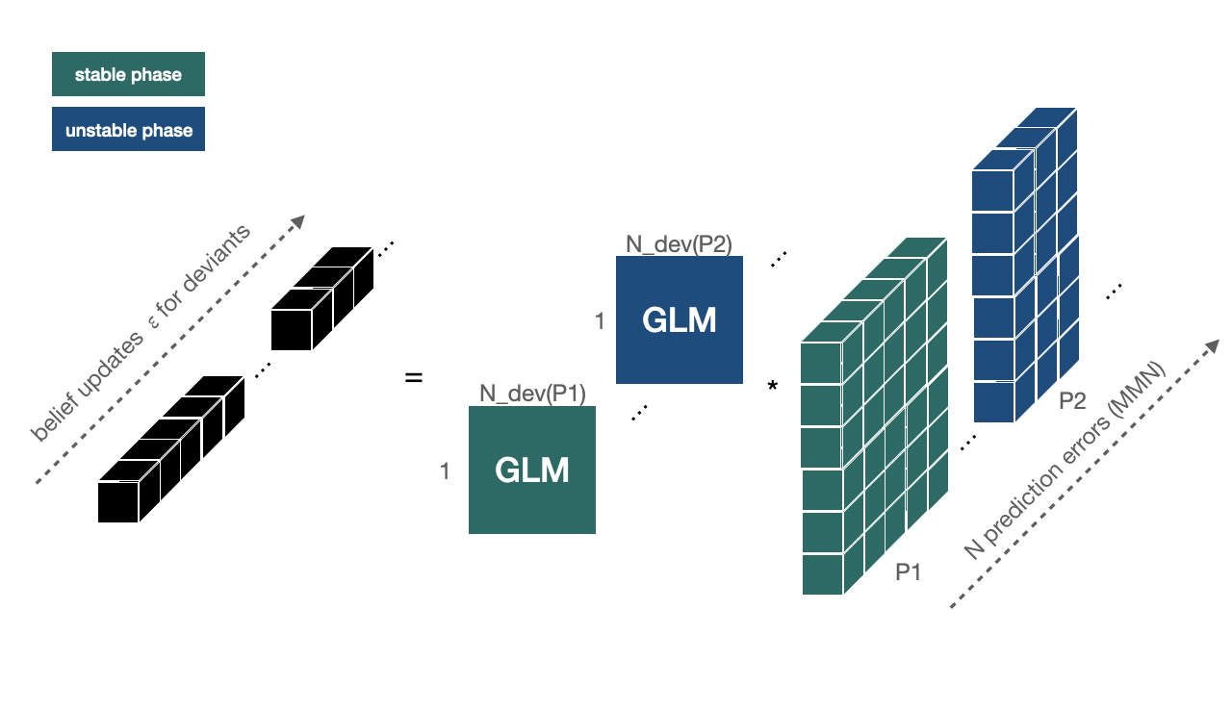
Generalized Linear Model

Slide 23
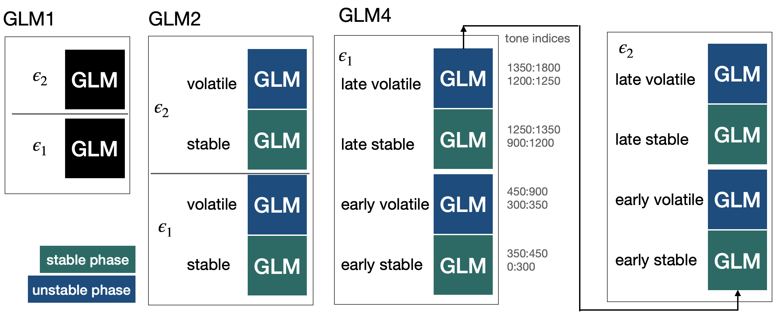
Generalized Linear Model

Slide 24
Prof. Dr. Beat Muster
Funktion des Präsentierenden
beat.muster@abcd.ethz.ch
ETH Zürich
Organisationseinheit Gebäude Raum Strasse Hausnummer 0000 Ort
www.abcd.ethz.ch

