Slide 1
Authors: Dagmara Zadrożna & Dominika Sawicka
Movie analysis based on OMDb database
Tutor: dr Krzysztof Ziółkowski

Slide 2
Agenda
H&S moment
Project Specification
Project details
Code
Web page & Functionality
Summary
Q&A

Slide 3

H&S moment
Working from home.
Getting your work done is important for businesses, but staying healthy (mentally and physically) is just as crucial. It’s all about creating boundaries between work and personal life.
Here are some tips:
Maintain Regular Hours.
Create Morning Routine.
Schedule Breaks.
Leave Home.
Socialize with Colleagues.
OSHA and Working from Home.

Slide 4
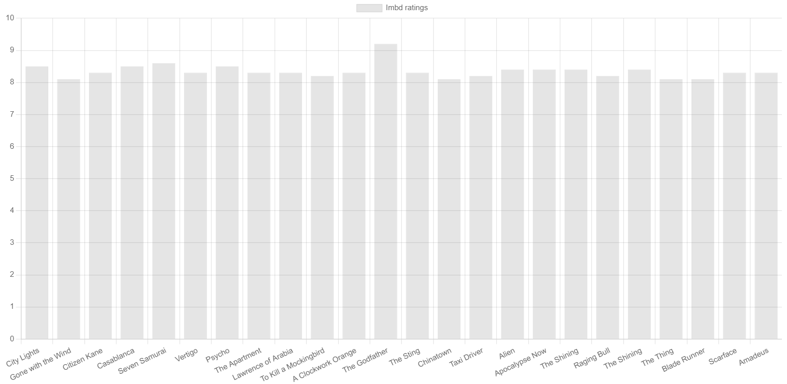
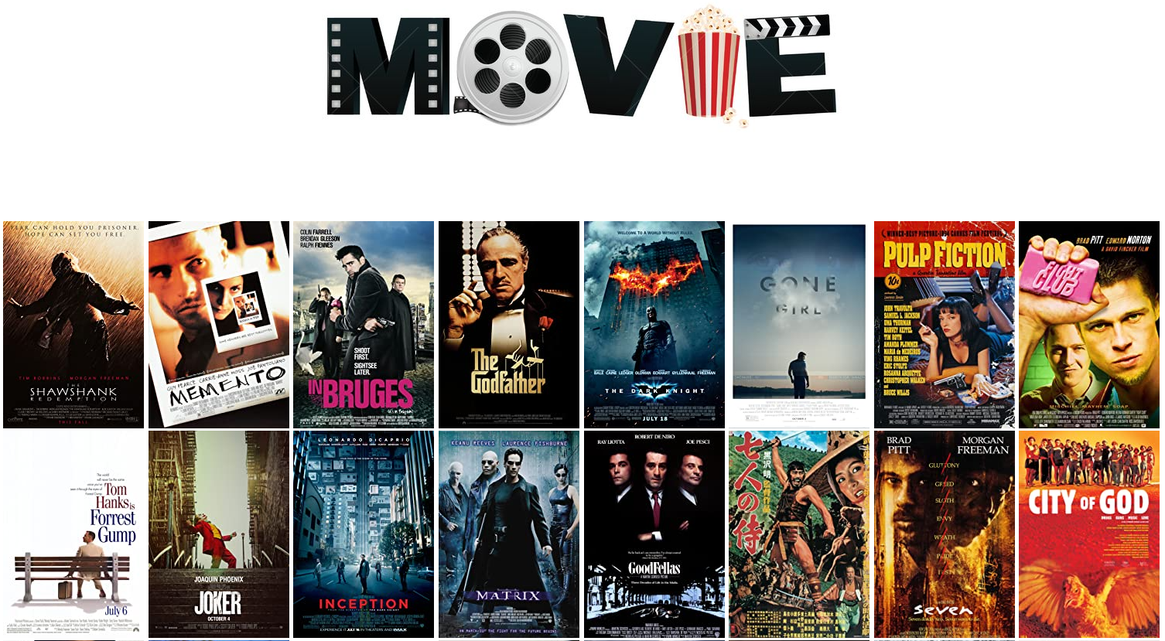
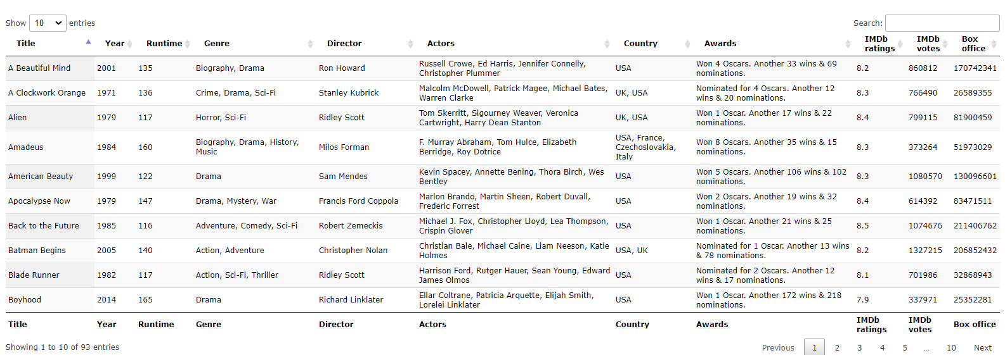
Project Specification
The aim of this project was to analyse specific numbers of movies based on certain attributes and visualise this information in easy and user-friendly manner.
Demonstrate usability of the software’s like Python with django framework, HTML, JavaScript, CSS and supporting it database engine SQLite3 to design and implement a web based solution.

Slide 5
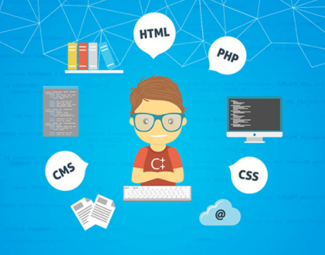
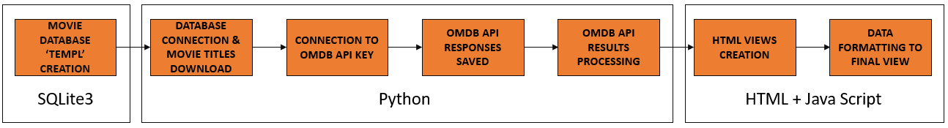
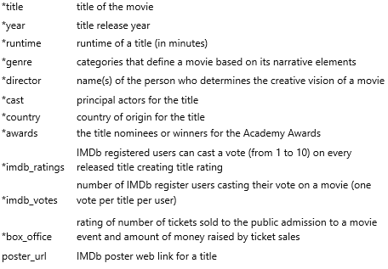
Project details
For the purpose of this project, we made data
analysis of movies using the following software's:
Python 3.6.2
django 3.1.7 framework
Git
PythonAnywhere
Libraries used for Python, Java and CSS:
Requests
Pandas
NumPy
SQLite3

Slide 6
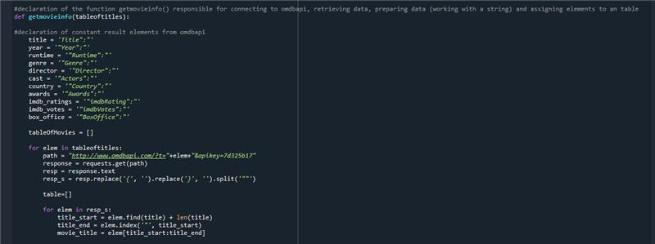
Code
Getting data from
Difficulties:
Getting data fromOMDb API.
Creation of the main data frame.

Slide 7




Web page & Functionality
To see and test movies2021.pythonanywhere.com
functionality, tabs were created, allowing users to view multiple panels of information within a single window.
About. Information about the project and authors of the project.
Poster. See up to the top 100 titles, their movie posters and short description.
Movies. Data visualisation in form of sortable table.
Diagrams. Graphical representation of data based on selected attributes.
Use of ‘Randomiser’ allow for random movie selection for
the night.
Any issue regarding this page can be raised
through contact us page.

Slide 8

Summary
We believe that our web page can be seen as a good example of
technical solutions learned and implemented, aptitude for
additional knowledge gained through the creation of this web page.
A well-designed web page can help guide users to the source of information and build trust in the data presented. We believe that the movies2021 web page will appeal to users due to simplicity of the design, functionality, consistency and basic aesthetic values.

Slide 9

Q&A

