Slide 1


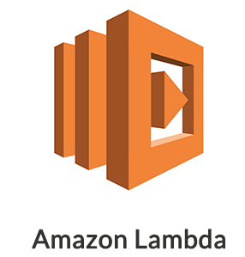

Architecture 1

Slide 2
Architecture 2
API key

Slide 3
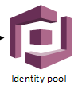

Architecture 3
Out of scope
Get AWS credentials
Access resources

Slide 4
Architecture 1

Slide 5
Folder structure
Serverless-fileupload: root directory
  front-end: angular code
  gateway: AWS API gateway config
  lambda: AWS lambda code
  documents: this file and other docs

Slide 6
Check front-end and lambda
Checkout code
  $ git clone git@github.com:daghanacay/serverless-fileupload.git
Front-end
  app/app.component.html: created a basic form with file upload button
  app/app.component.ts: created the functionality without server upload
Lambda
  Created lambda function to store file in S3

Slide 7
Prepare Lambda
Go to lambda folder and run the npm and download the dependencies
  $ cd lambda
  $ npm install
Zip the contents of the lambda folder (node_modules folder and s3-file-load-lambda.js file)

Slide 8
Architecture 1

Slide 9
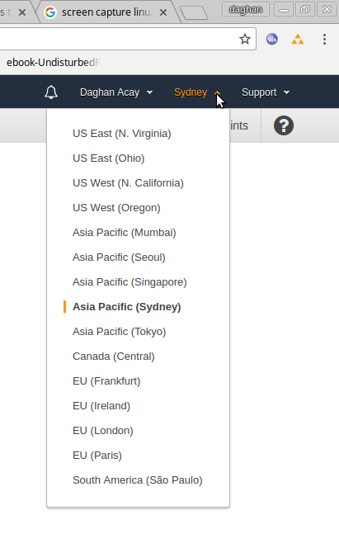
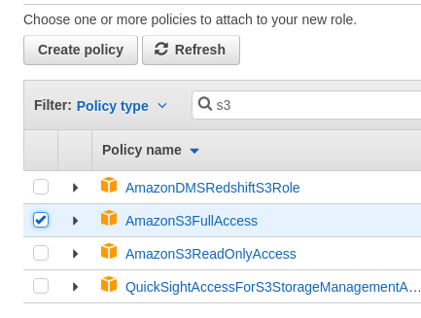
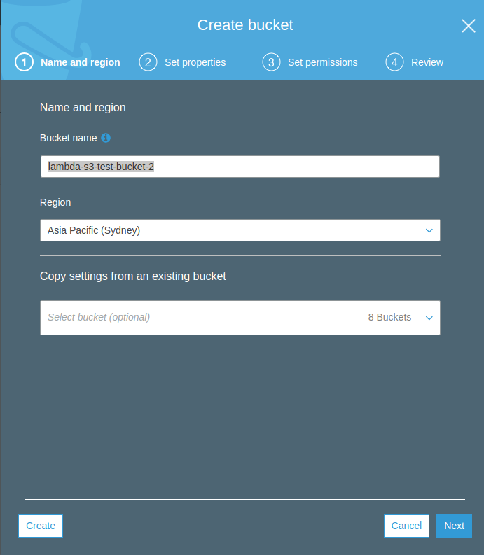
Prepare AWS (1/4)
Roles
From services select IAM
Click roles
Click create role
Select Lambda
Select AmazonS3FullAccess and CloudWatchLogsFullAccess
Name the role as “serverless-file-load”
S3 bucket
From services open S3
Click on “Create Bucket” called serverless-file-load, make sure that the bucket name is different since it needs to be unique in all regions.
Make sure it is not public.
Select region to Syndey and click “Create”

Slide 10
Architecture 1

Slide 11
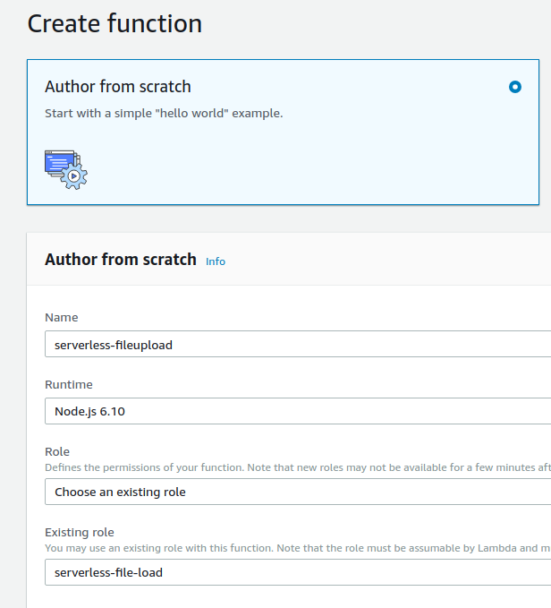
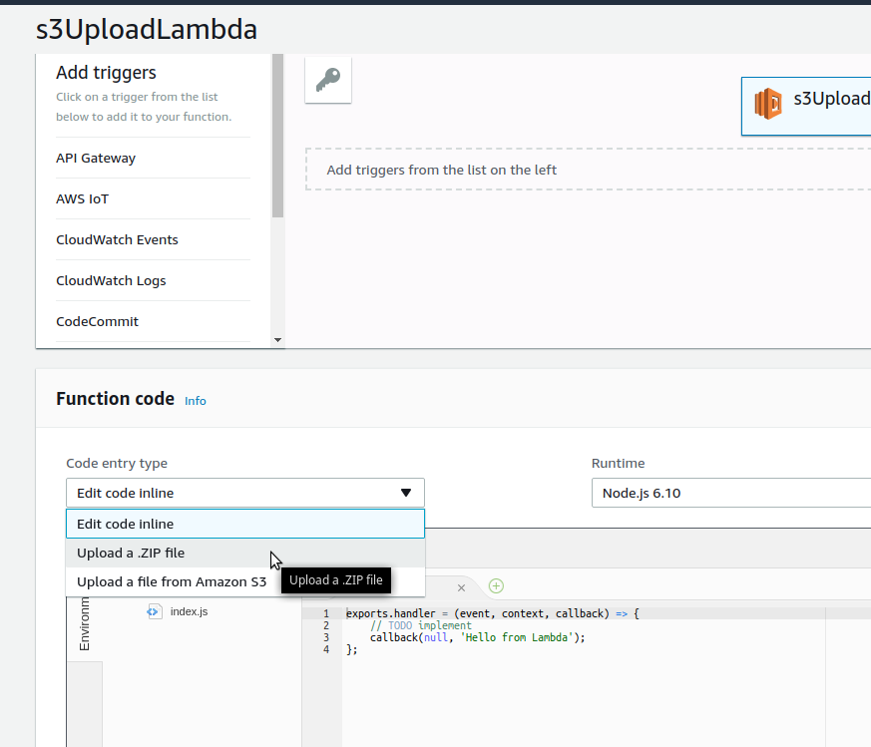
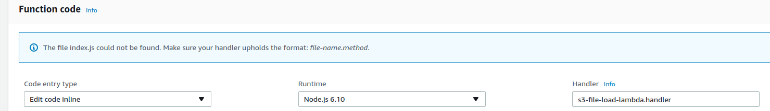
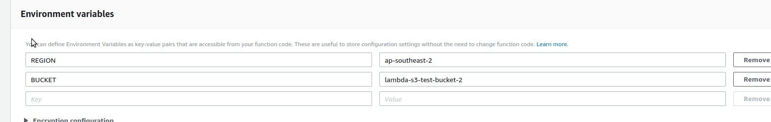
Prepare AWS (2/4)
Lambda
From services open Lambda
On the right hand click on “Create Function”
name it “serverless-fileupload” and choose the existing role from the list “serverless-file-load” and click create function
In the function code select upload an upload the zip file you have created.
In the handler write “s3-file-load-lambda.handler” and click save
Set up the environment variables as REGION=ap-southeast-2 and BUCKET=serverless-file-load

Slide 12
Architecture 1

Slide 13
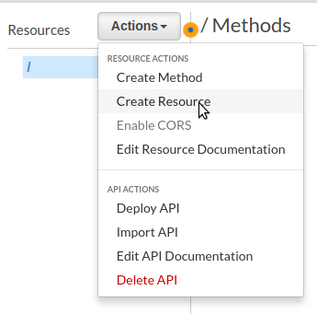
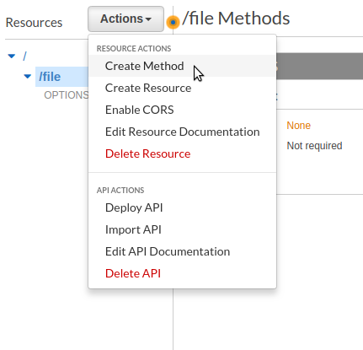
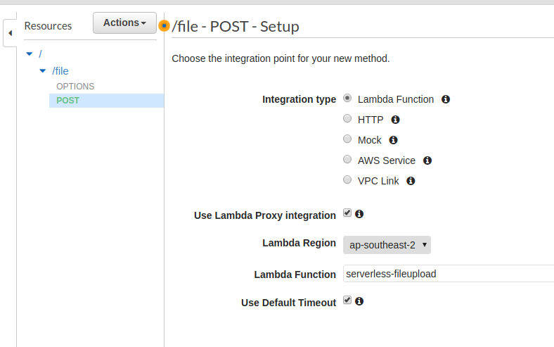
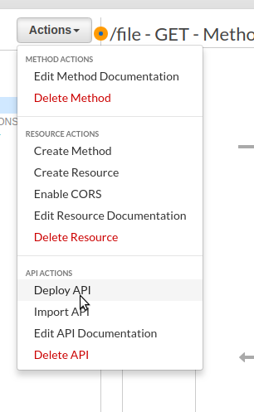
Prepare AWS (3/4)
API Gateway
Select API gateway from services
Click on “Create API” fill in api name “serverless-fileupload” and click on the “Create” button
In the Actions drop-down select “Create Resource” and create a resource called “file” and enable CORS
Select /file resource on the right and in the actions menu select create method and choose it to be POST. Since we are going to upload file using this endpoint.
Click on the POST request and select the lambda function that has been created. Also check “Use Lambda proxy integration” and click save. Click OK to approve the permission to invoke Lambda.
Next, deploy the API by clicking on resource link and from the actions select “deploy API”. You can call it anything you like in this example I call it “develop”

Slide 14
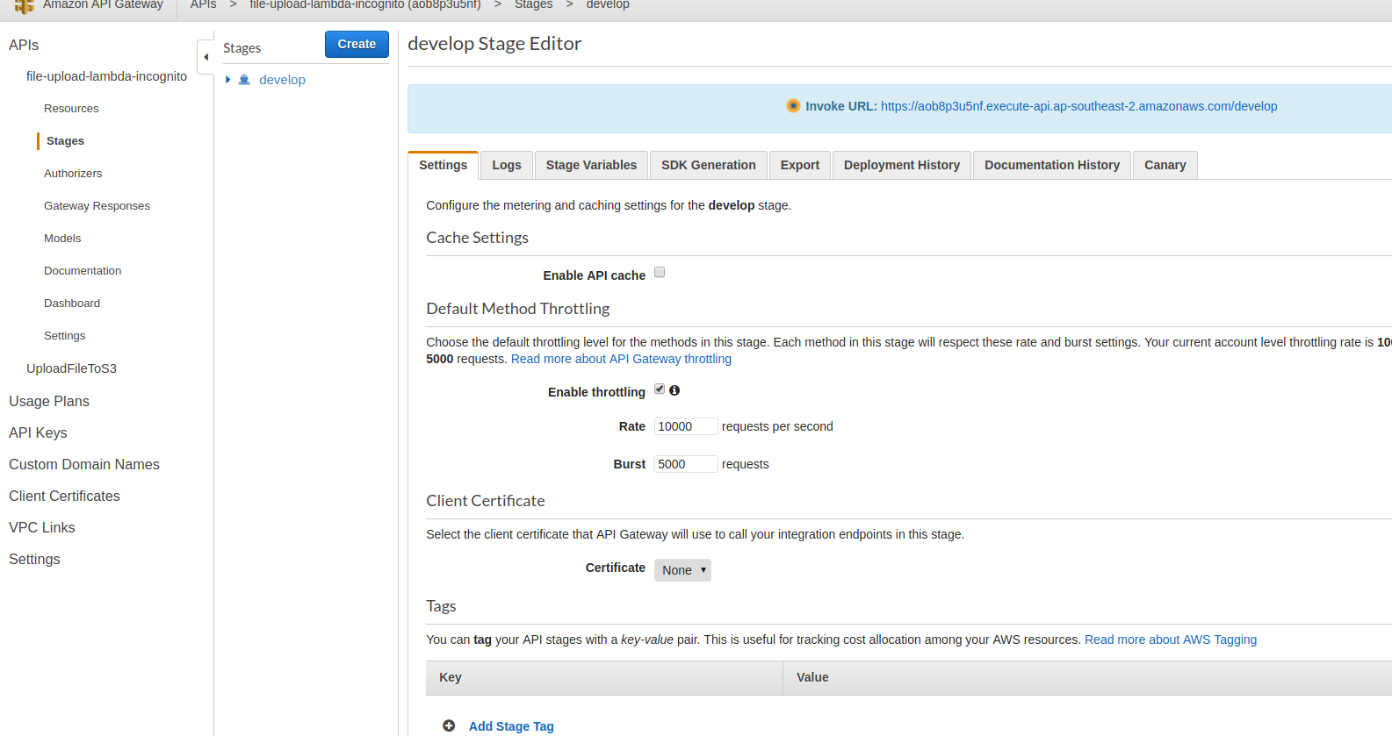
Prepare AWS (4/4)
API Gateway (continued)
Now click on the “Stages” and click on develop and note the URL
Update src/environments/environment.ts with your URL

Slide 15
Architecture 2
API key

Slide 16
Architecture 3
Out of scope
Get AWS credentials
Access resources

Slide 17


Future work
User User pool or Facebook login
Authenticate and get tokens
Replace tokens with
AWS credentials
Access resources
Deploy App to S3

