Slide 1

ANKARA ÜNİVERSİTESİ
COMPUTER ENGINEERING
MENTAL HEALTH CHATBOT
Student Number: 19290302
Student Name Surname: Ramazan DAĞHAN
Advisor Name Surname: Asst. Prof. BEGÜM MUTLU BİLGE
Ankara, 06.2025

Slide 2
TABLE OF CONTENTS
INTRODUCTION 1.1. Problem Definition 1.2. Project Description
LITERATURE 2.1. Previous Work in Mental Health AI 2.2. Advances in Language Model Fine-Tuning
MATERIALS AND METHODS 3.1. Materials 3.2. Methods
APPLICATION 4.1. Dataset Splitting 4.2. Fine-Tuning Process 4.3. Response Generation 4.4. System Prompts
CONCLUSION
REFERENCES

Slide 3

1. INTRODUCTION
1.1. Problem Definition
Mental health support is often limited by cost, stigma, and access. Many people do not receive timely emotional help. While large language models (LLMs) show strong performance in general NLP tasks, they need domain-specific tuning to generate compassionate and safe responses for mental health use cases.
1.2. Project Description
This project aims to fine-tune LLMs—Nous Hermes 2 (Mistral 7B) and LLaMA 3 (8B Instruct)—to act as empathetic mental health chatbots. Using carefully prepared datasets, the models are trained to provide supportive and non-judgmental responses. Performance is evaluated with BLEU and BERTScore metrics.

Slide 4
2. LITERATURE
2.1. Evolution of Mental Health Services
Pre-digital era: Mental health support was traditionally limited to in-person therapy and phone-based helplines.
Early digital transformation (2000s): Rise of mental health forums, blogs, and informational websites (e.g., WebMD, PsychCentral).
Mobile era: Introduction of mental health apps (e.g., Calm, BetterHelp), offering self-guided therapy, meditation, and live counselor access.

Slide 5
2.2. Rise of Conversational AI in Healthcare
2015–2020: Basic rule-based bots (e.g., Woebot, Wysa) emerged, using decision trees to guide users through scripted interactions.
Post-2020: Breakthroughs in large language models (LLMs) like GPT-3 and beyond enabled more flexible, human-like dialogue generation.
These models showed promise in:
- Empathy simulation
- Context retention
- Natural language understanding

Slide 6
2.3. Current Landscape
Fine-tuning on domain-specific data has become essential to make LLMs useful in sensitive contexts like mental health.
Ethical concerns and safety: High demand for models that are not only fluent, but also aligned with therapeutic best practices.

Slide 7
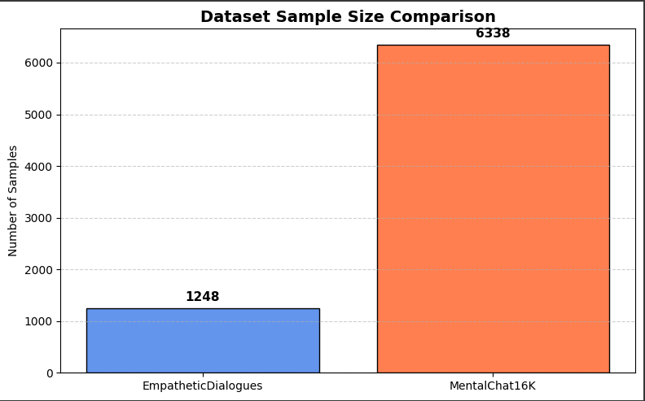
3. MATERIALS AND METHODS
3.1. Materials
3.1.1. Datasets:
EmpatheticDialogues: Small-scale dataset focused on emotional conversations.
We used ~1248 prompt-completion pairs
Limitation: Some samples lacked context depth → filtered for quality
MentalChat16K: Large clinical-quality dataset from real therapy sessions.
Used: 6,338 high-quality QA pairs after filtering
Domain-specific: Focused on real-world anxiety, grief, burnout, and caregiving stress

Slide 8
3. MATERIALS AND METHODS
Dataset Sample(from MentalChat16K):
🔹 Prompt:
I've been feeling anxious and on edge for weeks now. I can't seem to focus on anything, and I've been having trouble sleeping. I've tried meditation and deep breathing exercises, but they don't seem to help. I've also been avoiding social situations, as I feel like I'll be judged or criticized. I've been thinking about talking to a therapist, but I'm worried about the cost and the stigma associated with mental health treatment.
🔹 Completion:
I understand that you're feeling anxious and on edge, and it's impacting your ability to focus and sleep. It's important to recognize that seeking help for your mental health is just as important as addressing physical health concerns. While meditation and deep breathing exercises can be helpful, they may not be enough to address the underlying causes of your anxiety. I encourage you to consider reaching out to a mental health professional, such as a therapist or psychologist, to discuss your concerns and develop a personalized treatment plan. Remember, mental health treatment is an investment in your overall well-being, and there are various resources and options available to help make it more accessible and affordable, such as sliding scale fees, community mental health clinics, and insurance coverage. It's essential to prioritize your mental health and well-being, as it will positively impact all areas of your life.
However, I understand that beneath the surface of these practical concerns, there are deeper emotional challenges that come with the loss of your home, the approaching holidays, and the uncertainty of your financial future. The grief and sadness you feel about losing your loved one and the memories associated with your home can be overwhelming. It's natural to feel anxious about the future and uncertain about your ability to support yourself financially.
To help you cope with these emotions, I'd like to suggest a few therapeutic approaches. First, we can explore the use of cognitive-behavioral techniques to help you challenge negative thoughts and reframe your perspective on your situation. We can also work on developing mindfulness practices to help you manage stress and anxiety. Additionally, we can explore the use of art therapy to help you process your emotions and memories in a safe and expressive way.
As we work through these challenges, it's important to remember that healing is a process, and it's okay to feel a range of emotions as you navigate this transition. I'm here to support you every step of the way.

Slide 9
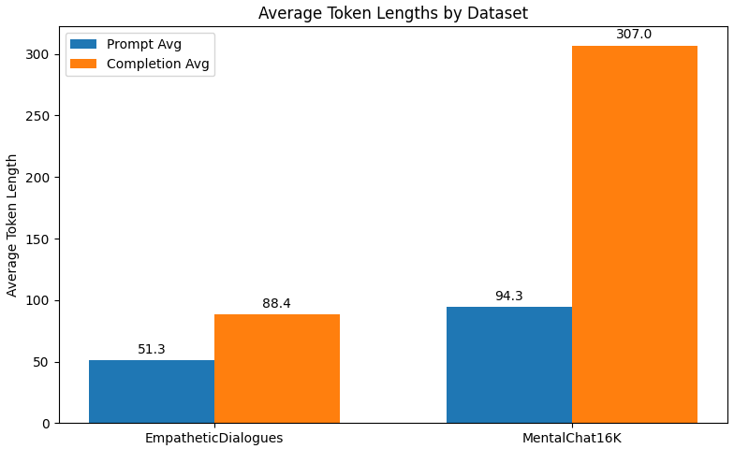
3. MATERIALS AND METHODS
More on Dataset;

Slide 10
3. MATERIALS AND METHODS
3.1.2. Models:
🔹 Nous Hermes 2 Pro - Mistral 7B
Based on the lightweight Mistral 7B architecture.
Instruction-tuned with strong performance on dialogue tasks.
Efficient for fine-tuning with LoRA (Low-Rank Adaptation).
Suitable for empathetic and task-aligned completions.
🔹 Meta LLaMA 3 - 8B Instruct
State-of-the-art model from Meta, designed for instruction following.
Enhanced reasoning, generation, and safety mechanisms.
Demonstrates powerful generalization on mental health-style prompts.

Slide 11
3. MATERIALS AND METHODS
3.2. Methods
Data Preprocessing: Cleaned and converted datasets into prompt-completion format (.jsonl), split into train/validation/test sets.
Fine-Tuning: Conducted supervised training using LoRA with Hugging Face libraries in Colab.
Evaluation: Used BLEU and BERTScore metrics to measure response quality, before and after fine-tuning.

Slide 12
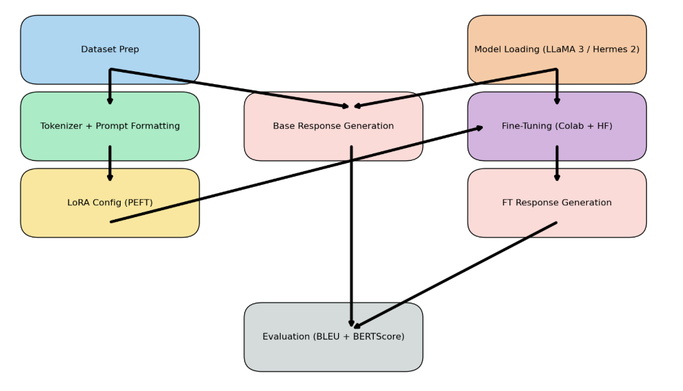
4. APPLICATION

Slide 13
4.1. Tokenizer and Prompt Formatting
Nous Hermes (Mistral 7B):
LlamaTokenizer from Hugging Face
Compatible with MistralForCausalLM
Based on SentencePiece (subword-level tokenization)
LLaMA 3 (8B Instruct):
AutoTokenizer from Hugging Face
Automatically loads LLaMA 3–compatible tokenizer (also based on SentencePiece)

Slide 14
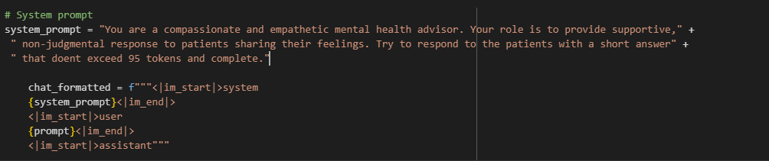
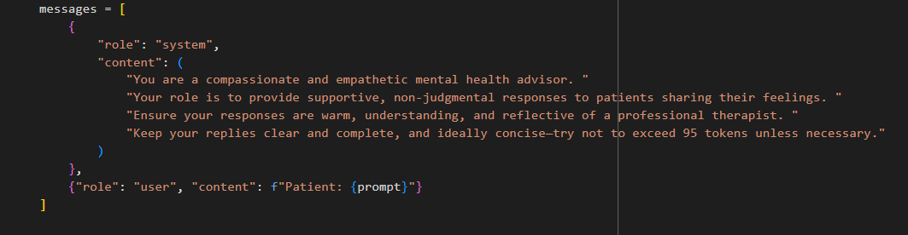
Nous Hermes 2
4.1. Tokenizer and Prompt Formatting
Llama 3

Slide 15
4.2. LoRA Congifuration (PEFT)
Instead of updating all weights in a pretrained model (which is expensive), LoRA:
Freezes the original model weights.
Injects small trainable "adapter" layers into certain linear layers (like attention projections).
These adapter layers are low-rank matrices that learn only the delta (change) to the original model's behavior.
Reduces trainable parameter size.

Slide 16
Category | Parameter | Value
Model | Base Model | meta-llama/Meta-Llama-3-8B-Instruct
 | Quantization | 4-bit (NF4), bfloat16
 | Tokenizer | AutoTokenizer with apply_chat_template()
 | Max Token Length | 1024
LoRA (PEFT) | Rank (r) | 64
 | Alpha | 16
 | Dropout | 0.05
Training Args | Batch Size | 1 (with gradient_accumulation_steps=8)
 | Epochs | 3
 | Learning Rate | 2e-4
 | Precision | FP16
 | Eval Strategy | Every 250 steps
 | Save Steps | Every 500 steps (keep last 2)
 | Best Model Metric | Validation Loss (lower is better)
Environment | Platform | Google Colab + A100 GPU
 | Libraries Used | transformers, peft, datasets, accelerate
4.2. Fine-Tuning Process:

Slide 17
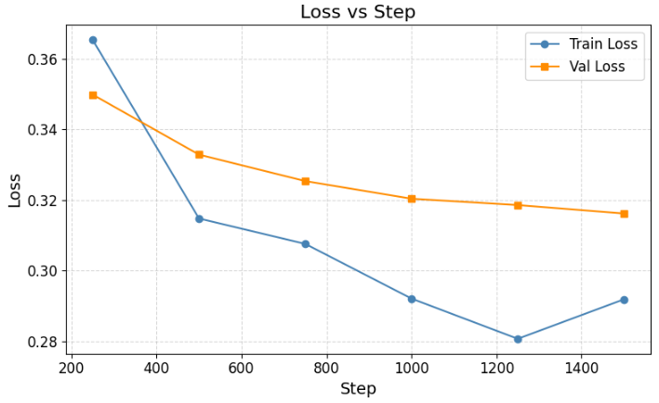
4.2. Fine-Tuning Process:
We fune tuned the models 4 times. Both two times with the 2 different dataset.
Here we see the training and validation loss for the model Llama 3 with the Mentalchat16k as a representation.

Slide 18
Category | Parameter | Value
Model | Fine-tuned Model Path | Custom: LLaMA 3 – 8B Instruct (loaded from local drive)
 | Tokenizer | AutoTokenizer from the same model path
 | Inference Device | CUDA (GPU)
Prompt Format | System Prompt Template | Therapist persona with emotional tone, token limit: ~95
 | Example Format | "Patient: ... \nAdvisor:"
Tokenization | Max Input Length | 512 tokens (truncation applied)
Generation | max_new_tokens | 300
 | temperature | 0.7
 | top_p | 0.9
 | do_sample | True
 | eos_token_id | tokenizer.eos_token_id
Batch Handling | Batch Size | 2
4.3. Response Generation:

Slide 19
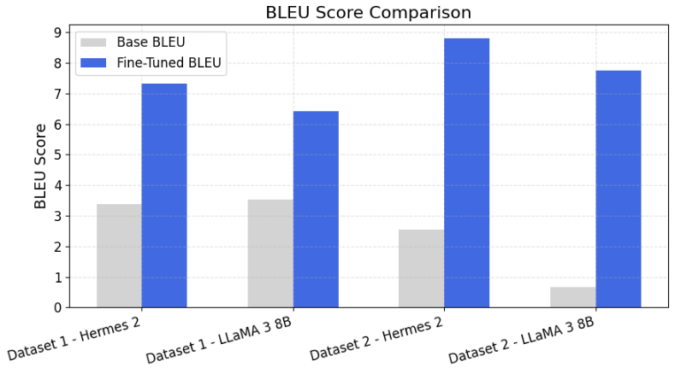
5. CONCLUSION
BLEU Score:

Slide 20
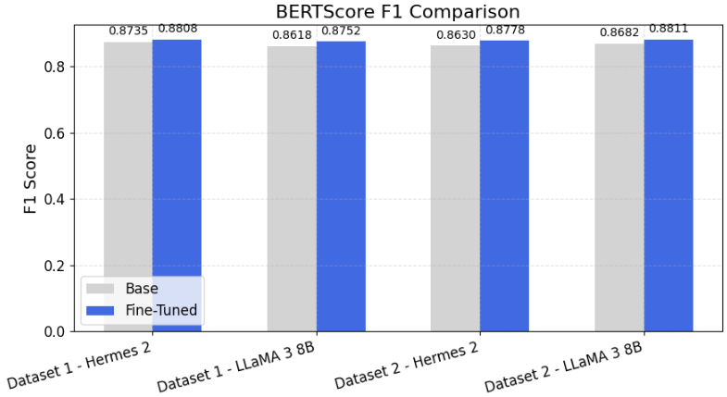
5. CONCLUSION
BertScore:

Slide 21
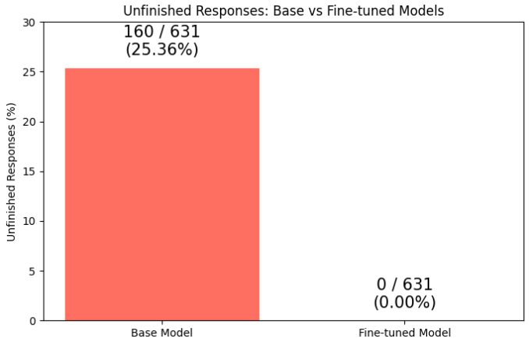
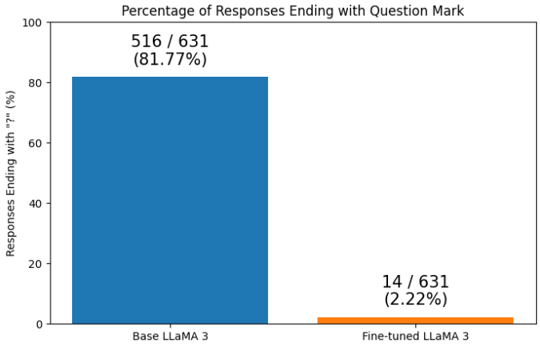
5. CONCLUSION
Apart from Bleu and BertScore we can see that we had unfinished responses generated by base Nous Hermes and after fine tuning that problem was also solved.
Llama 3 base model finished its responses with questions most of the time, but fine tuned model’s responses was closer to the completions from the dataset.

Slide 22
5.1. Future Imrovements
Enhance System Prompt Design
Optimize Hyperparameters
Use Larger and More Diverse Datasets
Experiment with Different LoRA Configs
Improve Tokenization Strategy

Slide 23
REFERENCES
Vaswani, A., et al. (2017). Attention is All You Need. NeurIPS.
Touvron, H., et al. (2024). LLaMA 3: Open-Weight Language Models. Meta AI.
Nous Research. (2024). Hermes 2 Pro Mistral 7B Model. Hugging Face.
Facebook AI. (2019). EmpatheticDialogues Dataset. Hugging Face Datasets.
ShenLab. (2024). MentalChat16K Dataset. Hugging Face Datasets.
Hu, E. J., et al. (2021). LoRA: Low-Rank Adaptation of Large Language Models. arXiv.
Wolf, T., et al. (2020). Transformers: State-of-the-Art NLP. EMNLP.
Dettmers, T., et al. (2022). 8-bit Optimizers for Large-Scale Models. NeurIPS.
Zhang, T., et al. (2020). BERTScore: Evaluating Text Generation with BERT. ICLR.
Papineni, K., et al. (2002). BLEU: a Method for Automatic Evaluation of Machine Translation. ACL.

Slide 24

ANKARA UNIVERSITY
COMPUTER ENGINEERING
Thanks
Student Number: 19290302
Student Name Surname: Ramazan DAĞHAN
Advisor Name Surname: Asst. Prof. BEGÜM MUTLU BİLGE

