Slide 1
WezTerm
$ wezterm connect unix
3 panes restored
$ ls
report.pdf slides.pptx
$ █
Conceptual Architecture
CISC 322/326 · Assignment 1
TheZucks
Armaan · Arnav · Avaneesh · Dagi · Ibraheem · Rahul
October 9, 2026
Notes:
[0:00 – 0:23] WezTerm: Conceptual Architecture
Hi everyone, we're TheZucks. In the next ten minutes we'll present the conceptual architecture of WezTerm, an open-source terminal emulator and multiplexer written in Rust. We'll cover how we derived it, its eight subsystems, two use cases, the architectural styles it uses, the alternatives we discarded, and what we learned.

Slide 2
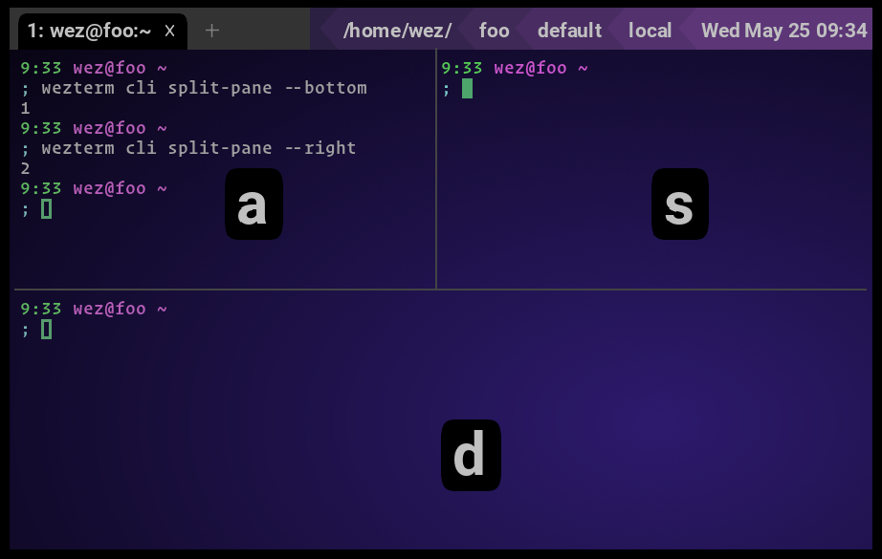




What WezTerm does
intro
Terminal emulator
Keystrokes to the shell, output to the screen, on the GPU
Built-in multiplexer
Tabs and split panes, no tmux needed
Persistent sessions
Sessions keep running in a separate server process
Configuration is code
One window, three panes (screenshot: wezterm.org docs)
A Lua script, wezterm.lua, instead of a settings menu
Cross-platform: Linux, macOS and Windows, created by Wez Furlong
Notes:
[0:23 – 0:55] What WezTerm does
A terminal emulator sits between you and your shell: it turns keystrokes into bytes for the shell, and turns the shell's output into a picture on the screen. WezTerm does that on the GPU, and it adds a built-in multiplexer: tabs and split panes, like this window with three, plus sessions that keep running in a separate server process. And it has no settings menu; the configuration is a Lua script.

Slide 3

How we derived the architecture
§2
01
02
03
Read
Trace
Merge
WezTerm docs + repo crate layout
Course material on styles
Group crates, one owner each
2 use cases, 2 paths
Who calls whom, in order
Found the async output
Lifeline → box
Message kind → arrow
Group boxes into tiers
→ 8 candidate subsystems
→ 2 sequence diagrams
→ box-and-arrow diagram
Checked in reverse: every arrow traces to a use-case step or the documentation
Notes:
[0:55 – 1:40] How we derived the architecture
We derived the architecture in three steps. First, we read WezTerm's documentation and its repository's crate layout, alongside the course material on styles. Grouping related crates gave us eight candidate subsystems, and each of us researched one or two. Second, we traced two use cases through them as sequence diagrams. This showed behaviour the documentation didn't: output doesn't come back as one chain of calls. Third, we merged both diagrams: every lifeline became a box and every kind of message became an arrow. Then we checked in reverse, so every arrow is used by a use case or backed by the docs.

Slide 4
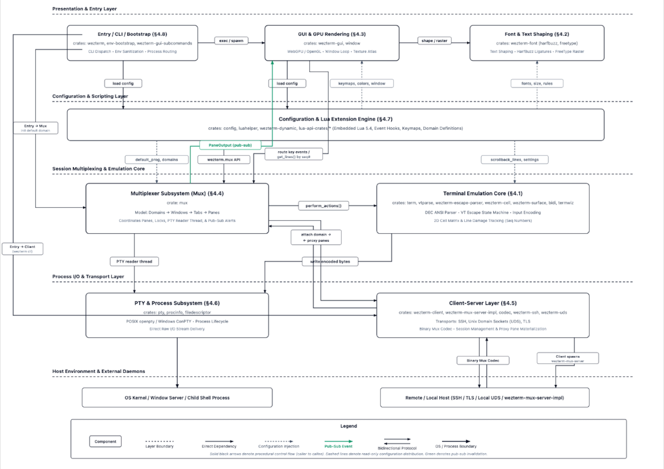
Conceptual architecture
§3
How to read it
Call / direct dependency
Read-only config injection
Pub-sub notification
8 subsystems, 4 tiers
plus a host band: OS, shell and mux server host
Tiers ≠ layered style
Entry calls the Mux directly, the Mux notifies the GUI upward, Config serves every tier
Notes:
[1:40 – 2:20] Conceptual architecture
Here's the result: eight subsystems in four tiers. At the top are Entry, the GUI and Font shaping. Below is Configuration and Lua, which nearly everything reads from; those are the dashed arrows. In the middle are the Multiplexer and the Terminal Emulation Core, and at the bottom PTY and Process and the Client-Server layer. Solid arrows are calls, and green is a publish-subscribe notification. The tiers are a grouping, not a layered style: Entry calls the Mux directly, the Mux notifies the GUI upward, and Configuration serves every tier.

Slide 5
Eight subsystems, one job each
§4
Subsystem | Responsibility | Tier
Entry / CLI / Bootstrap §4.8 | Starts every process; routes commands (front controller) | Presentation
GUI & GPU Rendering §4.3 | Windows and input; draws only dirty lines on the GPU | Presentation
Font & Text Shaping §4.2 | Finds fonts, shapes text (HarfBuzz), rasterizes glyphs (FreeType) | Presentation
Configuration & Lua §4.7 | Runs wezterm.lua → typed config; event hooks; hot reload | Config
Multiplexer (Mux) §4.4 | Owns every session: domains → windows → tabs → panes | Core
Terminal Emulation Core §4.1 | Parses escape sequences; keeps cell grid, scrollback, seq numbers | Core
PTY & Process §4.6 | Creates pseudo-terminals; spawns and feeds the shell | Process I/O
Client–Server Layer §4.5 | Mux server, codec protocol, proxy panes over UDS / SSH / TLS | Process I/O
Notes:
[2:20 – 3:01] Eight subsystems, one job each
Each subsystem has one job. Entry starts every WezTerm process and routes its command. Configuration runs wezterm dot lua and reloads it when the file changes. The GUI owns windows and input and draws on the GPU. Font shaping turns text into glyphs. The Multiplexer is the centre: it owns every session as domains, windows, tabs and panes. The Terminal Core parses escape sequences and keeps the screen grid. PTY and Process runs the shell. And the Client-Server layer lets a headless mux server own sessions while a GUI attaches to them.

Slide 6




Why the subsystems interact this way
§3.2
GUI → one Pane interface → Mux
Mux ⇢ GUI: PaneOutput event
Local and remote: one Pane trait
Mux publishes; GUI pulls changed lines
Why: the GUI draws both the same way
Why: a mux server can run with no GUI at all
A reader thread per pane
Config ⇢ everyone; Lua → Mux
PTY output parsed off the GUI thread
Settings flow one way, read-only
Why: heavy output can't freeze the window
Why: scripts can still drive sessions via wezterm.mux
Notes:
[3:01 – 3:40] Why the subsystems interact this way
Four interactions explain most of the design. First, every pane implements one Pane interface, so the GUI draws local and remote panes the same way. Second, the Mux never calls the renderer; it publishes a notification, which is why a mux server can run with no GUI. Third, a reader thread per pane parses output off the GUI thread, so heavy output never freezes the window. And fourth, configuration flows one way, read-only, into every subsystem, while Lua scripts can drive the Mux back through wezterm dot mux.

Slide 7
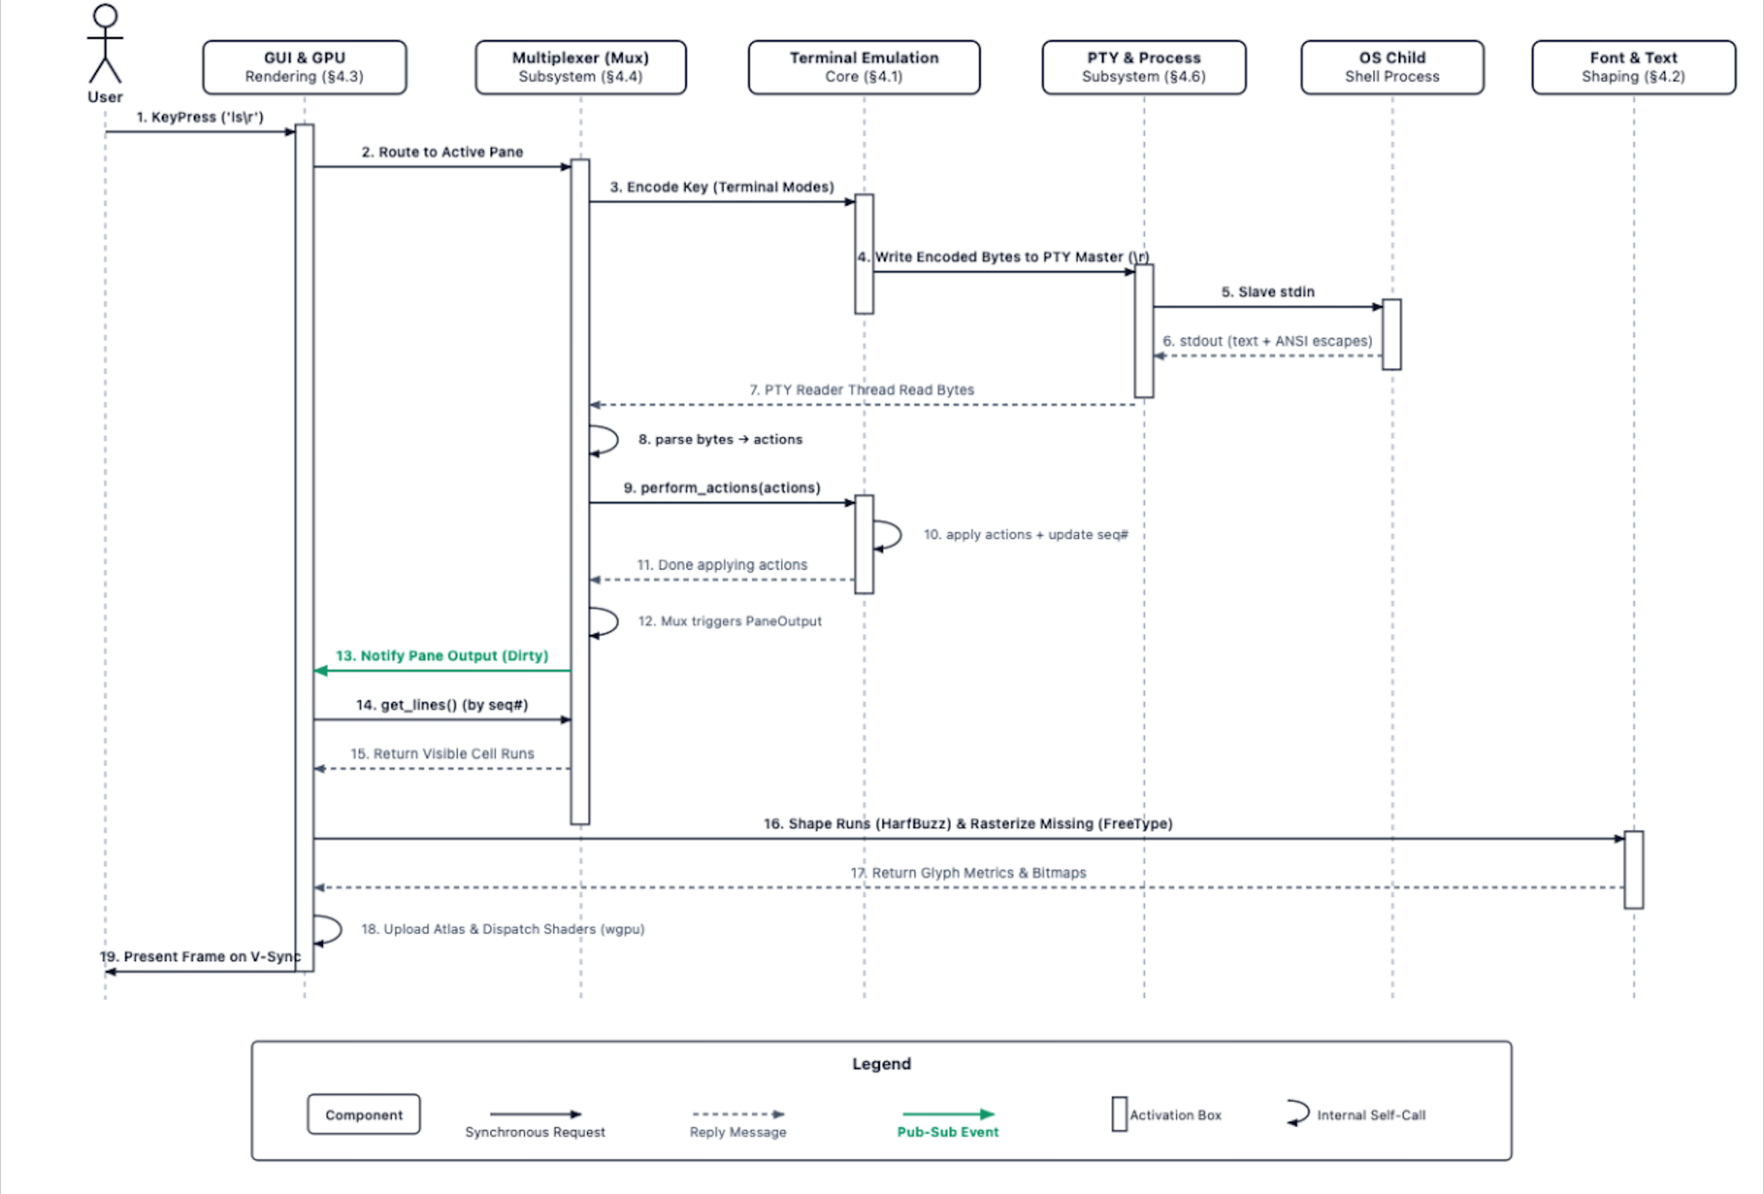
Use case 1: type a command, see the output
§5.1
Steps 1–6 · Input
Key → Mux → Terminal Core encodes → PTY → shell
Steps 7–13 · Output
Reader thread parses; Mux publishes PaneOutput
Steps 14–19 · Render
GUI pulls dirty lines, shapes them, draws the frame
Matches §3
Step 9 = perform_actions()
Step 13 = green PaneOutput
Notes:
[3:40 – 4:39] Use case 1: type a command, see the output
Use case one: you type ls and press Enter. Steps one to six are the input path. The GUI finds no shortcut and routes the key to the active pane in the Mux. The Terminal Core encodes it for the current terminal modes and writes it to the PTY, and the shell runs the command. Steps seven to thirteen are the output path. A reader thread in the Mux reads the bytes, parses them, and applies them to the Terminal Core, which bumps the sequence number of each changed line. The Mux then publishes PaneOutput, the green arrow. In steps fourteen to nineteen, the GUI fetches only the changed lines, shapes them and presents the frame. Every arrow maps to the box diagram: step nine is perform actions, step thirteen is the green arrow.

Slide 8
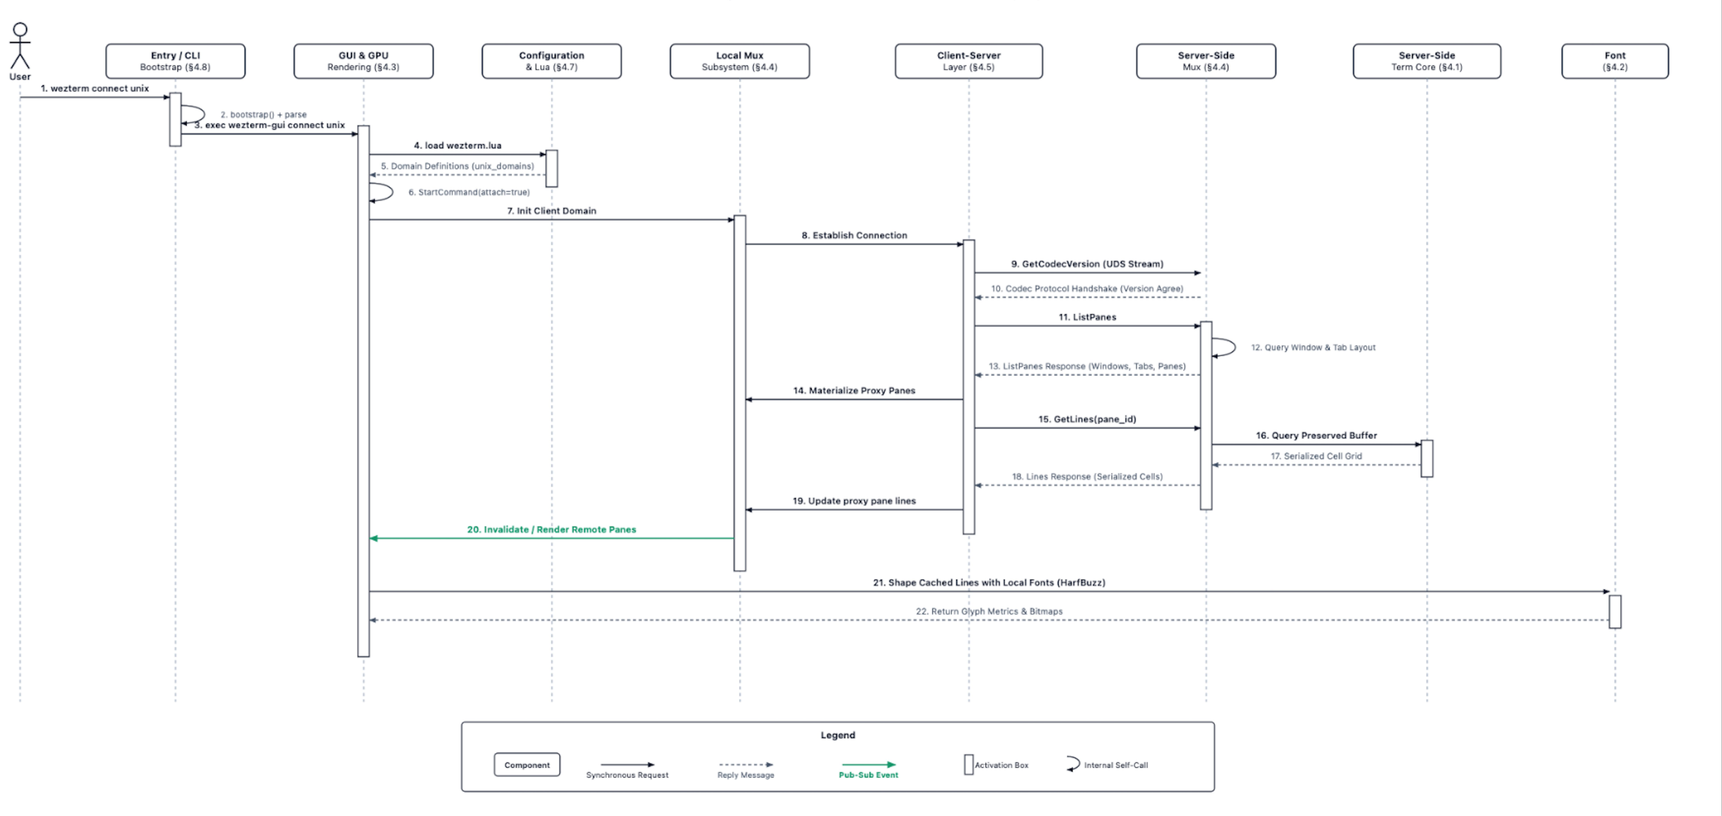
Use case 2: reconnect to a saved session
§5.2
1–7 Startup: load the unix domain
8–14 Handshake + proxy panes
15–22 Fetch lines + redraw
Notes:
[4:39 – 5:28] Use case 2: reconnect to a saved session
Use case two: reconnecting with wezterm connect unix. In steps one to seven, Entry hands the command to the GUI, which reads the unix domain from the configuration and creates a client domain in the local Mux. In steps eight to fourteen, the client agrees on a protocol version with the server, lists its panes, and builds matching proxy panes. They implement the same Pane interface, so the GUI doesn't know they're remote. In steps fifteen to twenty-two, the client fetches each pane's preserved lines as parsed cells, never raw bytes or pixels, and the same green notification as use case one triggers a redraw with the client's own fonts.

Slide 9


Style 1: client–server
§6.1
GUI (client)
proxy panes, local fonts
codec PDUs
wezterm-mux-server
real Terminals + PTYs
over Unix socket · SSH · TLS
Benefits
Costs
Sessions outlive the GUI
TLS domains reconnect after a dropped connection
Server needs no fonts or display
Remote keystrokes are a network round trip; local echo prediction adds complexity
SSH domains need a compatible WezTerm on the remote host
Notes:
[5:28 – 6:10] Style 1: client-server
Our first style is client-server. The service is session management: wezterm-mux-server owns the real terminals and PTYs, and the GUI connects as a client over a unix, SSH or TLS domain, all using one protocol. Use case two is this style end to end. The benefits: sessions outlive the GUI, TLS domains reconnect after a dropped connection, and the server never needs fonts or a display. The challenges: every remote keystroke is a network round trip, so local echo prediction adds complexity, and an SSH domain needs a compatible WezTerm on the remote host.

Slide 10
Style 2: implicit invocation (pub-sub)
§6.2
Mux
publisher
PaneOutput
GUI
subscriber
Same idea in Lua
wezterm.on(event, fn)
get_lines()
Benefits
Costs
Mux independent of GUI → headless server
No polling: redraw only on change
Extend via Lua, no Rust changes
Control flow harder to trace (needed a new arrow type)
A handler returning false skips later ones
Reloading the config clears every handler
Notes:
[6:10 – 6:49] Style 2: implicit invocation (publish-subscribe)
Our second style is implicit invocation, or publish-subscribe: a component announces an event without knowing who responds. WezTerm uses it at two levels. The Mux announces that a pane changed and the GUI pulls the changed lines, and Lua scripts register callbacks with wezterm dot on. The benefits: the Mux doesn't depend on the GUI, nothing polls, and users extend WezTerm without changing Rust. The challenges: control flow is harder to trace, and a handler that returns false skips later ones, so one script can silently override another.

Slide 11
Alternatives we discarded
§7
GUI owns all sessions
rejected
Direct calls or polling
rejected
instead of client–server
instead of pub-sub
Gains
Gains
Fewer processes
No protocol, versioning or proxy panes
Direct calls easy to follow
Polling simple to reason about
Loses
Loses
Sessions end when the window closes
Remote multiplexing much harder
Reconnecting (UC2) much harder
Direct calls couple Mux to renderer: no headless server
Polling wastes work and delays redraws
Verdict: each would simplify one part but give up a benefit of the chosen styles
Notes:
[6:49 – 7:33] Alternatives we discarded
We discarded two alternatives. First, the GUI could own every session, PTY and shell directly. That's simpler, with fewer processes and no protocol or proxy panes, but sessions would end when the window closed, and reconnecting, use case two, would be much harder. Second, the Mux could call the GUI directly, or the GUI could poll every pane. Direct calls are easy to follow but couple the Mux to the renderer and rule out a headless server. Polling wastes work on unchanged panes and delays redraws. Each would simplify one part but give up a benefit of the chosen styles.

Slide 12

Limitations and lessons learned
§9
Limitations
Lessons learned
Derived from docs and crate layout, not verified source; A2's reflexion analysis will test it
Two use cases leave paths untraced (SSH setup, config reload)
AI share (~15%) is an estimate from phase weights, not measured
Trace behaviour first: our early §3 text had the GUI polling until the UC1 diagram showed the notification
Small diagram changes ripple: step numbers are shared references
Crates ≠ architecture: group by responsibility, not folder
Six writers need one vocabulary, taken from the final diagram
Notes:
[7:33 – 8:18] Limitations and lessons learned
Two limitations first. Our architecture comes from documentation and the repository layout, not verified source code; A2 will test it. And two use cases leave paths untraced, like SSH setup and configuration reload. Now our lessons. Trace behaviour before describing structure: our early section three text had the GUI polling the Mux, until the merge review compared it with the use case one diagram, which shows the notification. Small diagram changes ripple, so step numbers became shared references. Crates are not the architecture; we grouped by responsibility, not folder. And six writers need one vocabulary, taken from the final diagram.

Slide 13




Our AI teammate
App. D
~15%
about 1/7 of the project, or slightly higher
Selection
Claude Opus 5.5 (5 members): long inputs, code structure, images · ChatGPT (Rahul): explanation, brainstorming
Tasks
Explain subsystems · check diagrams vs write-ups · revise to final diagrams · find merge inconsistencies
Protocol
Our own material + one specific question; every session logged in Discord with one template
0.3×25% + 0.5×5% + 0.2×30% ≈ 16%
Humans ~85%, shared evenly across six members. The AI made no architecture decisions.
Validation
Nothing used until checked against wezterm.org or the repo; owners confirmed every fix
Notes:
[8:18 – 9:02] Our AI teammate
Our AI teammate. Five of us used Claude Opus 5.5 for long inputs, code structure and reading diagram images; Rahul used ChatGPT for explanation and brainstorming. It had four tasks, none involving architecture decisions: explaining subsystems, checking diagrams against our write-ups, revising sections to match the final diagrams, and finding inconsistencies during the merge. Every prompt carried our own material and one specific question, every session was logged, and nothing was used until checked against wezterm.org or the repository. Weighted by phase, it contributed about fifteen percent. It was most valuable as a reviewer, not a source of content.

Slide 14
Conclusion
› Mux at the centre: one Pane interface for local and remote sessions
› Client–server: sessions outlive the window that shows them
› Publish–subscribe: the Mux reports output without depending on the renderer
Trade-off: simplicity for capability. Control flow is harder to trace, and remote typing depends on latency.
TheZucks
Thank you · report, slides and video on our group website
$ exit
Notes:
[9:02 – 9:23] Conclusion
To conclude: WezTerm is organized around the Multiplexer. One Pane interface treats local and remote sessions alike, the client-server split lets sessions outlive the window, and publish-subscribe lets the Mux report output without depending on the renderer. The design trades simplicity for capability. Thanks for watching.

