Slide 1
Engineering Mechanics I
Addis Ababa Science and Technology University
Animut.A

Slide 2
1.1 Introduction
Mechanics is an area of science concerned with the behavior of physical bodies when subjected to forces or displacement.
Translation
Rotation

Slide 3
1.1 Introduction
What is mechanics and its application Engineering science?
Mechanics is the physical science which deals with the effects of forces on objects. It is divided into three parts:
      mechanics of rigid bodies,
      mechanics of deformable bodies, and
      mechanics of fluids.
      Mechanics of rigid bodies includes
      Statics
      Dynamics
.
Notes:
Good morning?
Today we will see, …
we will begin with brainstorming questions that such as:…
How could define …?
Why it is important to …?

Slide 4
1.2 Basic Concepts
The following definition and concepts are basic to the study of mechanics.
Space: geometric region occupied by bodies
Time: the measure of the succession of events
Mass: measure of inertia of a body. Mass can also be thought of as the quantity of matter in a body
Force: the action of one body on other. It tends to move a body in its direction of action
Particle: a body of negligible dimensions
Rigid body: a body is considered rigid when the change in distance between any two of its points is negligible.

Slide 5
Fundamental Principles
The three laws of newton
First law: a particle remain at rest or continues to move in a straight line with a uniform velocity if there is no unbalanced force acting on it
Second law: the acceleration of a particle is proportional to the resultant force acting on it and its in the direction of this resultant force
Third law: the forces of action and reaction of interacting are equal in magnitude, opposite in direction and collinear

Slide 6
1.3 Scalars and Vectors
What is a Scalar quantities?
have only magnitude.
What is a Vector quantities ?
have both magnitude and direction

Slide 7
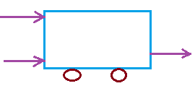

Types of Vectors
Free Vectors:
(not confined or associated with a unique line)
Sliding Vectors:
have unique line in space

Slide 8
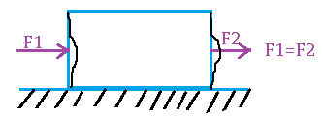
Types of Vector
3) Fixed Vectors:
(unique and well-defined point of application)

Slide 9
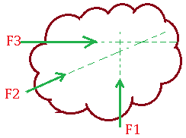
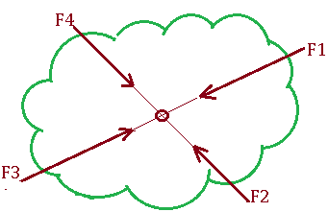
Classification of Vector
Based on coexistence of vector
Concurrent vector:- the line of action of the vector meet at one point.
concurrent non concurrent

Slide 10
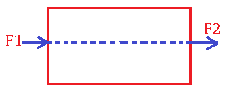
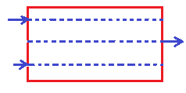
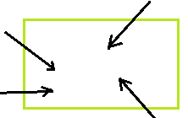
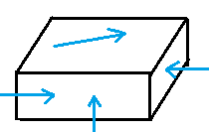
Classification of Vector
Collinear vectors:- all of the line of actions of them are parallel.
linear non linear
Coplanar vectors:- lines of action of the vectors lie on the same plane. Any two vectors are coplanar
Space vectors:-

Slide 11
Representation of Vector
Graphical representation
Head
Length of the line segment
Tail

Slide 12

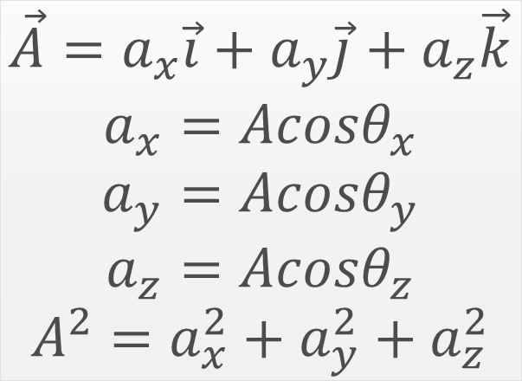



Representation of Vector
B. Algebraic (Arithmetic) representation
represented by the components of the vector
$$\vec{A}=a_{x}\vec{i}+a_{y}\vec{j}+a_{z}\vec{k}$$
$$a_{x}=Acosθ_{x}$$
$$a_{y}=Acosθ_{y}$$
$$a_{z}=Acosθ_{z}$$
$$A^{2}=a_{x}^{2}+a_{y}^{2}+a_{z}^{2}$$
z
$$\vec{A}$$
$$a_{z}$$
y
$$a_{x}$$
$$a_{y}$$
x

Slide 13

Properties of Vectors
Equality of vectors:
have the same magnitude and direction
The Negative of a vector:
equal magnitude but opposite in direction.
$$\vec{A}=\vec{B}=\vec{C}$$
A
B
C
A
-A

Slide 14
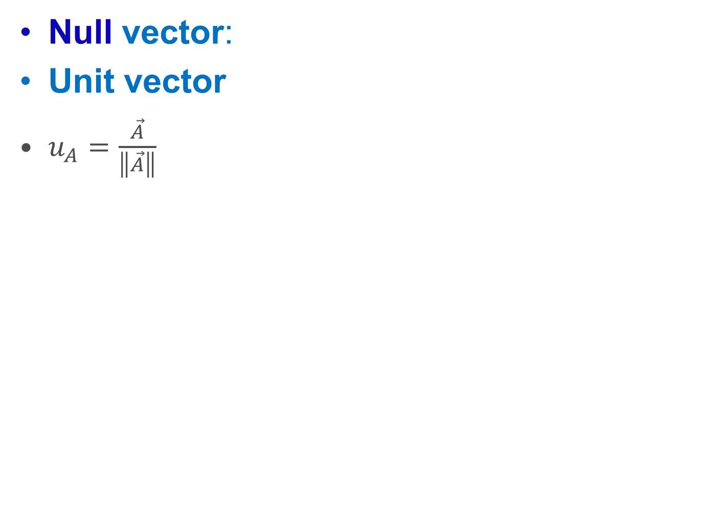
Properties of Vector
Null vector:
Unit vector
$u_{A}=\frac{\vec{A}}{\left\|\vec{A}\right\|}$

Slide 15
1.4 Operation With Vectors
Vector Addition or Composition
A. Graphical Method
B. Analytical Method

Slide 16






1.4 Operation With Vectors
A. Graphical Method
The parallelogram law
$$\vec{R}$$
$$\vec{A}$$
$$\vec{A}$$
$$\vec{R}=\vec{A}+\vec{B}$$
$$\vec{B}$$
$$\vec{B}$$

Slide 17
1.4 Operation With Vectors
II. The Triangle rule
$$\vec{R}$$
$$\vec{A}$$
$$\vec{A}$$
$$\vec{R}=\vec{A}+\vec{B}$$
$$\vec{B}$$
$$\vec{B}$$

Slide 18
1.4 Operation With Vectors
B. Analytic method
Trigonometric rules
applying the cosine and the sine rules.

Slide 19



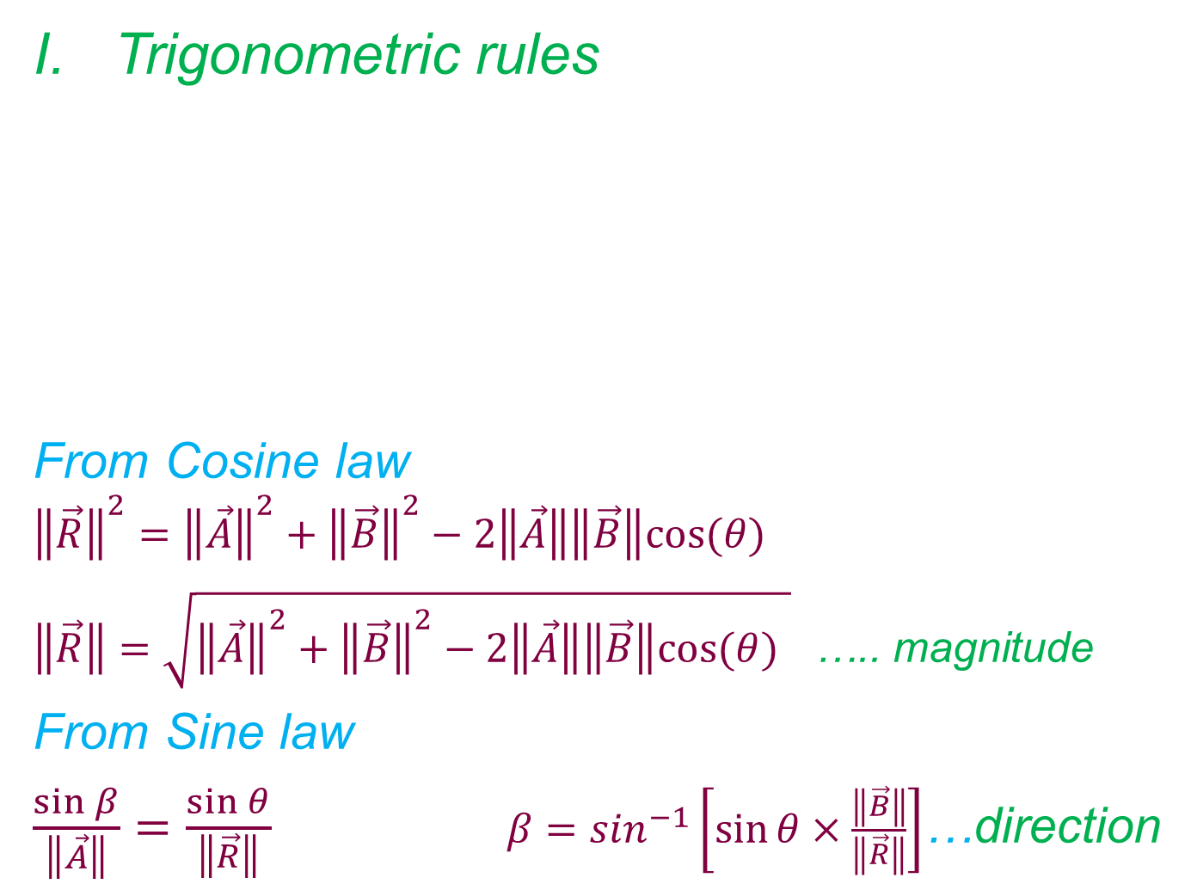





1.4 Operation With Vectors
Trigonometric rules
From Cosine law
$${\left\|\vec{R}\right\|}^{2}={\left\|\vec{A}\right\|}^{2}+{\left\|\vec{B}\right\|}^{2}−2\left\|\vec{A}\right\|\left\|\vec{B}\right\|cos⁡(θ)$$
$\left\|\vec{R}\right\|=\sqrt{{\left\|\vec{A}\right\|}^{2}+{\left\|\vec{B}\right\|}^{2}−2\left\|\vec{A}\right\|\left\|\vec{B}\right\|cos⁡(θ) }$ ….. magnitude
From Sine law
$\frac{\sin{β}}{\left\|\vec{A}\right\|}=\frac{\sin{θ}}{\left\|\vec{R}\right\|}$ $β=\sin^{−1}\left[\sin{θ×\frac{\left\|\vec{B}\right\|}{\left\|\vec{R}\right\|}}\right]$…direction
$$\vec{B}$$
$$\vec{R}$$
$$\vec{A}$$
$$\vec{A}$$
$$θ$$
$$α$$
$$β$$
$$\vec{B}$$

Slide 20
1.4 Operation With Vectors
II. Component Method of Vector Addition

Slide 21
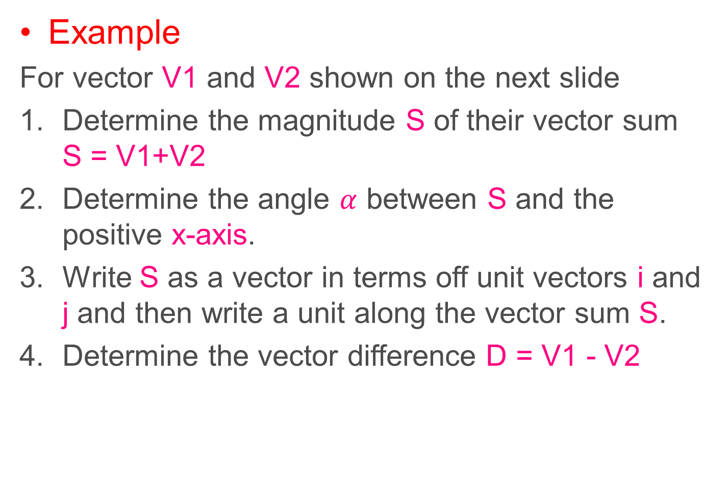
1.4 Operation With Vectors
Example
For vector V1 and V2 shown on the next slide
Determine the magnitude S of their vector sum S = V1+V2
Determine the angle $α$ between S and the positive x-axis.
Write S as a vector in terms off unit vectors i and j and then write a unit along the vector sum S.
Determine the vector difference D = V1 - V2

Slide 22
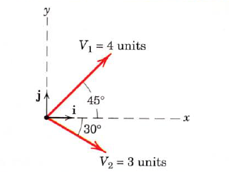
1.4 Operation With Vectors
Example cont..

Slide 23
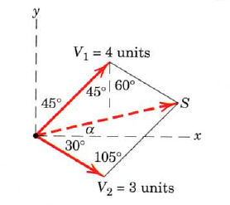
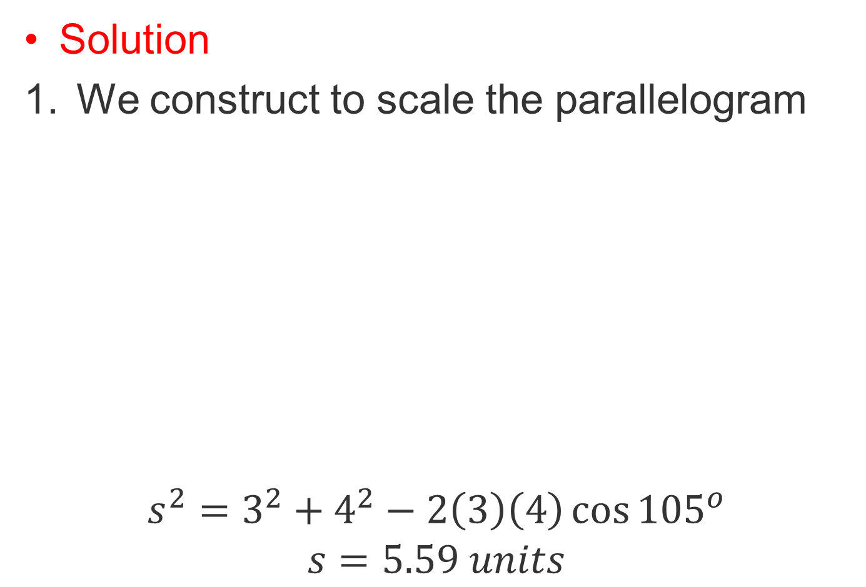
1.4 Operation With Vectors
Solution
We construct to scale the parallelogram
$$s^{2}=3^{2}+4^{2}−2\left(3\right)\left(4\right)\cos{{105}^{o}}$$
$$s=5.59 units$$

Slide 24
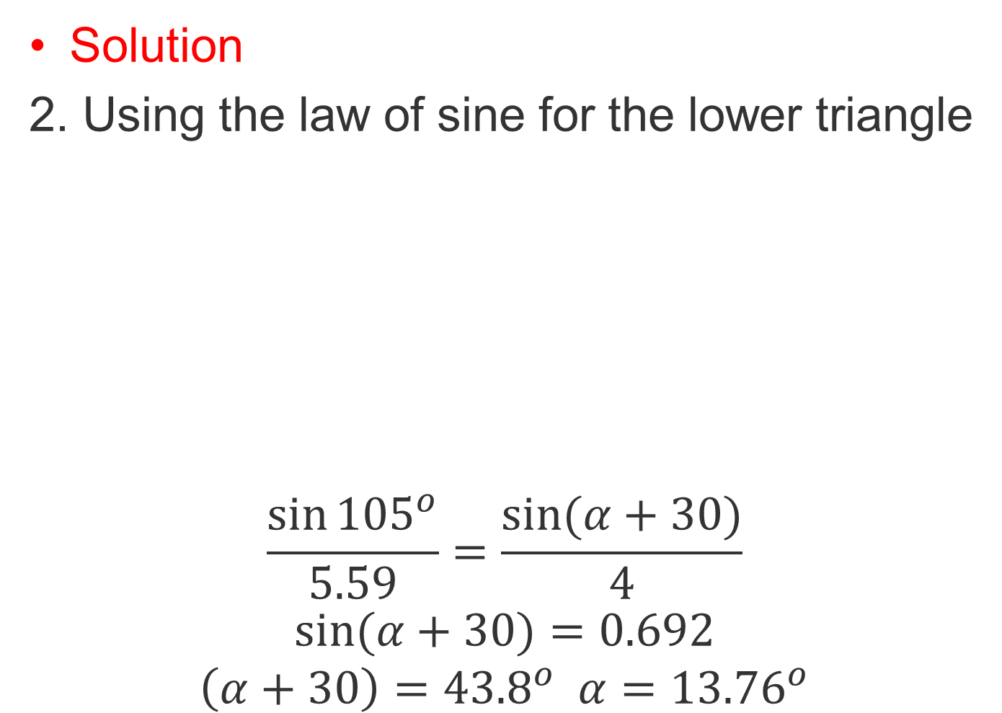
1.4 Operation With Vectors
Solution
2. Using the law of sine for the lower triangle
$$\frac{\sin{{105}^{o}}}{5.59}=\frac{\sin{(α+30)}}{4}$$
$$\sin{(α+30)}=0.692$$
$$\left(α+30\right)={43.8}^{o} α={13.76}^{o}$$

Slide 25
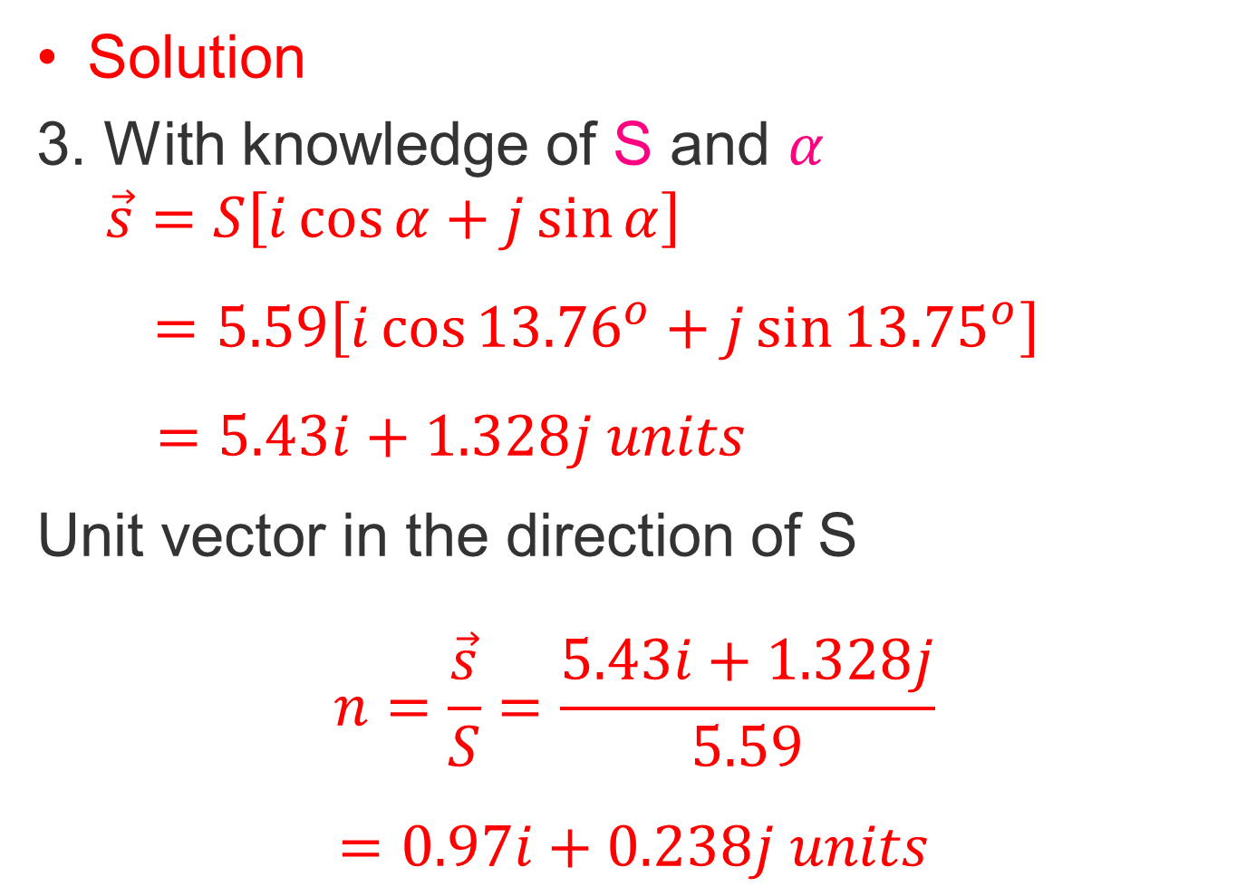
1.4 Operation With Vectors
Solution
3. With knowledge of S and $α$
$$\vec{s}=S\left[i\cos{α}+j\sin{α}\right]$$
$=5.59\left[i\cos{{13.76}^{o}}+j\sin{{13.75}^{o}}\right]$
$$=5.43i+1.328j units$$
Unit vector in the direction of S
$$n=\frac{\vec{s}}{S}=\frac{5.43i+1.328j}{5.59}$$
$$=0.97i+0.238j units$$

Slide 26
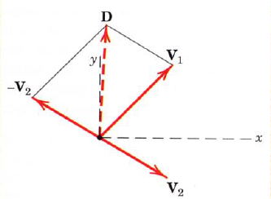
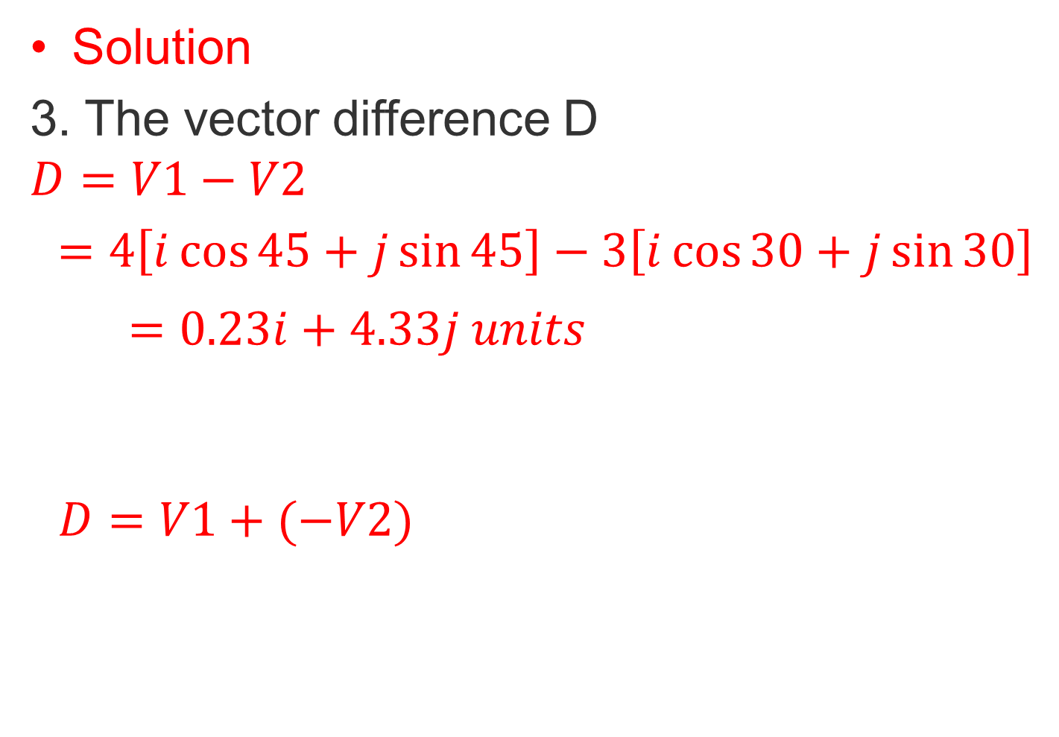
1.4 Operation With Vectors
Solution
3. The vector difference D
$$D=V1−V2$$
$=4\left[i\cos{45}+j\sin{45}\right]−3\left[i\cos{30}+j\sin{30}\right]$
$$=0.23i+4.33j units$$
$$D=V1+(−V2)$$

Slide 27
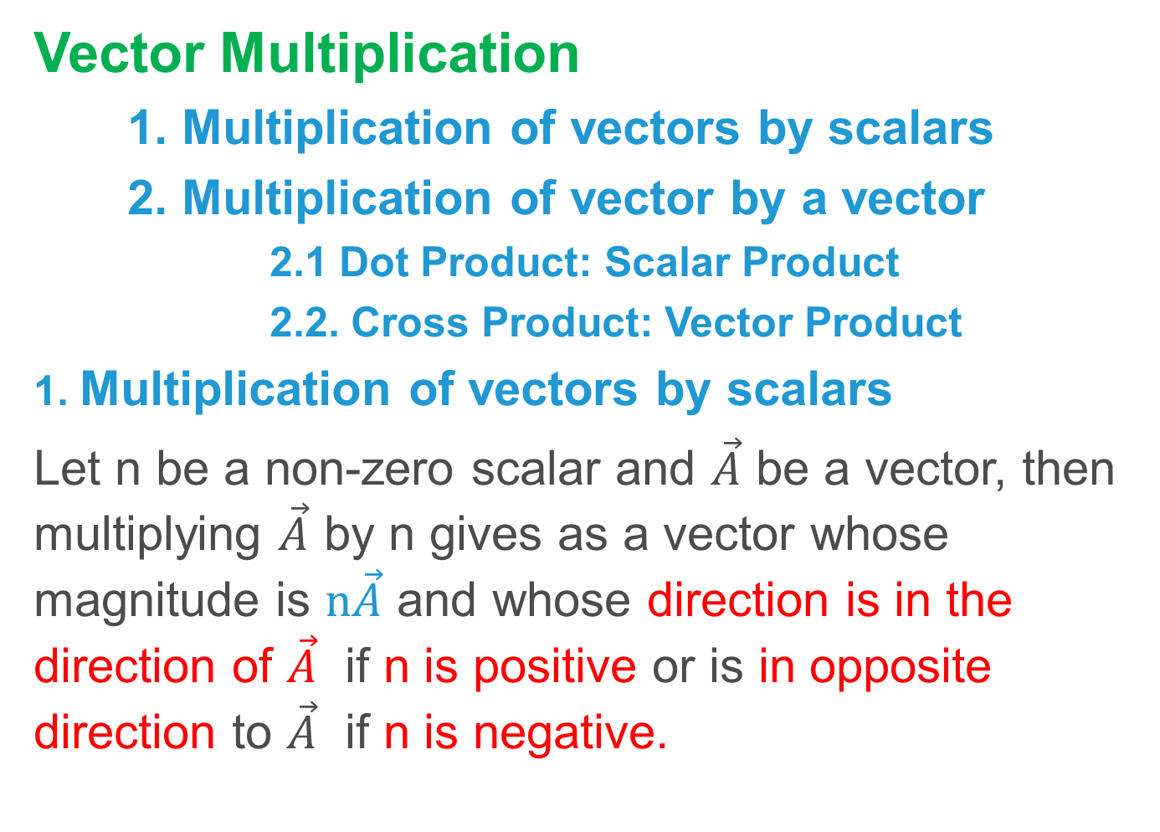
1.4 Operation With Vectors
Vector Multiplication
1. Multiplication of vectors by scalars
2. Multiplication of vector by a vector
2.1 Dot Product: Scalar Product
2.2. Cross Product: Vector Product
1. Multiplication of vectors by scalars
Let n be a non-zero scalar and $\vec{A}$ be a vector, then multiplying $\vec{A}$ by n gives as a vector whose magnitude is $n\vec{A}$ and whose direction is in the direction of $\vec{A}$ if n is positive or is in opposite direction to $\vec{A}$ if n is negative.

Slide 28
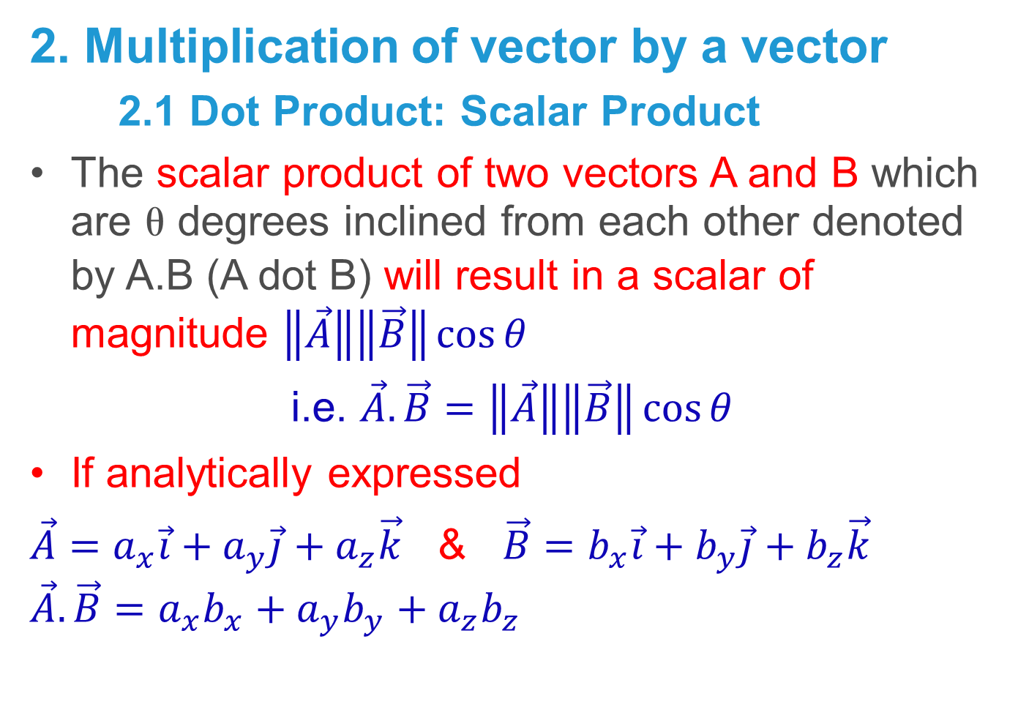
1.4 Operation With Vectors
2. Multiplication of vector by a vector
2.1 Dot Product: Scalar Product
The scalar product of two vectors A and B which are  degrees inclined from each other denoted by A.B (A dot B) will result in a scalar of magnitude $\left\|\vec{A}\right\|\left\|\vec{B}\right\|\cos{θ}$
i.e. $\vec{A}.\vec{B}=\left\|\vec{A}\right\|\left\|\vec{B}\right\|\cos{θ}$
If analytically expressed
$\vec{A}=a_{x}\vec{i}+a_{y}\vec{j}+a_{z}\vec{k}$ & $\vec{B}=b_{x}\vec{i}+b_{y}\vec{j}+b_{z}\vec{k}$
$$\vec{A}.\vec{B}=a_{x}b_{x}+a_{y}{b_{y}+a}_{z}b_{z}$$

Slide 29
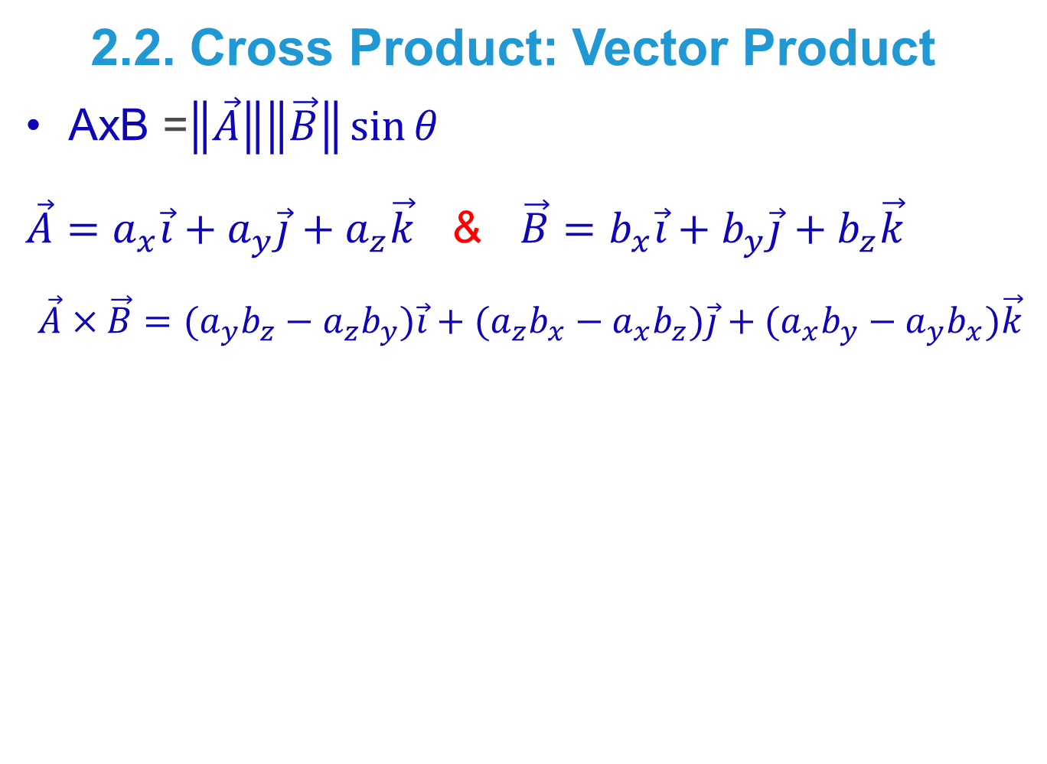
1.4 Operation With Vectors
2.2. Cross Product: Vector Product
AxB =$\left\|\vec{A}\right\|\left\|\vec{B}\right\|\sin{θ}$
$\vec{A}=a_{x}\vec{i}+a_{y}\vec{j}+a_{z}\vec{k}$ & $\vec{B}=b_{x}\vec{i}+b_{y}\vec{j}+b_{z}\vec{k}$
$$\vec{A}×\vec{B}={(a}_{y}b_{z}−a_{z}b_{y})\vec{i}+{(a}_{z}{b_{x}−a_{x}b_{z})\vec{j}+(a}_{x}b_{y}−a_{y}b_{x})\vec{k}$$

Slide 30
Thank You

