Slide 1

Force System
Addis Ababa Science and Technology University
Chapter Two
Engineering Mechanics

Slide 2

2.1 Introduction
What is a force?
A force can be defined as the action of one body on another that changes/tends to changes the state of the body acted on.
Types of forces
Contact force
Remote action (Body force)
Concentrated
Distributed
internal (strain & stress)
external (applied & reactive)
Collinear forces
Concurrent forces
General forces

Slide 3
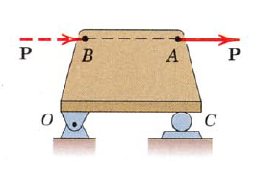
2.1 Introduction
Principle of Transmissibility
It is not necessary to restrict the action of an applied force to a given point.

Slide 4
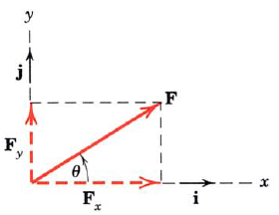
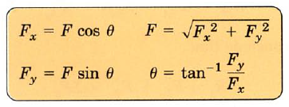

2.2.1. Resolution of a Force
Rectangular Component
The most common two-dimensional resolution
Rectangular components of a force are the components of the force along the rectangular coordinate axes.

Slide 5
2.2.2. Non-Coplanar Force Systems (3-D)
Many problems in mechanics requires analysis in 3 dimension
A force F in 3-d system has a rectangular components Fx, Fy, Fz

Slide 6
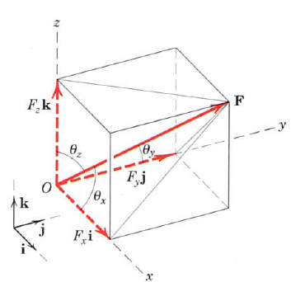
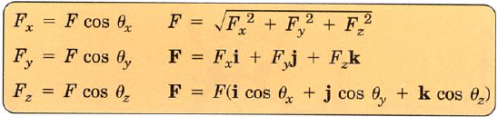
Rectangular Components

Slide 7
Direction of force
A. By two points on the line of action of the force, or
B. By two angles which orient the line of action.

Slide 8
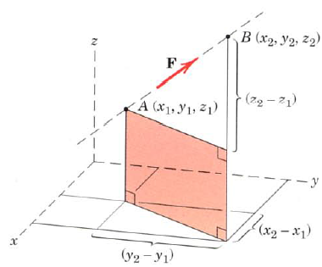

Cont…..
A. By two points on the line of action of the force

Slide 9
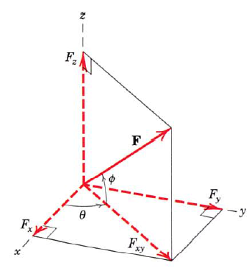


Contd……………….
B. By two angles which orient the line of action.

Slide 10
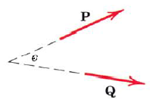
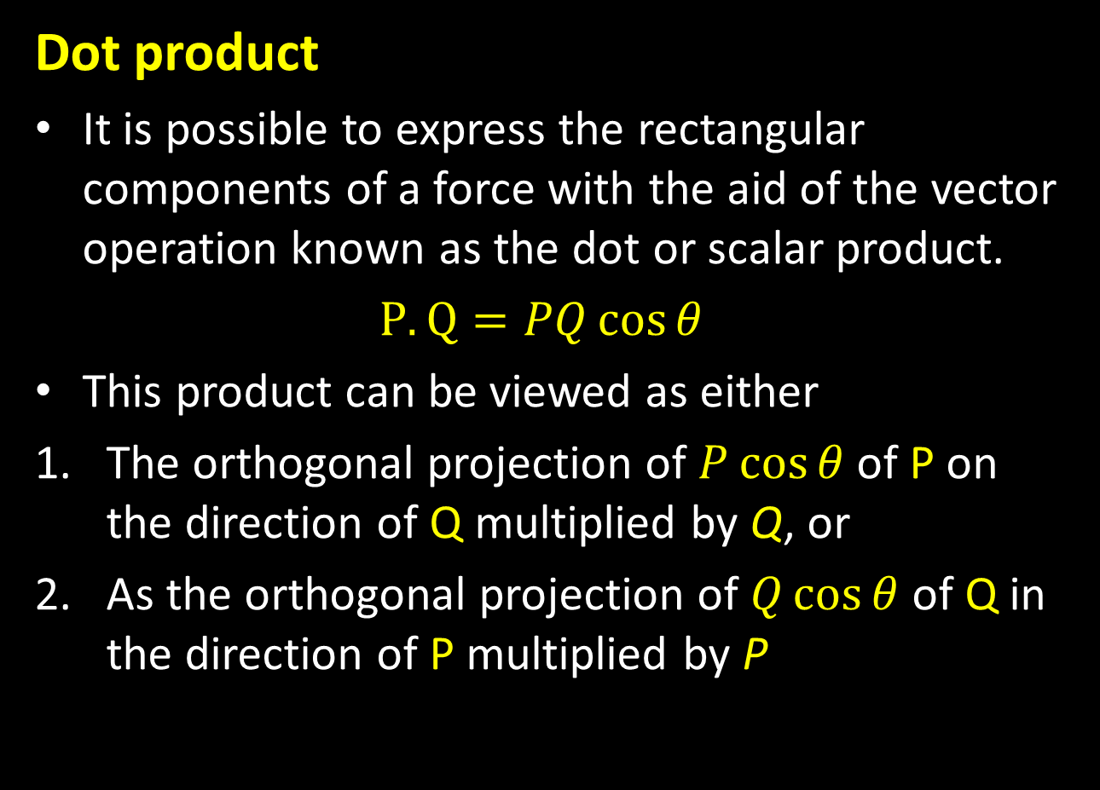
Rectangular Components
Dot product
It is possible to express the rectangular components of a force with the aid of the vector operation known as the dot or scalar product.
$P.Q=PQ\cos{θ}$
This product can be viewed as either
The orthogonal projection of $P\cos{θ}$ of P on the direction of Q multiplied by Q, or
As the orthogonal projection of $Q\cos{θ}$of Q in the direction of P multiplied by P

Slide 11
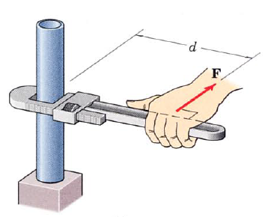
2.3. Moment, Couple & Force-Couple systems
What is a Moment?
tendency of a force to rotate or
rotational tendency of a force
magnitude of moment can be obtained by:
M = F x d

Slide 12
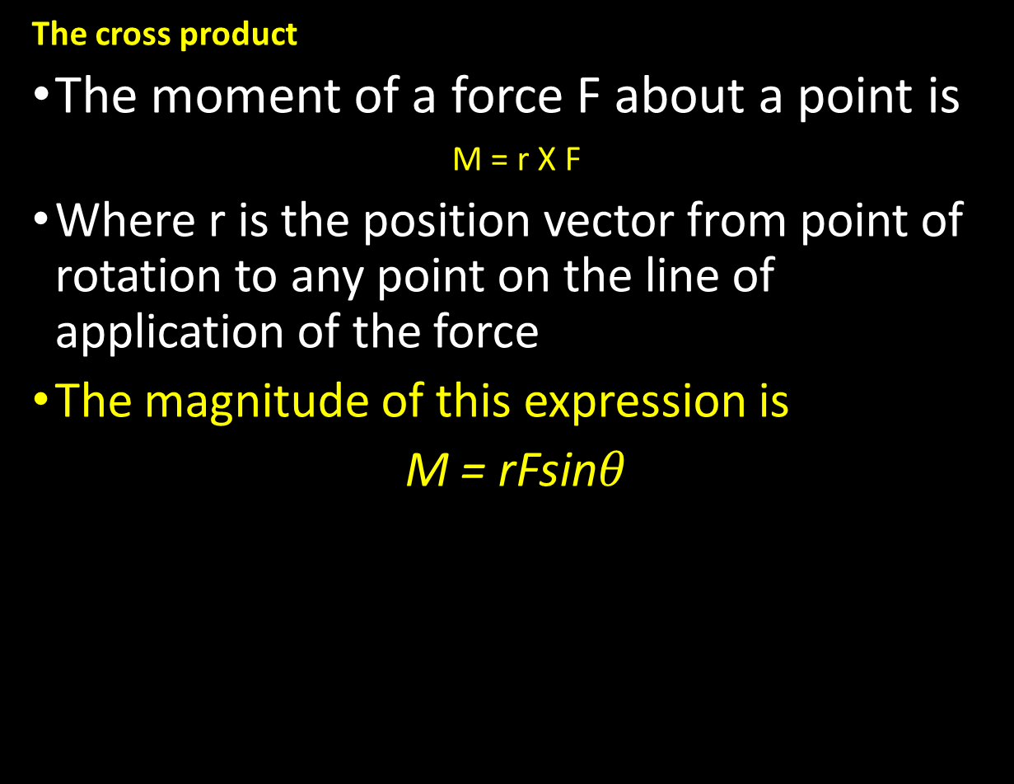
Moment
The cross product
The moment of a force F about a point is
M = r X F
Where r is the position vector from point of rotation to any point on the line of application of the force
The magnitude of this expression is
M = rFsin$θ$

Slide 13


Moment
Varignon's theorem
One of the most important principles in mechanics
states “the moment of a force about any point is equal to the sum of the moments of the components of the force about the same point.”

Slide 14
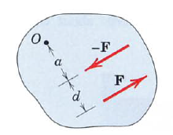
Couple
The moment produced by two equal and opposite and non-collinear forces
These two forces can’t be combined in to a single force of the same effect on the body, as their sum in every direction is zero
Their only effect is to create a tendency of rotation

Slide 15
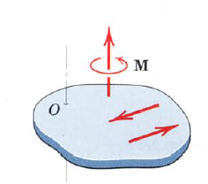
Couple
The combined moment of the two forces about an axis normal to their plane and passing through any point such as o in their plane is the couple, M.

Slide 16
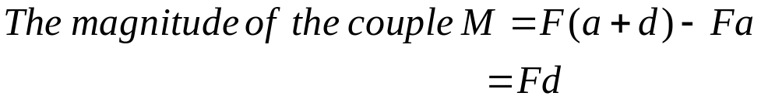
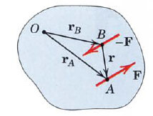
Couple

Slide 17
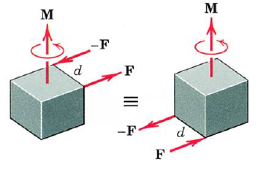
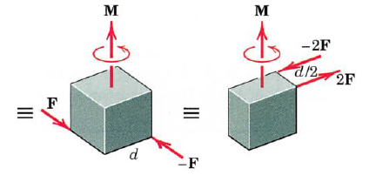
Couple
Equivalent Couples
Changing the value of F and d does not change a given couple as long as the product Fad remains the same.
Likewise, a couple is not affected if the forces act in a different but parallel plane.

Slide 18
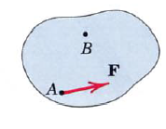
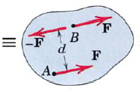
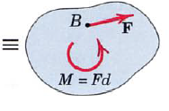
Force-Couple System
The effect of a force on a body is the tendency to push or pull and to rotate the body.
The representation of this dual effect can be facilitated by replacing the given force by an equal and parallel force and a couple to compensate for the change in the moment of the forces.

Slide 19
2.3.2. Moment and Couple 3-D
Moments in three dimensions
In two dimensional analysis it is convenient to use the moment arm rule (M=Fd)
However, In three dimensions, the determination of the perpendicular distance between a point or line and the line of action of the force can be a tedious computation.
In such cases the use of a vector approach with cross-product multiplication becomes advantageous

Slide 20
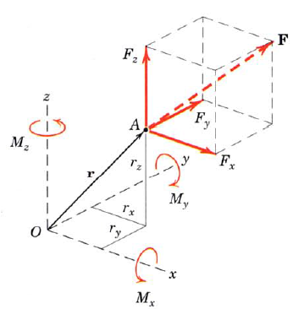

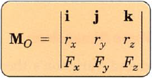
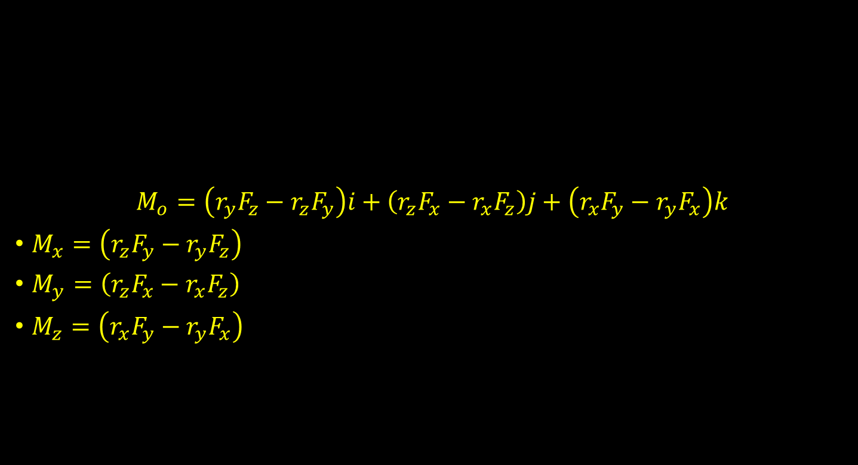
Cross product
$$M_{o}=\left(r_{y}F_{z}−r_{z}F_{y}\right)i+\left(r_{z}F_{x}−r_{x}F_{z}\right)j+\left(r_{x}F_{y}−r_{y}F_{x}\right)k$$
$M_{x}=\left(r_{z}F_{y}−r_{y}F_{z}\right)$
$M_{y}=\left(r_{z}F_{x}−r_{x}F_{z}\right)$
$M_{z}=\left(r_{x}F_{y}−r_{y}F_{x}\right)$

Slide 21
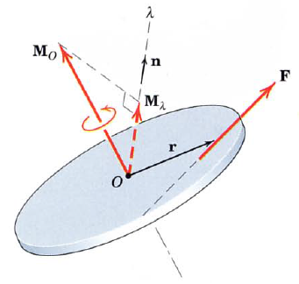
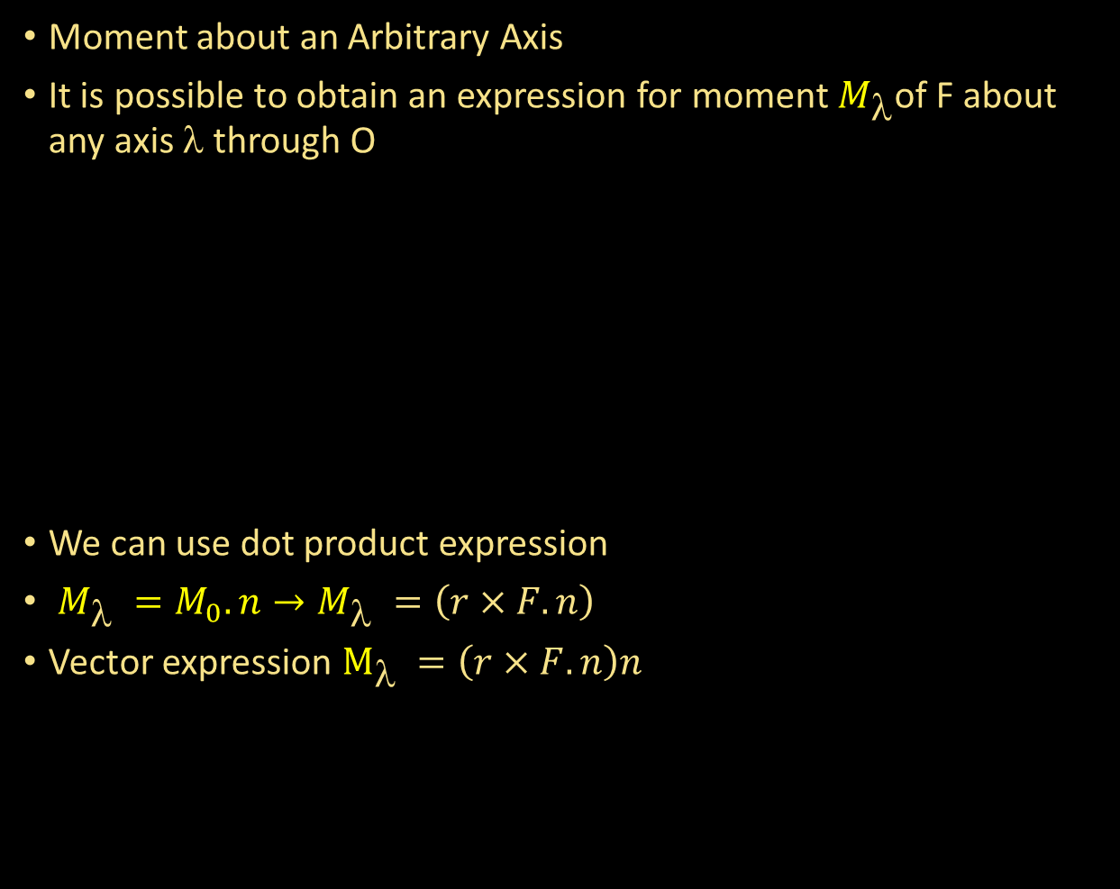
2.3.2. Moment and Couple 3-D
Moment about an Arbitrary Axis
It is possible to obtain an expression for moment $M_{\text{λ}}$of F about any axis λ through O
We can use dot product expression
$M_{\text{λ} }=M_{0}.n→M_{\text{λ} }=\left(r×F.n\right)$
Vector expression $M_{\text{λ} }=\left(r×F.n\right)n$

Slide 22
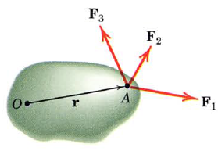

2.3.2. Moment and Couple 3-D
Varignon's theorem
Varignon's theorem introduced in two-dimension can be easily extended to three dimensions.

Slide 23
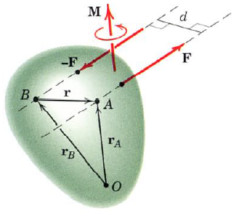
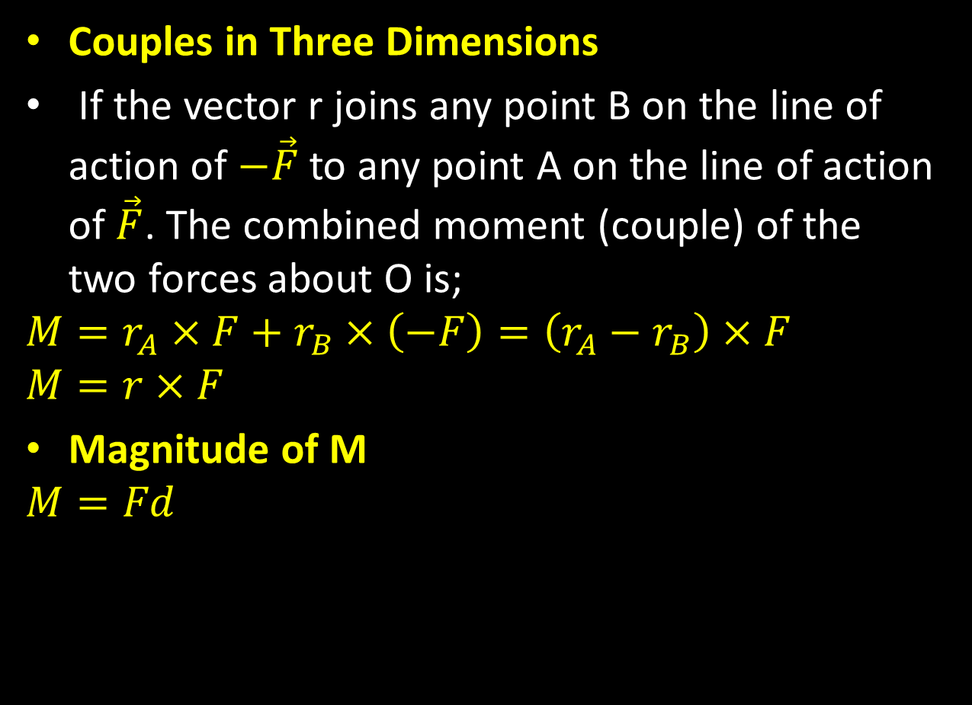
2.3.2. Moment and Couple 3-D
Couples in Three Dimensions
If the vector r joins any point B on the line of action of $−\vec{F}$ to any point A on the line of action of $\vec{F}$. The combined moment (couple) of the two forces about O is;
$$M=r_{A}×F+r_{B}×\left(−F\right)=\left(r_{A}−r_{B}\right)×F$$
$$M=r×F$$
Magnitude of M
$$M=Fd$$

Slide 24
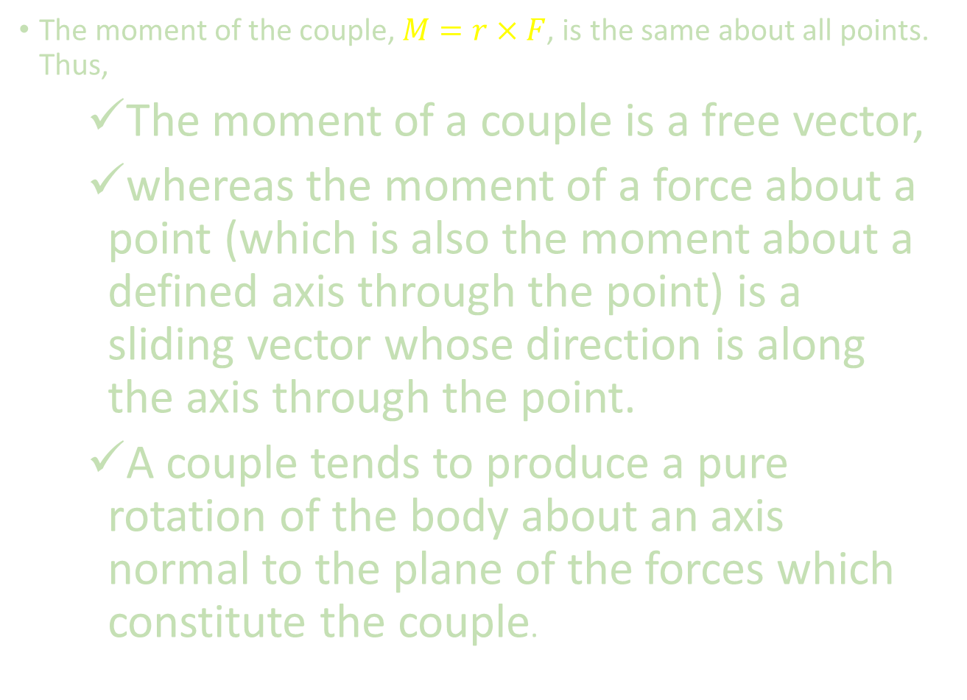
2.3.2. Moment and Couple 3-D
The moment of the couple, $M=r×F$, is the same about all points. Thus,
The moment of a couple is a free vector,
whereas the moment of a force about a point (which is also the moment about a defined axis through the point) is a sliding vector whose direction is along the axis through the point.
A couple tends to produce a pure rotation of the body about an axis normal to the plane of the forces which constitute the couple.

Slide 25
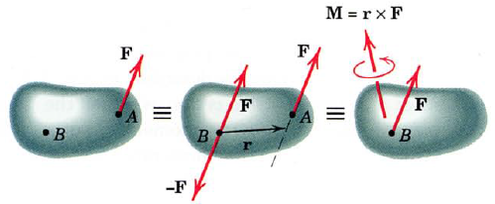
2.3.2. Moment and Couple 3-D
Force-Couple System
It is possible to carry out replacement of a force by its equivalent force-couple system in three dimensions.

Slide 26
2.4. Resultants
The resultant of a force system is the simplest force combination that can replace the original forces without altering the external effect of the system on the rigid body to which the forces are applied.
The equilibrium of a body is the condition where the resultant if all forces that act on it is zero.

Slide 27
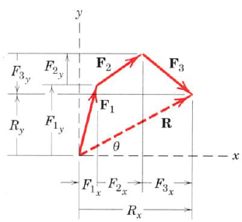
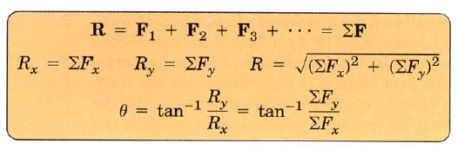
2.4. Resultants
The resultant can be computed by using the parallelogram rule or using analytical methods.

Slide 28
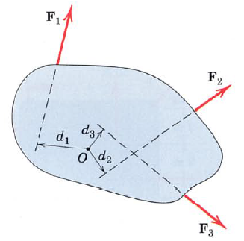
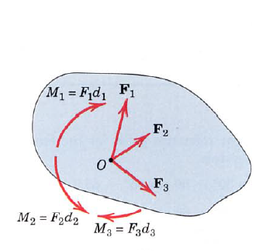
2.4. Resultants
The algebraic method can be used to obtain the resultant force and its line of action.
Steps
1. Choose a convenient reference point and move all forces to that point. Also determine the couple resulting from the transfer of forces.

Slide 29
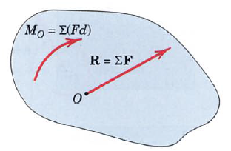
2.4. Resultants (2D)
2. Add all forces at the point chosen to form the resultant force R and add all the couples to form the resultant couple M. Then the single force-couple system can be obtained.

Slide 30
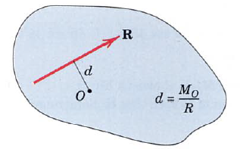
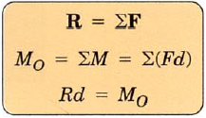
2.4. Resultants
3. The line of action of the resultant force R can be obtained by determining the arm distance d required to create the moment M

Slide 31

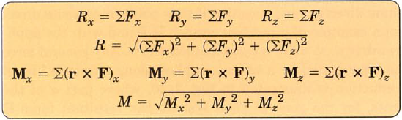
2.4. Resultants
The resultant of a force system is the simplest force combination
Any system of forces may be replaced by its resultant force R and the resultant couple M
The magnitude of the resultants and their components are

Slide 32
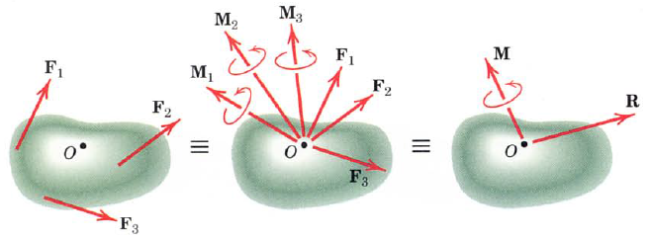
2.4. Resultants
The point O selected as the point of concurrency for the force is arbitrary
The magnitude and direction of M depend on the particular point O selected
However the magnitude and direction of R are the same no matter which point is selected.

Slide 33
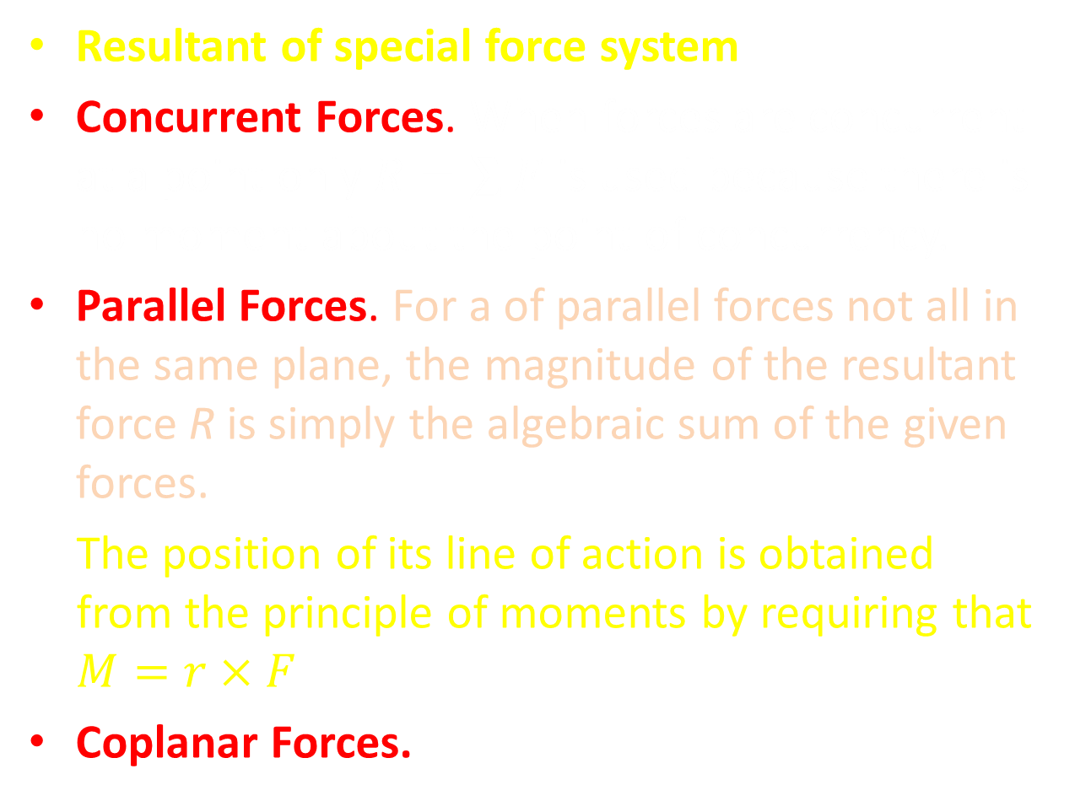
2.4. Resultants
Resultant of special force system
Concurrent Forces. When forces are concurrent at a point only $R=\sum{F}$ is used because there is no moment about the point of concurrency.
Parallel Forces. For a of parallel forces not all in the same plane, the magnitude of the resultant force R is simply the algebraic sum of the given forces.
The position of its line of action is obtained from the principle of moments by requiring that $M=r×F$
Coplanar Forces.
Notes:
Not all in the zam

Slide 34
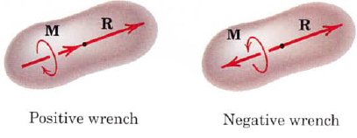
2.4. Resultants
Wrench Resultant. When the resultant couple vector is parallel to the resultant force R the resultant is called a wrench.

Slide 35
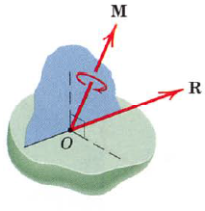
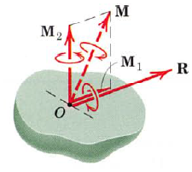
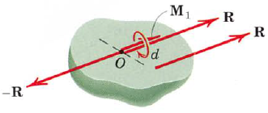
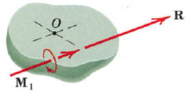
2.4. Resultants
Any general force system may be represented by a wrench applied along a unique line of action.

Slide 36
Thank you

