Slide 1

Equilibrium
Engineering mechanics

Slide 2

Equilibrium
3.1. Introduction
A body is said to be in equilibrium when the resultant of all the forces acting on it is zero

Slide 3

System Isolation and the Free Body Diagram
Free Body Diagram (FBD)
A mechanical system is defined as a body or group of bodies that can be conceptually isolated from all other bodies

Slide 4
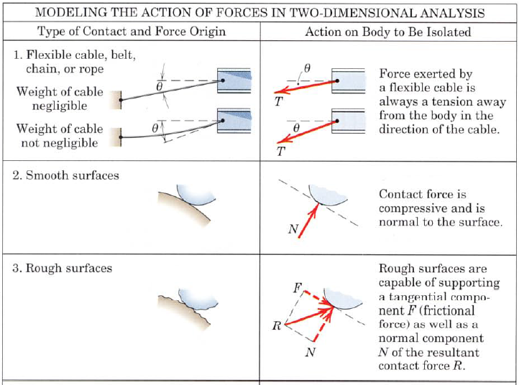
Modeling the action of forces
shows the external forces exerted on the rigid body

Slide 5
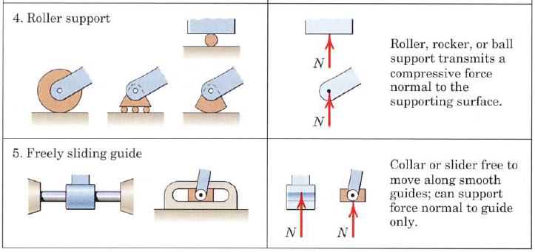
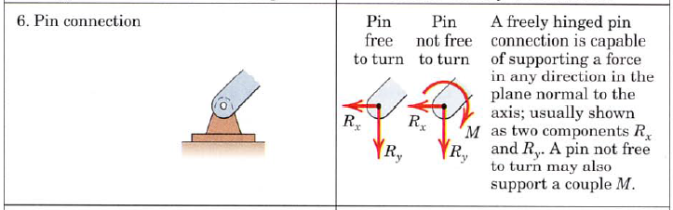

Slide 6
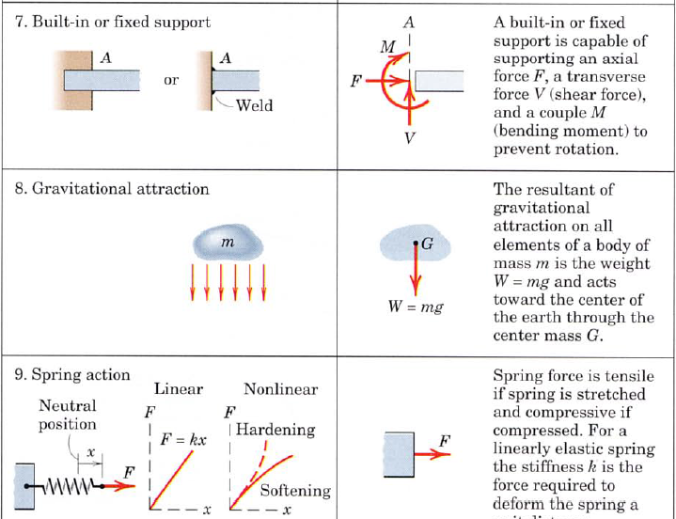

Slide 7
Categories of Equilibrium
Category 1 equilibrium of collinear forces
Category 2 equilibrium of concurrent forces
Category 3 equilibrium of parallel forces in a plane
Category 4 equilibrium of a general system of forces in a plane

Slide 8
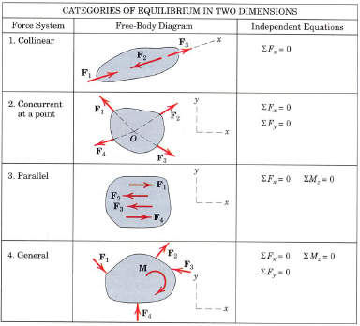

Slide 9
Constraints and Statical Determinacy
Statically determinate: no of constraints = no of equilibrium
Statically indeterminate: no of constraints > no of equilibrium
Redundant: Supports which can be removed without destroying the equilibrium condition of the body

Slide 10
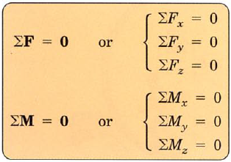
3.3. Equilibrium in Three-Dimensions

Slide 11
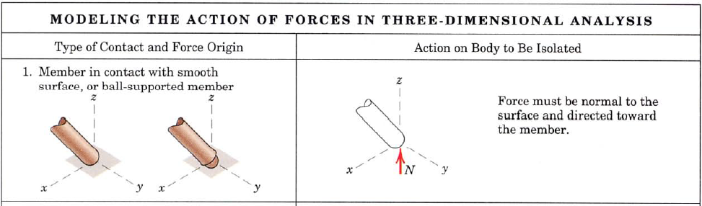
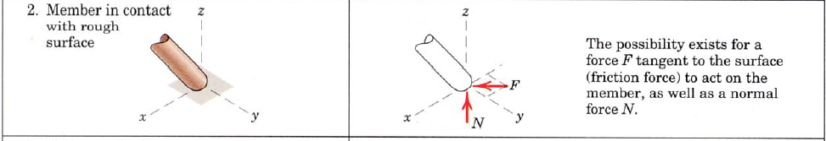
3.3. Equilibrium in Three-Dimensions
Modeling the action of forces

Slide 12
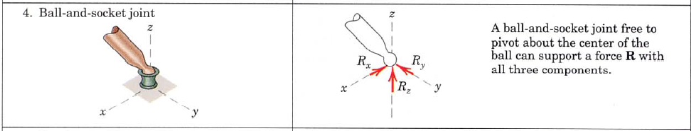
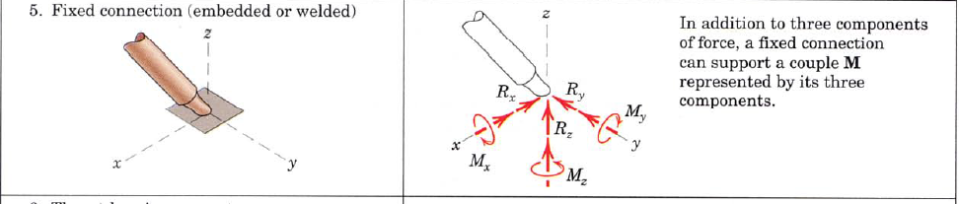
3.3. Equilibrium in Three-Dimensions
Modeling the action of forces

Slide 15
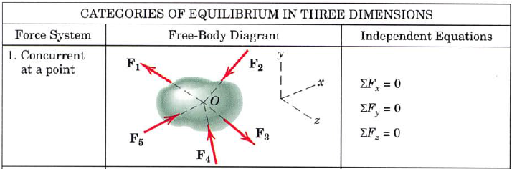
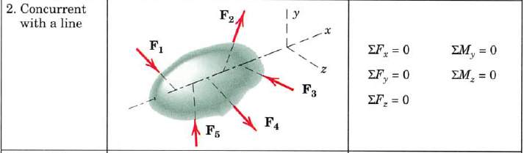
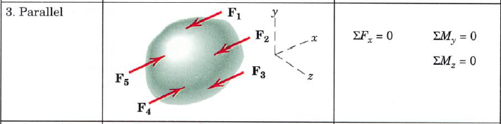
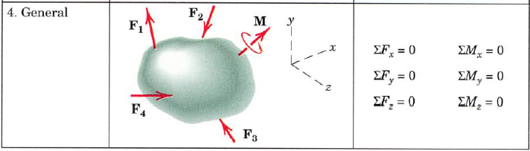
3.3. Equilibrium in Three-Dimensions
Categories of Equilibrium

Slide 16
QUIZ(5%(
Are you in equilibrium or not? justify

