Slide 1
Structures
Addis Ababa Science and Technology University
Chapter 4
Engineering Mechanics I

Slide 2
Content
4. ANALYSIS OF STRUCTURES
4.1. Introduction
4.2. Trusses
4.2.1. Plane Trusses
- Method of Joints
- Method of Sections
4.2.2. Space Trusses
4.3. Pin-ended Multi-Force Structures
4.3.1. Frames
4.3.2. Simple Machines

Slide 3
4.1 Introduction
This chapter focus on determination of the force internal to the structure.
An engineering structure is any connected system of members built to support or transfer forces and to safely withstand the loads applied to it.
Internal forces acting on trusses, frames and machines will be analyzed.

Slide 4
4.2 Trusses
4.2.1. Plane Trusses
A truss is a framework composed of members joined at their ends to form a rigid structure.
When the members of the truss lie essentially in a single plane, the truss is known as a plane truss
Bridges, roof supports, derricks are common examples of trusses

Slide 5
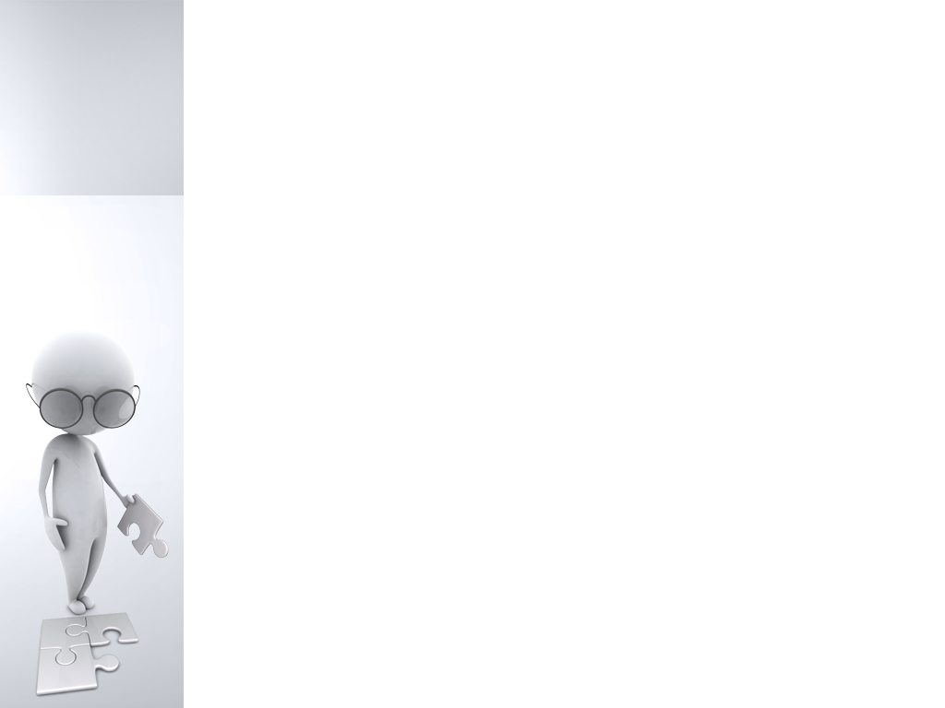
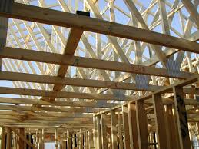
Roof Truss

Slide 6
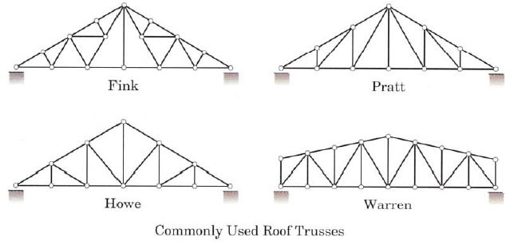
Commonly Used Roof Trusses

Slide 7
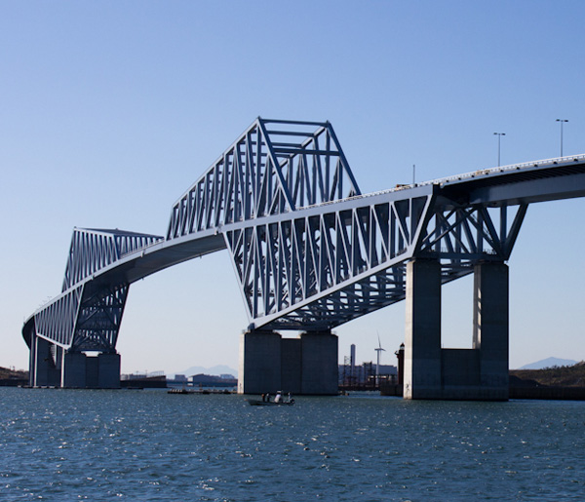
Tokyo Gate Bridge, a 2.6km long truss bridge

Slide 8
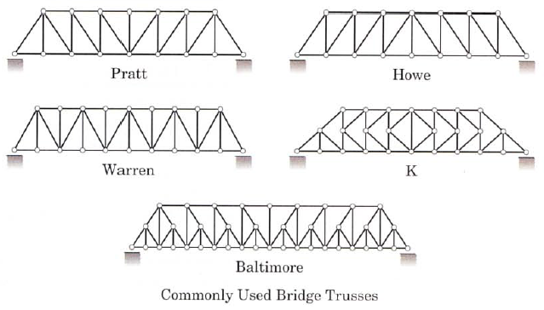
Commonly Used Bridge Trusses

Slide 9
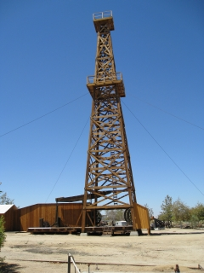
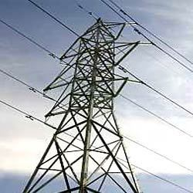
Derricks
t
Transmission Towers

Slide 10
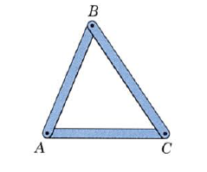
Simple Truss
The basic element of a plane truss is the triangle.
Three bars joined by a pin at their end forms a rigid frame
Structures built from a basic triangle are known are simple truss.

Slide 11
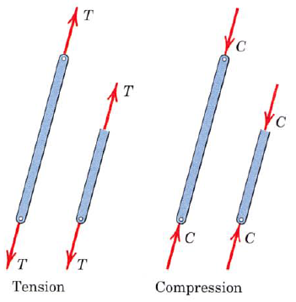
Simple Truss
Assumptions in the force analysis of simple trusses
All members are assumed to be two-force members.
The two forces are applied at the ends of the member.
The forces are necessarily equal, opposite and collinear.

Slide 12
Simple Truss
Assumptions in the force analysis of simple trusses
The members may be in tension or compression.
The tension or compression acting on the cut section is same for all sections.
If weight must be taken to account, replace the weight W of the member by two forces each W/2, acting at each end
Connection is pin joint
All external forces are applied at the pin connections.

Slide 13
Force analysis of plane trusses
Two methods for the force analysis of simple trusses will be given.
The external reactions are usually determined first from the equilibrium equations applied to the truss as a whole before the force analysis of the remainder of the truss.

Slide 14
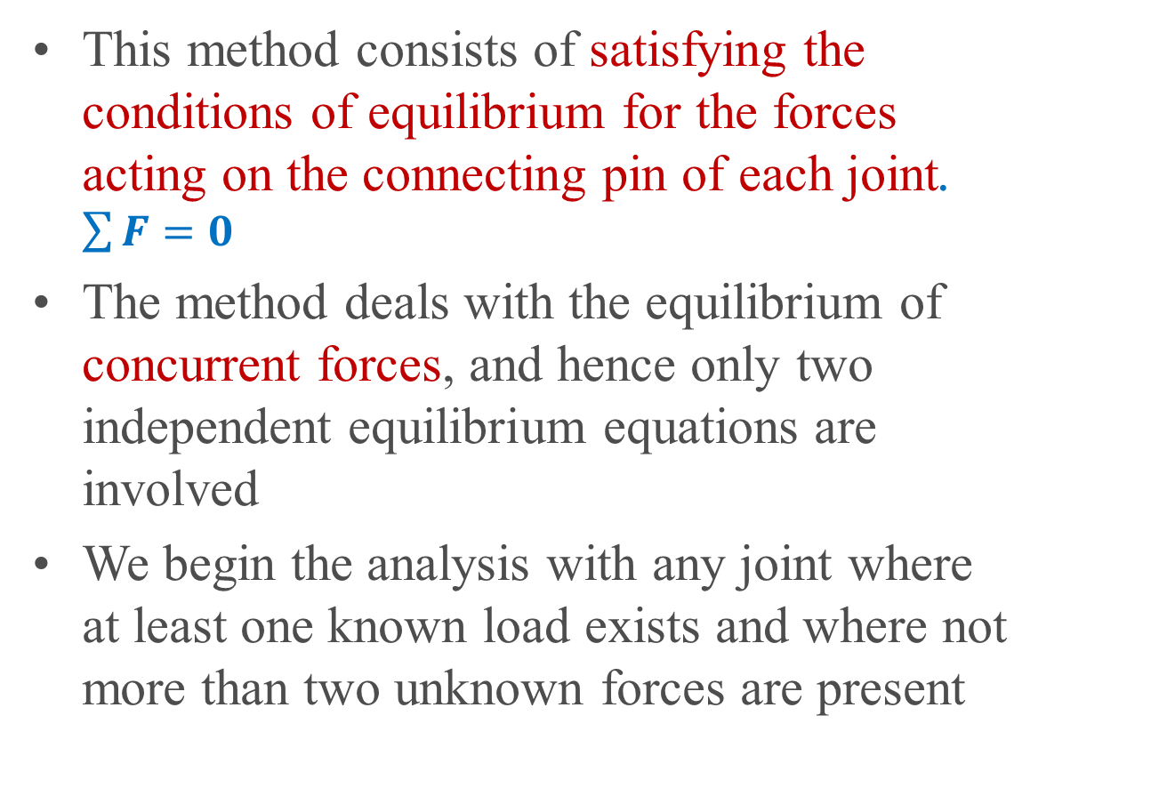
Method Of Joint
This method consists of satisfying the conditions of equilibrium for the forces acting on the connecting pin of each joint. $\sum{F}=0$
The method deals with the equilibrium of concurrent forces, and hence only two independent equilibrium equations are involved
We begin the analysis with any joint where at least one known load exists and where not more than two unknown forces are present

Slide 15
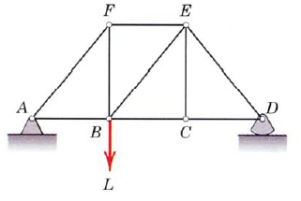
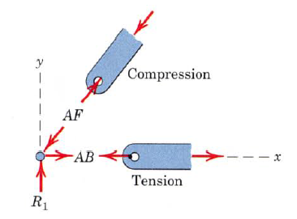
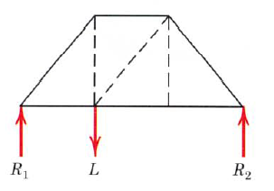
Print master
Taking free body diagram of a joint, tension will always be indicated by an arrow away from the pin, and compression will always be indicated by an arrow toward the pin.
External
Reactions are
calculated first
Equilibrium conditions
must be satisfied
at each joint

Slide 16
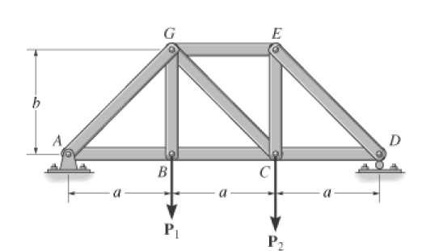
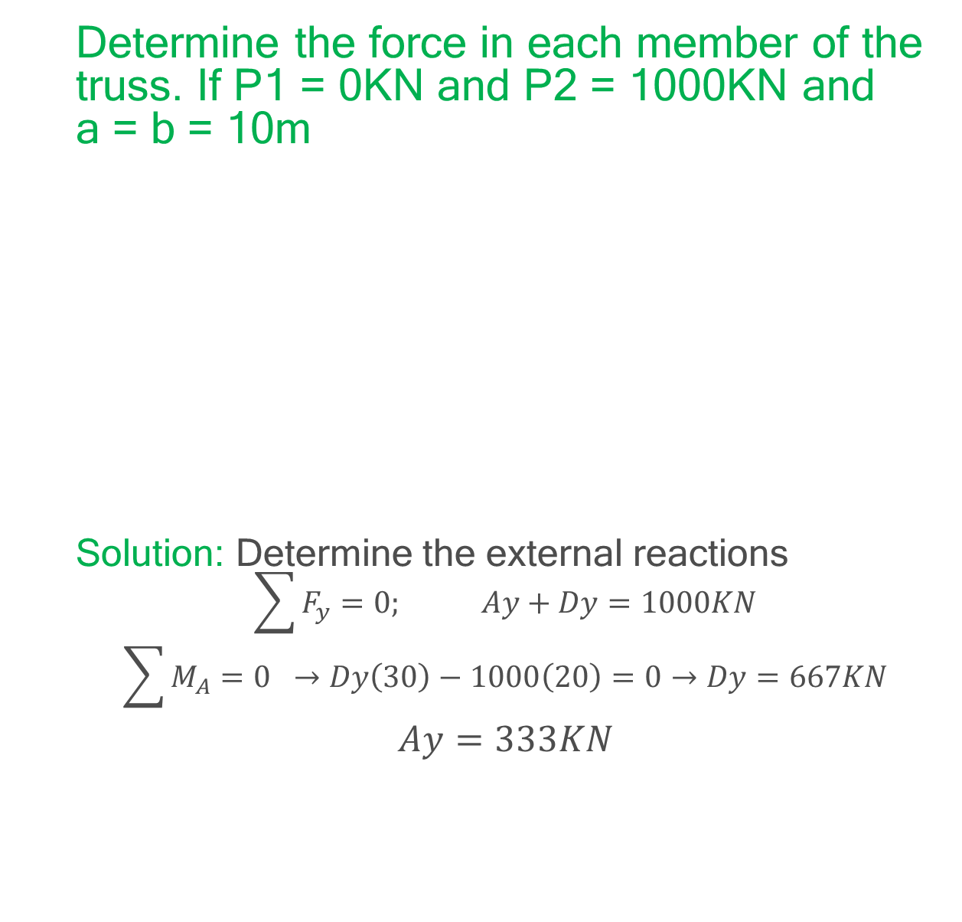
Example
Determine the force in each member of the truss. If P1 = 0KN and P2 = 1000KN and a = b = 10m
Solution: Determine the external reactions
$$\sum{F_{y}=0; Ay+Dy=1000KN}$$
$$\sum{M_{A}=0 } →Dy\left(30\right)−1000\left(20\right)=0→Dy=667KN$$
$$Ay=333KN$$

Slide 17
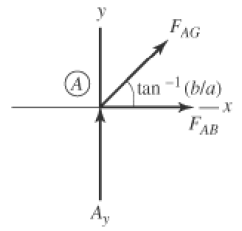
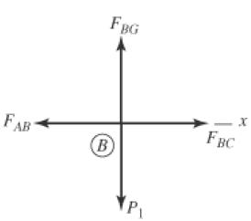

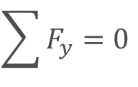

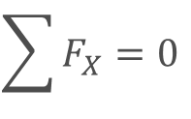




Solution
Equilibrium equation at joint A
Equilibrium equation at joint B
$$\sum{F_{y}}=0$$
$$Ay+F_{AG}\sin{45}=0$$
$$F_{AG}=−471KN$$
$$\sum{F_{X}}=0$$
$$F_{Ab}+F_{AG}\cos{45}=0$$
$$F_{AB}=333KN$$
$$F_{AB}=F_{Bc}=333KN$$
$$F_{BG}=0KN$$

Slide 18
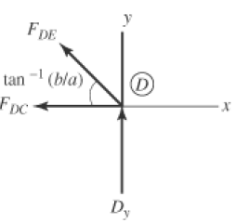
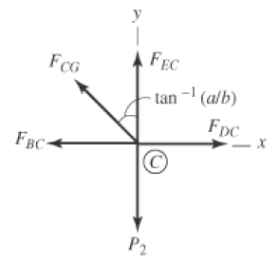

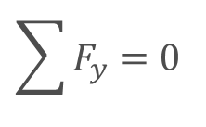


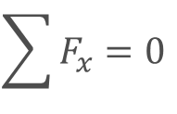


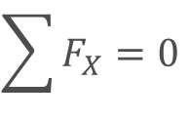




Solution
Equilibrium equation at joint D
Equilibrium equation at joint C
$$\sum{F_{y}}=0$$
$$Dy+F_{DE}\sin{45}=0$$
$$F_{DE}=667KN$$
$$\sum{F_{X}}=0$$
$$F_{DC}+F_{DE}\cos{45}=0$$
$$F_{DC}=−943KN$$
$$\sum{F_{x}}=0$$
$$F_{DC}−F_{Bc}−F_{Bc}\cos{45=0}$$
$$F_{CG}=471KN$$
$$\sum{F_{y}}=0$$
$$F_{EC}−P_{2}+F_{CG}\sin{45=0}$$
$$F_{Ec}=667KN$$

Slide 19
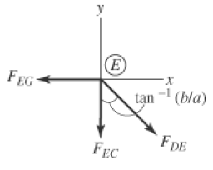

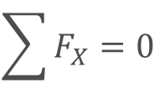

Solution
Equilibrium equation at joint E
$$\sum{F_{X}}=0$$
$$F_{DE}\cos{45}−F_{EG}=0$$
$$F_{EG}=−667KN$$

Slide 20
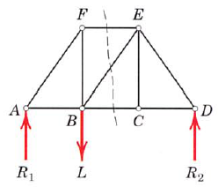
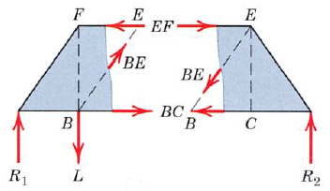
Method of Section
Takes advantages of the third or moment equation of equilibrium.
This method has the basic advantage that the force in almost any desired member may be found directly from an analysis of a section which has cut that member
Not more than three members whose forces are unknown may be cut

Slide 21
Method of Section
Important Considerations
Entire portion of the truss is considered a single body in equilibrium. Thus, the forces in members internal to the section are not involved in the analysis.
The section is preferably passed through the members and not the joints.
Methods of sections and joints can be combined for an efficient solution.
The moment equations are used to great advantage in the method of sections. One should choose a moment center, either on or off the section, through which as many unknown forces as possible pass.

Slide 22
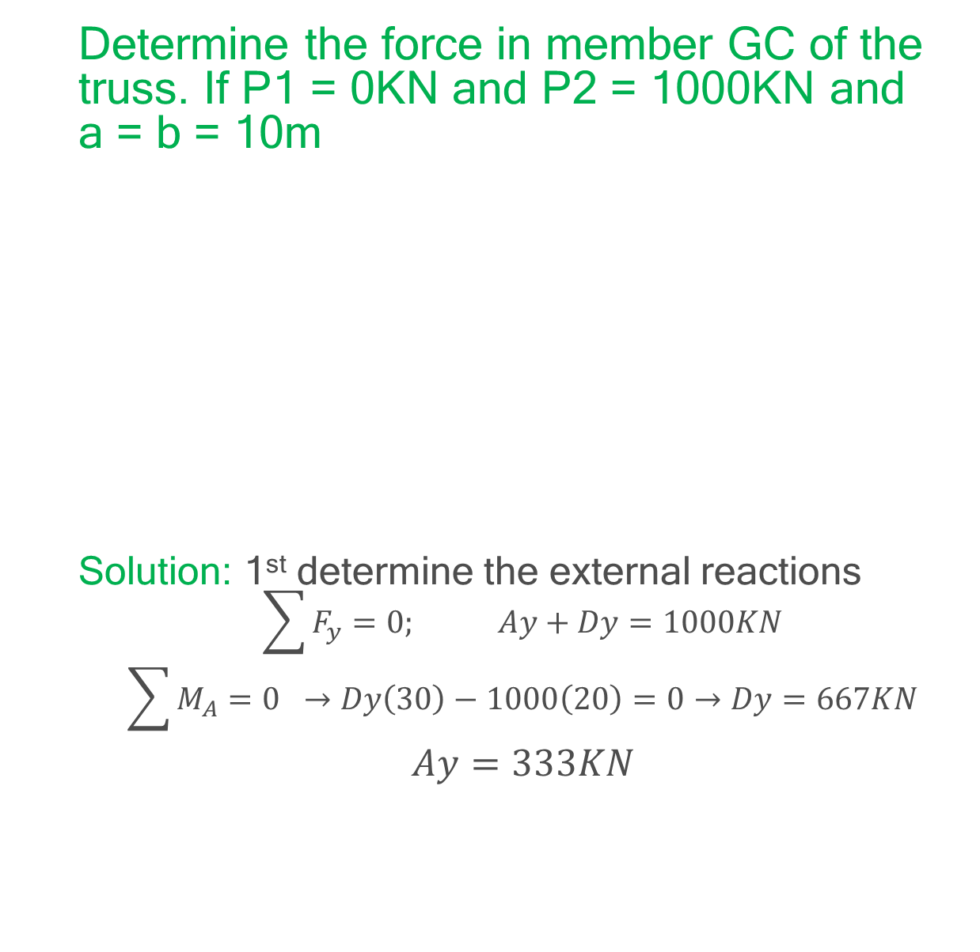
Example
Determine the force in member GC of the truss. If P1 = 0KN and P2 = 1000KN and a = b = 10m
Solution: 1st determine the external reactions
$$\sum{F_{y}=0; Ay+Dy=1000KN}$$
$$\sum{M_{A}=0 } →Dy\left(30\right)−1000\left(20\right)=0→Dy=667KN$$
$$Ay=333KN$$

Slide 23
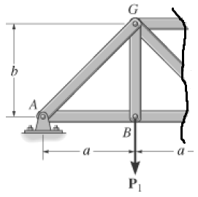


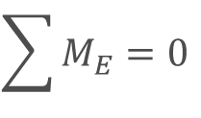



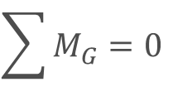


Solution
$$F_{GE}$$
$$\sum{M_{G}}=0$$
$$F_{GC}$$
$$−Ay\left(10\right)+F_{BC}(10)=0$$
$$333\left(10\right)−F_{BC}(10)=0$$
$$F_{BC}$$
$$F_{BC}=333KN$$
$$\sum{M_{E}}=0$$
$$Ay\left(20\right)−F_{Gc}\sin{45}\left(10\right){−F}_{BC}(10)=0$$
$$333\left(20\right)−F_{Gc}\sin{45}\left(10\right)−333 (10)=0$$
$$F_{GC}=471KN$$

Slide 24
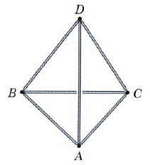
4.2.2 Space Truss
A space truss is the three dimensional counterpart of plane truss.
Space truss require six bars joined at their end to form the edges of tetrahedron as the basic noncollapsible unit
A space truss formed by tetrahedrons is called a simple space truss.

Slide 25
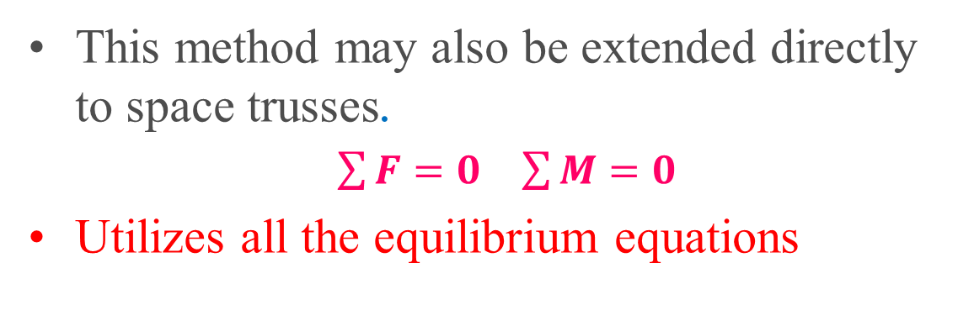
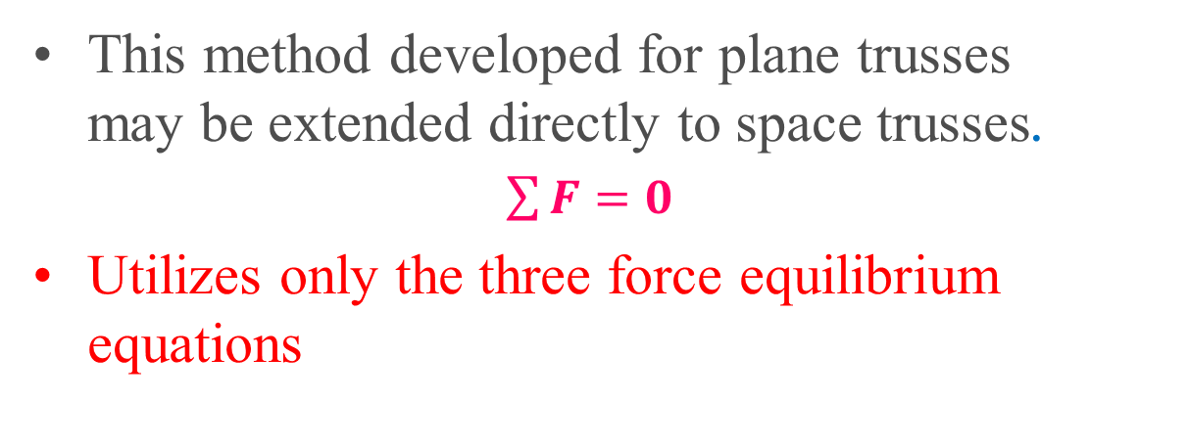
Method Of Joint
This method developed for plane trusses may be extended directly to space trusses.
$\sum{F}=0$
Utilizes only the three force equilibrium equations
Method Of Sections
This method may also be extended directly to space trusses.
$\sum{F}=0$ $\sum{M}=0$
Utilizes all the equilibrium equations

Slide 26
4.3 Frames and Machines
A structure is called a frame or machine if at least one of its individual members is a multiforce member.
A multiforce member is defined as one with three or more forces acting on it or one with two or more forces and one or more couples acting on it.
Because frames and machines contain mutliforce members, the forces in these members in general will not be in the direction of the members.

Slide 27
4.3 Frames and Machines
Frames are structures which are designed to support applied loads and are usually fixed in position.
Machines are structures which contain moving parts and are designed to transmit forces or couples from input values to output values.
This chapter unlike the previous chapter, which deals with equilibrium of single rigid body, concentrate on equilibrium of interconnected rigid bodies.

Slide 28
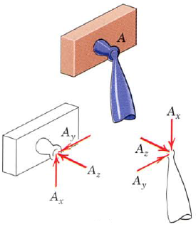
Frames and Machines
The forces acting on each member of a connected system are found by isolating the member with a free-body diagram and applying the established equations of equilibrium.
The principle of action and reaction must be carefully observed when we represent the forces of interaction on the separate free-body diagrams.

Slide 29
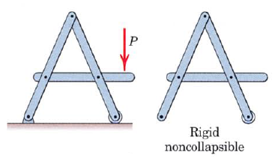
Cont..
If the frame or machine constitutes a rigid unit by itself when removed from its supports, the analysis is best begun by establishing all the forces external to the structure considered as a single rigid body

Slide 30
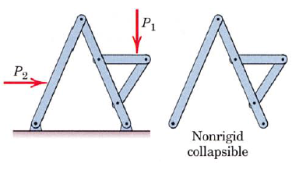
Cont..
If the structure is not a rigid unit by itself but depends on its external supports for rigidity, as in the figure below, then the calculation of the external support reactions cannot be completed until the structure is dismembered and the individual parts are analyzed

Slide 31
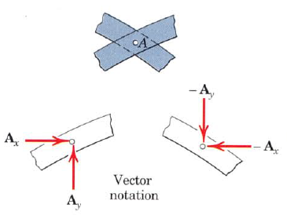
Cont..
It is not always possible to assign every force or its components in the proper sense
In any event it is absolutely necessary that a force be consistently represented on the diagrams for interacting bodies,

Slide 32
THANK YOU!!!

