Slide 1

MOMENT OF INERTIA
Addis Ababa Science and Technology University
Chapter 7
Engineering Mechanics
By Bayelign H.

Slide 2
Content
Introduction
Moment of inertia of area
Radius of gyration
Parallel axis theorem or transfer of axes
Moment of area of composite bodies
Product of inertia
Principal Axes and Principal Moments of Inertia
Mohr’s Circle

Slide 3
Introduction
Quantities called moments of inertia arise repeatedly in analyses of engineering problems.
Moments of inertia of areas are used in the study of distributed forces and in calculating deflections of beams.
The moment exerted by the pressure on a submerged flat plate can be expressed in terms of the moment of inertia of the plate s area.
In dynamics, mass moments of inertia are used in calculating the rotational motions of objects.

Slide 4
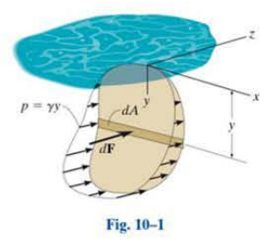
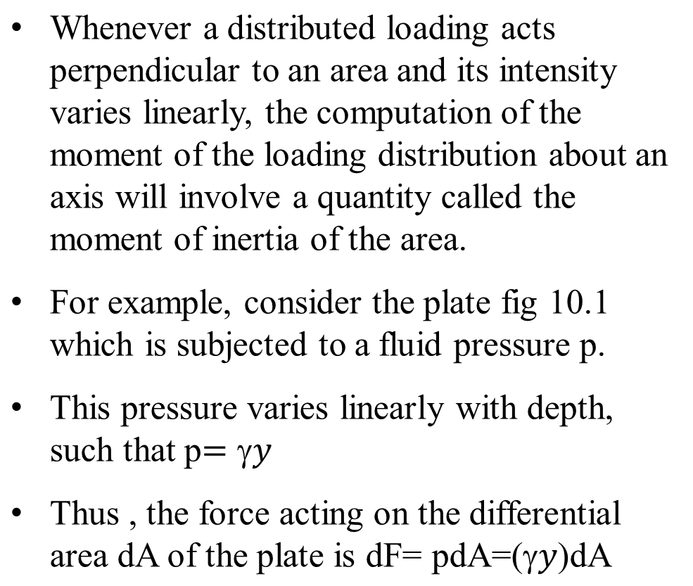
Moment of Inertia of an Area
9 - <number>

Slide 5
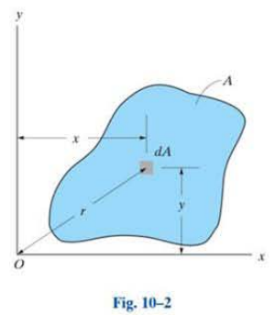
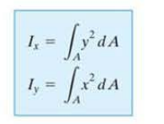

Moment of Inertia of an Area

Slide 6
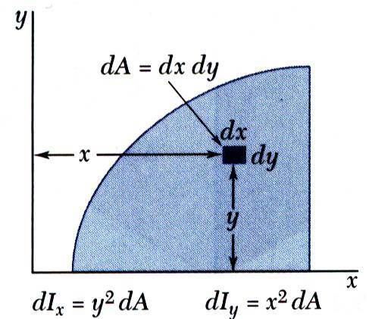

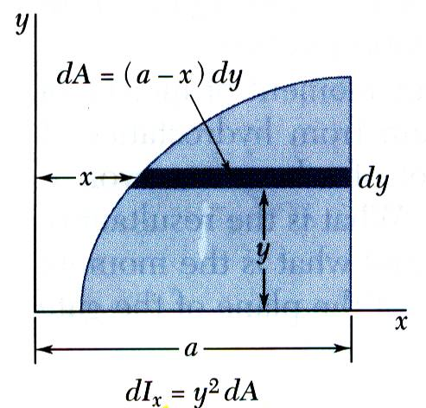
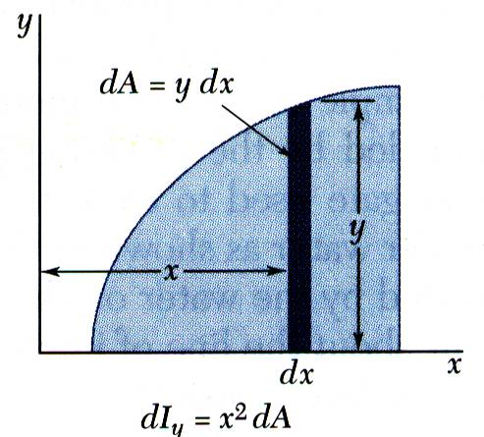
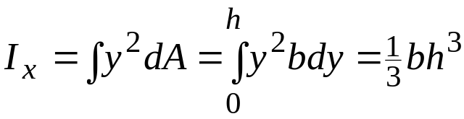
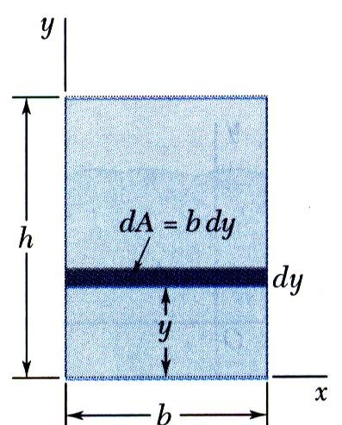
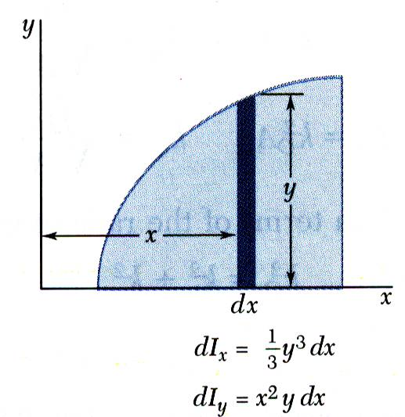

Moment of Inertia of an Area by Integration
Second moments or moments of inertia of an area with respect to the x and y axes,
Evaluation of the integrals is simplified by choosing dΑ to be a thin strip parallel to one of the coordinate axes.
For a rectangular area,
The formula for rectangular areas may also be applied to strips parallel to the axes,
9 - <number>

Slide 7
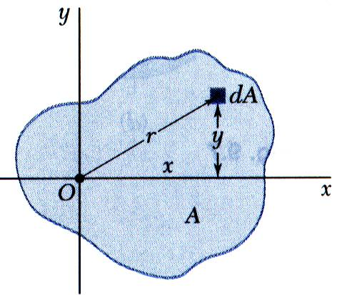

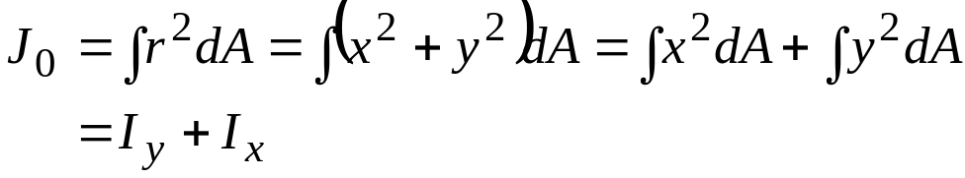
Polar Moment of Inertia
The polar moment of inertia is an important parameter in problems involving torsion of cylindrical shafts and rotations of slabs.
The polar moment of inertia is related to the rectangular moments of inertia,
9 - <number>

Slide 8
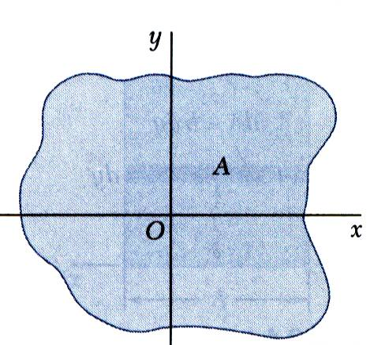
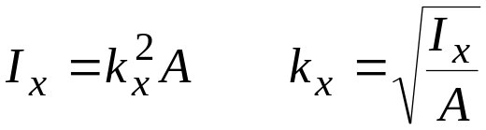
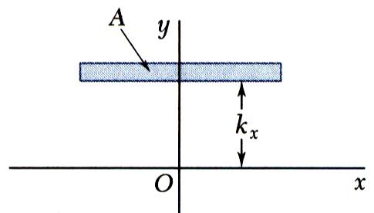
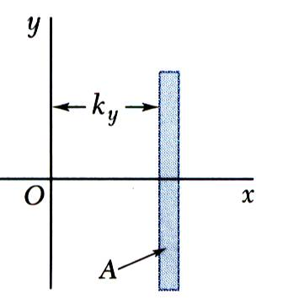
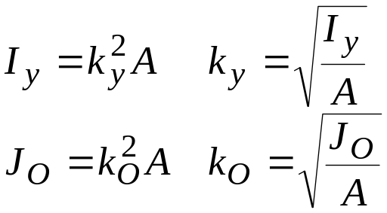
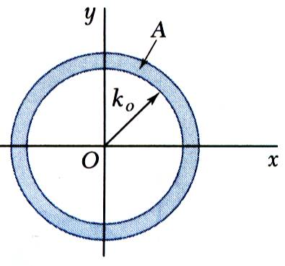

Radius of Gyration of an Area
Consider area A with moment of inertia I_{x}. Imagine that the area is concentrated in a thin strip parallel to the x axis with equivalent I_{x}.
k_{x} = radius of gyration with respect to the x axis
Similarly,
9 - <number>

Slide 9
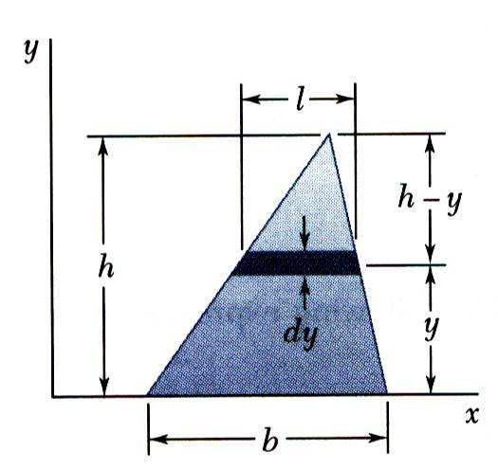
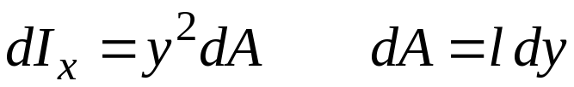
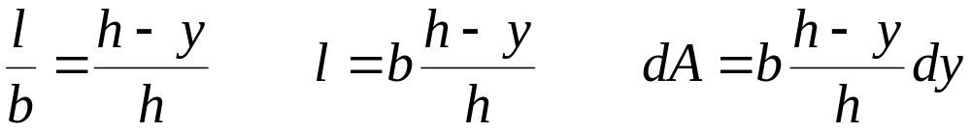
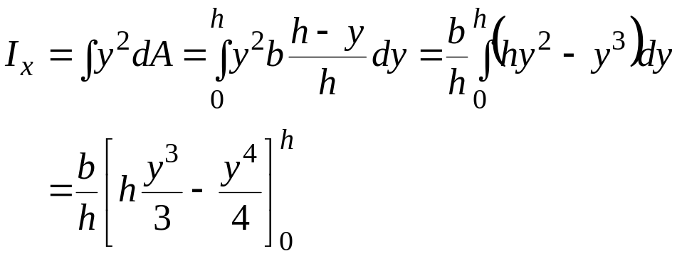
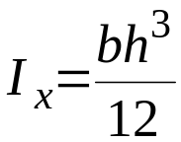
Sample Problem 9.1
SOLUTION:
A differential strip parallel to the x axis is chosen for dA
For similar triangles,
Determine the moment of inertia of a triangle with respect to its base.
Integrating dI_{x} from y = 0 to y = h,
9 - <number>

Slide 10
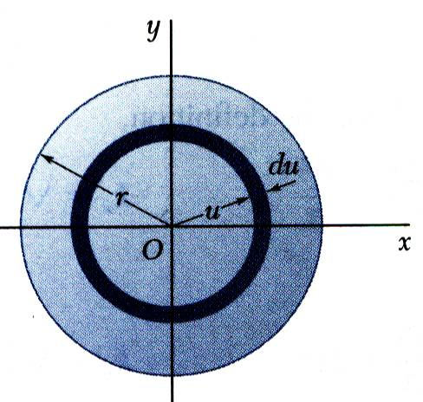
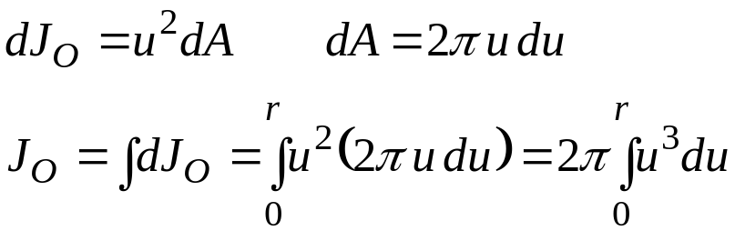
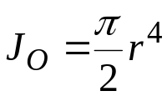
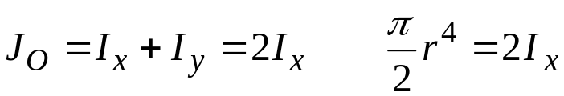
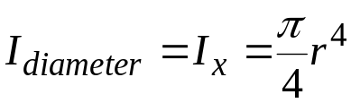
Sample Problem 9.2
SOLUTION:
An annular differential area element is chosen,
a) Determine the centroidal polar moment of inertia of a circular area by direct integration.
b) Using the result of part a, determine the moment of inertia of a circular area with respect to a diameter.
From symmetry, I_{x} = I_{y},
9 - <number>

Slide 11
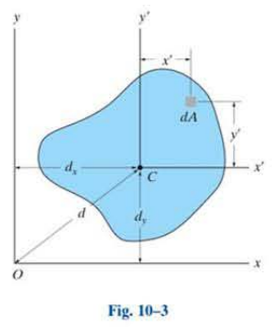
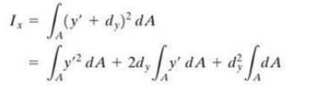


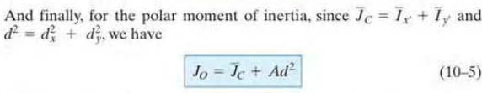
Parallel Axis Theorem
9 - <number>

Slide 12
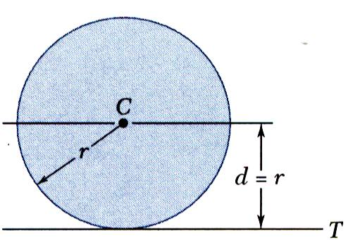
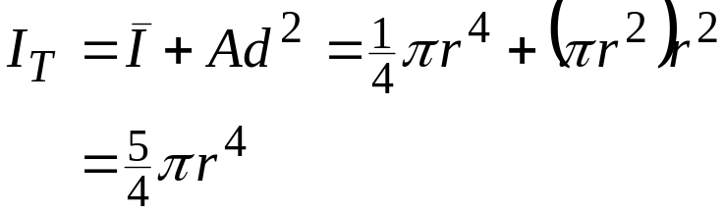
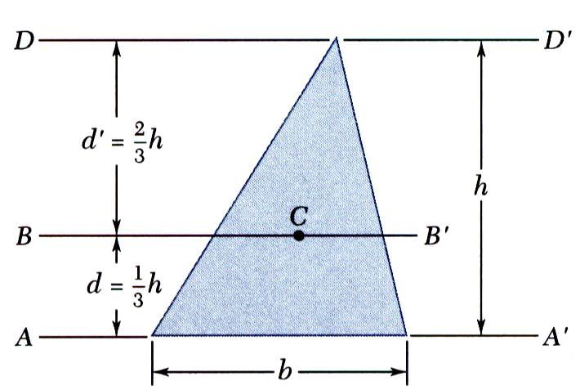
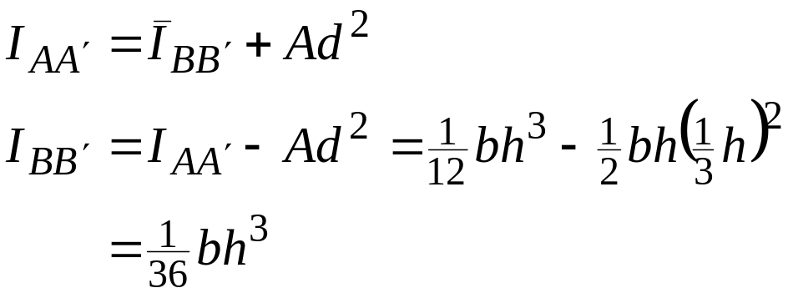
Parallel Axis Theorem
Moment of inertia I_{T} of a circular area with respect to a tangent to the circle,
Moment of inertia of a triangle with respect to a centroidal axis,
9 - <number>

Slide 13
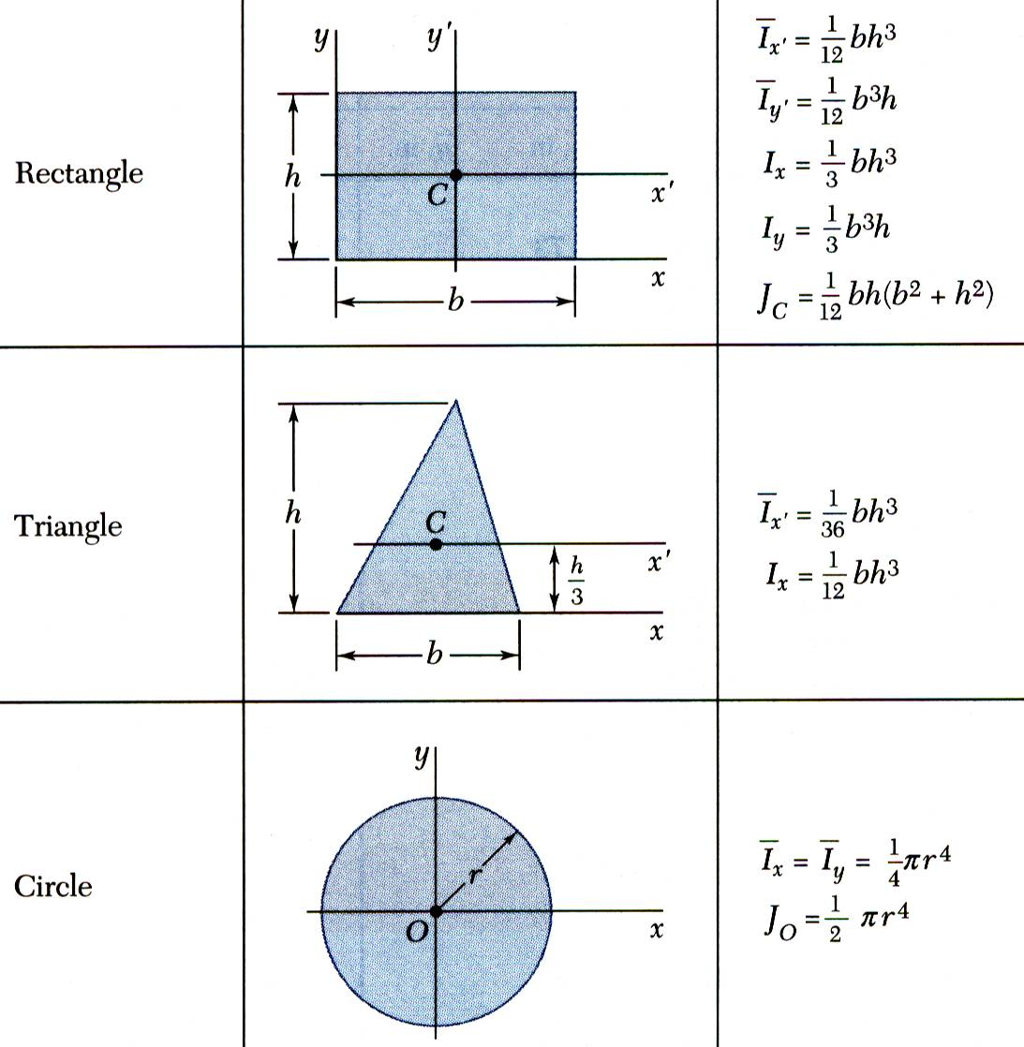
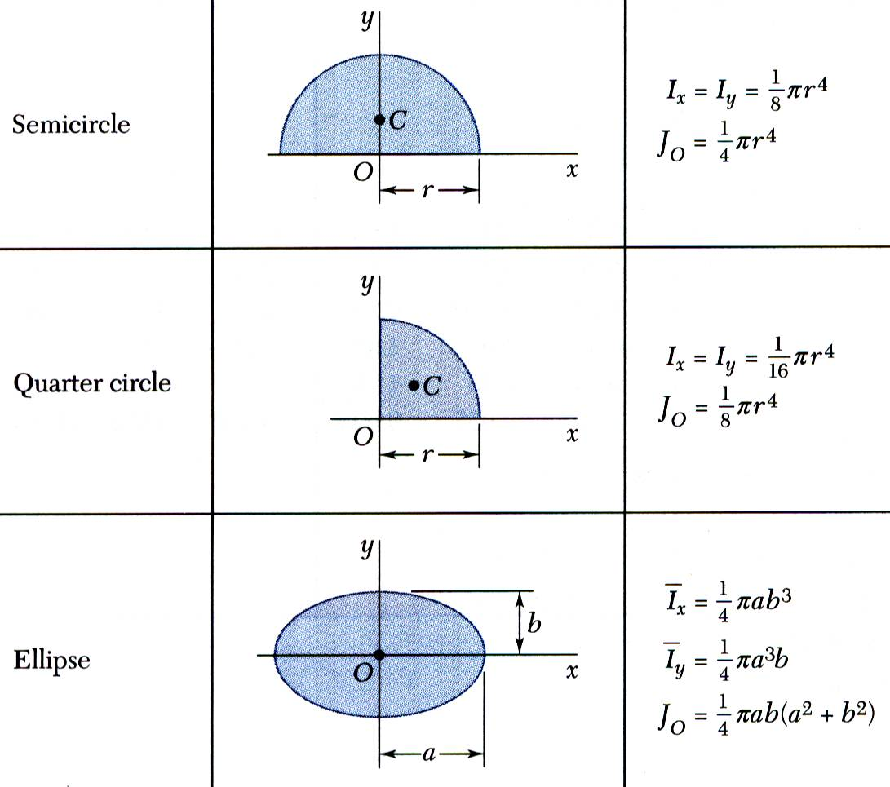
Moments of Inertia of Composite Areas
The moment of inertia of a composite area A about a given axis is obtained by adding the moments of inertia of the component areas A₁, A₂, A₃, ... , with respect to the same axis.
9 - <number>

Slide 14
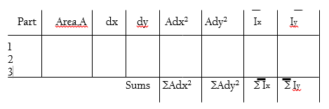
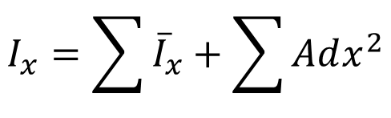
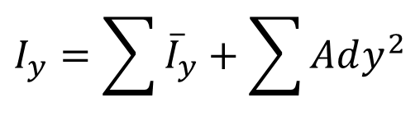
Moments of Inertia of Composite Areas

Slide 15
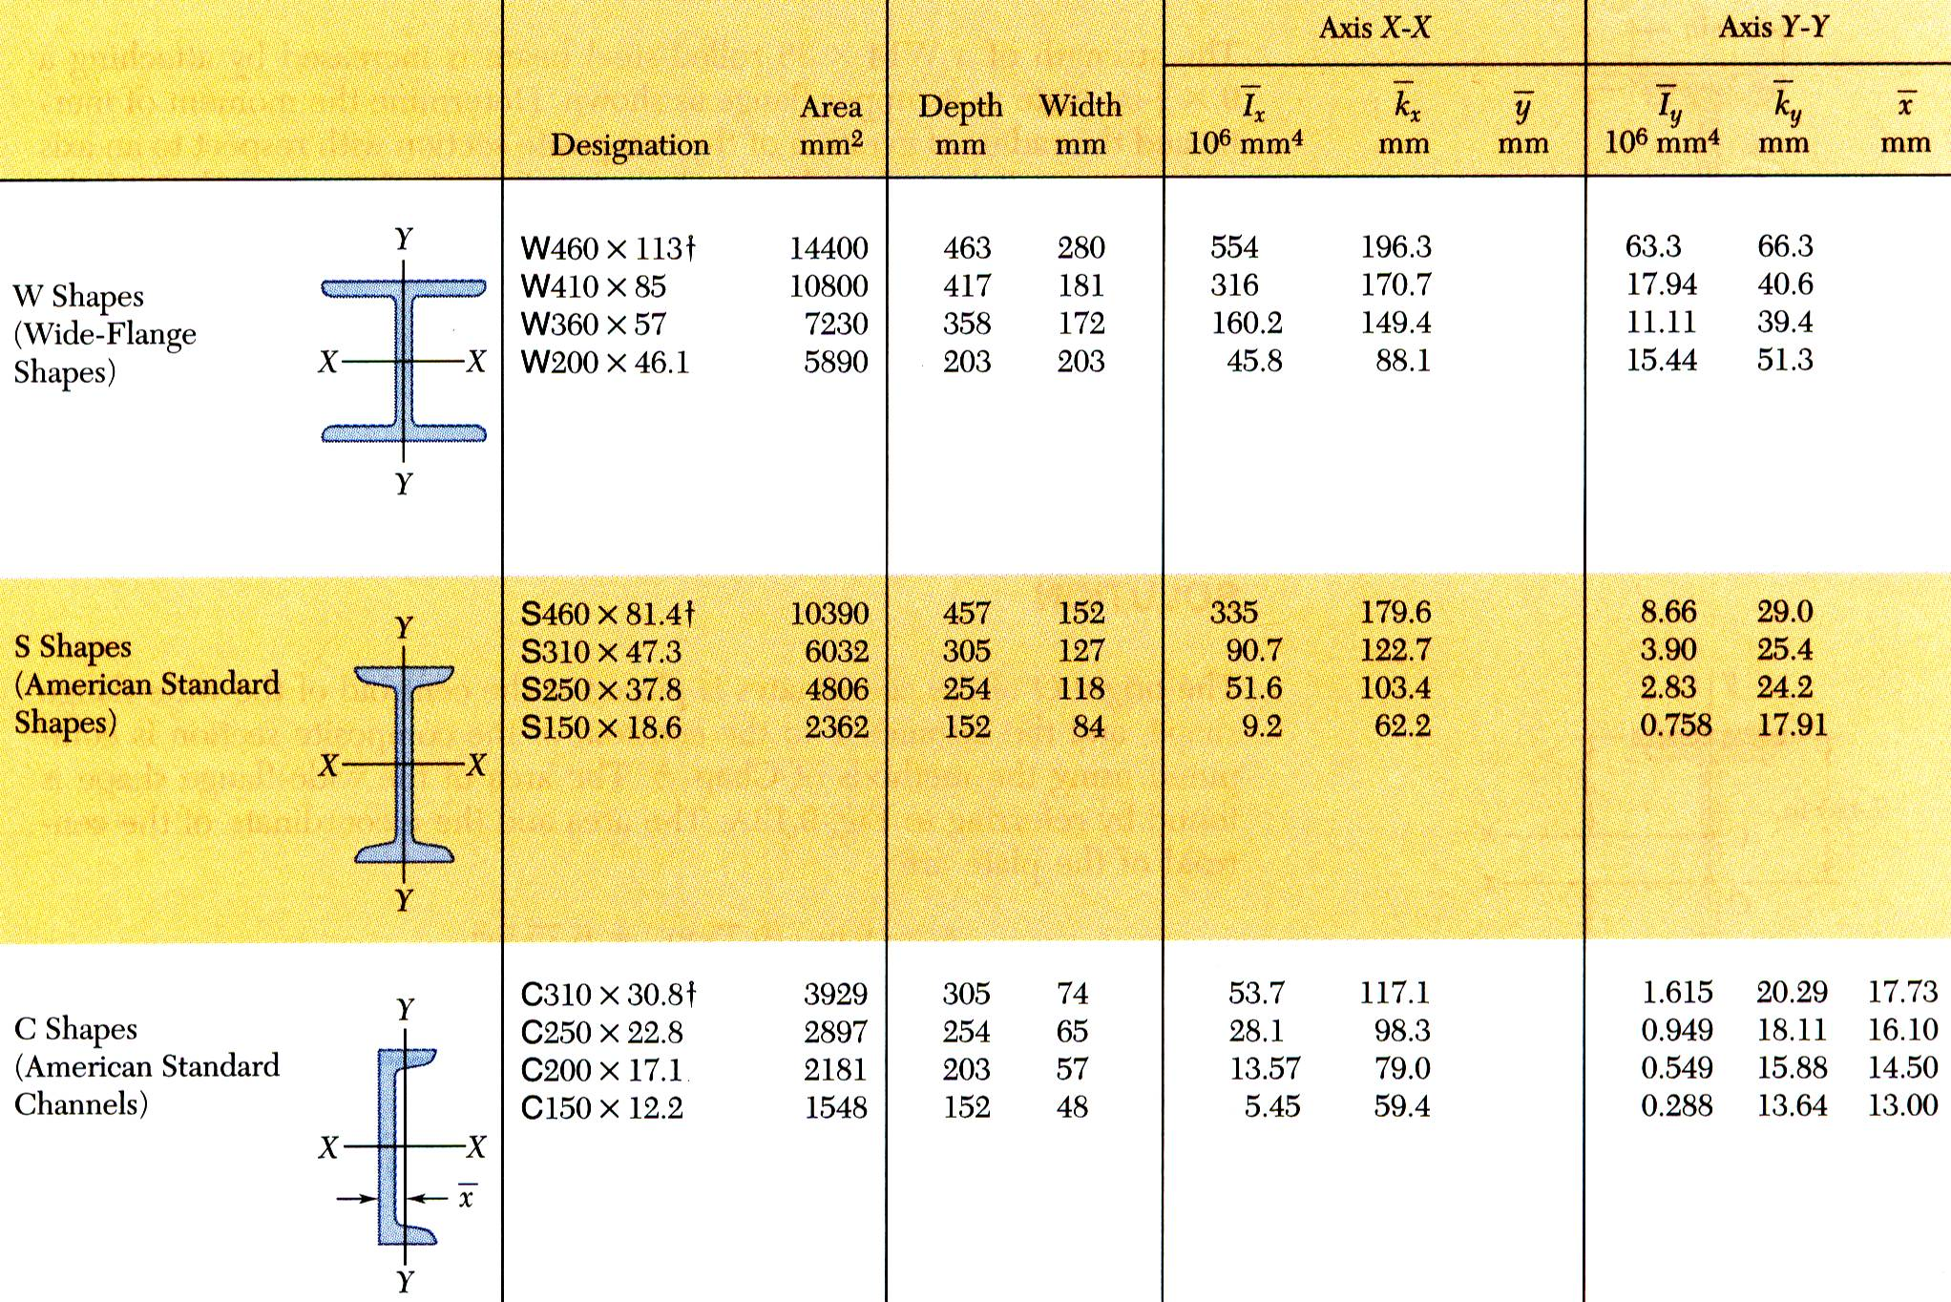
Moments of Inertia of Composite Areas
9 - <number>

Slide 16
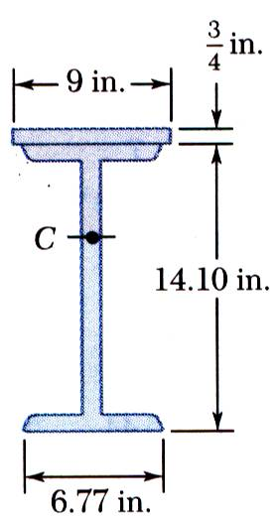
Sample Problem 9.4
SOLUTION:
Determine location of the centroid of composite section with respect to a coordinate system with origin at the centroid of the beam section.
Apply the parallel axis theorem to determine moments of inertia of beam section and plate with respect to composite section centroidal axis.
The strength of a W14x38 rolled steel beam is increased by attaching a plate to its upper flange.
Determine the moment of inertia and radius of gyration with respect to an axis which is parallel to the plate and passes through the centroid of the section.
Calculate the radius of gyration from the moment of inertia of the composite section.
9 - <number>

Slide 17
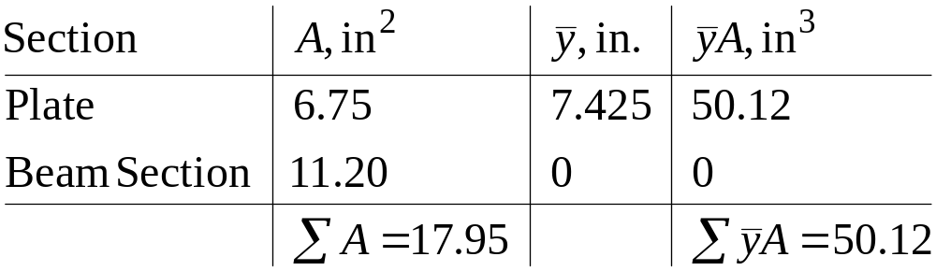
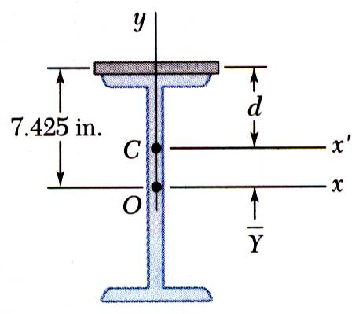
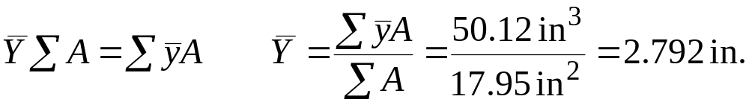
Sample Problem 9.4
SOLUTION:
Determine location of the centroid of composite section with respect to a coordinate system with origin at the centroid of the beam section.
9 - <number>

Slide 18
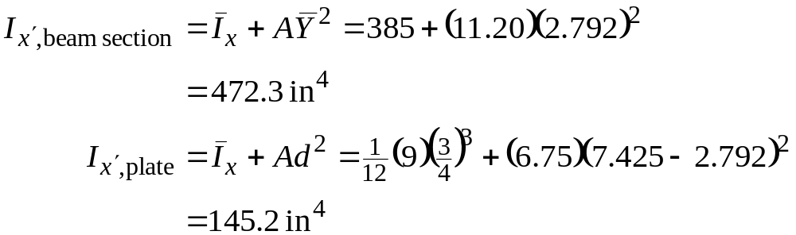

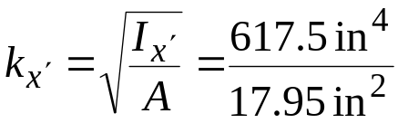

Sample Problem 9.4
Apply the parallel axis theorem to determine moments of inertia of beam section and plate with respect to composite section centroidal axis.
Calculate the radius of gyration from the moment of inertia of the composite section.
9 - <number>

Slide 19
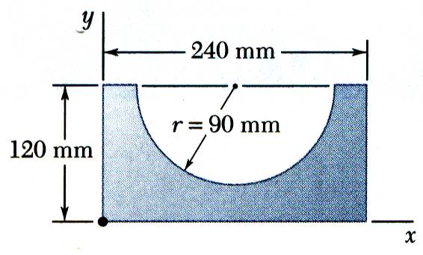
Sample Problem 9.5
SOLUTION:
Compute the moments of inertia of the bounding rectangle and half-circle with respect to the x axis.
The moment of inertia of the shaded area is obtained by subtracting the moment of inertia of the half-circle from the moment of inertia of the rectangle.
Determine the moment of inertia of the shaded area with respect to the x axis.
9 - <number>

Slide 20

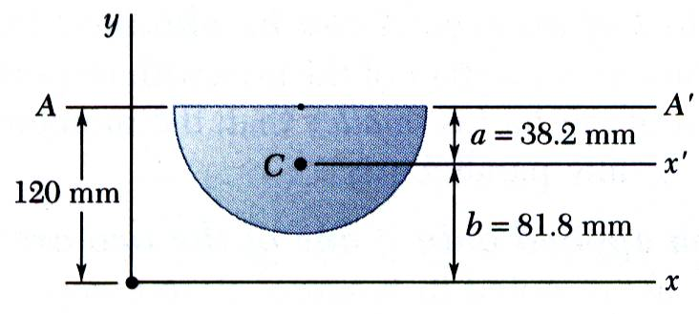

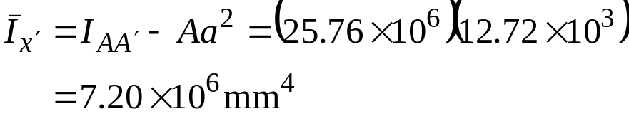


Sample Problem 9.5
SOLUTION:
Compute the moments of inertia of the bounding rectangle and half-circle with respect to the x axis.
Rectangle:
Half-circle:
moment of inertia with respect to AA’,
moment of inertia with respect to x’,
moment of inertia with respect to x,
9 - <number>

Slide 21





Sample Problem 9.5
The moment of inertia of the shaded area is obtained by subtracting the moment of inertia of the half-circle from the moment of inertia of the rectangle.
9 - <number>

Slide 22





Product of Inertia
Product of Inertia:
When the x axis, the y axis, or both are an axis of symmetry, the product of inertia is zero.
Parallel axis theorem for products of inertia:
9 - <number>

Slide 23





Principal Axes and Principal Moments of Inertia
The change of axes yields
The equations for I_{x’} and I_{x’y’} are the parametric equations for a circle,
Given
we wish to determine moments and product of inertia with respect to new axes x’ and y’.
Note:
The equations for I_{y’} and I_{x’y’} lead to the same circle.
9 - <number>

Slide 24



Principal Axes and Principal Moments of Inertia
At the points A and B, I_{x’y’} = 0 and I_{x’} is a maximum and minimum, respectively.
The equation for Θ_{m} defines two angles, 90º apart which correspond to the principal axes of the area about O.
I_{max} and I_{min} are the principal moments of inertia of the area about O.
9 - <number>

Slide 25

Sample Problem 9.6
SOLUTION:
Determine the product of inertia using direct integration with the parallel axis theorem on vertical differential area strips
Apply the parallel axis theorem to evaluate the product of inertia with respect to the centroidal axes.
Determine the product of inertia of the right triangle (a) with respect to the x and y axes and
(b) with respect to centroidal axes parallel to the x and y axes.
9 - <number>

Slide 26




Sample Problem 9.6
SOLUTION:
Determine the product of inertia using direct integration with the parallel axis theorem on vertical differential area strips
Integrating dI_{x} from x = 0 to x = b,
9 - <number>

Slide 27




Sample Problem 9.6
Apply the parallel axis theorem to evaluate the product of inertia with respect to the centroidal axes.
With the results from part a,
9 - <number>

Slide 28

Sample Problem 9.7
SOLUTION:
Compute the product of inertia with respect to the xy axes by dividing the section into three rectangles and applying the parallel axis theorem to each.
For the section shown, the moments of inertia with respect to the x and y axes are I_{x} = 10.38 in⁴ and I_{y} = 6.97 in⁴.
Determine (a) the orientation of the principal axes of the section about O, and (b) the values of the principal moments of inertia about O.
Determine the orientation of the principal axes (Eq. 9.25) and the principal moments of inertia (Eq. 9. 27).
9 - <number>

Slide 29




Sample Problem 9.7
SOLUTION:
Compute the product of inertia with respect to the xy axes by dividing the section into three rectangles.
Apply the parallel axis theorem to each rectangle,
Note that the product of inertia with respect to centroidal axes parallel to the xy axes is zero for each rectangle.
9 - <number>

Slide 30






Sample Problem 9.7
Determine the orientation of the principal axes (Eq. 9.25) and the principal moments of inertia (Eq. 9. 27).
9 - <number>

Slide 31



Mohr’s Circle for Moments and Products of Inertia
The moments and product of inertia for an area are plotted as shown and used to construct Mohr’s circle,
Mohr’s circle may be used to graphically or analytically determine the moments and product of inertia for any other rectangular axes including the principal axes and principal moments and products of inertia.
9 - <number>

Slide 32

Sample Problem 9.8
SOLUTION:
Plot the points (I_{x} , I_{xy}) and (I_{y} ,-I_{xy}). Construct Mohr’s circle based on the circle diameter between the points.
Based on the circle, determine the orientation of the principal axes and the principal moments of inertia.
The moments and product of inertia with respect to the x and y axes are I_{x} = 7.24x106 mm⁴, I_{y} = 2.61x106 mm⁴, and I_{xy} = -2.54x10⁶ mm⁴.
Using Mohr’s circle, determine (a) the principal axes about O, (b) the values of the principal moments about O, and (c) the values of the moments and product of inertia about the x’ and y’ axes
Based on the circle, evaluate the moments and product of inertia with respect to the x’y’ axes.
9 - <number>

Slide 33










Sample Problem 9.8
SOLUTION:
Plot the points (I_{x} , I_{xy}) and (I_{y} ,-I_{xy}). Construct Mohr’s circle based on the circle diameter between the points.
Based on the circle, determine the orientation of the principal axes and the principal moments of inertia.
9 - <number>

Slide 34






Sample Problem 9.8
Based on the circle, evaluate the moments and product of inertia with respect to the x’y’ axes.
The points X’ and Y’ corresponding to the x’ and y’ axes are obtained by rotating CX and CY counterclockwise through an angle Θ = 2(60º) = 120º. The angle that CX’ forms with the x’ axes is φ = 120º - 47.6º = 72.4º.
9 - <number>

