Slide 1
5. Internal actions in beams
Introduction
Beams are structural members which offer resistance to bending due to applied loads. Most beams are long prismatic bars, and the loads are usually applied normal to the axes of the bars.
Beams are undoubtedly the most important of all structural members, so it is important to understand the basic theory underlying their design.
To analyze the load-carrying capacities of a beam we must first establish the equilibrium requirements of the beam as a whole and any portion of it considered separately.
Second, we must establish the relations between the resulting forces and the accompanying internal resistance of the beam to support these forces. The first part of this analysis requires the application of the principles of statics. The second part involves the strength characteristics of the material and is usually treated in studies of the mechanics of solids or the mechanics of materials(i.e an other course).
Notes:
Good morning?
Today we will see, …
we will begin with brainstorming questions that such as:…
How could define …?
Why it is important to …?

Slide 2
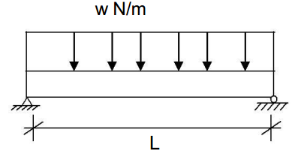
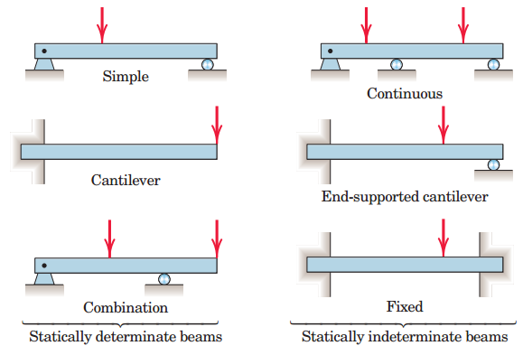
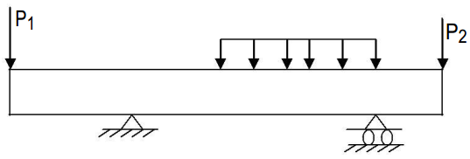
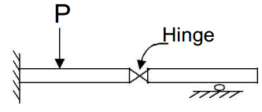
5. beams…
Types of beams
Beams supported so that their external support reactions can be calculated by the methods of statics alone are called statically determinate beams. A beam which has more supports than needed to provide equilibrium is statically indeterminate. To determine the support reactions for such a beam we must consider its load-deformation properties in addition to the equations of static equilibrium.
Simply supported beams
(simple beams)
Overhanging beam
Compound beam (one example)
Notes:
Good morning?
Today we will see, …
we will begin with brainstorming questions that such as:…
How could define …?
Why it is important to …?

Slide 3

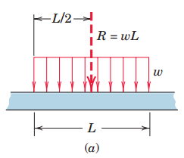
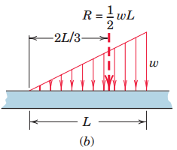
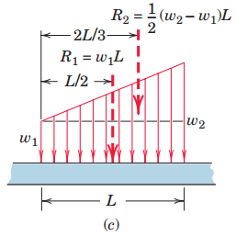
5. beams…
Determining external effects
Beams may also be identified by the type of external loading they support.
Beams supporting
Concentrated loads
Distributed loads
  Uniform: constant load intensity, w
  Linearly varying
  Trapezoidal………………….
Resultant load R is represented by the area formed by the intensity w (force per unit length of
beam) and the length L over which the force is distributed. The resultant passes through the centroid of this area.
The trapezoidal area is broken into a rectangular and a triangular area, and the corresponding resultants R₁ and R₂ of these subareas are determined separately.
Notes:
Good morning?
Today we will see, …
we will begin with brainstorming questions that such as:…
How could define …?
Why it is important to …?

Slide 4
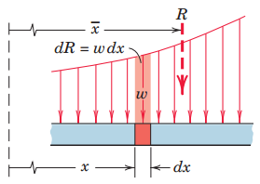


5. beams…
Determining external effects…
For a more general load distribution,
we must start with a differential increment of force dR =w dx. The total load R is then the sum of the differential forces, or
The resultant R is located at the centroid of the area under consideration. The x-coordinate of this centroid is found by the principleof moments
Once the distributed loads have been reduced to their equivalent concentrated loads, the external reactions acting on the beam may be found by a straightforward static analysis
Notes:
Good morning?
Today we will see, …
we will begin with brainstorming questions that such as:…
How could define …?
Why it is important to …?

Slide 5
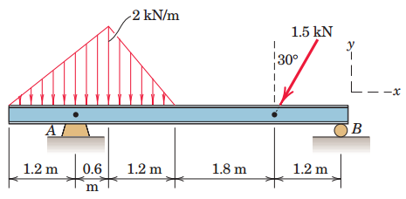
5. beams…
Determining external effects...
Example
Determine the reactions at A and B for the beam subjected to a combination of distributed and point loads.
R₁=(2kN/m)*1.8m/2= 1.8kN
R₂=(2kN/m)*1.2m/2= 1.2kN
1.8kN
1.0m
1.2kN
1.3kN
2.6m
1.2m
0.75kN
A_{X}
A_{y}
B_{y}
ΣM_{A}=0, By*4.8 – 1.3*3.6 - 1.2*1 =0 ;
By=1.23 kN
ΣF_{x}=0, Ax – 0.75=0;
Ax=0.75kN
ΣF_{y}=0, Ay + 1.23- 2 - 1.2 -1.3=0 ;
Ay=3.07 KN
Notes:
Good morning?
Today we will see, …
we will begin with brainstorming questions that such as:…
How could define …?
Why it is important to …?

Slide 6
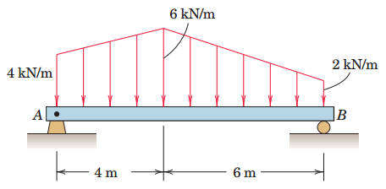
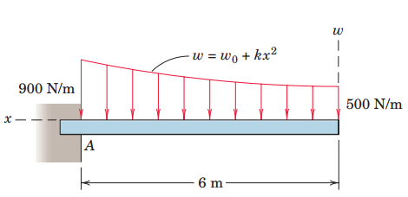
5. Beams…
Determining external effects…
Exercise
1. Calculate the support reactions at A and B for the beam subjected to the two linearly varying load distributions
2. A cantilever beam supports the variable load shown. Calculate the supporting force R_{A} and moment M_{A} at A
Notes:
Good morning?
Today we will see, …
we will begin with brainstorming questions that such as:…
How could define …?
Why it is important to …?

Slide 7
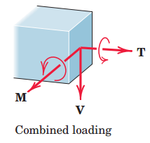
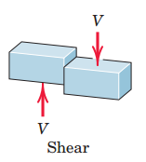
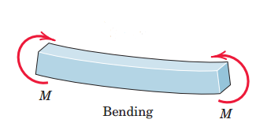
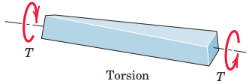
5. beams…
Determining internal effects
In this article we introduce internal beam effects and apply principles of statics to calculate the internal shear force and bending moment as functions of location along the beam.
Shear, Bending, and Torsion
In addition to supporting tension or compression, a beam can resist
shear, bending, and torsion. These three effects are illustrated in Figures below. The force V is called the shear force, the couple M is called the bending moment, and the couple T is called a torsional moment. These effects represent the vector components of the resultant of the forces acting on a transverse section of the beam as shown in the right figure.
Notes:
Good morning?
Today we will see, …
we will begin with brainstorming questions that such as:…
How could define …?
Why it is important to …?

Slide 8
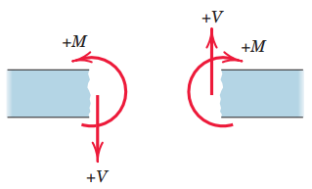
5. beams…
Determining internal effects …
Consider the shear force V and bending moment M caused by forces applied to the beam in a single plane. The conventions for positive values of shear V and bending moment M shown in Figure below are the ones generally used.
From the principle of action and reaction we can see that the directions of V and M are reversed on the two sections. It is frequently impossible to tell without calculation whether the shear and moment at a particular section are positive or negative. For this reason it is advisable to represent V and M in their positive directions on the free-body diagrams and let the algebraic signs of the calculated values indicate the proper directions.
Notes:
Good morning?
Today we will see, …
we will begin with brainstorming questions that such as:…
How could define …?
Why it is important to …?

Slide 9
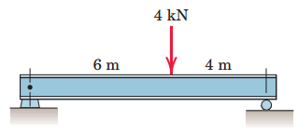
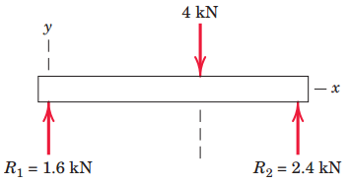
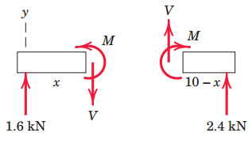



5. beams…
Determining internal effects …
Example
Determine the shear and moment distributions produced in the simple beam by the 4-kN concentrated load.
Solution: 1st using FBD of entire system
determine external or support reactions
A section of the beam of length x is next isolated with its FBD on which we show the shear V and the bending moment M in their positive directions. Equilibrium gives
These values of V and M apply to all sections of the beam to the left of the 4-kN load. A section of the beam to the right of the 4-kN load is next isolated with its
free-body diagram on which V and M are shown in their positive directions.
Equilibrium requires
Notes:
Good morning?
Today we will see, …
we will begin with brainstorming questions that such as:…
How could define …?
Why it is important to …?

Slide 10
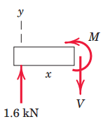


5. beams…
Shear and moment diagrams
Example
Determine the shear and moment distributions produced in the simple beam by the 4-kN concentrated load.
Solution:
1st using FBD of entire system determine external or support reactions
1
2
x
x
A section of the beam of length x is next isolated with its FBD on which we show the shear V and the bending moment M in their positive directions. Equilibrium gives
FBD of Section 1
These values of V and M apply to all sections of the beam to the left of the 4-kN load.
Notes:
Good morning?
Today we will see, …
we will begin with brainstorming questions that such as:…
How could define …?
Why it is important to …?

Slide 11
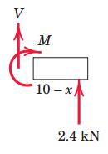
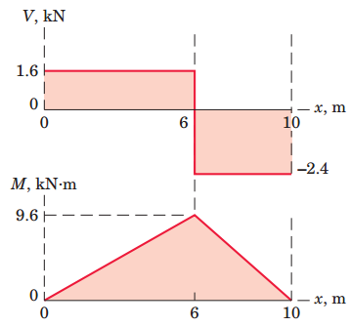
5. Beams…
Shear and moment diagrams…
Solution: continued…
A section of the beam to the right of the 4-kN load is next isolated with its free-body diagram on which V and M are shown in their positive directions. Equilibrium requires
These results apply only to sections of the beam to the right of the 4-kN load. The values of V and M are plotted as shown.
FBD of Section 2
The maximum bending moment occurs where the shear changes direction. As we move in the positive x-direction starting with x = 0, we see that the moment M is merely the accumulated area under the shear diagram.
Notes:
Good morning?
Today we will see, …
we will begin with brainstorming questions that such as:…
How could define …?
Why it is important to …?

Slide 12
5. beams…
Shear and moment diagrams…
Example 2: Construct the shear and moment diagrams for the beam loaded as shown
2 kN
1 kN/m
2 kNm
A
2 m
2 m
1 m
1 m
2 m
B
Solution:
i) Analyze the beam externally (i.e determine support reactions )
Free body diagram
2 kN
1 kN/m
2 kNm
A_{X}
A_{y}
2 m
1 m
B_{y}
2 m
1 m
2 m
Substitute the distributed force by its equivalent concentrated force at its centroid
(1 kN/m)*2m=
2kN
1 kN/m)*2m/2=
1kN
2 kN
2 kNm
A_{X}
A_{y}
1.33 m
0.67 m
1 m
1 m
B_{y}
1 m
1 m
2 m
By considering the beam as it is under state of equilibrium, we can solve the unknowns through equations of equilibrium
Notes:
Good morning?
Today we will see, …
we will begin with brainstorming questions that such as:…
How could define …?
Why it is important to …?

Slide 13
5. beams…
Shear and bending moment diagrams…
Example 2: Solution…
∑Fx=0, Assume as positive, hence Ax+0=0, Ax=0
∑M_{A}=0, Assume CCW as positive moment, Thus
By*8m-1kN*1.33m-2kN*3m-2kNm-2kN*6m=0; By=2.67kN ( )
∑Fy=0, Assume as positive, thus Ay+By-1kN-2kN-2kN=0,
Ay+By=5kN
by substituting the value of By=2.67 kN, then Ay=2.33kN ( )
ii) Analyze the beam internally (i.e determine internal actions such as shear and bending moment )
Free body diagram this time including values of support reactions
1
2
3
4
2 kN
5
1 kN/m
2 kNm
1
2
1 m
3
4
5
2 m
2 m
1 m
2 m
2.33kN
2.67kN
Decide on the number of segments to be analyzed. (i.e the number of sections to cut the beam )
Show the representative sections on the above free body diagram
(0≤ X ≤2)…by section 1---1 where x: distance on the beam as it is measured from left end.
(2≤X ≤4)…by section 2---2
(4≤ X ≤5)…by section 3---3
(5≤ X ≤6)…by section 4---4
(6≤ X ≤8)…by section 5---5
Notes:
Good morning?
Today we will see, …
we will begin with brainstorming questions that such as:…
How could define …?
Why it is important to …?

Slide 14
5. beams…
Shear and moment diagrams…
Example 2: solution …
Analysis of beam segment (0< X ≤2)
Free body diagram of LHS of section 1---1
w (kN/m)
V
M
2.33kN
x
w
1
From triangle similarity, w/1=x/2 ; Thus w=(x/2)kN/m.
Its equivalent concentrated force =w*x/2
=(x/2)*(x/2)=x²/4
Which is to be located 2x/3 from left end
x
2
X²/4 kN
Now it is easy to write equilibrium equation
From
∑Fy=0, Assume as positive, thus
2.33-x²/4-V=0, V=2.33- x²/4;
∑M_{A}=0, Assume CCW as positive moment, thus
M-2.33*x+(x²/4)*x/3=0; M=2.33x-x³/12
V
M
When x=0, V=2.33 kN
When X=2, V=2.33- 2²/4=1.33kN
2x/3
x/3
2.33kN
x
When x=0, M=2.33*0-0³/12=0
When X=2, M=2.33*2- 2³/12=4kN
Notes:
Good morning?
Today we will see, …
we will begin with brainstorming questions that such as:…
How could define …?
Why it is important to …?

Slide 15
5. beams…
Shear and moment diagrams…
Example 2: solution …
Analysis of beam segment (2≤ X ≤4)
Free body diagram of LHS of section 2---2
(1kN/m)*(x-2)=1(X-2) kN
1 (kN/m)
(1kN/m)*2m=1 kN
V
M
V
M
2m
1.33m
0.67m
x-2
2.33kN
x-2
2.33kN
x
x
Now it is easy to write equilibrium equation
From
∑Fy=0, Assume as positive, thus
2.33-1-1(x-2)-V=0, V=2.33-1-(x-2); V=1.33 - (x-2);
∑M_{A}=0, Assume CCW as positive moment, thus
M-2.33*x+1*(x-1.33)+1(x-2)*(x-2)/2=0;
M=2.33x-(x-1.33)-(x-2)*(x-2)/2
When x=2, V=1.33 kN
When X=4, V=1.33 - (4-2)=-0.67kN
When x=2, M=2.33*2-(2-1.33)-(2-2)*(2-2)/2=4kNm
When X=4, M=2.33*4-(4-1.33)-(4-2)*(4-2)/2=4.65kNm
Notes:
Good morning?
Today we will see, …
we will begin with brainstorming questions that such as:…
How could define …?
Why it is important to …?

Slide 16
5. beams…
Shear and moment diagrams…
Example 2: solution …
Analysis of beam segment (4≤ X <5)
Free body diagram of LHS of section 3---3. RHS of this and other sections afterwards may be easy. But lets use LHS for all of them. You can check by using RHS
(1kN/m)*(2m)=2 kN
1 (kN/m)
(1kN/m)*2m=1 kN
M
M
V
1.33m
0.67m
1m
x-3
V
2.33kN
2m
2m
2.33kN
x
x
Now it is easy to write equilibrium equation
From
∑Fy=0, Assume as positive, thus
2.33-1-2-V=0, V=2.33-1-2=-0.67kN
(Shear force is constant throughout this segment);
∑M_{A}=0, Assume CCW as positive moment, thus
M-2.33*x+1*(x-1.33)+2(x-3)=0;
M=2.33x-(x-1.33)-2(x-3)
When x=4, V=-0.67 kN
When X=5, V=-0.67kN
When x=4, M=2.33*4-(4-1.33)-2(4-3)=4.65kNm
When X=5, M=2.33*5-(5-1.33)-2(5-3)=3.98kNm
Notes:
Good morning?
Today we will see, …
we will begin with brainstorming questions that such as:…
How could define …?
Why it is important to …?

Slide 17
5. beams…
Shear and moment diagrams…
Example 2: solution …
Analysis of beam segment (5< X <6)
Free body diagram of LHS of section 4---4.
(1kN/m)*(2m)=2 kN
1 (kN/m)
(1kN/m)*2m=1 kN
2kNm
M
M
1.33m
0.67m
1m
x-3
V
2.33kN
2m
2m
V
2.33kN
x
x
Now using equilibrium equation
From
∑Fy=0, Assume as positive, thus
2.33-1-2-V=0, V=2.33-1-2=-0.67kN
(Shear force is constant throughout this segment);
∑M_{A}=0, Assume CCW as positive moment, thus
M-2.33*x+1*(x-1.33)+2(x-3)-2=0;
M=2.33x-(x-1.33)-2(x-3)+2
When x=4, V=-0.67 kN
When X=5, V=-0.67kN
When x=5, M=2.33*5-(5-1.33)-2(5-3)+2=5.98kNm
When X=6, M=2.33*6-(6-1.33)-2(6-3)+2=5.31kNm
Notes:
Good morning?
Today we will see, …
we will begin with brainstorming questions that such as:…
How could define …?
Why it is important to …?

Slide 18
5. beams…
Shear and moment diagrams…
Example 2: solution …
Analysis of beam segment (6< X <8)
Free body diagram of LHS of section 5---5
1 (kN/m)
2 kN
2kNm
M
2.33kN
2m
2m
1m
1m
V
x
1 kN
2 kN
2 kN
2kNm
M
1.33m
0.67m
1m
1m
1m
1m
2.33kN
V
x
Now using equilibrium equation
From ∑Fy=0, Assume as positive, thus 2.33-1-2-2-V=0, V=2.33-1-2-2=-2.67kN
(Shear force is constant throughout this segment);
∑M_{A}=0, Assume CCW as positive moment, thus
M-2.33*x+1*(x-1.33)+2(x-3)-2+2(x-6)=0;
M=2.33x-(x-1.33)-2(x-3)-2(x-6)+2
When x=6, V=-2.67 kN
When X=8, V=-2.67kN
When x=6, M=2.33*6-(6-1.33)-2(6-3)-2(6-6)+2=5.31kNm
When X=8, M=2.33*8-(8-1.33)-2(8-3)-2(8-6)+2=0kNm
Notes:
Good morning?
Today we will see, …
we will begin with brainstorming questions that such as:…
How could define …?
Why it is important to …?

Slide 19
5. beams…
Shear and moment diagrams…
Example 2: solution …
iii) Draw diagrams
Force diagram
2 kN
1 kN/m
2 kNm
2.33kN
2 m
2 m
1 m
1 m
2 m
Shear force diagram
2.67kN
+ve
2.33
1.33
V(kN)
0
-ve
-0.67
Bending moment diagram
5.98
-2.67
4.65
4
3.98
5.31
M(kNm)
+ve
0
-ve
Notes:
Good morning?
Today we will see, …
we will begin with brainstorming questions that such as:…
How could define …?
Why it is important to …?

Slide 20
5. beams…
Shear and moment diagrams…
Example 2: Solution …
iv) Determine the minimum and maximum moment
The location of minimum and maximum moment corresponds to the location where shear force is zero. Thus, look at the shear force diagram and identify the segment. After this use the segment`s equation of shear to be equal to zero.
i.e in this case segment two(2≤x≤4) with equations
V=1.33-(x-2)
M=2.33x-(x-1.33)-(x-2)*(x-2)/2
@ M _{max,} , V=0 hence 1.33-(x-2)=0 , x=3.33m from left is the location
Where shear force is zero and corresponding maximum moment in this segement.
Substituting x=3.33m in the moment equation gives the maximum moment as M_{max}=2.33*3.33-(3.33-1.33)-(3.33-2)*(3.33-2)/2
=7.76-2-0.88; M_{max}=4.88kNm in segment two. But look at the BMD, due to presence of CW concentrated moment at X=3, The BMD rises by that amount resulting in the maximum moment through out the beam. Thus M_{max}=5.98 kNm
M_{min}=0 by inspection, at the both in ends of the beam
Notes:
Good morning?
Today we will see, …
we will begin with brainstorming questions that such as:…
How could define …?
Why it is important to …?

Slide 21
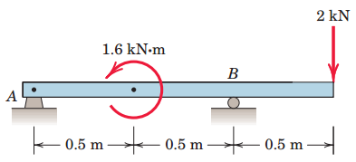
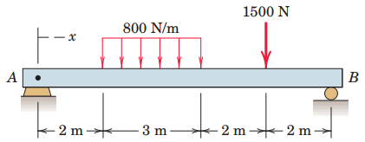
5. beams…
Shear and moment diagrams…
Exercise
1. Construct the shear and moment diagrams for the beam loaded by the 2-kN force and the 1.6-kN m couple. State the value of the bending moment at point B.
2. Plot the shear and moment diagrams for the beam loaded with both the distributed and point loads. What are the values of the shear and moment
at Determine the maximum bending moment, M_{max}
Notes:
Good morning?
Today we will see, …
we will begin with brainstorming questions that such as:…
How could define …?
Why it is important to …?

