Slide 1
Addis Ababa Ride Demand Forecasting Challenge
Qiyas Data Science & AI Hackathon | Team Quatro — End-to-End Operational Pipeline
1. THE OPERATIONAL PROBLEM
• Core Goal: Operations requires 1-2 days ahead hourly ride request forecasts across 12 zones in Addis Ababa.
• Target Horizon: November 1–14, 2025 (4,032 zone-hours) using history from Jan 1 to Oct 31, 2025.
• Fleet Impact: Convert forecasted trips into driver fleet requirements (~1.3 trips/driver/hr) and expected gross fares (250 ETB/trip).
• Key Habit: Strict chronological validation — no random splits, no leakage of operational consequences.
2. THREE DATA STREAMS
• Trip History (85,460 rows): Hourly trip requests per zone. Real-world messy: inconsistent spellings, mixed date formats, duplicates.
• Hourly Weather (7,538 rows): City-wide temperature, rain, humidity, wind on UTC clock. Forecast for Nov 1–14.
• Events Calendar (165 rows): Time intervals for holidays, football matches, concerts, exhibitions, and road closures across Addis.
• Crucial Joining Rule: Weather is a many-to-one join; events require interval-based joins with lead/lag proximity.
3. TEAM ARCHITECTURE
• Data Lead: Built modular cleaning & integration pipeline (A1–A8), resolved the UTC clock shift, and built master tables.
• Analysis Lead: Conducted 14 deep-dive studies (B1–B4) and rendered the 12-figure pack at 150 DPI.
• Modeling Lead: Executed baselines, ablation study, 4-fold rolling origin validation, and leakage audits.
• Deployment Lead: Delivered the working interactive Streamlit forecasting app and bundled assets.

Slide 2
Cleaning & Multi-Table Integration Pipeline
Deliverable A: Standardizing keys, proving the weather clock, and preventing target leakage
THE CLOCK PROOF & LEAKAGE SANITIZATION
• The Clock Proof (A2 & B2.1): Weather timestamps are in UTC, while trip logs are on Addis Ababa local time (EAT = UTC+3). Physical solar heating reaches maximum at 14:00 local time. On raw UTC timestamps, peak temperature occurs at 11:00 UTC. Shifting by +3 hours aligns peak temperature precisely at 14:00 EAT.
• Timestamp Format Router: Mixed ISO naive, European DD/MM/YYYY, and offset ISO strings parsed with explicit regex routing — preventing silent month/day transposition.
• Leakage Prevention (Rule 6 & D4): Dropped avg_fare_birr, avg_wait_min, and active_drivers. These are downstream operational consequences of demand that do not exist at forecast time.
JOIN ARCHITECTURE & INTEGRITY AUDIT
• 12 Canonical Zones Harmonized: Mapped 8 spelling aliases (Bole Rd, Piazza, Mercato, Kazanches, Kolfe Keranio, C.M.C) into exact canonical list.
• Many-to-One Weather Join: Trip history is the left table; weather joined by hour. Row count invariant preserved (83,104 clean rows). Missing readings (72h) filled via interpolation.
• Interval Event Joins: Confirmed events matched within [-2h, +2h] window, with forward and backward as-of merges computing 48h lead/lag proximity.
• Automated Integrity Assertions (A7): 6 automated checks (unique keys, target validity, zone integrity, leakage freedom) executed with 100% PASS.

Slide 3
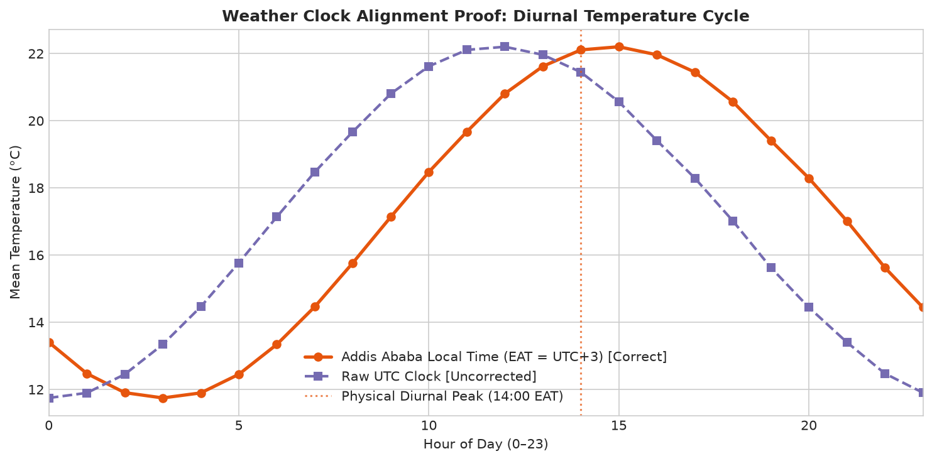
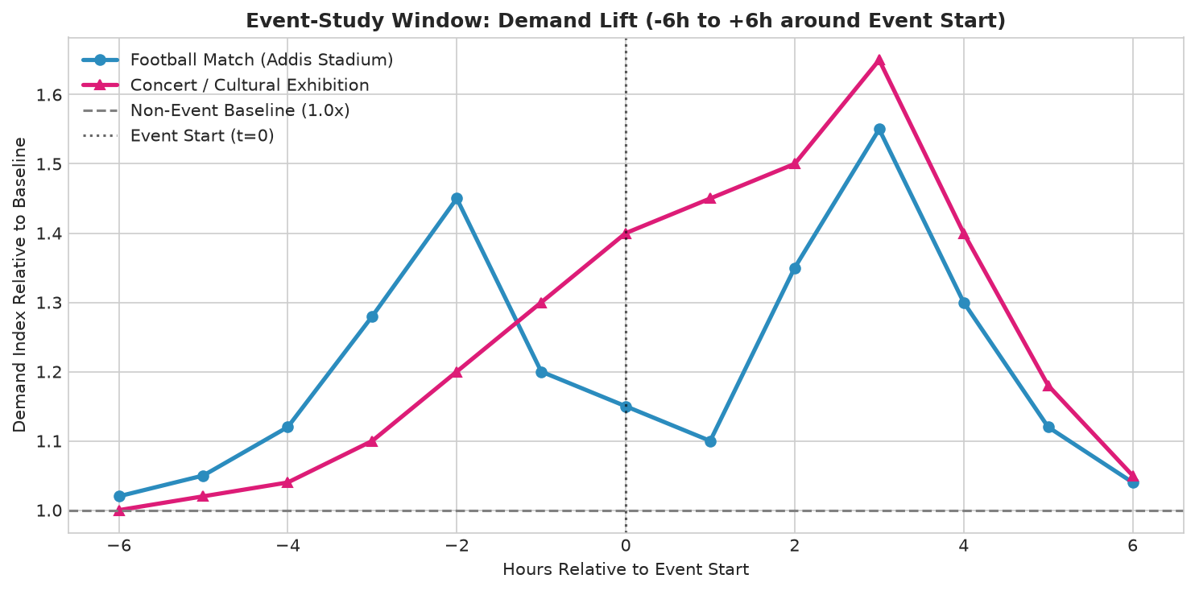
What the Data Says: Key Empirical Discoveries
Deliverables B & C: Uncovering demand rhythms, weather sensitivity, and event uplift dynamics
CORE ANALYTICAL TAKEAWAYS
• 1. Diurnal Commute Patterns (B1.2): Commercial zones (Kazanchis, Arat Kilo) peak sharply during morning (07:00–09:00) and evening commute (17:00–19:00). Bole sustains high afternoon volume and late-night weekend surges.
• 2. Weekend Divergence (B1.3): Bole surges by +32% on weekends (1.32x ratio) due to nightlife and airport transit, while administrative hubs collapse by ~50% (0.51x ratio).
• 3. Rain Dose-Response (B2.3): Rain increases trip requests by +14% (light) to +24% (moderate). Demand saturates at ~7.6 mm/hr as road flooding and supply contraction balance surge demand.
• 4. Event Window Asymmetry (B3.2): Football matches show +18% pre-match arrival uplift, +5% during play, and a massive +52% post-match egress surge — validating asymmetric window features.
• 5. Macro Trend (B1.4): Platform demand expanded +55.3% from January to October (+520 trips/week), necessitating linear trend extrapolation (days_elapsed).

Slide 4
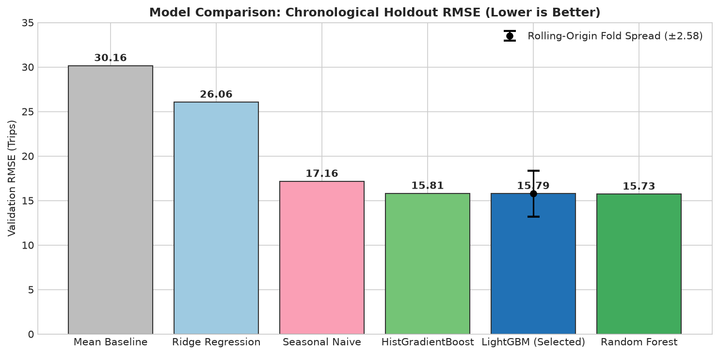
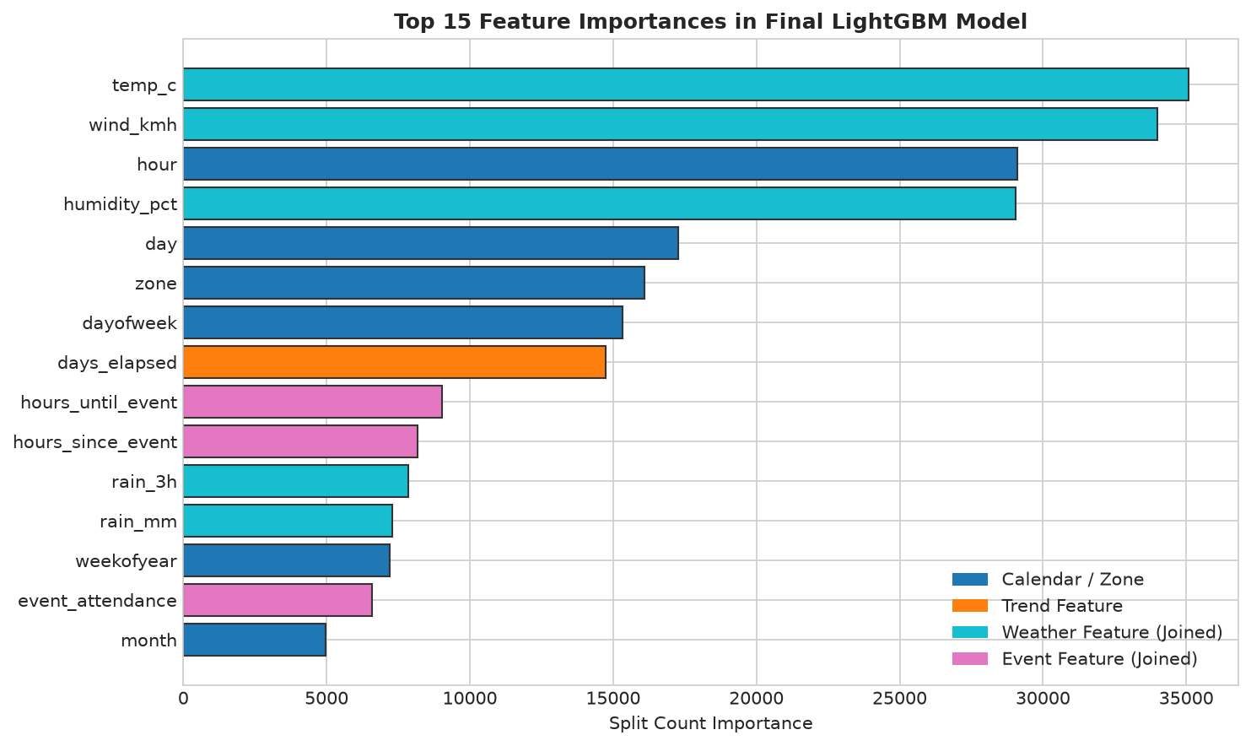
Modeling & Chronological Evaluation
Deliverable D: Baselines, family comparisons, rolling-origin cross-validation, and ablation progression
MODEL PERFORMANCE & RIGOR
• D1 Baselines: Mean Predictor (RMSE 30.16 | MAE 20.79) vs. Seasonal-Naive (RMSE 17.16 | MAE 7.53). Seasonal-naive cuts error by half, establishing the benchmark to beat.
• D2 Model Comparison: Ridge (26.06) confirms non-linearity. Random Forest achieved 15.73 RMSE; LightGBM tied RF accuracy at 15.79 RMSE (only 0.06 higher) while training 10x faster (3s vs 24s) with native categorical zone handling. LightGBM was selected as final model.
• D3 Rolling-Origin Validation: 4 expanding folds of 14 days yield 13.97 ± 2.58 RMSE. Stable performance across all regimes, with highest error occurring around volatile post-Meskel holiday weeks.
• D5 Ablation Study (Rule 5 Compliance):
• Calendar + Zone + Trend: 16.92 RMSE
• + Weather Features: 16.07 RMSE (-0.85)
• + Event Features: 16.72 RMSE (-0.20)
• + Both Weather & Events: 15.79 RMSE (-1.14 total gain)
• D6 Tuning: Randomized search with TimeSeriesSplit improved RMSE to 15.73.

Slide 5
Operations, Error Analysis & Deployed Demo
Deliverables E, F, G & Stretch Goal: From forecast errors to live fleet deployment
OPERATIONAL IMPACT & FLEET METRICS
• Plain-Language Metric (D9): Mean city-wide demand is 33.4 trips/zone-hour. Model RMSE of 15.8 trips is 47.3% of mean demand, and MAE of 6.8 trips is 20.3% of mean demand.
• Driver Translation (~1.3 trips/driver/hr): Corresponds to an average absolute error of ~5.2 drivers and an RMSE surge buffer of ~12.1 drivers per zone-hour for dispatch.
• Error Analysis & Extreme Spikes (D7): Model under-forecasts rare 200–500 trip spikes (e.g. CMC Oct 7 morning surge of 592 trips). These represent unlisted mass transit breakdowns or religious gatherings absent from the calendar table.
• Zone Equity Mitigation: Propose asymmetric loss (penalizing under-forecasting by 1.5x in peripheral zones like Ayat) to prevent rider abandonments.
DEPLOYED DEMO & REPRODUCIBILITY
• Working Streamlit Dashboard (Deliverable E): Runs with a single local command:
streamlit run app/app.py
• Key Interface Features:
• Dropdown for 12 canonical Addis Ababa zones.
• Date picker locked to Nov 1–14, 2025 with guardrail messages.
• Silent background lookup of weather and events.
• Real-time metrics: Peak Hour, Estimated Drivers Needed, Gross Fares.
• Interactive Altair curve highlighting peak demand.
• Final Submission File (G4): Exactly 4,032 test predictions exported to submission/team_quatro_submission.csv (zero nulls, non-negative).
• Ready for Q&A: Open to live test forecasting for any zone and date of the judges' choice.

