Slide 1

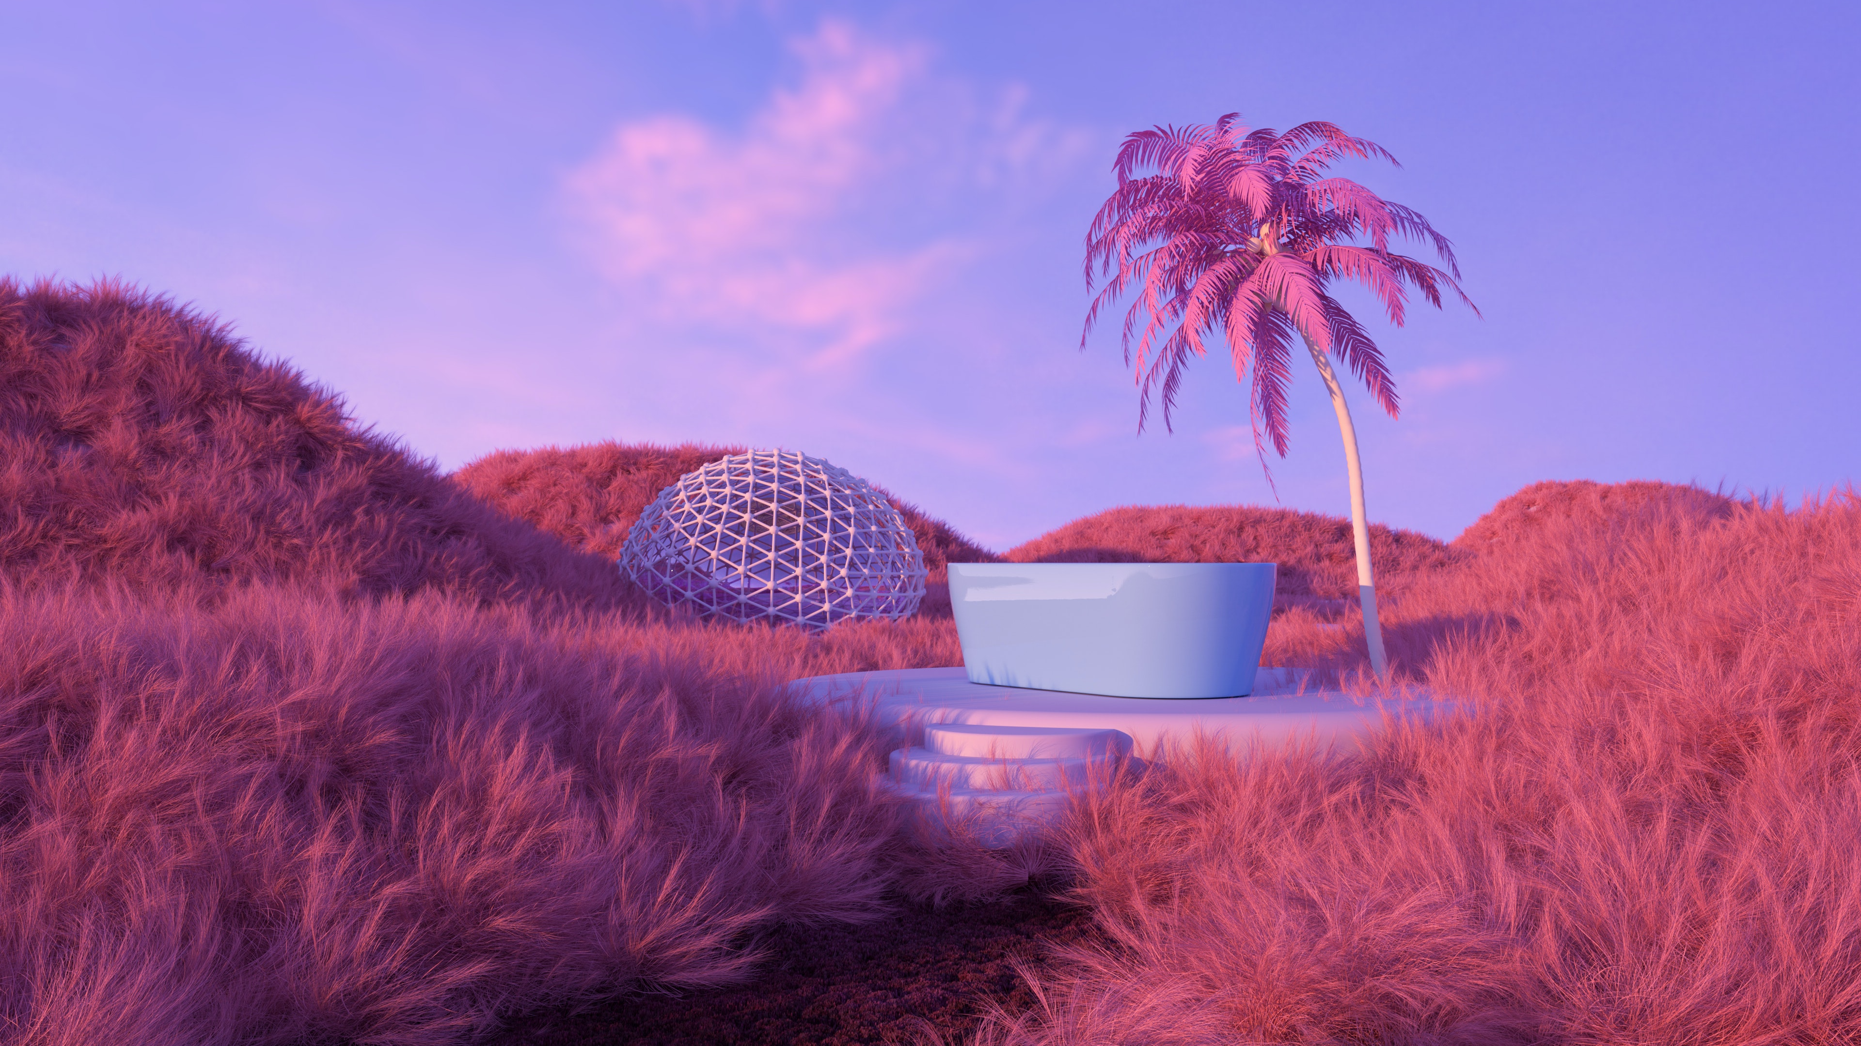
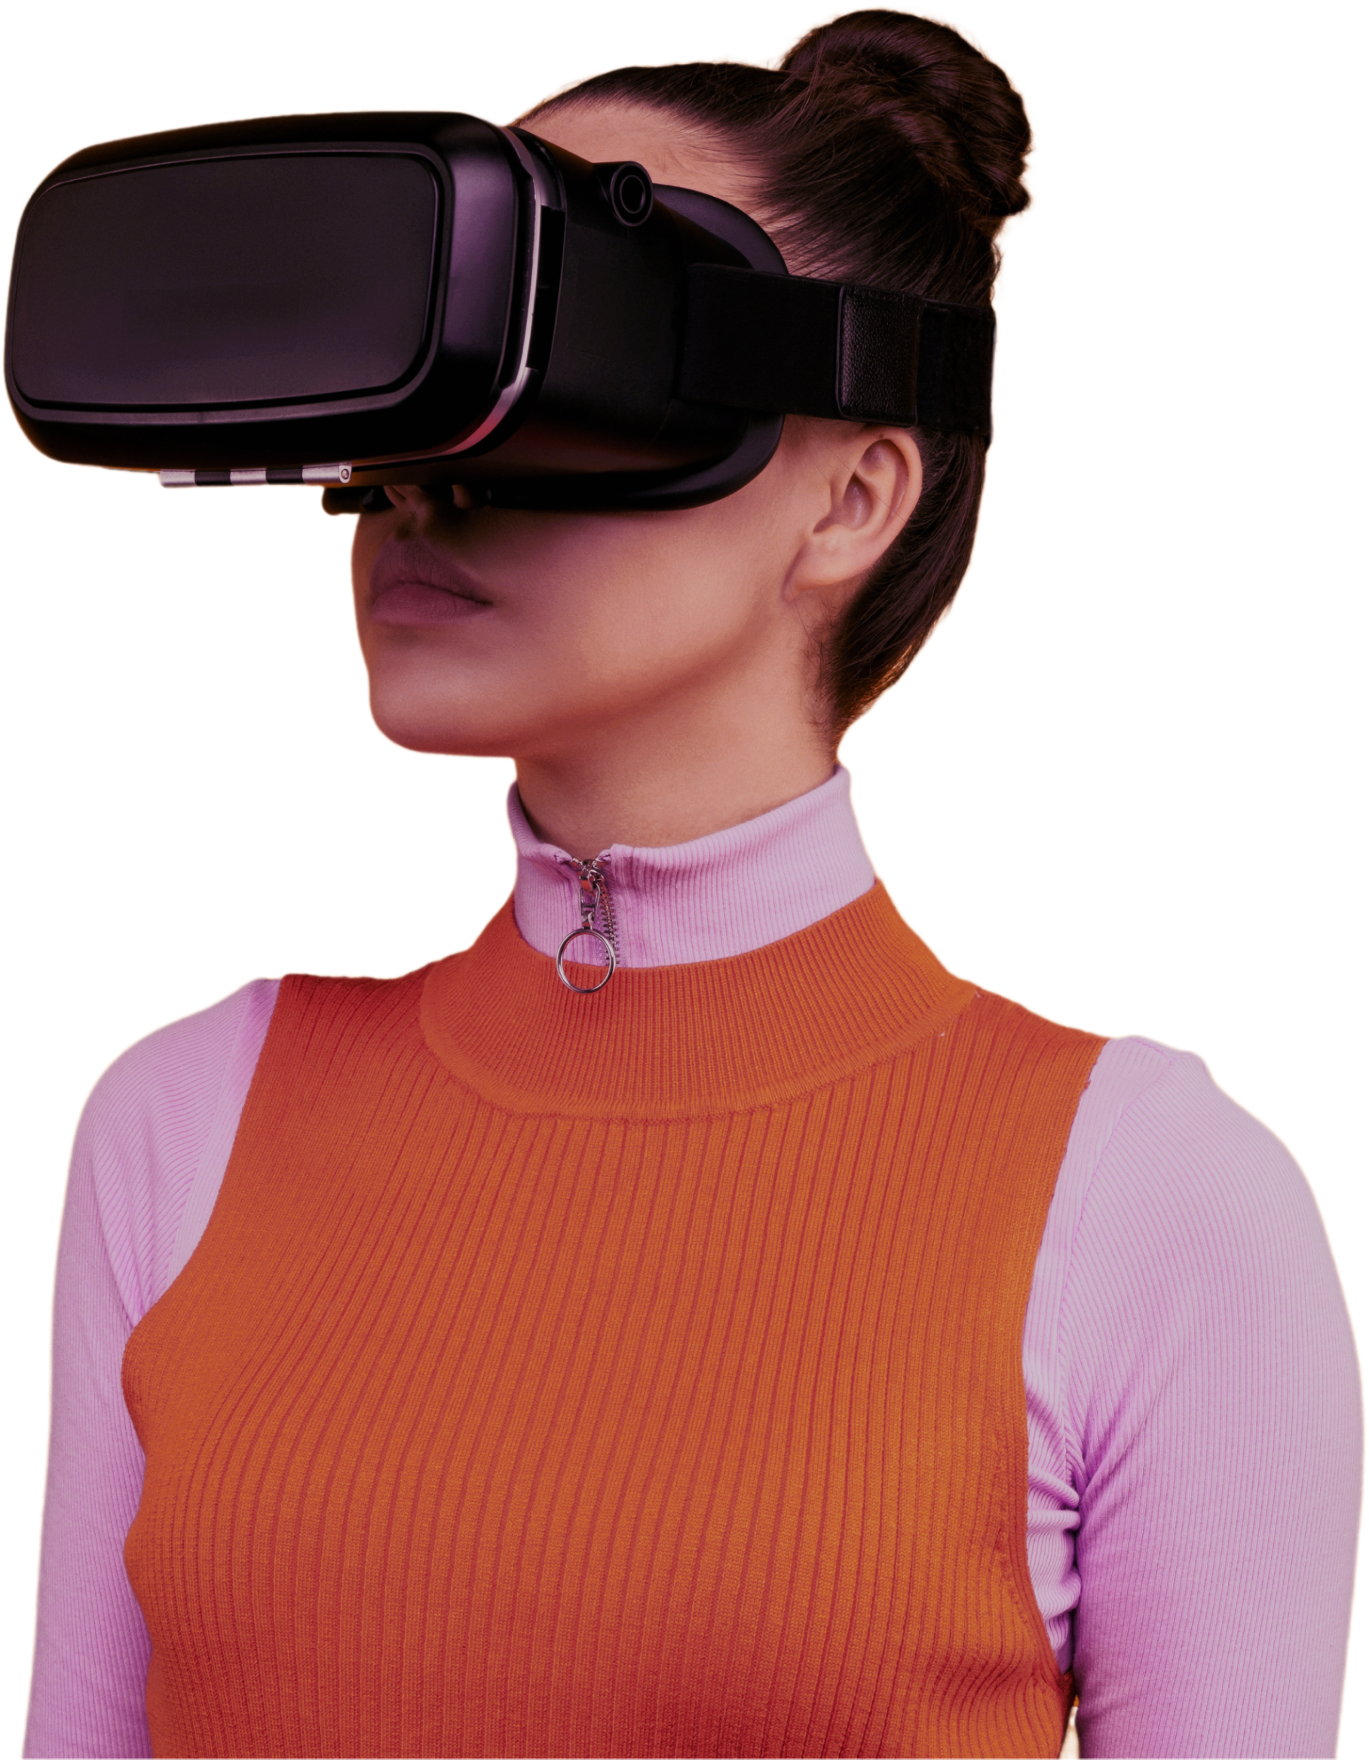

Good
Morning!
Let’s Plan Your
Wonderful Day!
Raminta
July 26, Tuesday
Tuesday
07:00
26
9 AM
10 AM
11 AM
12 AM
Gym
10:00 -11:00
16°
18°
20°
23°
Meeting
12:00 -13:00

Slide 2

Good
Morning!
Let’s Plan Your
Wonderful Day!
Raminta
July 26, Tuesday
Tuesday
07:00
26
9 AM
10 AM
11 AM
12 AM
Gym
10:00 -11:00
16°
18°
20°
23°
Meeting
12:00 -13:00
July 2023
Vilnius, Lithuania
S | M | T | W | T | F | S
 |  |  |  |  |  | 1
2 | 3 | 4 | 5 | 6 | 7 | 8
9 | 10 | 11 | 12 | 14 | 15 | 16
17 | 18 | 19 | 20 | 21 | 22 | 23
24 | 25 | 26 | 27 | 28 | 29 | 30
°
23
Tuesday
26
9 AM
10 AM
11 AM
12 AM
Breakfast
16°
18°
20°
23°
08:00 -09:00
Gym
Phone Battery
10:00 -11:00
Meeting
12:00 -13:00
Lunch
75%
13:00 -14:00
Design Work
15:00 -16:00
Yoga
17:00 -18:00
Meditation
19:00 -20:00

Slide 3

Good
Morning!
Let’s Plan Your
Wonderful Day!
Raminta
Vilnius, Lithuania
Phone Battery
Tuesday
°
23
26
July 26, Tuesday
Tuesday
9 AM
10 AM
11 AM
12 AM
75%
Gym
07:00
26
10:00 -11:00
16°
18°
20°
23°
Meeting
12:00 -13:00
9 AM
10 AM
11 AM
12 AM
Breakfast
08:00 -09:00
16°
18°
20°
23°
Gym
10:00 -11:00
Meeting
12:00 -13:00
July 2023
Lunch
S | M | T | W | T | F | S
 |  |  |  |  |  | 1
2 | 3 | 4 | 5 | 6 | 7 | 8
9 | 10 | 11 | 12 | 14 | 15 | 16
17 | 18 | 19 | 20 | 21 | 22 | 23
24 | 25 | 26 | 27 | 28 | 29 | 30
13:00 -14:00
Design Work
15:00 -16:00
Yoga
17:00 -18:00
Meditation
19:00 -20:00

Slide 4
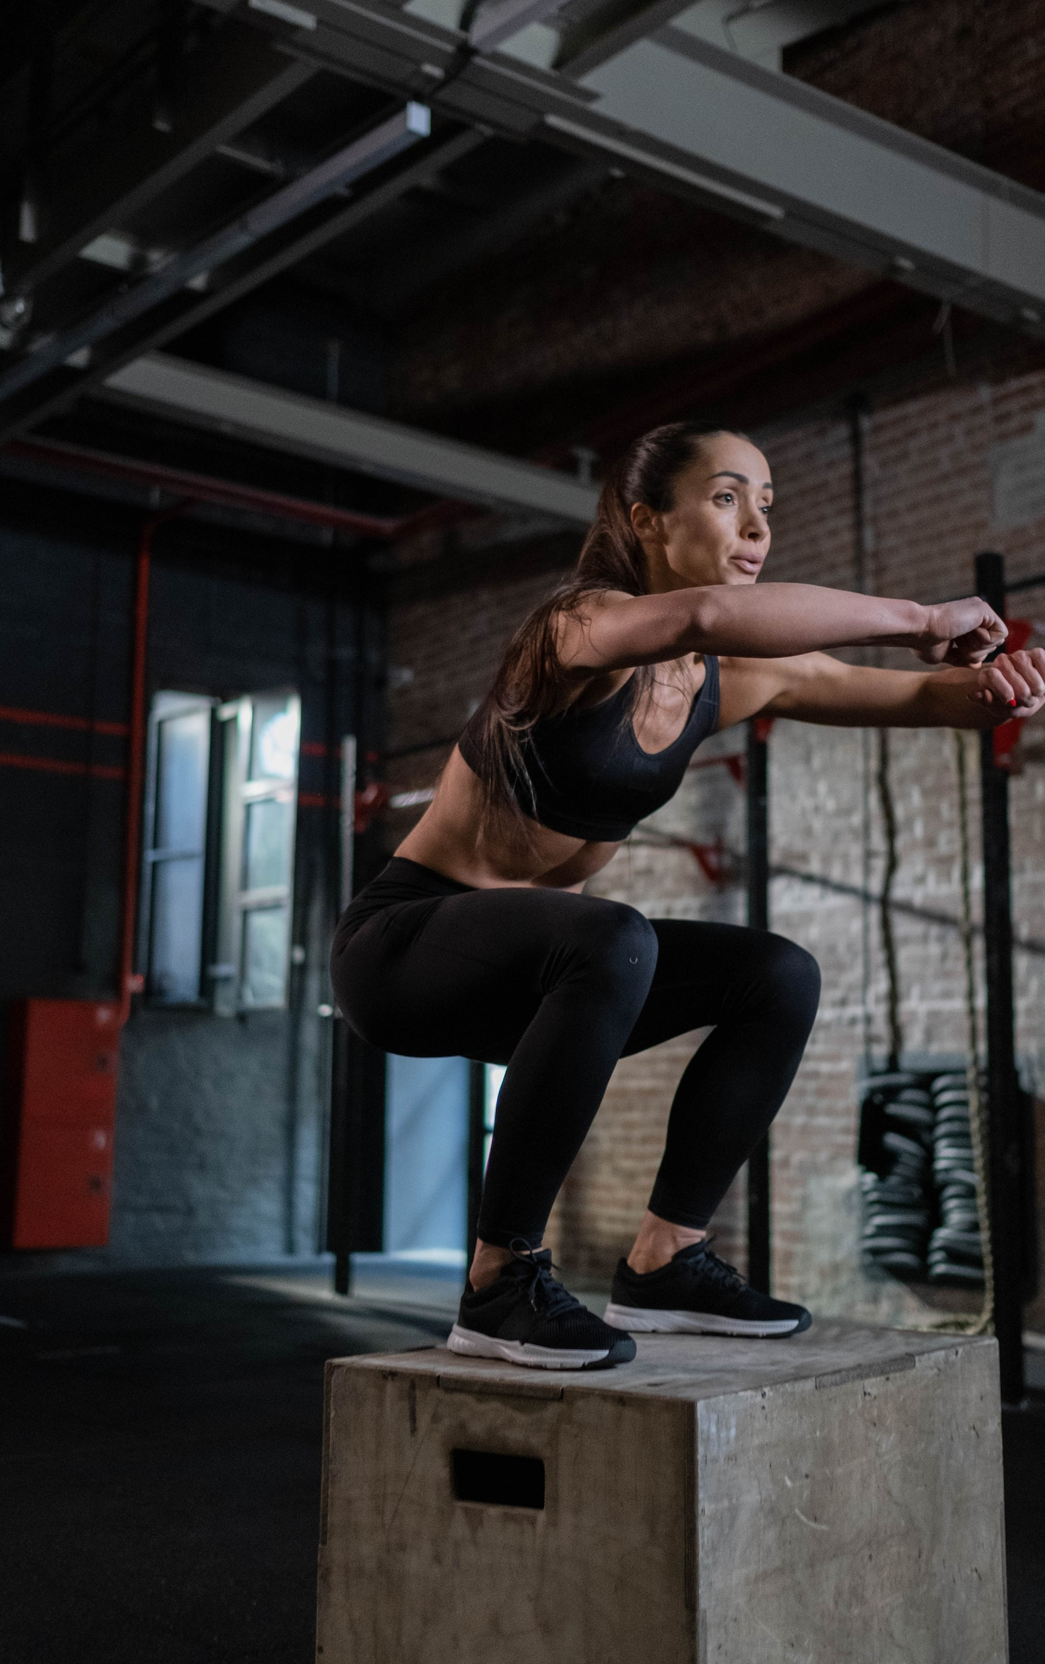
Go Back
Gym
Warm Up
10:00 – 11:00
5 minutes
Squats
Sets: 4 | Reps: 12
Box Jumps
Sets: 4 | Reps: 12
Hip Thrusts
Sets: 4 | Reps: 12
Cool Down
5 minutes

