Slide 1

Hawcoder: Session 1
Lecture 1:
Intro
Arithmetic
Expressions
Variables
Presenter: Dagmawi Shigute

Slide 2
Intro & Logistics

Slide 3
Who are we?
Assistants
Presenter
B
Biniyam Mengistu
Dagmawi Shigute
A
Amr Abdulwahid
Co-founder, Hawcoder
M
Meklit Andualem
A
Abenezer
Feel free to ask the assistants questions anytime!

Slide 4
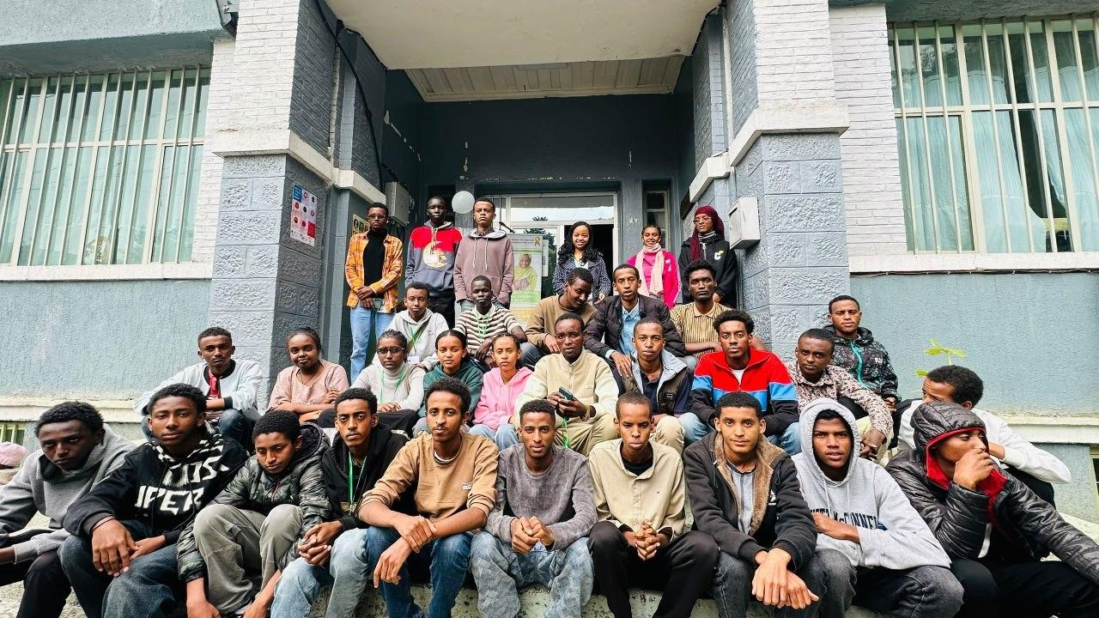
We learned this at AddisCoder 2026
We were students at AddisCoder 2026
4 weeks of Python, data structures & algorithms
Now we are bringing what we learned to you
Our group at AddisCoder 2026

Slide 5
Who are you?
Notes:
Icebreaker: names, grade, any coding experience?

Slide 6
What is this course?

Slide 7
Course Overview
Goal: build a core foundation of computational thinking through studying data structures and algorithms.
10 sessions, one per week (1 hour each):
Session 1: Intro, arithmetic, variables (today!)
Session 2: Data types, operators, casting
Session 3: Control flow, strings
Session 4: Loops, range, lists
Session 5: Functions, print vs. return
Session 6: Scope, recursion
Session 7: Time complexity
Session 8: Big-O, linear & binary search
Session 9: Sorting (bubble, selection, merge)
Session 10: Graphs, DFS, BFS

Slide 8
Session Structure
Mix of slides and a Colab notebook
Questions throughout
Interactive!
Ask our assistants questions anytime
When you see J, we jump to the notebook
TIME | SCHEDULE
0:00–0:10 | Intro: who we are, why CS, what is programming
0:10–0:17 | Google Colab basics & print()
0:17–0:27 | Arithmetic operators (+ - * / //)
0:27–0:37 | Exponentiation (**) & modulo (%)
0:37–0:47 | Order of operations & Think-Pair-Share
0:47–0:52 | Python errors & comments (#)
0:52–1:00 | Variables & naming rules
Let’s begin!

Slide 9
Lecture Goals
By the end of Session 1, you will know…
Who we are and how the course works (just finished)
What is programming and where do we do it?
Basic building blocks of code
  Colab basics & print()
  Arithmetic: + - * / // ** %
  Order of operations
  Errors & comments
  Variables & naming rules

Slide 10
Why Study Computer Science?
Daily life is powered by CS
A driver of human progress
Not just software engineering
Videos and social apps
Messaging
Maps and ride-hailing
Online banking
Self-driving cars
Decoding ancient DNA
AlphaGo beating Go champions
Weather forecasting
Biology and medicine
Finance and markets
Art and design
…and now AI!
Many reasons beyond just wanting to make websites and apps! It’s also just fun :)
Notes:
Ask: where did you use CS today?

Slide 11
Programming?

Slide 12
What is programming?
“Programming” is designing and writing code to accomplish some task.
Smaller Tasks
Show an image on a screen
Make a robot move its arm to the right
Compound interest calculator
Bigger Tasks
Browse videos on YouTube (build the YouTube app)
Build a website for your class
Find the fastest route from your home to school

Slide 13
Why Learn Python?
Perfect language to start coding in
Easy to read
Very little “syntax”
  syntax: the rules of grammar in a programming language
Used extensively in the real world
  YouTube, Instagram, NASA, and more
print("Hello, world!")
print(2 + 3)
Output
Hello, world!
5

Slide 14
Opening the Notebook in Colab
1
Sign in with a Google account
2
Open the notebook link: [add link]
3
File → Save a copy in Drive, so your changes are saved
4
Click a cell and press Shift + Enter to run it
Notes:
Walk through this live on the projector, then let students open it themselves before moving on.

Slide 15
Programming Environment
We will be coding in “Google Colab”...
Let’s jump to it
J
Notes:
Notebook: Colab basics, print("Hello my name is ..."), cells and shift+enter. Remind students multiplication is * not x.

Slide 16
Making the computer show something
“print” is a special word we use to tell the computer to show text on the screen.
print(12)
print(7 + 9)
12
16
We’ll learn more about where these special words come from later.
J
Notes:
Notebook: print(1 + 1), print(2 - 7), print(12 * 20). Without print, only the last line of a cell shows.

Slide 17
Expressions

Slide 18
Arithmetic Operators
The same operators that you’re used to in math work in Python.
Addition (+)
sum = 5 + 6
In Colab:
Each computation runs in a cell
Shift + Enter runs a cell
Only the last line of a cell is shown
Multiplication is * (not x)
Subtraction (-)
diff = 12 - 5
Multiplication (*)
product = 8 * 4
Division (/)
quot = 12 / 5
J
Notes:
Notebook (cells 3-12): 2 - 5, 10 / 5, 5 * 12, then 1 + 1, 12 + 12, 100 - 20, 472 - 111. Stress shift + enter, that only the last line shows, and * not x.

Slide 19
Division is Special
Floor division: // divides 2 numbers and rounds down to the nearest int.
x // y answers the question “How many times does y completely fit into x?”
Examples:
10 / 2 # 5.0
9 / 2 # 4.5
9 // 2 # 4
100 // 3 # 33
10 // 2 == 5
11 // 2 == 5
175 // 4 == 43
J
Notes:
Notebook (cells 14-18): 1+1, 10 / 2, 9 / 2, 9 // 2, 100 // 3.

Slide 20
Expressions
Expressions are combinations of operators and values evaluating to a single value.
Operands
Operator: +, -, //
Expression: 1 + 1, 72 // 3
Evaluate: apply the operator and get the resulting value
2 + 4
Operator
2 + 4 evaluates to 6.

Slide 21
Expressions
The operands in an expression can themselves be expressions. Expressions are always evaluated operand-first.
17 + (3 * 11)
17 + (33)
50
Python will simplify any expression, no matter how complicated, down until it gets to a single value!

Slide 22
Order of Operations
Operations happen in a specific order in Python. So far:
1
Multiplication & division
* / //
2
Addition & subtraction
+ -
Multiplication and division have equal precedence: they run left to right.
1 + 2 * 3 // 2 # 4
J
Notes:
Notebook (cells 21-25): 1 * 2 + 3, 1 + 2 * 3, the five basic expressions, 1 + 2 * 3 // 2, 1 + 2 * 3 // 2 - 3.

Slide 23
Order of Operations: Parentheses
You can also use parentheses in Python. Parentheses always happen first.
7 + ((20 // 4) * 2)
7 + ((20 // 4) * 2)
7 + (5 * 2)
7 + 10
17

Slide 24
Special Operation: Exponentiation
Suppose you want to compute 2⁵. You could write 2 * 2 * 2 * 2 * 2, but that is verbose!
Syntax: a ** b means a to the power b
It is NOT ^ ... beware!
2 * 2 * 2 * 2 * 2 # 32
2 ** 5 # 32
2 ** -1 # 0.5
3 ** -2 # 0.111…
J
Notes:
Notebook (cells 28-31): 2 * 2 * 2 * 2 * 2, 2 ** 5, 2 ** -1, 3 ** -2.

Slide 25
Special Operation: Modulo
Modulo: % takes the remainder after division
5 // 2 is 2, and the remainder is 1, so 5 % 2 is 1.
Examples:
5 % 2 == 1
10 % 2 == 0
17 % 5 == 2
17 % 5 = 2
three full groups of 5, with 2 left over
J
Notes:
Notebook (cells 33-36): 5 % 2, 10 % 2, 17 % 5, then 17 - (5 * 3) to show where the remainder comes from.

Slide 26
Order of Operations: Putting It All Together
1
Parentheses
( )
2
Exponent
**
3
Multiplication & division, left to right
* / // %
4
Addition & subtraction, left to right
+ -
Everything on the same line has equal precedence!

Slide 27
Order of Operations: Example
(1 + 2) * 3 ** 2 // 2
3 * 3 ** 2 // 2
3 * 9 // 2
27 // 2
13
the expression
parentheses first
exponent next
multiplication, left to right
floor division
J
Notes:
Notebook (cells 39-40): (1 + 2) * 3 ** 2 // 2 and 27 // 2.

Slide 28
Think-Pair-Share: Predict Before Running!
Look at each expression with a neighbor. What will Python output?
5 // 2 * 4
5 * 2 // 4
6 // 5 * 8 / 3
1 + (3 * 2 + 1) ** 2
Predict first, then we run it live!
J
Notes:
Notebook (cells 42-45). Answers: 8, 2, 2.6666666666666665, 50.

Slide 29
Errors
Programming languages are very specific
If you do not write code precisely, you get an error
Errors are normal! You will see many in lab
Read the message: it tells you what went wrong
1 + # SyntaxError
2 * * 4 # SyntaxError
3 x 4 # SyntaxError
10 / 0 # ZeroDivisionError
ZeroDivisionError: division by zero
J
Notes:
Notebook (cells 47-51): 2 ** 4 works, then 1 +, 2 * * 4, 10 / 0, 3 x 4.

Slide 30
If you’re confused, test in Colab!
We have limited time in lecture
Most of the course happens in lab
When a question is confusing, the best way to find out is to test it yourself
10 % -1
10 / -1
10.2321 % 2
20 ** 0.5
10 % 20
J
Notes:
Notebook (cells 53-58): run the five confusing examples, then the final cell with print(1 + 1), print(2 - 7), print(12 * 20) to show several outputs from one cell.

Slide 31
Comments
Text after # is ignored by Python
Used to explain code to other people
Also great for notes to your future self
# hello I am a comment
# print("Hello my name is Dagmawi")
# print(1 + 1)
print(75 // 10)
Output: 7
# I think 2 ** 2 will go first
print(1 + 10 * 2 ** 2)
Output: 41
J
Notes:
Notebook (cells 60-61).

Slide 32
Variables

Slide 33
Think back to your algebra class...
a = 5
b = 6
c = a + b
What’s the value of c?
How did you know?

Slide 34
Python Variables
Python has the same concept.
A variable is a storage location filled with a value and associated with an identifier.
num_apples = 5
Think of it as a box with a name in the computer’s brain.

Slide 35
Assign and Reference
Assigning a variable means storing a value in memory with a given name.
In variable assignment, the variable name is always on the left side of the equals sign:
x = 7
y = x + 2
name = "Dagmawi"
Global frame
computer’s “memory”
x
7
y
9
name
"Dagmawi"

Slide 36
Assign and Reference
Referencing a variable is how you read the value from memory.
x = 7
print(x)
Global frame
x
7
print(x) looks up x in memory and shows 7.

Slide 37
Assign and Reference
You can reassign a variable...give it a new value.
# assign 5 to num_apples
num_apples = 5
print(num_apples)
# assign a new value
num_apples = 7
print(num_apples)
Global frame
num_apples
7
Output
5
7
J
Notes:
Notebook (cell 63): assign 5 to num_apples and print, then reassign to 7 and print. Left of = assigns, otherwise it references.

Slide 38
Variable Names in Python
Must be made up of letters, digits (0-9) or the underscore character _ .
May not start with a digit.
May not be a “reserved word”
✓
my_variable
✕
dagmawi!
✓
DAGMAWI
✕
1stplace
✓
place1
✕
2472ab
✓
x
✕
for
✓
first_name
✓
_first_name
J
Notes:
Notebook (cells 65-68): my_variable and DAGMAWI work, 1stplace fails (place1 works), dagmawi! fails.

Slide 39
What Would Python Print? (WWPP)
Python runs and executes code line-by-line.
budget = 500
dinner_cost = 100
gift = 25
remaining = budget - dinner_cost - gift
print(remaining)
gift = 200
print(remaining)
Output
375
375
remaining is still 375: gift changed after remaining was computed.
budget | dinner_cost | gift | remaining
500
500 | 100
500 | 100 | 25
500 | 100 | 25 | 375
500 | 100 | 200 | 375
J
Notes:
Notebook (cell 69): budget / dinner_cost / gift. Changing gift later does not change remaining.

Slide 40
Variables Hold Different Types of Things
"Dagmawi"
True
12
7.5
str
text
bool
True / False
int
whole numbers
float
decimals
type(x) tells you the type of a value. We will study types in detail soon.
J
Notes:
Notebook (cell 70): var1 = "Dagmawi", var2 = True, var3 = 12, var4 = 7.5 and print(type(...)). Just a teaser; types are Session 2.

Slide 41
Recap
print() shows values on the screen
Operators: + - * / // ** %
Order of operations: ( ) → ** → * / // % → + -
Errors are normal: read them, then fix them
Variables: assign with =, reference by name
Names: letters, digits, _ (no leading digit, no reserved words)
Next: lab time! [add practice link / homework]

