Slide 1
Where is my program?
Does my microcontroller run C language code?
Where does it store its instructions?
How does the microcontroller know where to begin?
What happens during a reset?
How does a computer program a microcontroller
Are there going to be burgers in today’s class?

Slide 2
Microcontroller programming
Daniel Martínez
I7266 - Programación de Sistemas Embebidos
CUCEI - UDG

Slide 3
Compiler

Slide 4
Avr Memory Map

Slide 5
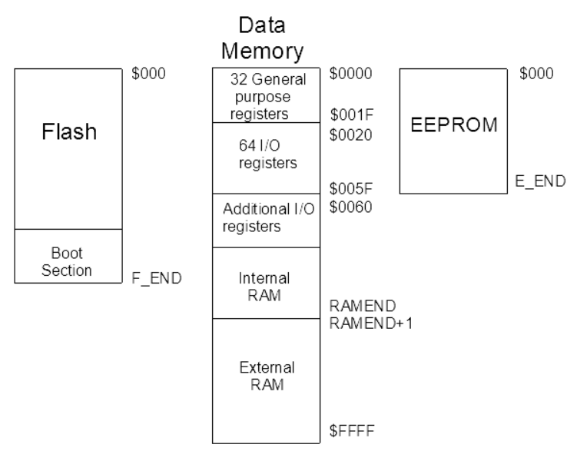

Slide 6
I/O ports and registers

Slide 7
How do we talk to the exterior?
Microcontrollers have input/output pins that can be used to receive and send signals with other devices.
In AVR microcontrollers, we usually have ports, which are controlled by i/o registers, for example, in the Atmega328p there are four ports, namely PORTA, PORTB, PORTC and PORTD, and the behaviour and data in these ports is configured and read via the DDRx, PORTx and PINx registers.

Slide 8
i/o ports basic functionalities
We will employ the ports in the following manner:
To set the direction of a port, we will use the Data Direction Register (DDRx).
  If DDxn is written logic one, Pxn is configured as an output pin, if DDxn is written logic zero, Pxn is configured as an input pin.
Remember, in this notation DDxn can be read as the bit “n” in the Data Direction Register for port “x”.
This all means writing 00000001 binary to DDRx will enable bit 0 of port “x” as output.

Slide 9
i/o ports basic functionalities
Example 1:
I look at the datasheet and I choose pin PC5 to output a digital signal.
From the name of the pin I know that I need to search for the register DDRC and I need to write a logic one into the bit 5.
In binary, a one in the bit 5 can be set in different equivalent ways. Let us explore some of them.

Slide 10
i/o ports basic functionalities
The objective is to send the binary value <<00100000>> to the DDRC register.
We should not write that value directly to the register, this is, we cannot do DDRC = 00100000 since that number would be interpreted as decimal.
It is possible, however, to indicate that it is a binary number appending the suffix “0b”, e.g.: 0b00100000. Note that this is not recommended since it is out of the standard.

Slide 11
i/o ports basic functionalities
Since it is not recommended to use <<0b00010000>>, we can use other methods to write that value to the DDRC register, the first one is using its decimal or hexadecimal value:
  In decimal, that value represents 16. So, DDRC = 16 is good.
  In hex, that value represents 0x10. So, DDRC = 0x10 is good too.
Another way is doing a bit shift, if we want to put a 1 in the 5th bit of a byte, we can do 1 << 5.
Indeed, DDRC = 1 << 5 would work just fine.

Slide 12
i/o ports basic functionalities
The aforementioned methods would do the job, but those are not the safest methods.
  First, it is a good practice that instead of assigning a logic one to a bit, we OR-operate it so the rest of the bits are not affected.
  Second, while using operators in C, we make use of parenthesis to make clearer the intention of the operator employed.
  Third, we can use macros and constants to make things clearer.
Here are some real life examples of this.

Slide 13
i/o ports basic functionalities
DDRC |= (1 << PORTC5);
  PORTC5 is a preprocessor constant equivalent to 5.
DDRC |= _BV(PORTC5);
  The macro _BV is a preprocessor function that does the shift during preprocessing, making things faster.

Slide 14
i/o ports basic functionalities
Example 2:
I look at the datasheet and I choose pin PB1 to read a digital signal.
From the name of the pin I know that I need to search for the register DDRB and I need to write a logic one zero the bit 1.
  If I want to set a zero, this time I need to AND-operate the value in order to preserve the other bits unaltered, the value that we will use will be referred as mask from now on.

Slide 15
i/o ports basic functionalities
Our mask needs to be the opposite of <<00000001>>, this means <<11111110>>, however, if we try to OR-operate that with a register, we would be setting all the other bits to 1. This is why we need to AND-operate with it.

Slide 16
i/o ports basic functionalities
DDRB &= ~(1 << PORTB1);
DDRB &= ~(_BV(PORTB1));

Slide 17
Exercise 1

Slide 18
Port manipulation
Gather in groups.
Every group has to figure out how to make the following pattern:
The pattern must repeat indefinitely.
You can draw the algorithm, write it in pseudocode or try to implement it in C.

Slide 19
The compiler
Est-ce que tu comprends ?

Slide 20
What is a Compiler

Slide 21
What is a compiler?
A compiler is a computer program that translates source code from a high level programming language into a low level programming language. It does its job in multiple steps.
In this lecture we will analize tools related to the GNU Compiler Collection for AVR devices.
We will use avr-gcc to compile our code, and it does almost everything we want with a single command!

Slide 22
What is a compiler?
To understand what the command does we have to read the documentation, however, that will take a lot of time, so we are going to get our hands dirty and learn in the process.
I have a program, the one that turns an LED on. I am going to compile it with the following command:
  avr-gcc main.c -mmcu=atmega328p
What is the output? What is next? Let us see…

Slide 23
avr-gcc

Slide 24
avr-gcc
avr-gcc is the program in charge of compiling our source code, we need to provide options to compile and a file to compile.
(show avr-gcc –help output)
If we only provide a file, we will not be able to compile successfully
(show avr-gcc main.c output)
If we provide a file and the option for the microcontroller we are using, then we get a file called a.out as output.
(show avr-gcc -mmcu=atmega328p main.c output)

Slide 25
avr-gcc
We can indicate where we want out output.
(show avr-gcc -mmcu=atmega328p main.c -o main.elf output)
That is the usual way to employ avr-gcc, but we can also run it so it shows us the intermediate steps. The first step is called preprocessing.

Slide 26
The preprocessor

Slide 27
The preprocessor
Preprocessing is one of the first steps to compile software, it takes certain necessary steps for the compiler to understand what we want to compile.
The C preprocessor performs these two main actions:
  Remove comments
  Substitue preprocessor directives:
    Adding includes, substituting constants, expand macros and pragmas

Slide 28
The preprocessor
avr-gcc -mmcu=atmega328p main.c -E -o main.i
avr-gcc -mmcu=atmega328p main.c -g -fdump-tree-all-graph -O1
xdot result.dot

Slide 29
The COMPILER

Slide 30
The Compiler
Compiling requires the preprocessed code and three main analysis functions:
  Lexical analysis
  Sintax analysis
  Semantic analysis
The C compiler then:
  Generates intermediate code
  Optimizes it
  Gives its output in assembly code

Slide 31
The compiler
avr-gcc -mmcu=atmega328p main.c -S -o main.s
vim main.s

Slide 32
The assembleR

Slide 33
The assembler
Once the code is compiled into assembly, it is assembled into machine language:
It translates, process directives and generates the object code.

Slide 34
The assembler
avr-gcc -mmcu=atmega328p main.c -o main.elf
hexyl main.elf

Slide 35
The linker

Slide 36
The linker
The linker is in charge of linking (surprisingly) all the object files into a single file and bind the adresses according to the memory map provided.
This is the last part of the process and this usualy ends with a .elf file.

Slide 37
The linker
avr-objdump main.elf -txS
avr-objcopy -O ihex main.elf main.hex
Hexyl main.hex

Slide 38
Rotabit and patterns

Slide 39
Rotabit and Patterns
Once you get the hang of it, try to replicate the following patterns:
  Binary count
  Sweep
  Rotabit
  Wave
  2-1-toggle
Check examples under
I7266/mega32A/002_Patterns/

Slide 40
Software architecture

Slide 41
Software architecture
This term refers to the high-level design and organization of software components, modules, and subsystems that collectively form the software stack running on the embedded device.
It encompasses the overall structure, relationships, and interactions between software elements, as well as the principles and patterns guiding their design and implementation.

Slide 42
The C program structure

Slide 43
C program structure
In embedded systems, a C program usually contains the following:
  Configuration and Initialization
  Main function and infinite loop
  Utility functions and libraries
  Hardware control functions
  Boot or startup code

Slide 44
C program structure
See the example from ArduinoClockv15

Slide 45
C program structure
The parts of a program that we have used so far are two:
  Configuration and initialization
  Main loop
The first refers to the code we use to set up the microcontroller to do what we want, for example, setting up outputs and inputs.
The second refers to a software loop in which we put the code that we want the microcontroller to always execute.

Slide 46
Interrupts

Slide 47
Interrupts
We are going back to the analogies: think about you in an evening having lots of stuff to do.
Imagine you have no food in the fridge and you choose to cook some rice.
The rice needs to cook for a few minutes, but you do not know the exact time, so you need to keep an eye on the pot so you do not have to eat burnt rice.
We will call this: Polling.

Slide 48
Interrupts
The event that we are expecting is the rice being cooked, an event that we can recognize because the water in the pot has all evaporated.
Polling refers to the action of taking a look at something every so often.
An event is that something that we are expecting to happen.
When we do this with the rice, if we do not check the rice at the right time, it might get burnt.

Slide 49
Toggle
Let us try to read a button input.
You will have to create a new program.
In your new program, you will have to configure a pin as an input. Also, connect a pushbutton to that pin.
You will also have to configure another pin as an output and connect an LED (with a resistor) to it.
Your task is to toggle the LED each time you press the pushbutton.

Slide 50
Toggle
To make things easier, let us review what the XOR bitwise operator does.
The XOR operator outputs 1 if a single input (any of the two) is 1, but outputs 0 if both inputs are 1 or 0. In other words, outputs 1 when their inputs are different, and 0 when they are equal.
If we apply an XOR operation to a byte with a mask, we will toggle the bits selected by the mask in the byte we are operating. Let us see some examples.

Slide 51
Toggle
Check examples
  I7266/mega32A/003_Toggle/001

Slide 52
Interrupts
Let us think of another analogy: what happens if you are doing your homework and then you feel the urge to go to the bathroom?
In this case, the event is emptying your bladder, but this time you are not checking if your bladder is at a good level every so often. When nature calls, you have to run.
This situation is the counterpart for polling an event, this is an event-driven routine, A.K.A. an interrupt.

Slide 53
Interrupts
There is another kind of interrupt. The one we just saw is an internal interrupt, since the event or the signal triggers the interrupt comes from inside our system (our body).
Now think the same scenario of the rice, but this time imagine you say “alexa, set a timer for 12 minutes” when your rice starts cooking. This way we know we will have a signal coming from the exterior when the rice is done. You can think of some other cooking examples where this applies.

Slide 54
Interrupts
In these new examples, we are waiting for an external interrupt, since the signal that triggers the interrupt comes from the exterior.
Internal interrupts are also called software interrupts.
External interrupts are also called hardware interrupts.
In short, interrupts make us stop whatever we are doing to switch to another task that needs our attention.

Slide 55
External interrupts

Slide 56
External Interrupts
Let us check the datasheed and look for information about external interrupts.

Slide 57
Internal interrupts

Slide 58
NoticeS!
WhatsApp and classroom groups, missing data, class formality.

Slide 59
Thanks!
Please feel free to ask any related questions at any time.

Slide 60
C embedded programming
What is the difference?

Slide 61
Embedded c
It is a sort of variant of the C language. It keeps the rules, but it is also tailored in the way it is used to be more effective in embedded systems.
Think of the constrains of embedded systems:
  Fast response (real-time operation)
  Limited storage space
  Low possibilities of changing firmware after production
  Among many others

Slide 62
Firmware vs embedded software
Although these may be concepts that are still evolving with the development of ever complex embedded technologies, my take on the question is the following:
  Embedded software refers to any kind of software, (i.e., code), that runs in a micro-electronic system with a limited functional scope.
  Firmware refers to the software in charge of the abstraction of hardware functionality as well as the basic behaviour of an embedded system.
This is not the most important piece of information, but the topic leads to the question:
  How complex and multi-purpose can an embedded system be?

Slide 63
Embedded systems software architechture

Slide 64
Software architecture
With the improvements in integrated circuit manufacturing, microprocessors became microcontrollers, and microcontrollers became system-on-chips.
As the hardware improves, the software has more room to grow too. This means that old programming structures or methods become obsolete.
Let us use this time to explore how we will make a program

