Slide 1
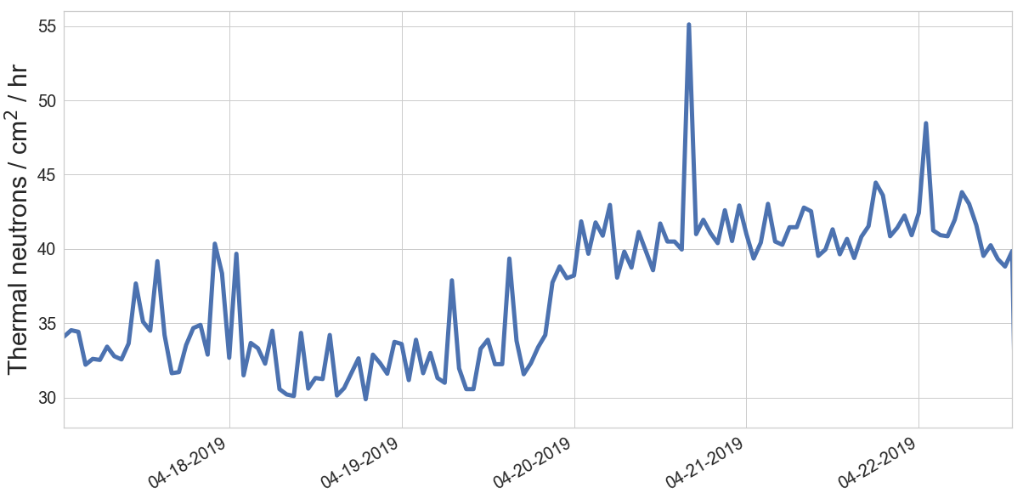
Avg: 41.28 n/cm²/h
24.4% increase
Avg: 33.17 n/cm²/h
2” of water
placed near detector

