Slide 1
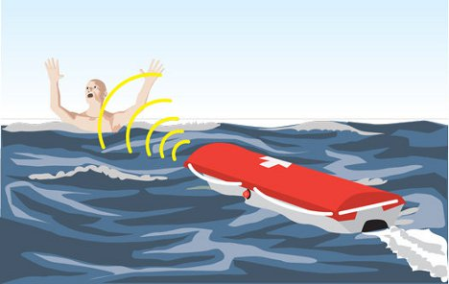
Autonomous Lifeguard
Darrel R. Deo (Project Lead)
Shehadeh H. Dajani
John P. Ash
David A. Goodman
University of California at Santa Cruz
Notes:
Hello, We are the autonomous Lifeguard group, My name is …, I am a … year … Engineer. Hello my name is ...... I am a ..... with a focus in ......

Slide 2
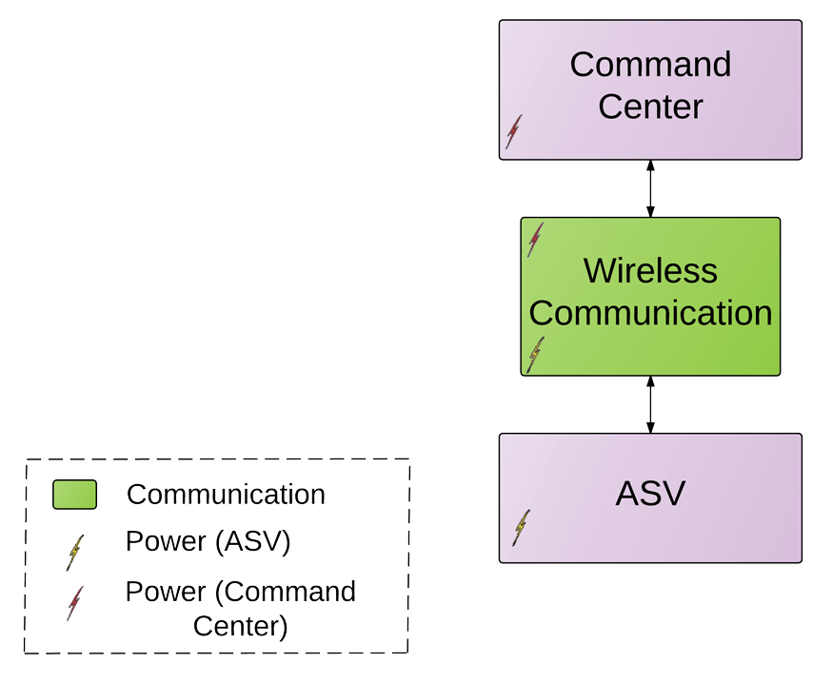
Mission Statement
Autonomous surface vessel (ASV) to aid and assist drowning victims.
2 part system:
  Command Center
  ASV
Notes:
We are proposing an autonomous surface vehicle to aid a drowning individual in the critical minutes that it takes a lifeguard to make it out to a person.
We are interested in the case beyond the breaks where it would take a lifeguard a while to make it out to the person.
Our system is composed of two subsystems

Slide 3
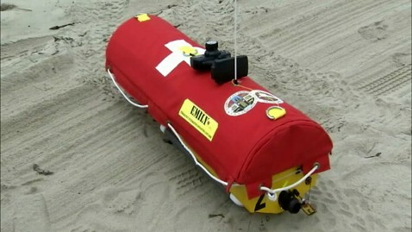
Motivation
Santa Cruz - “Surf City”
E.M.I.L.Y - Emergency Integrated Lifesaving Lanyard
      Remote controlled
      Deployed from beach
      Non-practical
Notes:
range is

Slide 4
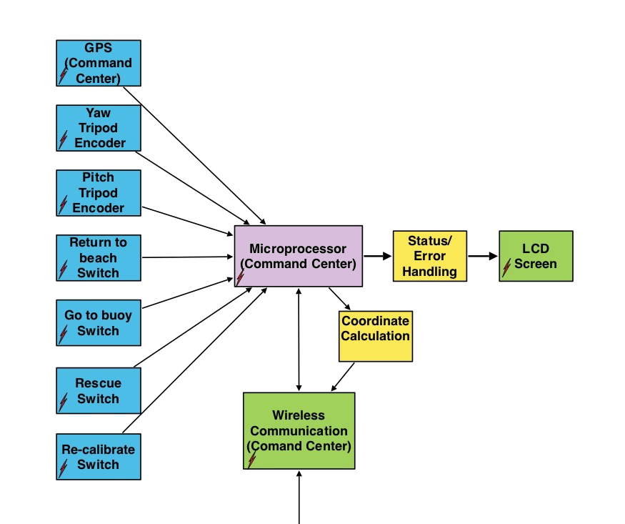
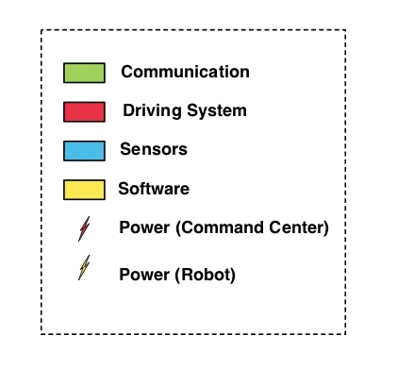
Block Diagram
Command Center

Slide 5
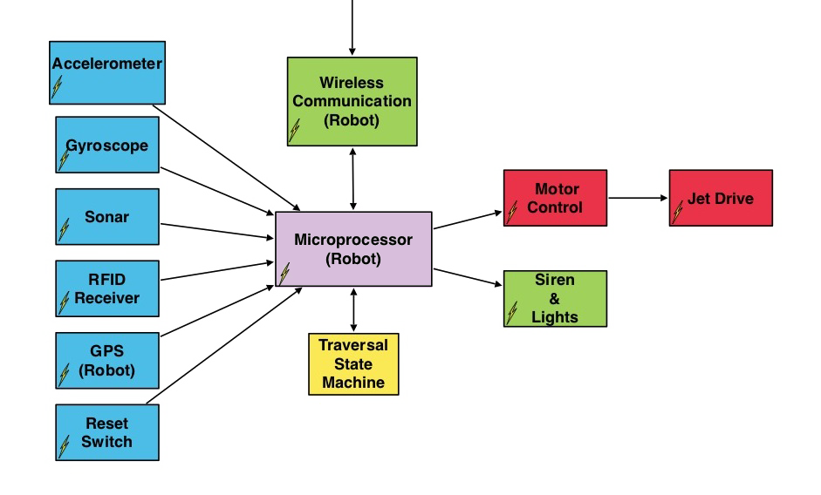
Block Diagram
ASV

Slide 6
Division of Labor
John Ash - Communications & Electronics
      Wireless Protocol, Power Management, Circuit Design
David Goodman - Software & GPS
      Test Harnesses, State Machine, GPS Integration
Shehadeh Dajani - Drive System & Design
      Motor Control, Board Design, Vehicle Design
Darrel Deo - Command Center & Sensors
      Sensor Integration, Tripod Design, Modeling
Notes:
John: qualifications: XBee experience (121 expansion), autonomous boat for ASL,
David: software eng. for 5yrs industry exp., DSP, and GPS (ASL)
Shehadeh: Quals: Mechatronics motor control, solidworks fiend, board layout exp.
Darrel : Quals: Sensor Technology experience, math modeling--Solid Mechanics

Slide 7
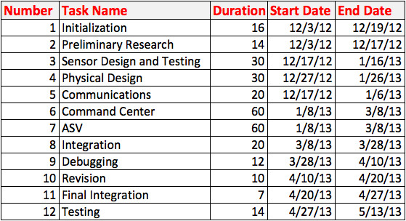
Gantt Chart

Slide 8
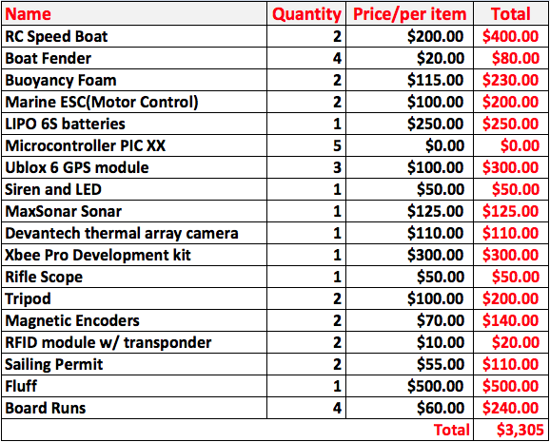
Budget

Slide 9
Progress
Solidified team
Preliminary Sensor Testing
Physical Calculations
Ready to start over Winter Break

Slide 10
References
EMILY:
  http://www.popsci.com/gadgets/article/2010-06/invention-month-robot-lifeguard

