Slide 1
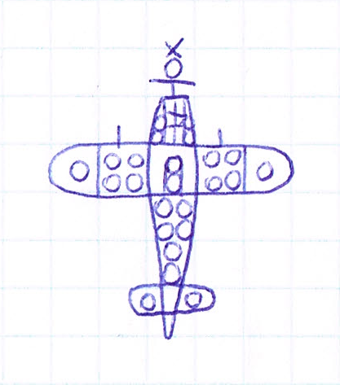
starting
point
propeller
engine
block
oil (coolant)
guns/ammo
crew
fuel
left steering
right steering

Slide 2
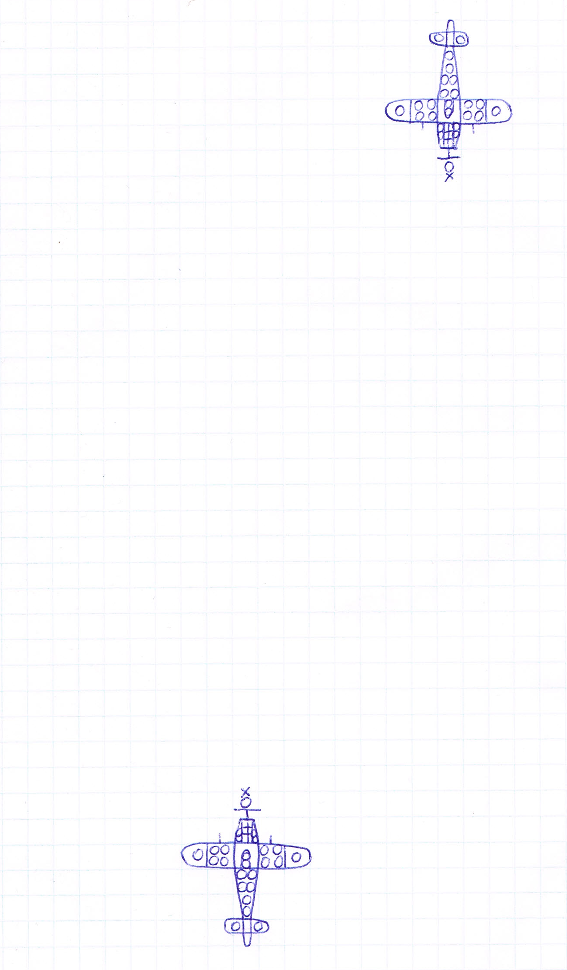
Player 2
Player 1

