Slide 1
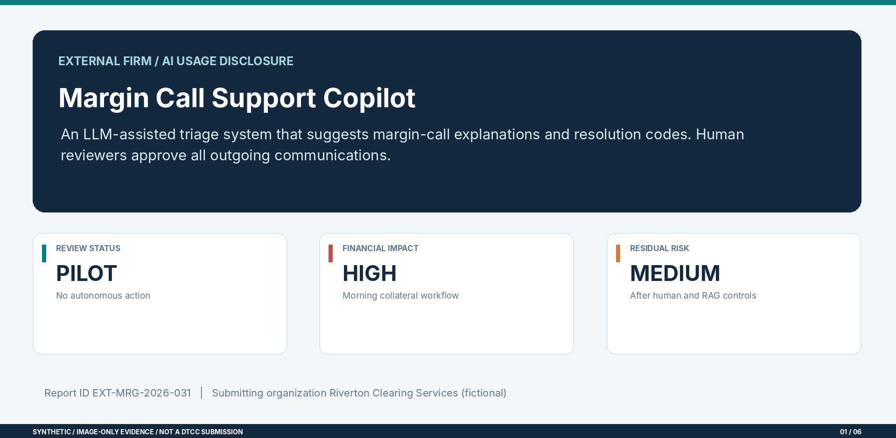
External AI Usage Disclosure

Slide 2
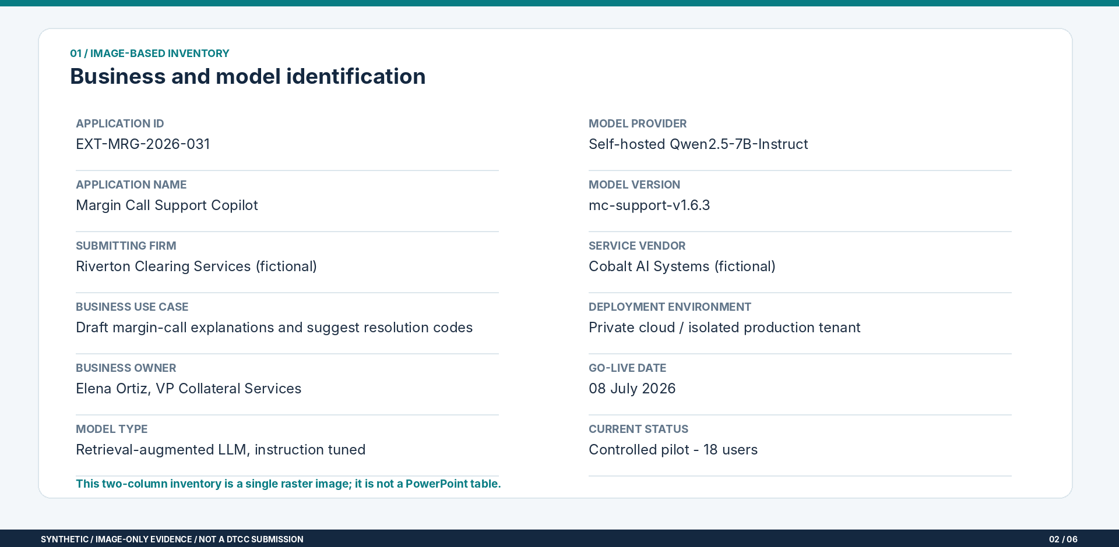
AI Inventory: Identity & Technology

Slide 3
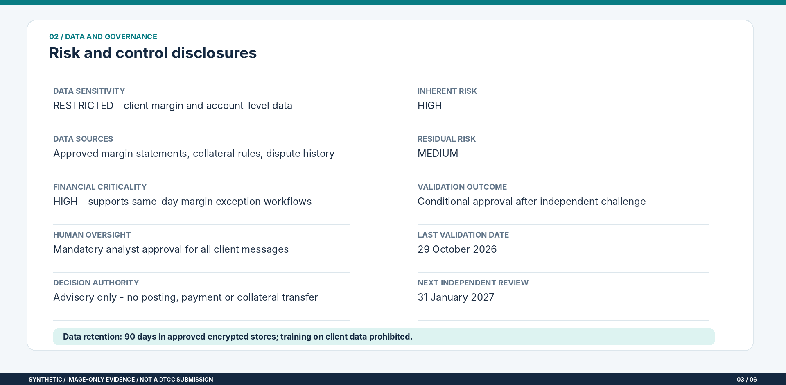
Governance, Data and Risk Rating

Slide 4
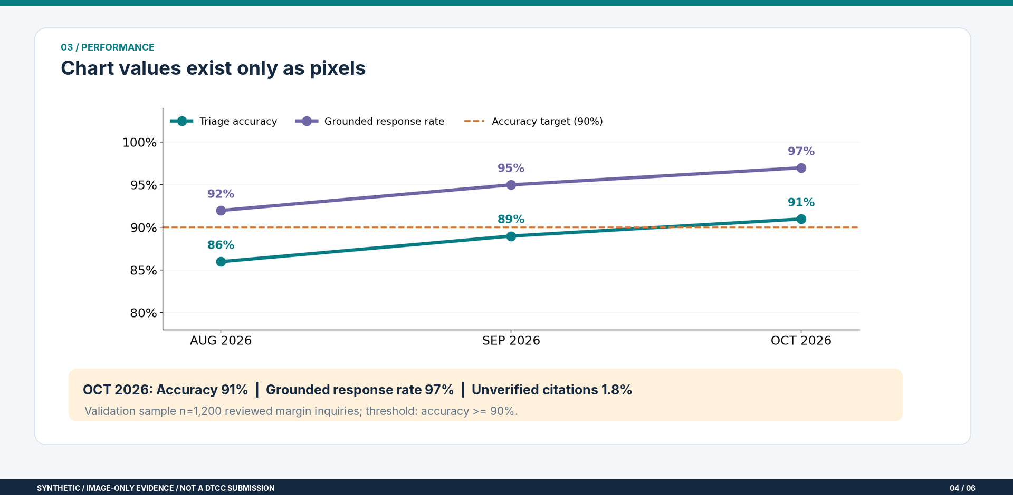
Performance: Visual Chart Evidence

Slide 5
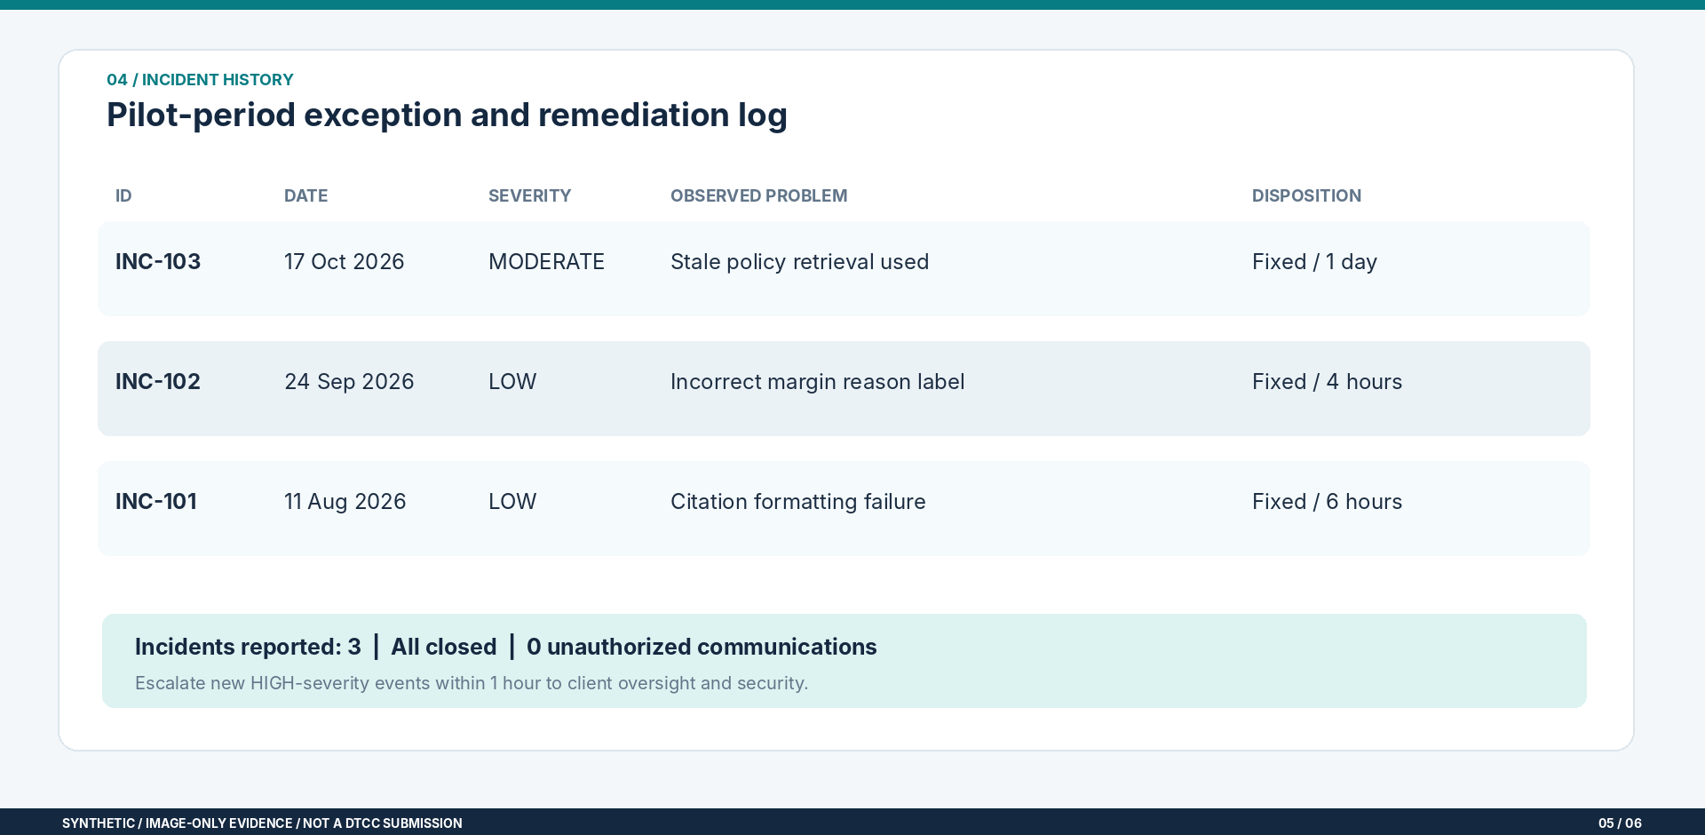
Incident History and Follow-up

Slide 6
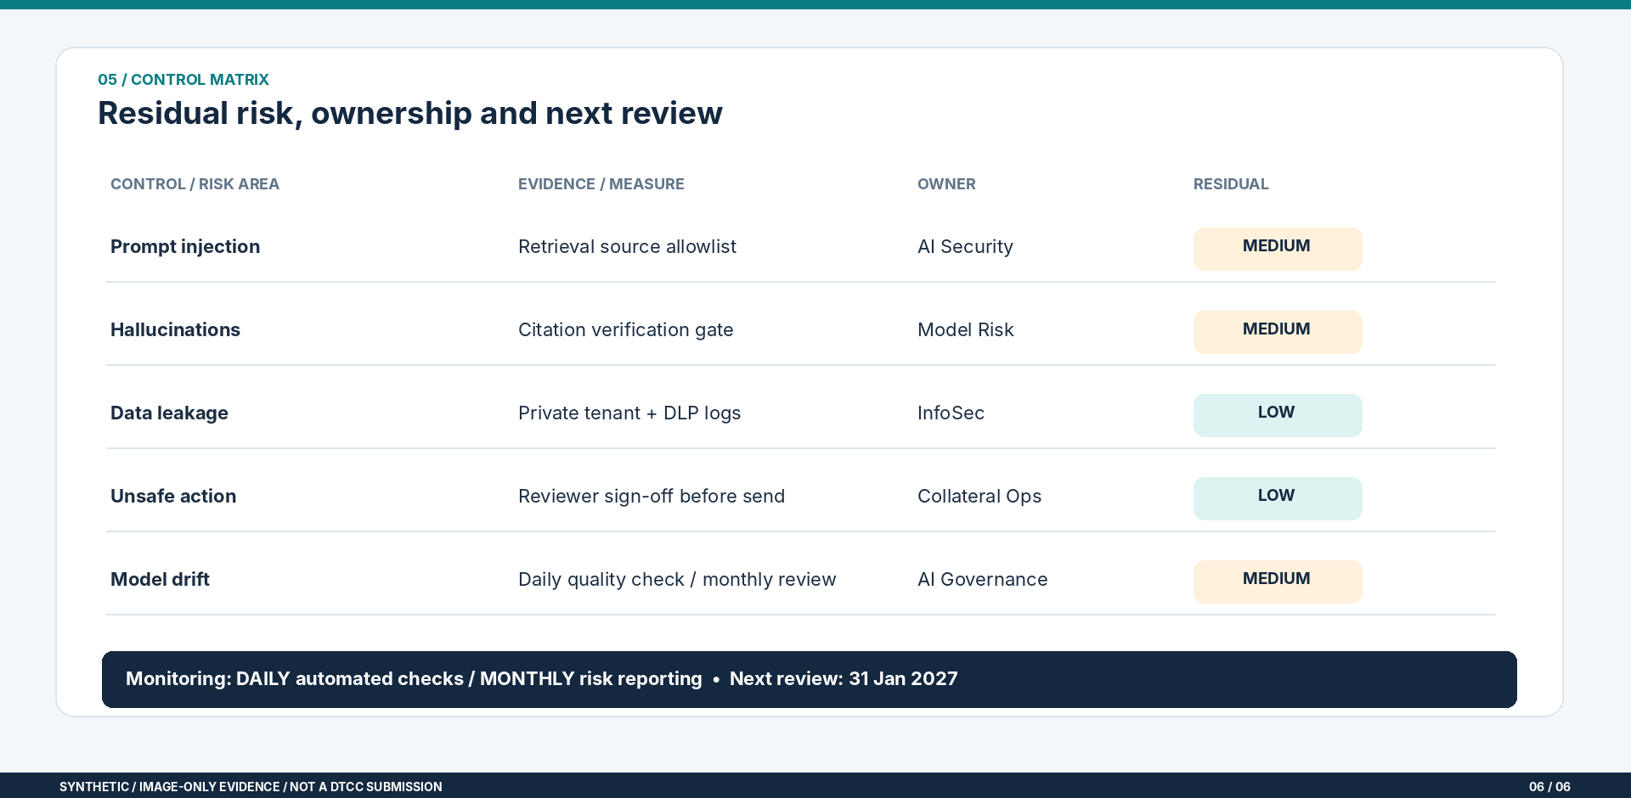
Control Matrix and Monitoring

