Slide 1

Team netdev
Reminder: Week goals
Martine
Helping hand for netdev / GNRC
Side-project: GNRC integration of gnrc_netif2
Kai
Porting SiLabs Mighty Gecko for IEEE 802.15.4
ICMPv6-ping with Dimitri‘s nrf52 radio
Dimitri
Porting nrf52 radio for IEEE 802.15.4
ICMPv6-ping with Kai‘s Mighty Gecko
GI-Dagstuhl Seminar 17303, July 23-28, 2017
IoT Hackathon: From Research to Practice

Slide 2
Martine
All device types ported to new NIC API (gnrc_netif2)
GNRC (except old NC and NDP) ported to new (gnrc_netif2)
As unintrusively as possible (lot‘s of [temporary] #ifdefs for now :-/)
60 files changed, 7328 insertions(+), 58 deletions(-)
Estimate: without all the #ifdefs
  more deletions than insertion (yay cleanup ^^“)
GI-Dagstuhl Seminar 17303, July 23-28, 2017
IoT Hackathon: From Research to Practice

Slide 3
Kai and the Migthy Gecko!
Aim for the Hackathon
Meet people!
Get introduction to RIOT hacking
What are the current „building sites“?
Aim for the week
Radio driver for Silicon Labs EFR32MG1 (aka. Migthy Gecko)
Basic send and receive
Exchange packages with Dimitri
GI-Dagstuhl Seminar 17303, July 23-28, 2017
IoT Hackathon: From Research to Practice

Slide 4
Kai and the Migthy Gecko!
Aim for the Hackathon
Meet people!
Get introduction to RIOT hacking
What are the current „building sites“?
My week:
Aim for the week
Radio driver for Silicon Labs EFR32MG1 (aka. Migthy Gecko)
Basic send and receive
Exchange packages with Dimitri
GI-Dagstuhl Seminar 17303, July 23-28, 2017
IoT Hackathon: From Research to Practice

Slide 5
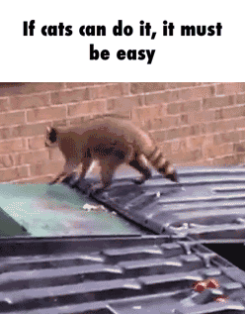
Kai and the Migthy Gecko!
Aim for the Hackathon
Meet people!
Get introduction to RIOT hacking
What are the current „building sites“?
My week:
Aim for the week
Radio driver for Silicon Labs EFR32MG1 (aka. Migthy Gecko)
Basic send and receive
Exchange packages with Dimitri
GI-Dagstuhl Seminar 17303, July 23-28, 2017
IoT Hackathon: From Research to Practice

Slide 6
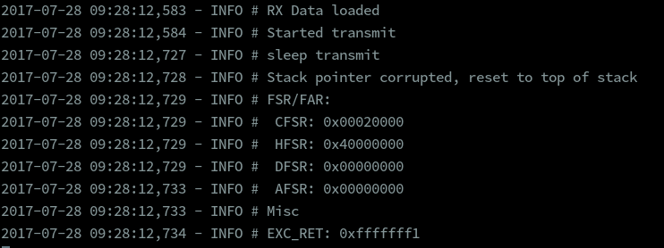
Kai and the Migthy Gecko!
Aim for the Hackathon
Meet people!
Get introduction to RIOT hacking
What are the current „building sites“?
My week:
Aim for the week
Radio driver for Silicon Labs EFR32MG1 (aka. Migthy Gecko)
Basic send and receive
Exchange packages with Dimitri
GI-Dagstuhl Seminar 17303, July 23-28, 2017
IoT Hackathon: From Research to Practice

Slide 7

Kai and the Migthy Gecko!
Aim for the Hackathon
Meet people!
Get introduction to RIOT hacking
What are the current „building sites“?
My week:
Aim for the week
Radio driver for Silicon Labs EFR32MG1 (aka. Migthy Gecko)
Basic send and receive
Exchange packages with Dimitri
GI-Dagstuhl Seminar 17303, July 23-28, 2017
IoT Hackathon: From Research to Practice

Slide 8
Kai and the Migthy Gecko!
Aim for the Hackathon
Meet people!
Get introduction to RIOT hacking
What are the current „building sites“?
My week:
Aim for the week
Radio driver for Silicon Labs EFR32MG1 (aka. Migthy Gecko)
Basic send and receive
Exchange packages with Dimitri
GI-Dagstuhl Seminar 17303, July 23-28, 2017
IoT Hackathon: From Research to Practice

Slide 9

Kai and the Migthy Gecko!
Aim for the Hackathon
Meet people!
Get introduction to RIOT hacking
What are the current „building sites“?
My week:
Aim for the week
Radio driver for Silicon Labs EFR32MG1 (aka. Migthy Gecko)
Basic send and receive
Exchange packages with Dimitri
GI-Dagstuhl Seminar 17303, July 23-28, 2017
IoT Hackathon: From Research to Practice

Slide 10
Kai and the Migthy Gecko!
Aim for the Hackathon
Meet people!
Get introduction to RIOT hacking
What are the current „building sites“?
My week:
Aim for the week
Radio driver for Silicon Labs EFR32MG1 (aka. Migthy Gecko)
Basic send and receive
Exchange packages with Dimitri
GI-Dagstuhl Seminar 17303, July 23-28, 2017
IoT Hackathon: From Research to Practice

Slide 11

Kai and the Migthy Gecko!
Aim for the Hackathon
Meet people!
Get introduction to RIOT hacking
What are the current „building sites“?
My week:
Aim for the week
Radio driver for Silicon Labs EFR32MG1 (aka. Migthy Gecko)
Basic send and receive
Exchange packages with Dimitri
GI-Dagstuhl Seminar 17303, July 23-28, 2017
IoT Hackathon: From Research to Practice

Slide 12

Kai and the Migthy Gecko!
Aim for the Hackathon
Meet people!
Get introduction to RIOT hacking
What are the current „building sites“?
My week:
Aim for the week
Radio driver for Silicon Labs EFR32MG1 (aka. Migthy Gecko)
Basic send and receive
Exchange packages with Dimitri
GI-Dagstuhl Seminar 17303, July 23-28, 2017
IoT Hackathon: From Research to Practice

Slide 13

Kai and the Migthy Gecko!
Aim for the Hackathon
Meet people!
Get introduction to RIOT hacking
What are the current „building sites“?
My week:
Aim for the week
Radio driver for Silicon Labs EFR32MG1 (aka. Migthy Gecko)
Basic send and receive
Exchange packages with Dimitri
GI-Dagstuhl Seminar 17303, July 23-28, 2017
IoT Hackathon: From Research to Practice

Slide 14
Kai and the Migthy Gecko!
Aim for the Hackathon
Meet people!
Get introduction to RIOT hacking
What are the current „building sites“?
Next steps
Aim for the week
Radio driver for Silicon Labs EFR32MG1 (aka. Migthy Gecko)
Basic send and receive
Exchange packages with Dimitri
GI-Dagstuhl Seminar 17303, July 23-28, 2017
IoT Hackathon: From Research to Practice

Slide 15

Kai and the Migthy Gecko!
Aim for the Hackathon
Meet people!
Get introduction to RIOT hacking
What are the current „building sites“?
Next steps
Aim for the week
Radio driver for Silicon Labs EFR32MG1 (aka. Migthy Gecko)
Basic send and receive
Exchange packages with Dimitri
GI-Dagstuhl Seminar 17303, July 23-28, 2017
IoT Hackathon: From Research to Practice

Slide 16
Kai and the Migthy Gecko!
Aim for the Hackathon
Meet people!
Get introduction to RIOT hacking
What are the current „building sites“?
Next steps
Try again!
But first
  Port RFR32 support to current RIOT version
  (Update Bas python scripts?)
  Add Silicon Labs SDK as RIOT package
Aim for the week
Radio driver for Silicon Labs EFR32MG1 (aka. Migthy Gecko)
Basic send and receive
Exchange packages with Dimitri
GI-Dagstuhl Seminar 17303, July 23-28, 2017
IoT Hackathon: From Research to Practice

Slide 17
Dimitri
ICMPv6-ping between nrf52 and samr21-xpro possible
nrf52 stops sending after a short while
Opened pull-request #7425
GI-Dagstuhl Seminar 17303, July 23-28, 2017
IoT Hackathon: From Research to Practice

