Slide 1
Dagstuhl Hackathon 17
Implementation of CoRE Resource Directory
(draft-ietf-core-resource-directory-11)
Pekka and Hauke
Final Presentation, July 28

Slide 2
What we set out to do:
Implement a CoRE RD using node.js
Integrate the RD in Node-RED
Implement RD client in RIOT
Annotate nodes using WoT Thing Descriptions
Implement automated export of SAUL devices in RIOT

Slide 3


What we set out to do:
Implement a CoRE RD using node.js
Integrate the RD in Node-RED
Implement RD client in RIOT
Annotate nodes using WoT Thing Descriptions
Implement automated export of SAUL devices in RIOT

Slide 4
And on the way...
Fixed handling of link-local IPv6 addresses in node.js → fixed and PRed
Extended gcoap: handling of Location-Path and Uri-Query options, generic option parsing on incoming packets, … → 7 Open PRs so far
Prepared a list with review comments to the CoRE working group

Slide 5
Demo time…

Slide 6
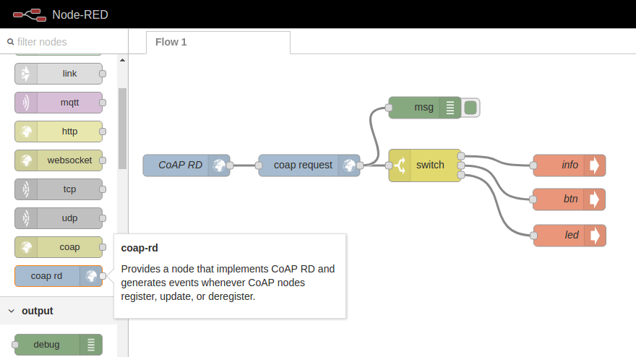
Node-RED setup:

Slide 7
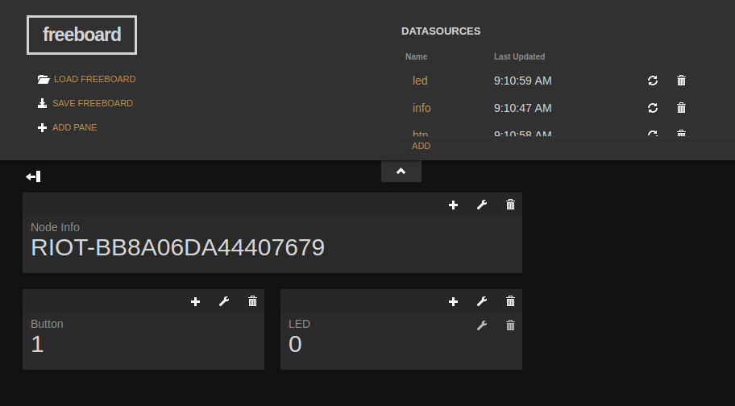
Freeboard output:

