Slide 1
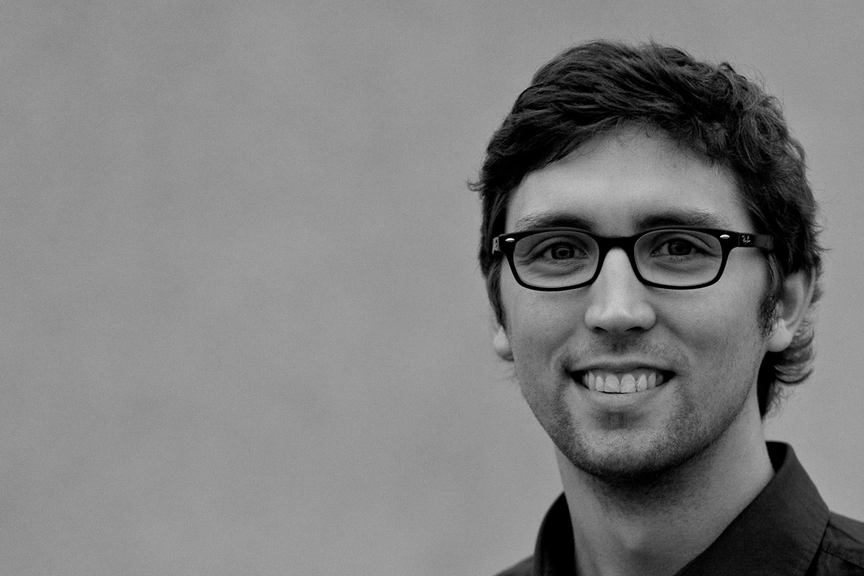

Hauke Petersen
Freie Universität Berlin
<Photo>
Research and Coding Interests
Efficient embedded OSes
Node/service discovery in the IoT
RIOT:
  porting
  hardware abstraction
  driver model
Wish List of Hackathon Topics
automated export of SAUL devices as (g)CoAP resources
integration of RIOT with CoAP-RD servers
Background
MSc in Computer Engineering from DTU
worked two years as Safety and Systems Engineer in the impeccable and trustworthy German car industry
GI-Dagstuhl Seminar 17303, July 23-28, 2017
IoT Hackathon: From Research to Practice

