Slide 1
First order temporal logic monitoring with BDDs
Klaus Havelund (NASA JPL, USA)
Doron Peled (Bar Ilan University, Israel)
Dogan Ulus (Verimag/Universite Grenoble-Alpes, France)
Verimag
2017

Slide 2
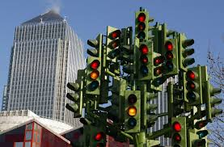


Runtime verification (RV)
Follows an execution and check against a temporal property.
Can issue warning against problems in current execution.
While model checking can check unbounded executions, RV is limited to checking the prefixes of executions.

Slide 3
RV: Following an execution against a temporal property.
There is no point in following [](p→<>q):
If p (“a file is opened”) happened; there is always the possibility that q (“a file is closed”) will happen even if it did not yet.
Should we assign a proposition p and q per each file???
If we follow <>p, and p happens, we know the property is satisfied.
If we follow []q and q does not happen at some state, then we know that the property failed.

Slide 4
Runtime verification (RV)
We can alarm against violation of safety properties, or identify the achievement of co-safety (reachability) properties.
For the rest of the properties, we can provide limited information (about their safety/co-safety components).
Temporal Safety properties: past time temporal property (checked at every state).

Slide 5


Past time temporal formulas

Slide 6
Past time temporal formulas
open(“tel”)
open(“dict”)
open(“out”)
close(“tel2”)
We need to save all past values of file names that were opened, and compare with the current one that is closed.

Slide 7
Some definitions
Domains D₁, D₂, …, possibly infinite
Variables V = {x,y,…} ranging over domains x : D_{1,} y : D_{2,} …
Assignments [x -> “tel”, y -> “tel2”]
Predicates open(“tel”), open(x), close(y), …
Ground predicates open(“tel”)
A state is a set of ground predicates: {open(“tel1”), open(“tel2”)}
A trace is a finite sequence of states: <s₁,s₂,…,s_{n}>

Slide 8
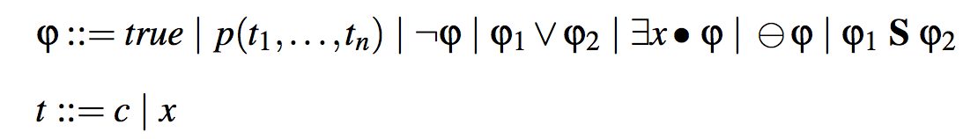
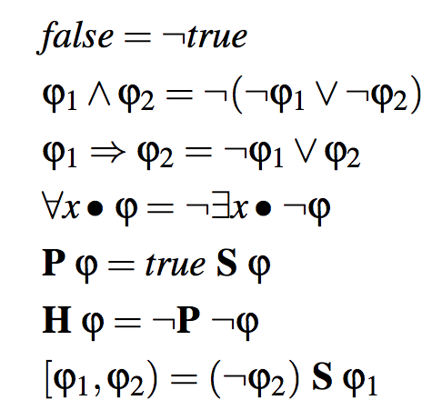
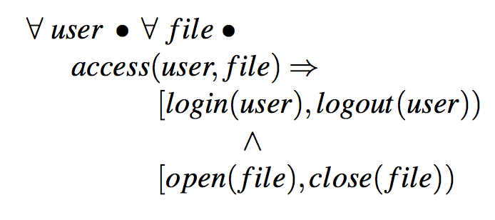
The Logic
Derived Constructs
Example

Slide 9
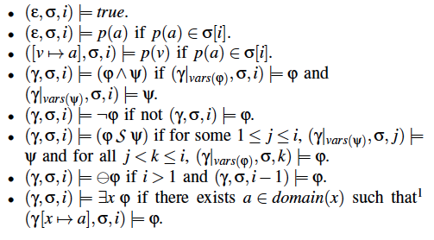
First Semantics: the “standard” definition

Slide 10
Lets look at a particular formula: ∃y ∃x (p(x) S q(y))
p(7),P(8),p(9)
P(9),p(10),p(11)
q(5)
p(6),P(7),p(8)
P(8),p(9),p(10)
The answer is F: there is no common value of p(x) since q(5).

Slide 11
Lets look at a particular formula: ∃y ∃x (p(x) S q(y))
p(7),P(8),p(9)
P(9),p(10),p(11)
q(5)
q(3),
p(6),P(7),p(8)
P(8),p(9),p(10)
The answer is T: there is a common value of p(9) since q(3).

Slide 12
∃y ∃x (p(x) S q(y)) The “bookkeeping” is nontrivial:
p(7),P(8),p(9)
P(9),p(10),p(11)
q(5)
q(3),
p(6),P(7),p(8)
P(8),p(9),p(10)
The answer is T: there is a common value of p(9) since q(3).
Keep common subsets of values of x in p(x) since you saw q(5).
Keep common subsets of values of x in p(x) since you saw q(3).

Slide 13

∃y ∃x (p(x) S q(y)) The “bookkeeping” is nontrivial:
y=3 with x=7,8,9
y=3 with x=8,9
y=3 with x=9
p(7),P(8), p(9)
P(8),p(9), p(10)
P(9),p(10), p(11)
The answer is T: there is a common value of p(9) since q(3).
Keep common subsets of values of x in p(x) since you see q(3).
Do the same with y=5
In general we keep track of sets of tuples of y and x values: {(3,7), (3,8), (5,7)…} at each point.
Standard semantics does not give a good intuition how to perform this bookkeeping!

Slide 14
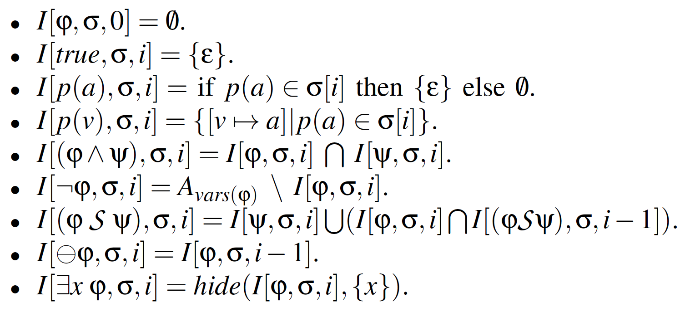
Second semantics: Set semantics. For each (sub)formula and prefix of an execution, assign all the (tuples of) free values that satisfy it.

Slide 15
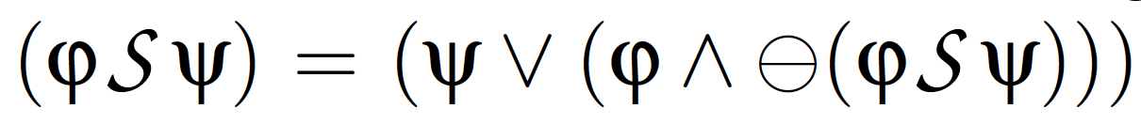

Second Semantics: result is a set of values
complement
set
=
infinite set
Theorem:

Slide 16
Lets look at the propositional case:
In order to calculate (ϕ S ψ) we need to calculate:
ϕ in the current state.
in the current state.
(ϕ S ψ) in the previous state.
It is always sufficient to calculate only the Boolean values of subformulas in the previous and current state.

Slide 17
Returning to the set semantics:
We can observe that we need to keep the set of tuples of subformulas in the current and previous state.

Slide 18
Representing sets of assignments as BDDs
not(p) ∧ q ∧ not(r)
(p ∧ q ∧ r)
∨
(p ∧ q ∧ not(r))
Notes:
order(r, q, p) ;
or(and(p,q,r), and(p,q,not(r))) ;
print($1) ;

Slide 19
Problem: How to represent complement of set (as in an implication)?
(not close(f)) ∨ P open(f)
open(“tel”)
open(“dict”)
open(“out”)
close(“tel2”)
now
seen values = {“tel”, “dict”,”out”, “tel2”}
not close(“tel2”) = {“tel”, “dict”,”out}
union {v | v has not been seen yet}

Slide 20

We do not represent values or tuple of values directly. Instead we enumerate values in binary. (We keep values in a hash to check reoccurrence.)
open(“tel”)
open(“dict”)
open(“out”)
close(“tel2”)
opened = {“tel”, “dict”,”out”}
b₀b₁b₂
“tel”
000
{000, 001, 010}
Value to
bit string
table
“dict”
001
λ(b₀b₁b₂).
“out”
010
(!b₀ ∧ !b₁ ∧ !b₂) ∨
(!b₀ ∧ !b₁ ∧ b₂) ∨
(!b₀ ∧ b₁ ∧ !b₂)
“tel2”
011

Slide 21
000
001
010
011
b₀b₁b₂
“tel”
000
Value to
bit string
table
“dict”
001
“out”
010
“tel2”
011
Notes:
http://eecs.ceas.uc.edu/~weaversa/BDD_Visualizer.html
---
order(b2, b1, b0) ;
and(not(b0), not(b1), not(b2)) ;
print($1) ;
---
order(b2, b1, b0) ;
and(not(b0), not(b1), b2) ;
print($1) ;
---
order(b2, b1, b0) ;
and(not(b0), b1, not(b2)) ;
print($1) ;
---
order(b2, b1, b0) ;
and(not(b0), b1, b2) ;
print($1) ;

Slide 22
Characteristic function for our bit vector set Representing the accumulated set of values Popen(f)
{“tel”, “dict” ,”out”}
{000, 001, 010}
{000} union {001} union {010}
BDD(000) or BDD(001) or BDD(010)
λ(b₀b₁b₂).
(!b₀ ∧ !b₁ ∧ !b₂) ∨
(!b₀ ∧ !b₁ ∧ b₂) ∨
(!b₀ ∧ b₁ ∧ !b₂)
Notes:
order(b2, b1, b0) ;
or(
and(not(b0), not(b1), not(b2)),
and(not(b0), not(b1), b2),
and(not(b0), b1, not(b2))
) ;
print($1) ;

Slide 23
Characteristic function for our bit vector set Popen(f)
{“tel”, “dict” ,”out”}
{000, 001, 010}
{000} union {001} union {010}
BDD(000) or BDD(001) or BDD(010)
But not BDD(011) (for “tel2”)
enumerations ≥ 100 are for values not seen so
far, here returning F.
λ(b₀b₁b₂).
(!b₀ ∧ !b₁ ∧ !b₂) ∨
(!b₀ ∧ !b₁ ∧ b₂) ∨
(!b₀ ∧ b₁ ∧ !b₂)
Notes:
order(b2, b1, b0) ;
or(
and(not(b0), not(b1), not(b2)),
and(not(b0), not(b1), b2),
and(not(b0), b1, not(b2))
) ;
print($1) ;

Slide 24
Characteristic function for our bit vector set
Enumerations ≥ 100 are for values not seen so far, returning F.
So we account for values not seen so far.
As long as we use n bits and there will be less
than 2^{n} values, then the higher enumerations represent values not seen so far.
In particular, the value 11…111 reresents “all values not yet seen” (in combination with any other variables).
We can negate, obtaining the BDD for ¬Popen(f)
This is easy: replace F by T at leaf level.
(!b₀ ∧ !b₁ ∧ !b₂) ∨
(!b₀ ∧ !b₁ ∧ b₂) ∨
(!b₀ ∧ b₁ ∧ !b₂)
Notes:
order(b2, b1, b0) ;
or(
and(not(b0), not(b1), not(b2)),
and(not(b0), not(b1), b2),
and(not(b0), b1, not(b2))
) ;
print($1) ;

Slide 25
When number of bits is insufficient
Big enumerations are for values not seen so far (returning the same value).
So we account for values not seen so far.
As long as we use n bits and there will be less
than 2^{n} values, then the higher enumerations represent values not seen so far.
In particular, the value 11…111 reresents “all values not yet seen” (in combination with any other variables).
We can start with a rather large value of n, hoping that the
BDD will be compact.
We may also add bit b “on the fly”, when more than 2^{n} values occur,
allowing twice as many enumerations:
When b=0, the BDD will return the same values as without b. When b=1, the BDD will return the value that the 11…111 returned.
Notes:
order(b2, b1, b0) ;
or(
and(not(b0), not(b1), not(b2)),
and(not(b0), not(b1), b2),
and(not(b0), b1, not(b2))
) ;
print($1) ;

Slide 26
Representing a set of assignments using enumerations
{
[x -> “a” , y -> 42] ,
[ x -> “b” , y -> 52]
}
x₀x₁x₂y₀y₁y₂
forall x . forall y .
send(x,y) -> P recv(x,y)
0 0 0 0 0 0
or
0 0 1 0 0 1
recv(“a”,42)
recv(“b”,52)
…
“a”
000
x ➔
“b”
001
y ➔
42
000
52
001
Notes:
order(y2, y1, y0, x2, x1, x0) ;
or(
and(not(x0),not(x1),not(x2),not(y0),not(y1),y2),
and(not(x0),not(x1),x2,not(y0),y1,not(y2))
) ;
print($1) ;

Slide 27
Representing a set of assignments
{
[x -> “a” , y -> 42] ,
[ x -> “b” , y -> 52]
}
x₀x₁x₂y₀y₁y₂
0 0 0 0 0 0
or
0 0 1 0 0 1
“a”
000
x ➔
“b”
001
y ➔
42
000
52
001
Notes:
order(y2, y1, y0, x2, x1, x0) ;
or(
and(not(x0),not(x1),not(x2),not(y0),not(y1),y2),
and(not(x0),not(x1),x2,not(y0),y1,not(y2))
) ;
print($1) ;

Slide 28
Representing a set of assignments
{
[x -> “a” , y -> 42] ,
[ x -> “b” , y -> 52]
}
x₀x₁x₂y₀y₁y₂
0 0 0 0 0 0
or
0 0 1 0 0 1
“a”
000
x ➔
“b”
001
y ➔
42
000
52
001
Notes:
order(y2, y1, y0, x2, x1, x0) ;
or(
and(not(x0),not(x1),not(x2),not(y0),not(y1),y2),
and(not(x0),not(x1),x2,not(y0),y1,not(y2))
) ;
print($1) ;

Slide 29
Representing a set of assignments
{
[x -> “a” , y -> 42] ,
[ x -> “b” , y -> 52]
}
x₀x₁x₂y₀y₁y₂
0 0 0 0 0 0
or
0 0 1 0 0 1
“a”
000
x ➔
“b”
001
y ➔
42
000
52
001
Notes:
order(y2, y1, y0, x2, x1, x0) ;
or(
and(not(x0),not(x1),not(x2),not(y0),not(y1),y2),
and(not(x0),not(x1),x2,not(y0),y1,not(y2))
) ;
print($1) ;

Slide 30
Looking back at the set semantics: since every tuple is a BDD function…
We can replace the set operations with BDD operations:
Union ∪ by disjunction ∨, Intersection ∩ by conjunction ∧, hide is existential quantification over all bits of variable.

Slide 31
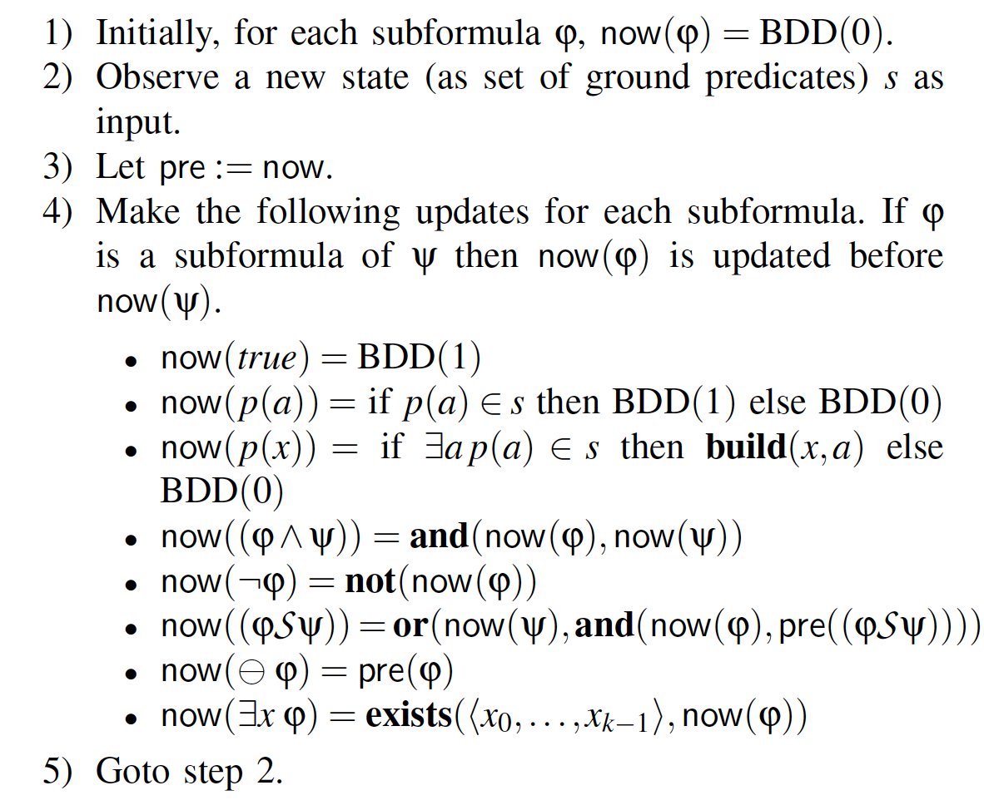

Algorithm Using BDD operations!
var pre : BDD
var now : BDD

Slide 32





Variant: Limiting quantification (when existential quantification are only over “seen value”)
Limiting quantification to seen values:
Finite domains:

Slide 33
Implementation: DejaVu

Slide 34

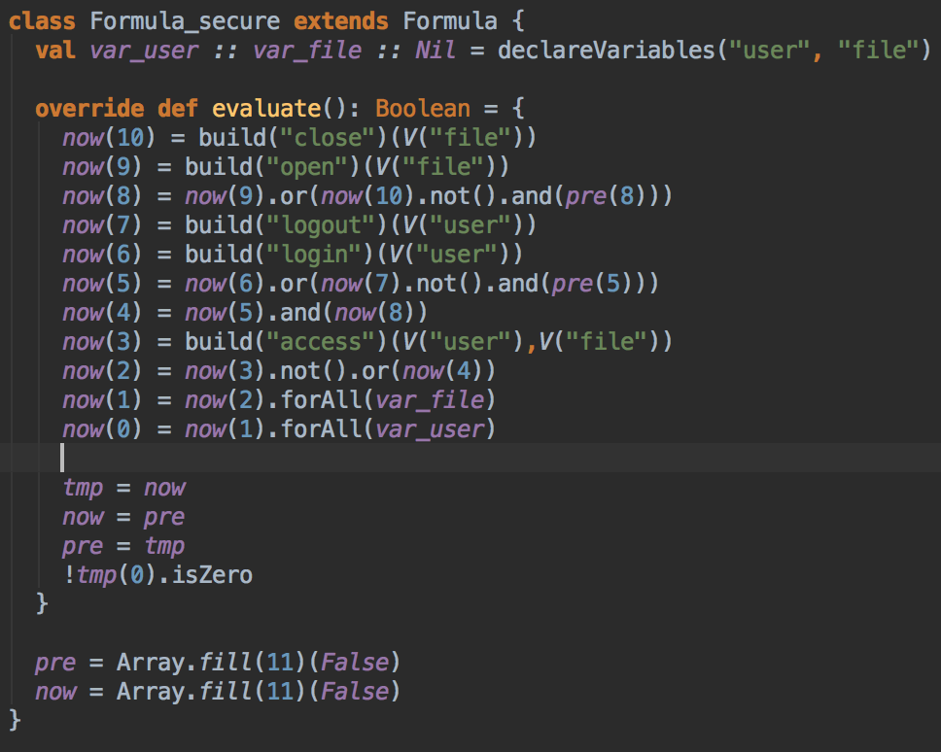

Architecture
prop secure : forall (user) forall (file) access(user,file) -> [login(user),logout(user)) & [open(file),close(file))
JavaBDD
Scala parser
combinators
login,John open,tel access,John,tel close,tel access,John,tel logout,John
Apache commons CSV
(Comma Separated Value format)
parser
*** Property secure violated on event number 5:
access(John,tel)

Slide 35
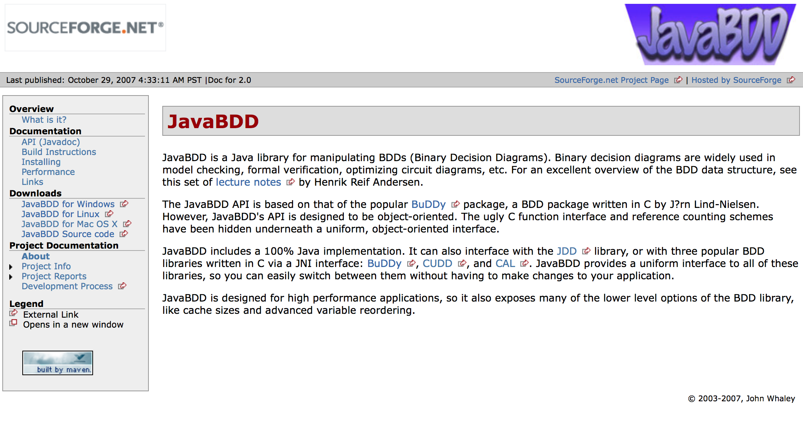
http://javabdd.sourceforge.net

Slide 36
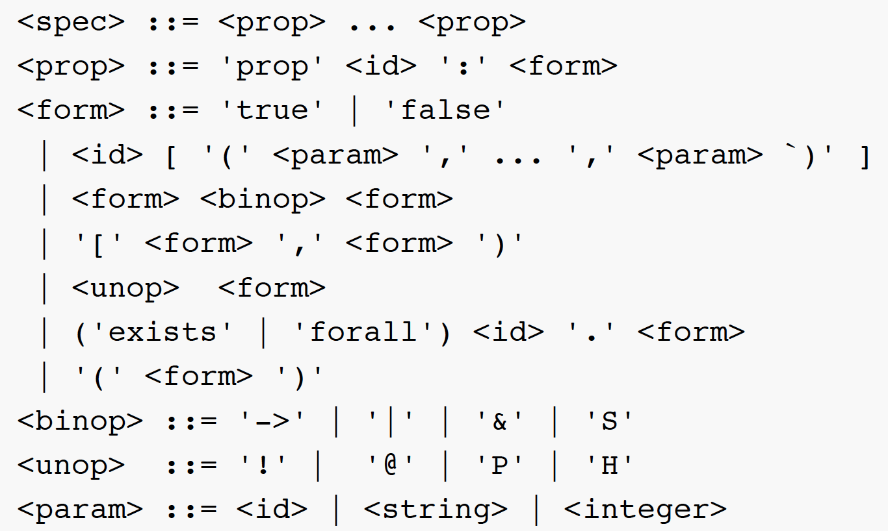
Grammar:

Slide 37
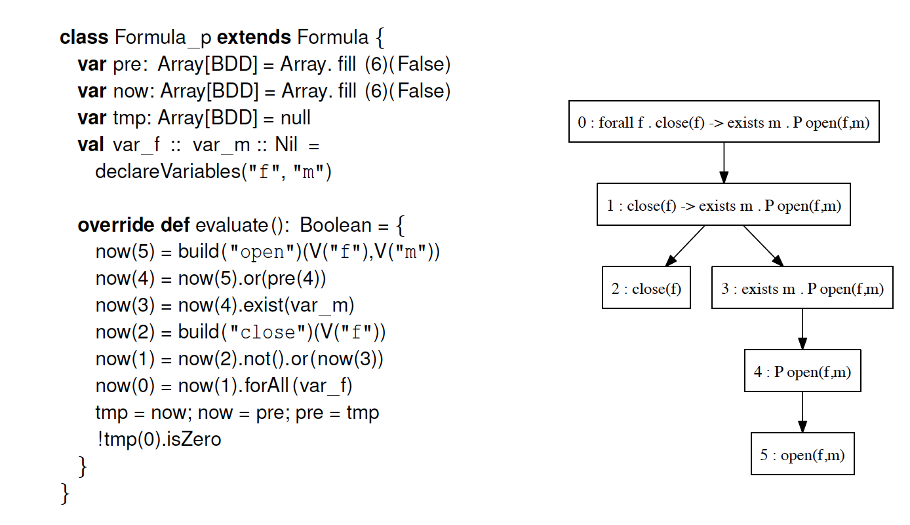

Slide 38
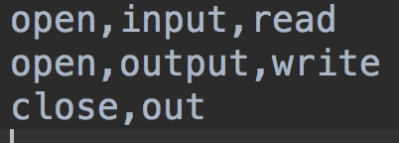
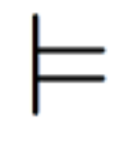
f
m

Slide 39
f
m

Slide 41
TRUE
TRUE
FALSE

Slide 45
TRUE
TRUE
FALSE

Slide 46
FALSE

Slide 50
FALSE

Slide 51
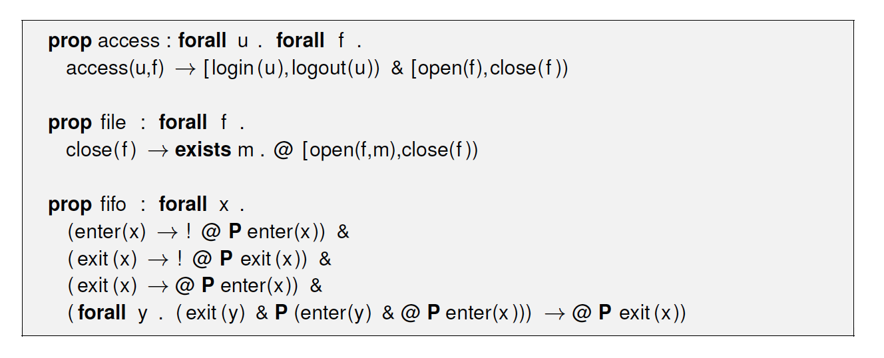
Evaluation Properties in QTL

Slide 52
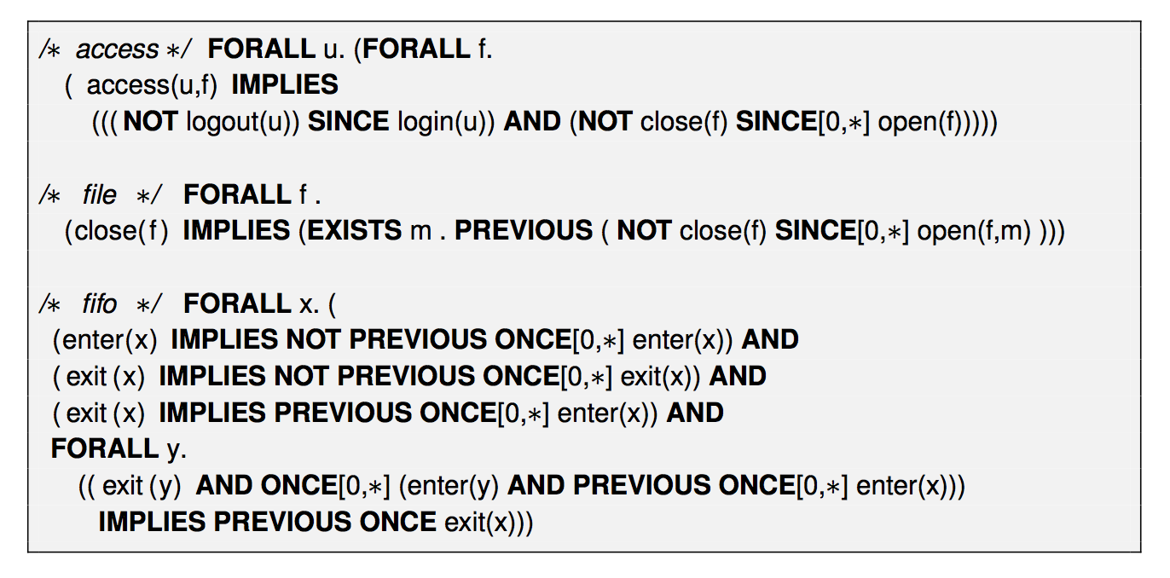
Evaluation Properties in MonPoly

Slide 53
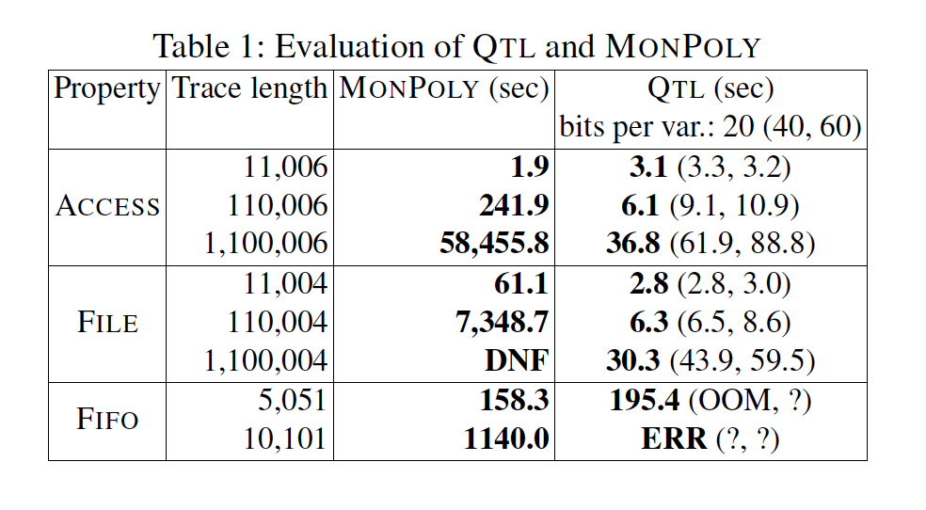
Evaluation Results

Slide 54
Pros
Compact. With k bits we can represent 2^{k} values
We expect to pay little for “surplus” bits.
We can extend the BDDs with additional bits dynamically if needed.
Complementation is efficient (just switching the 0 and 1 leaves).
Values not yet seen are represented by unused bit patterns.

Slide 55
Cons
We cannot compare values beyond equality
We cannot perform computations on values
prop p :
forall n . forall a .
anwer(n,a) ->
exists m . exists q .
P question(m,q) ∧
m < n ∧ f(q) = a

