Slide 1
Cytokinesis and FtsZ polymerization :
3rd day wrap-up session
Tutor: Wolf Liebermeister
Team: Ilya Kiselev, Naveen Kumar,
Yan Zhu, Daniel Priego

Slide 2
FtsZ polymerization
SMBL, SBGN map SBGN-ML:
Base SBML was created by BioUML
SBO terms added according to SBGN-PD specifications
Imported into Vanted for SBGN-(ML) creation.
List of unit definitions created separately
Requirements for integration team already in github

Slide 3
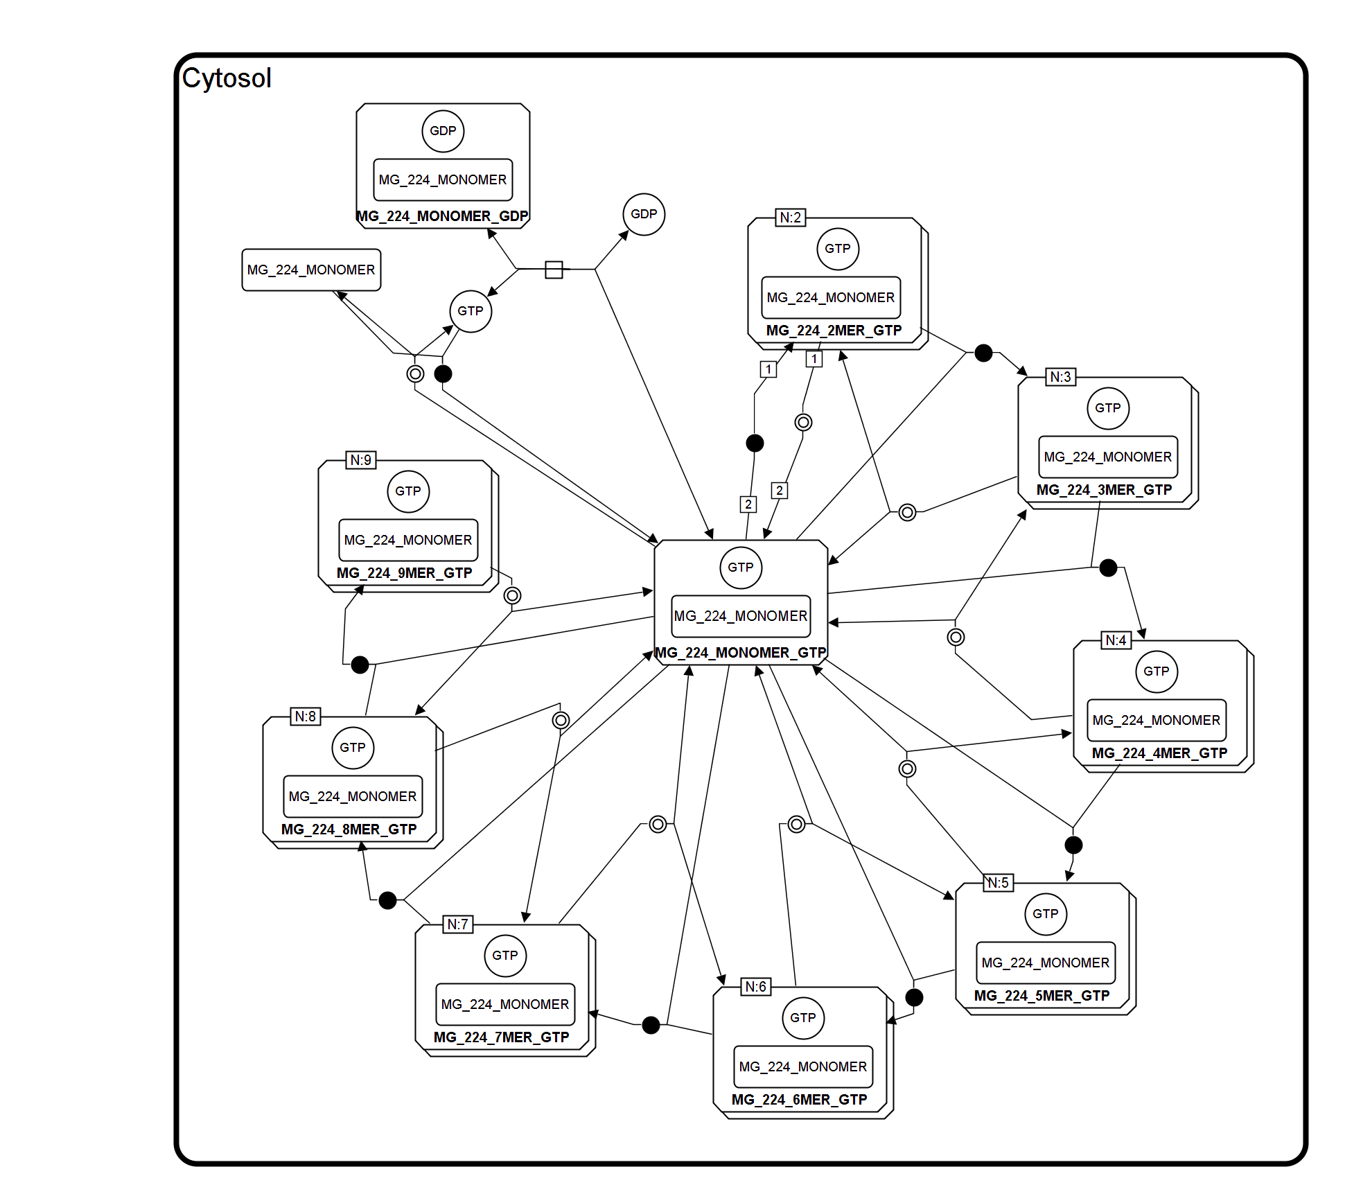
FtsZ polymerization

Slide 4
FtsZ polymerization
Simulations still in progress in BioUML
RDF annotations in progress

Slide 5
Cytokinesis
SMBL, SBGN map SBGN-ML:
Base SBML was created by BioUML
SBO terms added according to SBGN-PD specifications
Imported into Vanted for SBGN-(ML) creation. Most of the work with edge complexes done manually.
Requirements for integration team already in github

Slide 6
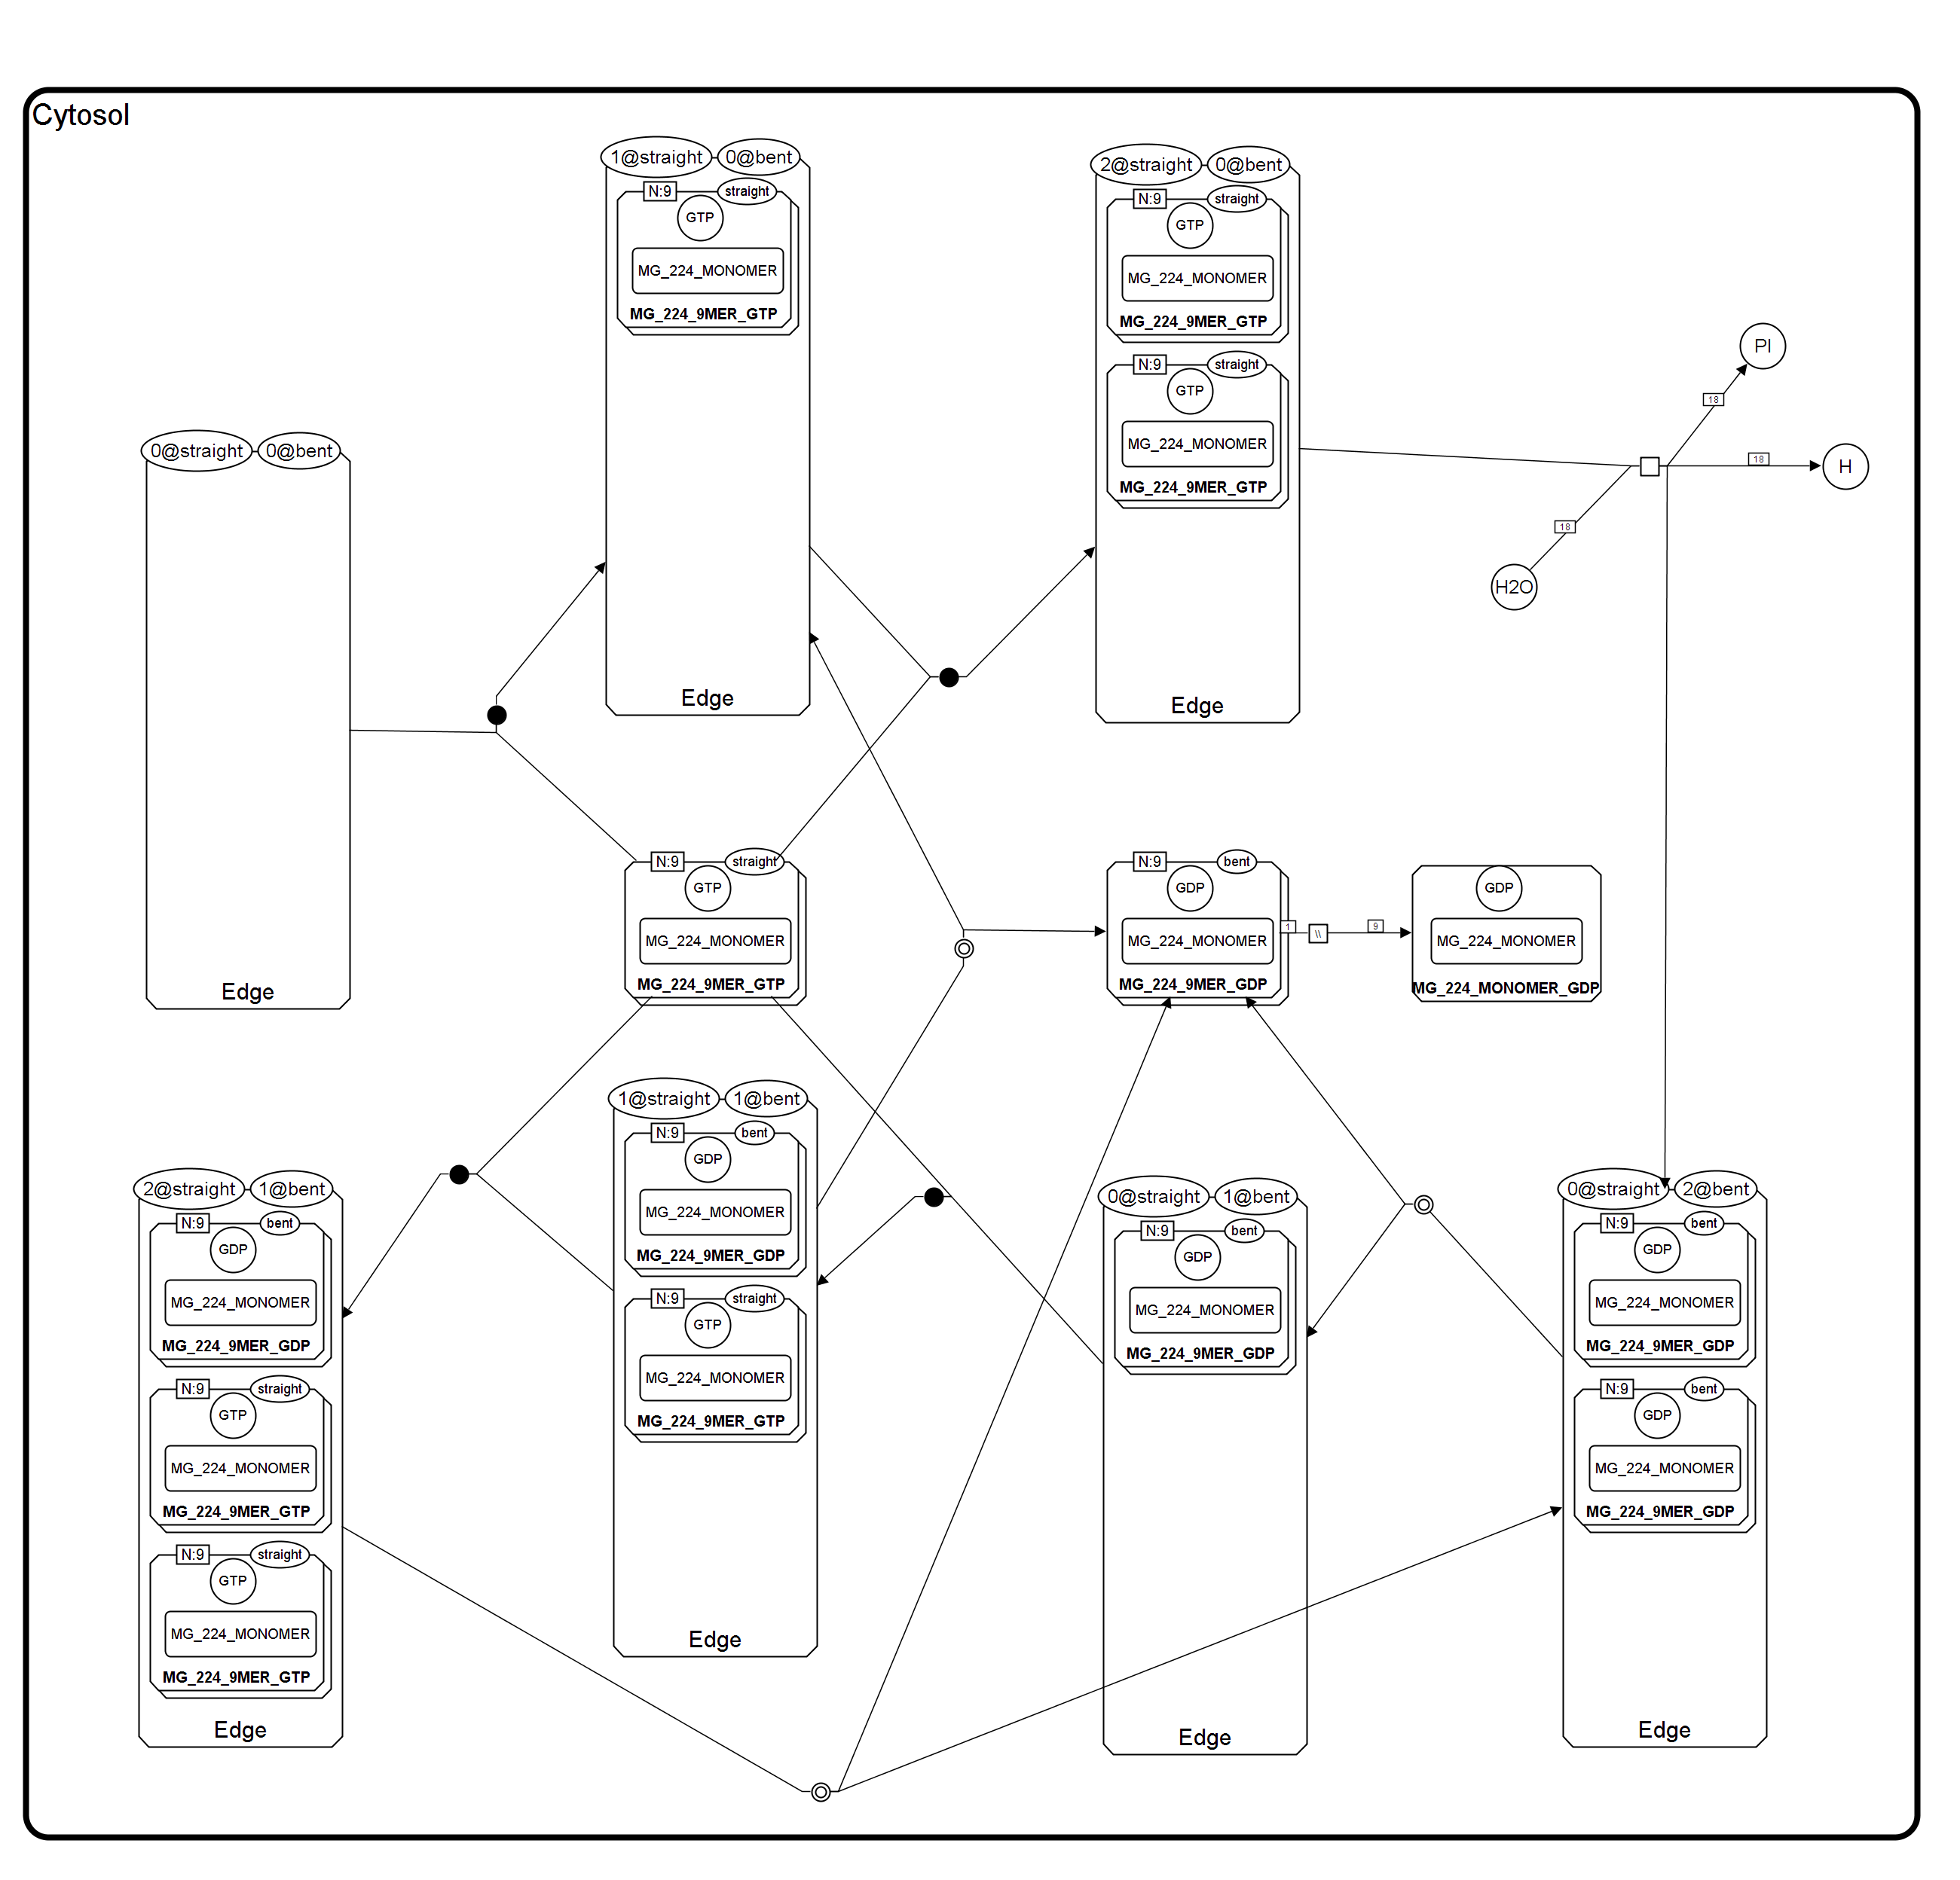
Cytokinesis

Slide 7
Cytokinesis
Stochasticity issues: We handled all the transitions (binding, bending, dissociation, depolymerization, pinching) by means of events (~22) and priorities.
Simulations still in progress in BioUML.

Slide 8
Perspectives
What was easy to achieve?
Due to small complexity of FtsZ polymerization submodule, first draft was done quickly.
What was difficult?
Implementation of SBGN and transition probabilities for cytokinesis submodule.
Some compatibility issues (import/export between different tools)

