Slide 1
BioUML (www.biouml.org)
ODE, Stochastic simulation
SBML v3.1 “comp”, “fbc” import export
SBGN visual representation
Antimony text format representation
Flux balance analysis using apache and gurobi
Co-simulation approach
Model flattening approach
Sed-ML(1.1, 1.2 soon)

Slide 2
Agent based modeling
Agents intilize
Agents do steps
Agent types:
SBML models simulated by ODE solver
MATLAB code
Java-script code

Slide 3
Matlab agent
Initialize:
addpath('C:\WholeCell-master\src');addpath('C:\WholeCell-master\src_test');f = load('C:\WholeCell-master\src_test\+edu\+stanford\+covert\+cell\+sim\+process\fixtures\FtsZPolymerization.mat');
m = f.fixture;
... test data init…
FtsZ_A9 = m.enzymes(11);
doStep:
m.evolveState;
FtsZ_A9 = m.enzymes(11);

Slide 4
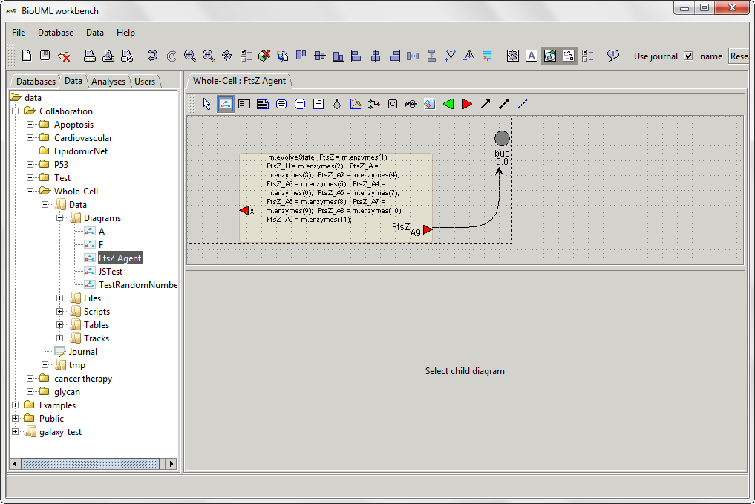

Slide 5
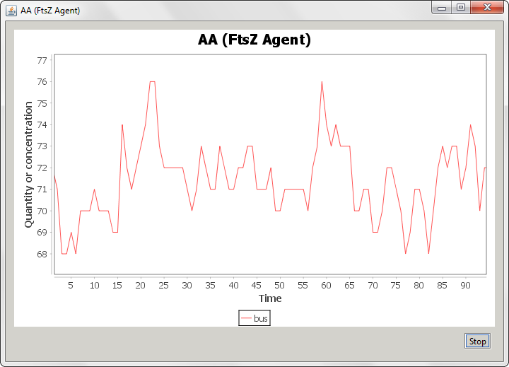

Slide 6
