Slide 1
Cytokinesis group
Tutor: Wolfram Liebermeister
Ilya Kiselev, Yan Zhu, Daniel Priego, Naveen Kumar

Slide 2
What have we done
Wrote our tasks for three days
Get used to the tool
Learn what is wrong with our SBGN
Decided to use VANTED for SBGN-ML generating
Add SBO annotation
Use COPASI for unit definitions
Working on the details of Cytokinesis module
Knowing our requirements (water and gdp)
Started defining inputs\outputs

Slide 3
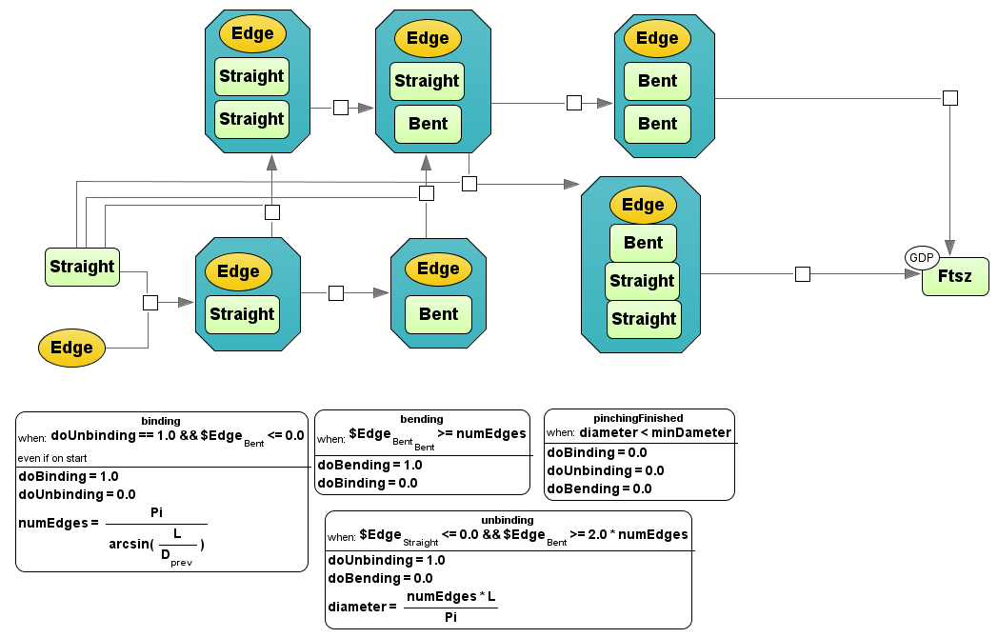
Cytokinesis

Slide 4
Diagram of cytokinesis
Cycle 1
start
start
One bend
One straight
One bend
Two straight
unbinding
Cycle 2,3,…
One bend
Two bend
Two straight
Pi
H₂O
FtsZ monomer
unbinding
FtsZ monomer

