Slide 1
Metabolism

Slide 2
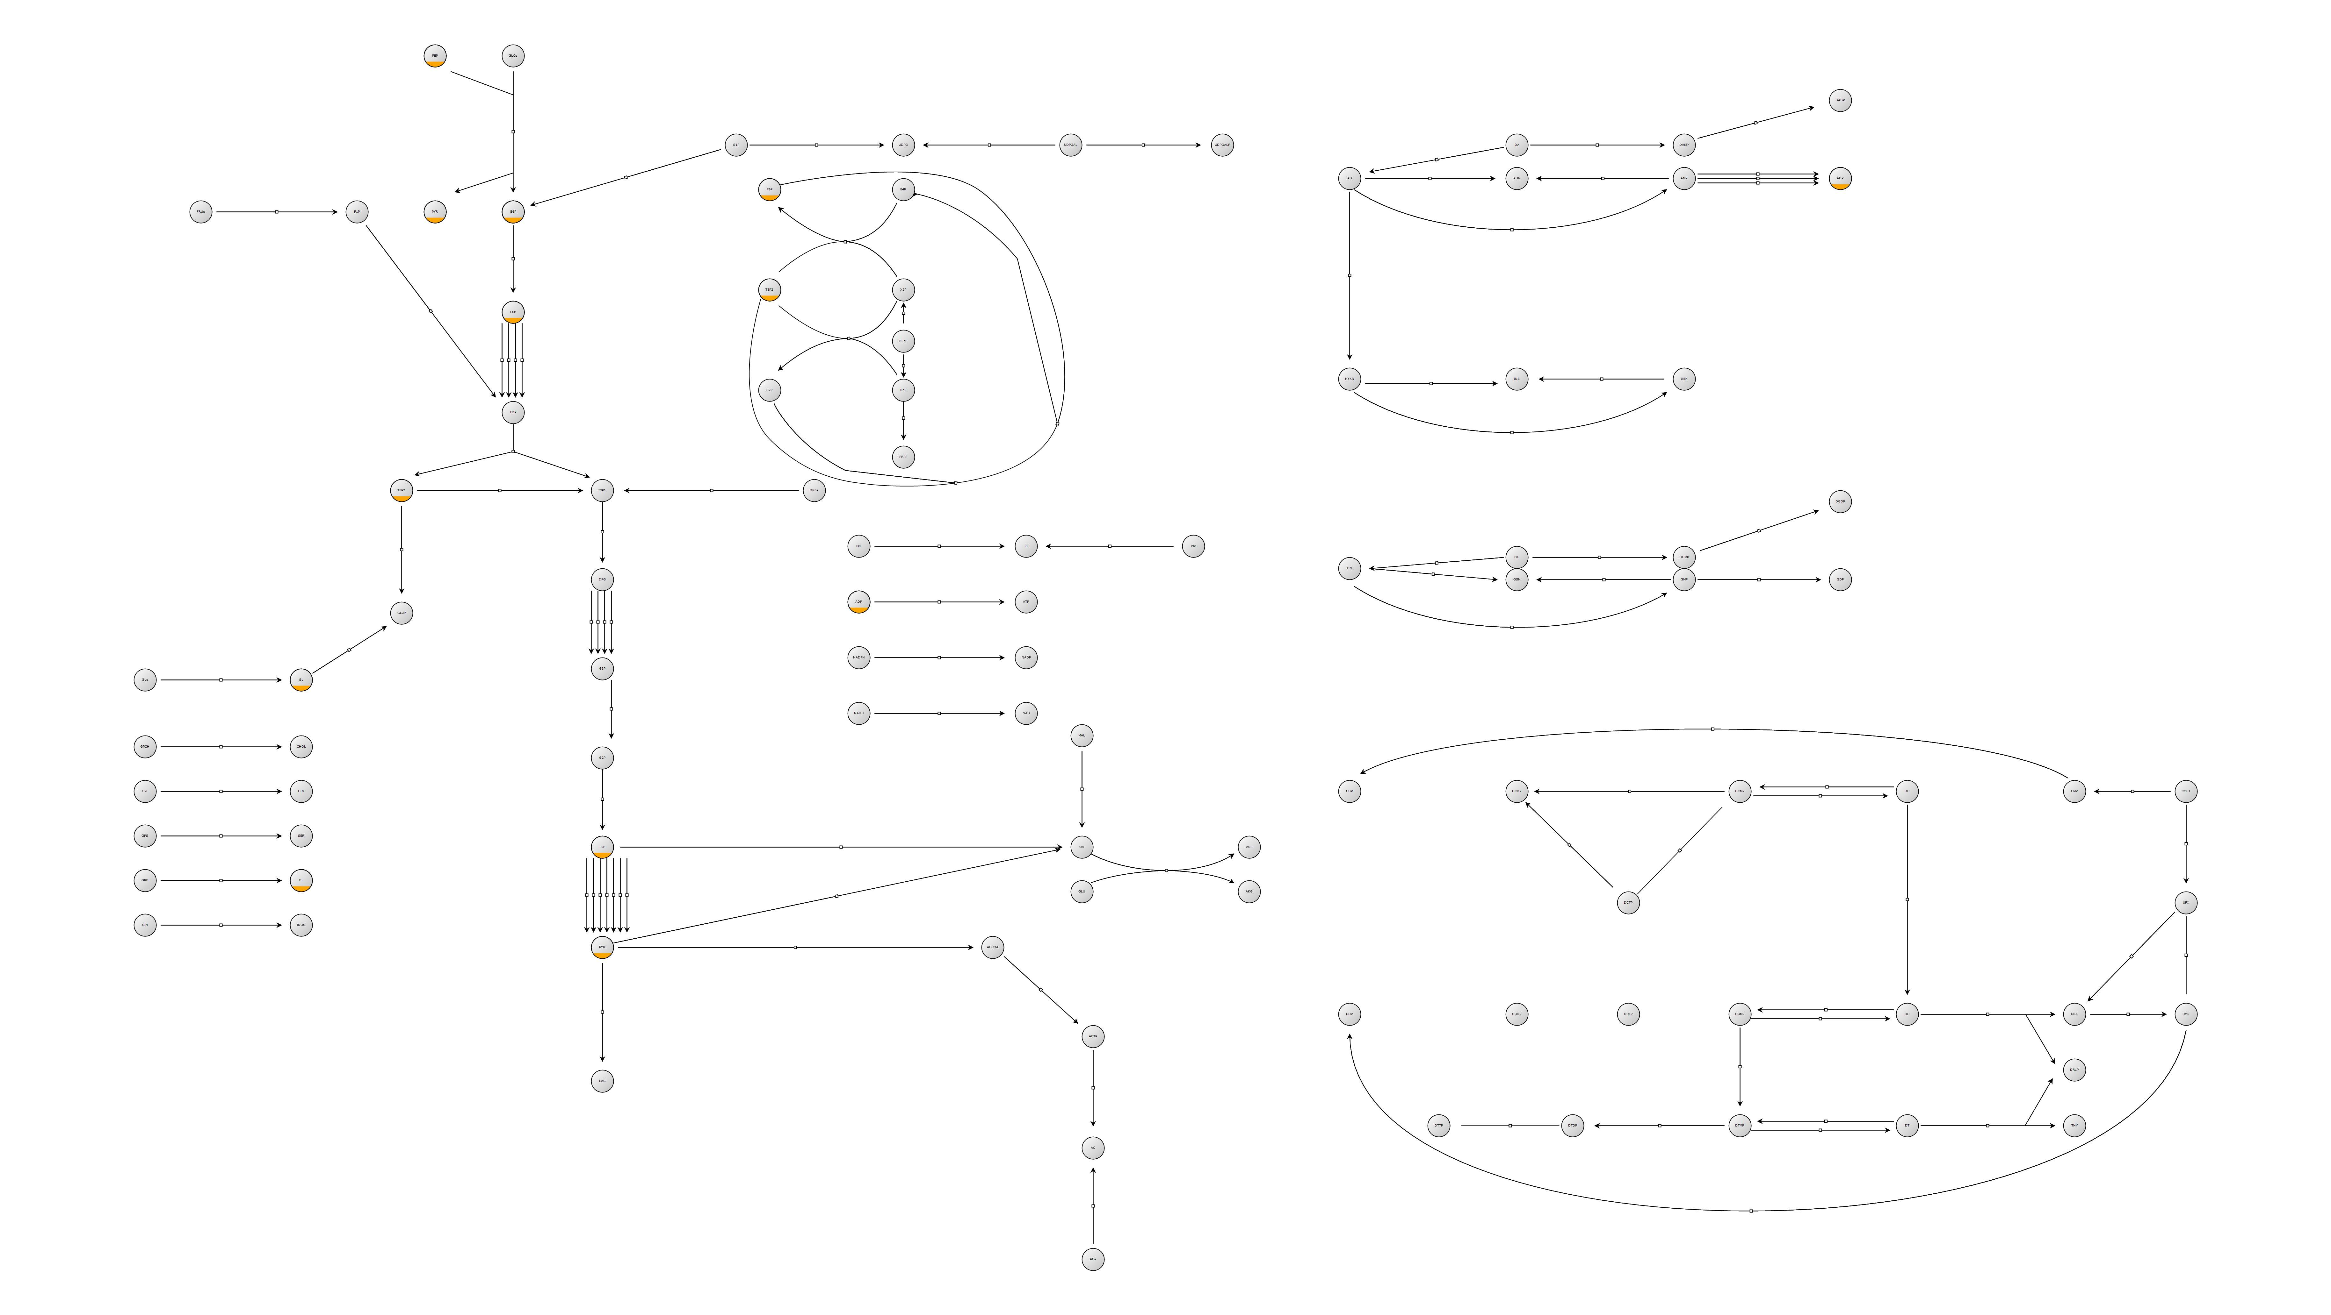
What We Did
Issue:
Ensuring compatibility with strict SBGN criteria.

Slide 3
How We Did It
libSBML to manipulate files.
Using existing pictures to define positions.
Sysbioapps layout to render image.

Slide 4
Almost Done
We have numerical input/output dumps from MATLAB simulation
  FBA simulation working
  SED-ML pseudo-scripts
  Prototypes to calculate dynamical fluxBounds and growthRate
  Schema in SED-ML and SBML to almost completely reproduce evolveState to MATLAB implementation

Slide 5
Comments
Existing graph tools could not layout whole network.
They could benefit from automatic layout of large well-annotated networks using existing maps (e.g. KEGG).

