Slide 1
Replication Initiation
Update II – 10/03/2015

Slide 2
Replication Initiation - Overview
Bind and form 7-mers at 4 specific binding sites
Activate monomers (ATP dependent)
Bind and polymerase (stochastic process)
Release monomers and polymers (stochastic process)

Slide 3
Challenges
Monomers can bind to around 2000 binding sites
How to model these binding processes without interfering with other groups?
Chromosome meeting?!
Many stochastic processes
Approaches for several situations identified

Slide 4
Today
MATLAB code
Understood workflow and identified possible challenges
Finished 6 of 7 submodules
I/O identification
Species & variable parameters
Resource requirements (how to communicate?)

Slide 5
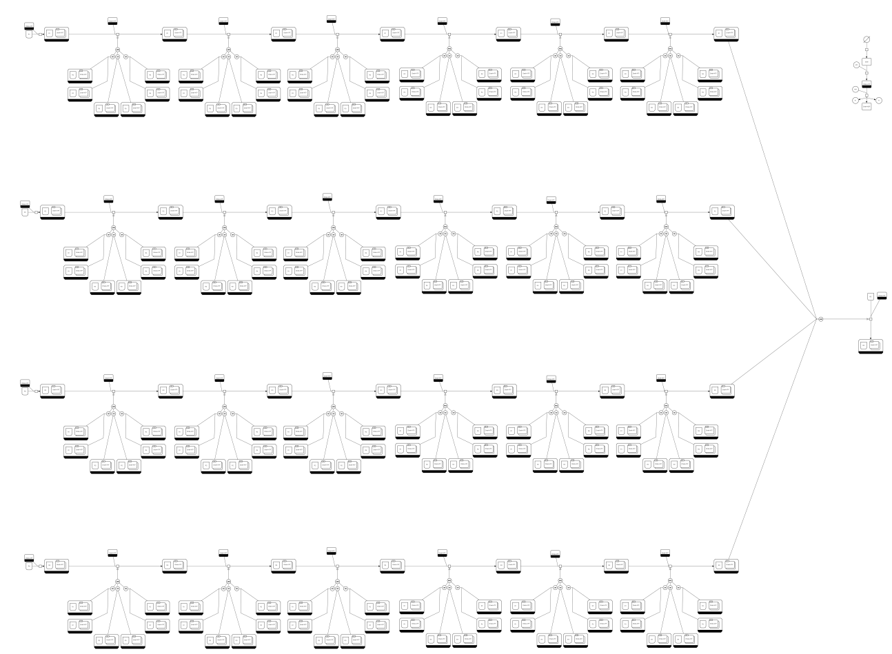
SBGN
SBGN of the whole model is almost finished

Slide 6
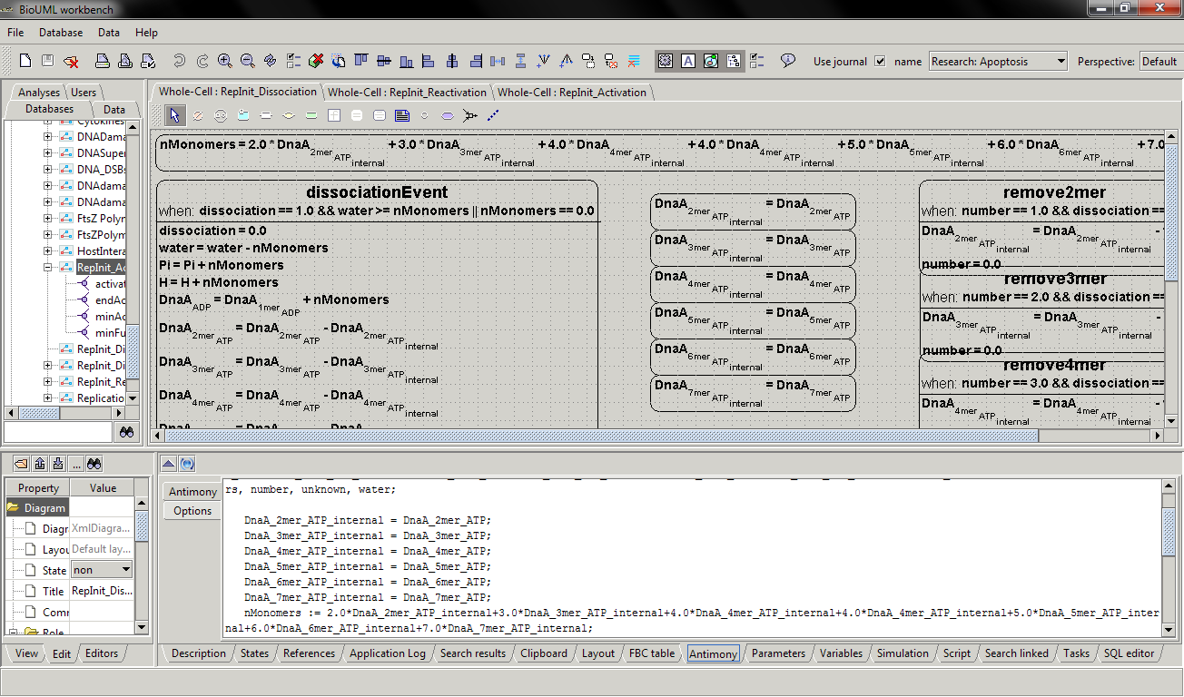
SBML
3 of the 7 submodules encoded in SBML
Stochastic processes uses ‘uniform distribution’ for now
BioUML

