Slide 1
Protein Translation Group (tRNA AminoAcylation & Protein Translation)
Pedro Mendes
Dan Hernandez
Denis Kazakiewicz
Hojjat Naderi
Joe Cursons

Slide 2
Tools Used
VANTED
python + libSBML
COPASI

Slide 3
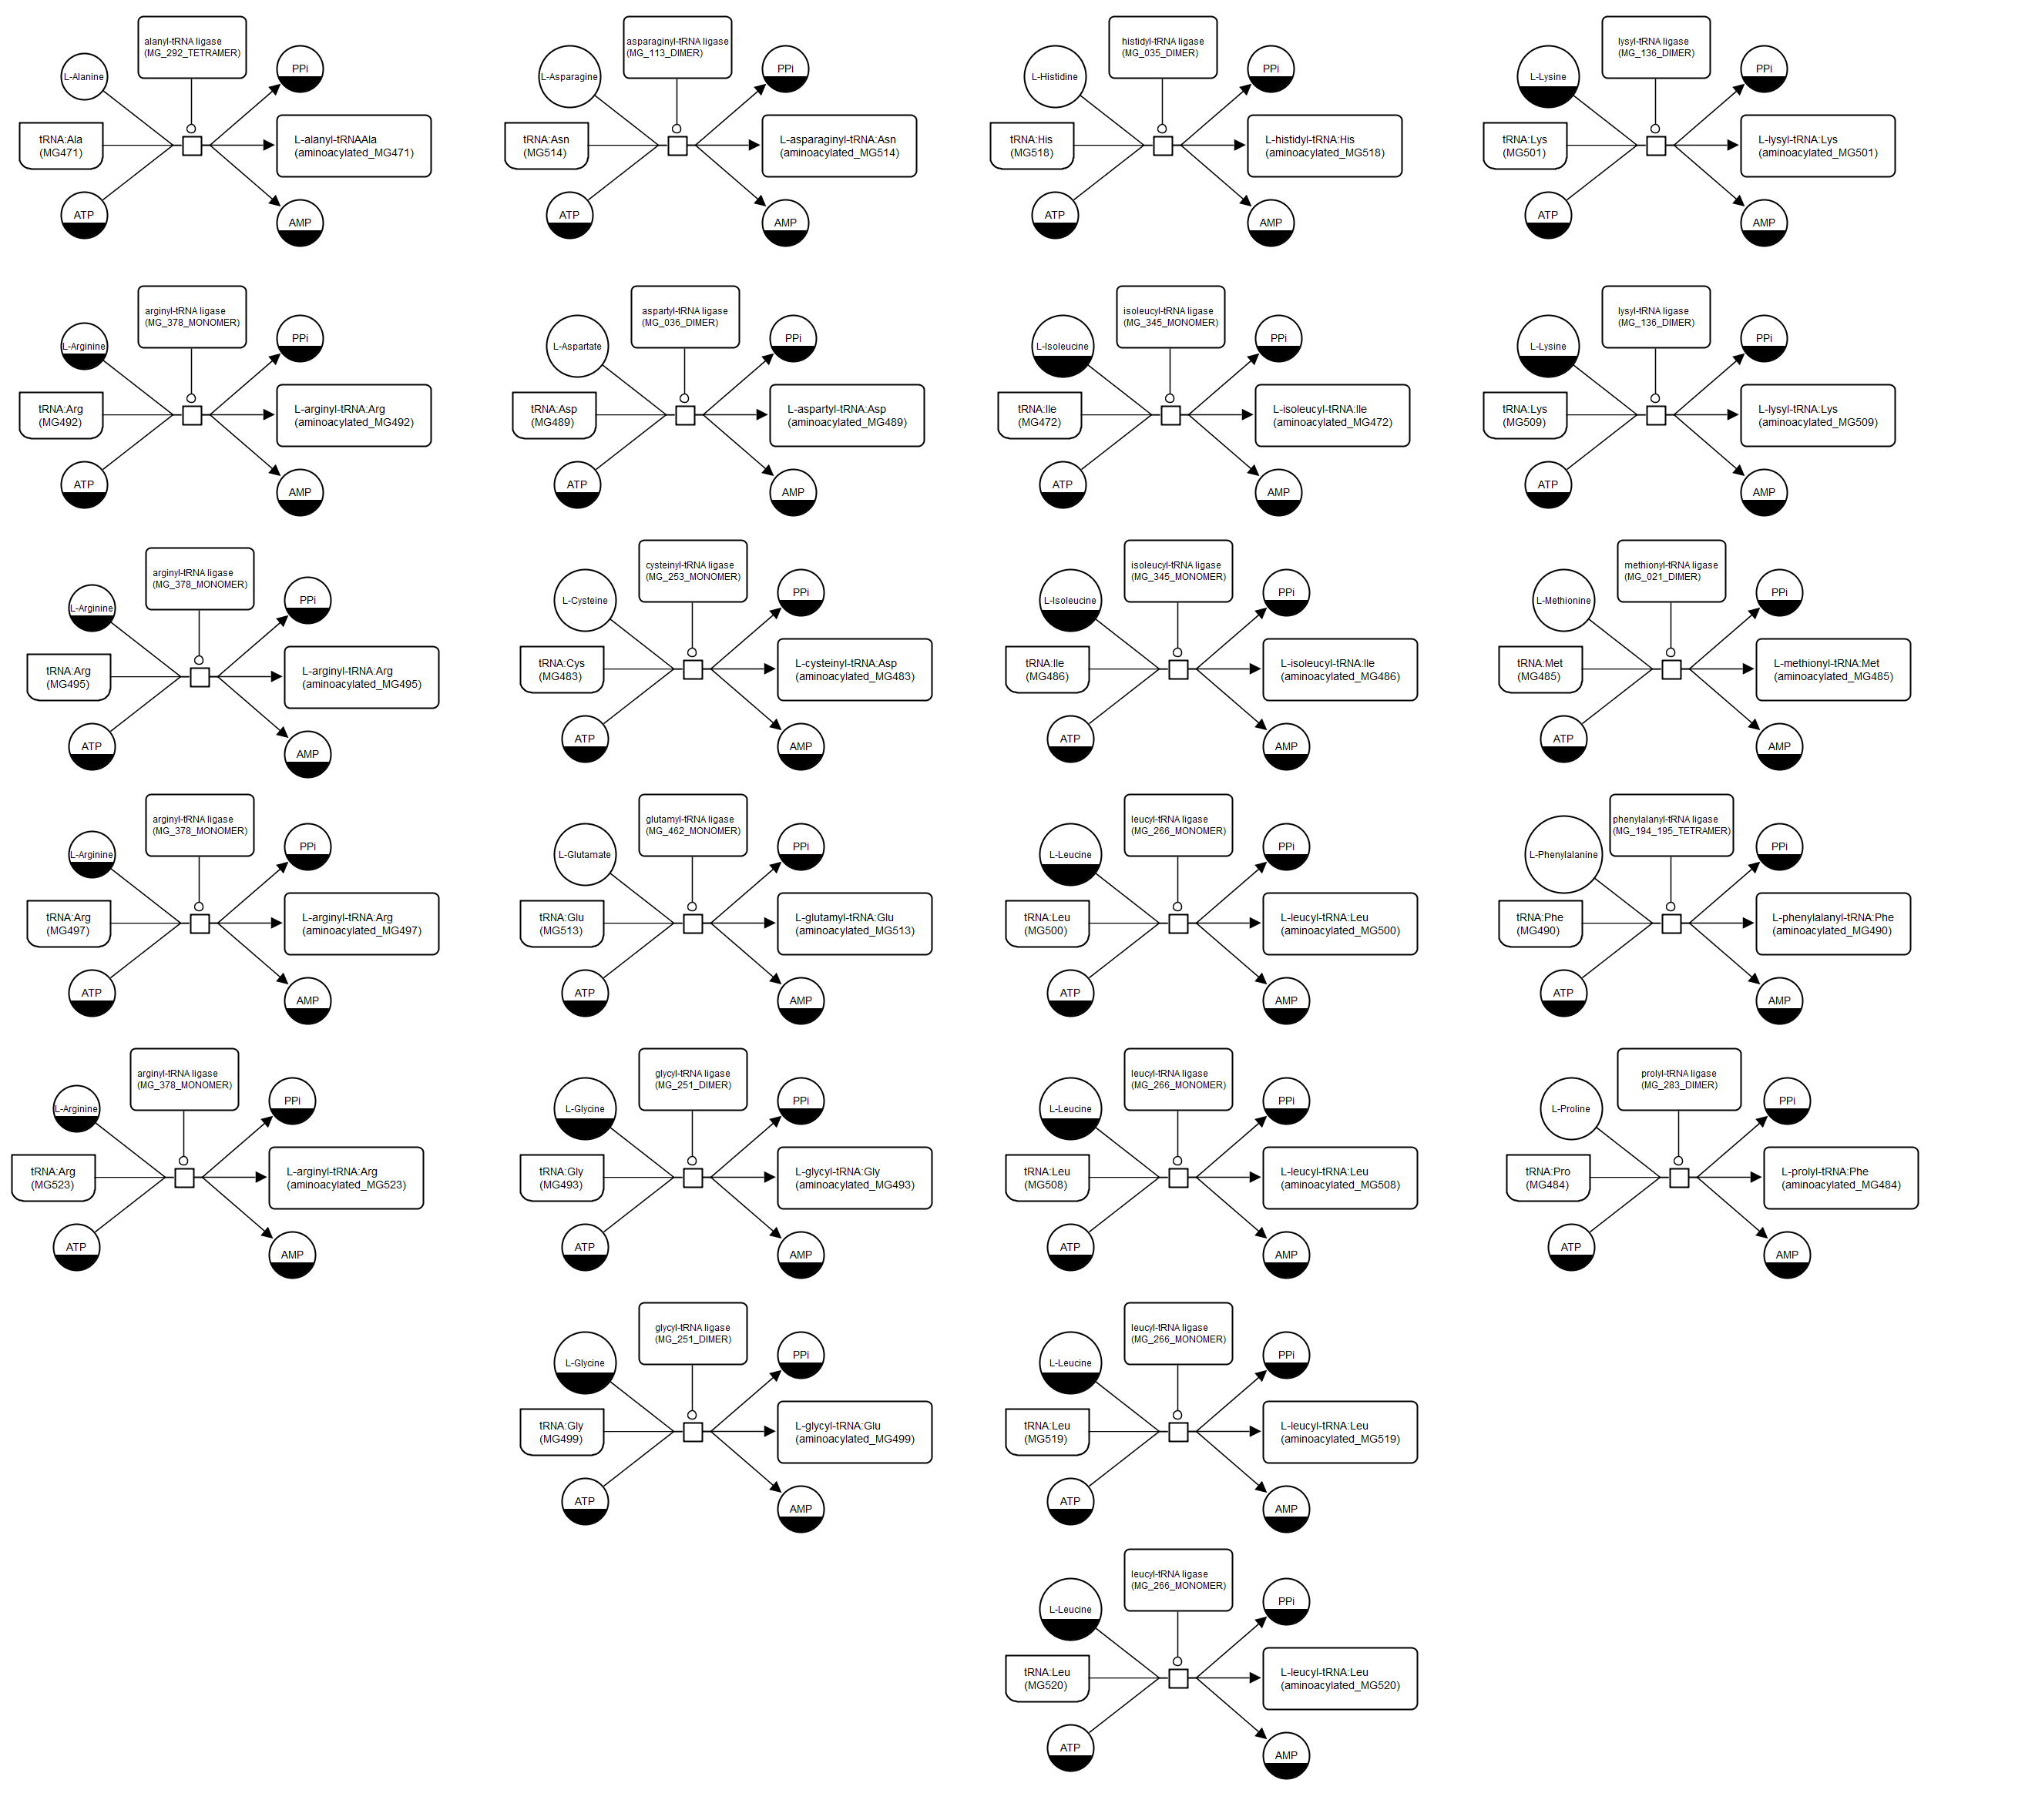
Current implementation – tRNA aminoacylation
As specified by Jonathan (30 odd reactions)

Slide 4
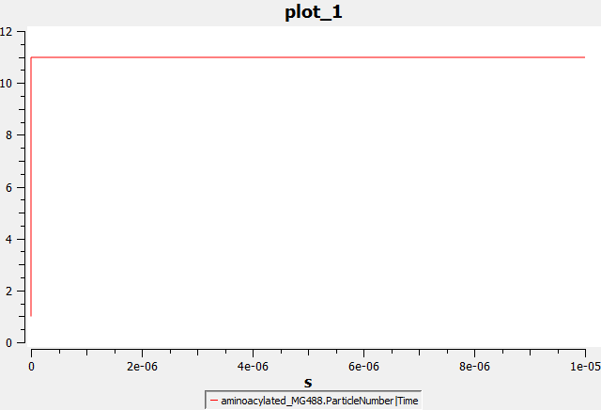
Current implementation – tRNA aminoacylation
SBML model opens/runs in COPASI
Very rapid (instant?) processes? Conversion of MET_MG488 to fMET_488

Slide 5
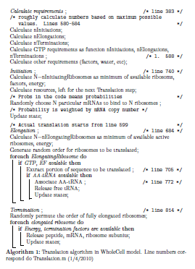
Jonathan’s Implementation

Slide 6
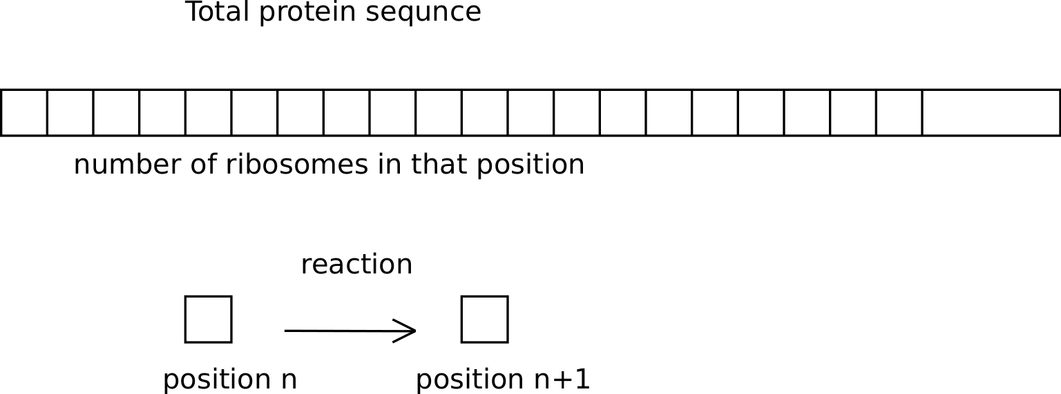
Current implementation – Translation
As specified by Jonathan
Define variables/reactions for stepwise (per amino acid) elongation of every polypeptide
Created by python.libSBML script using protein sequences

Slide 7
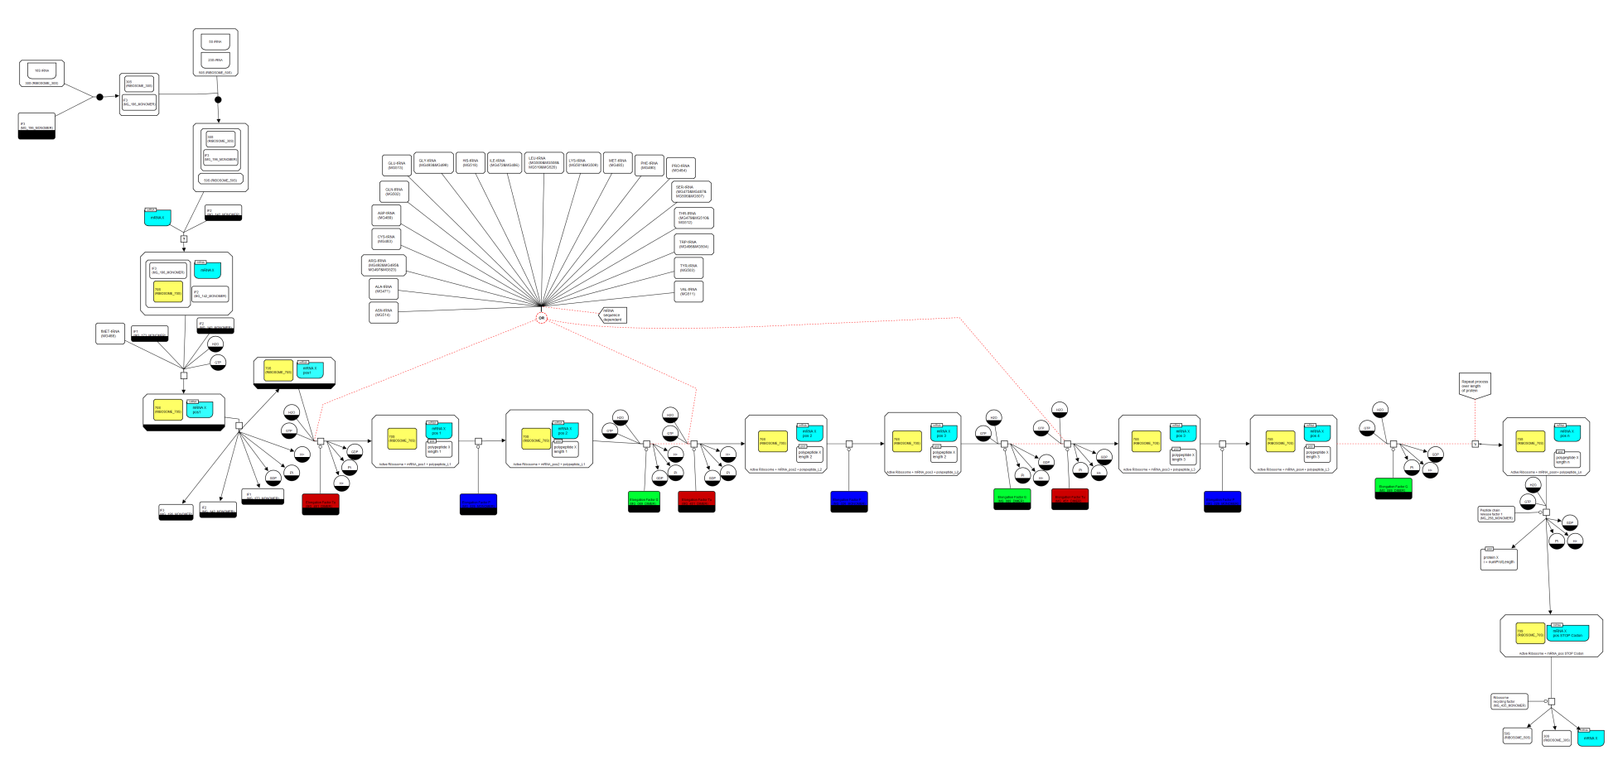
Current implementation – Translation

Slide 8
Current Implementation
Avoid stochastic process by applying Gillespie algorithm
Handles relative likelihoods of alternative reactions, weighted by concentrations
More natural SBML representation, but very large SBML files (long time to parse; much greater memory requirements; greatly increased run times in the absence of ‘sparse matrix’ representation)
Need to run smaller translation model (e.g. 30 proteins, reduced length) to test it

Slide 9
Things to fix/change - AminoAcylation
tRNA aminoacylation performed as a single step catalysed by AAx-tRNA ligase
Introduce intermediate steps
AAx + tRNA(AAx) + ATP → AAx-tRNA(AAx) + PPi + AMP
AAx + ATP → AAx-AMP + PPi
AAx-AMP + tRNA(AAx) → AMP + AAx-tRNA(AAx)

Slide 10
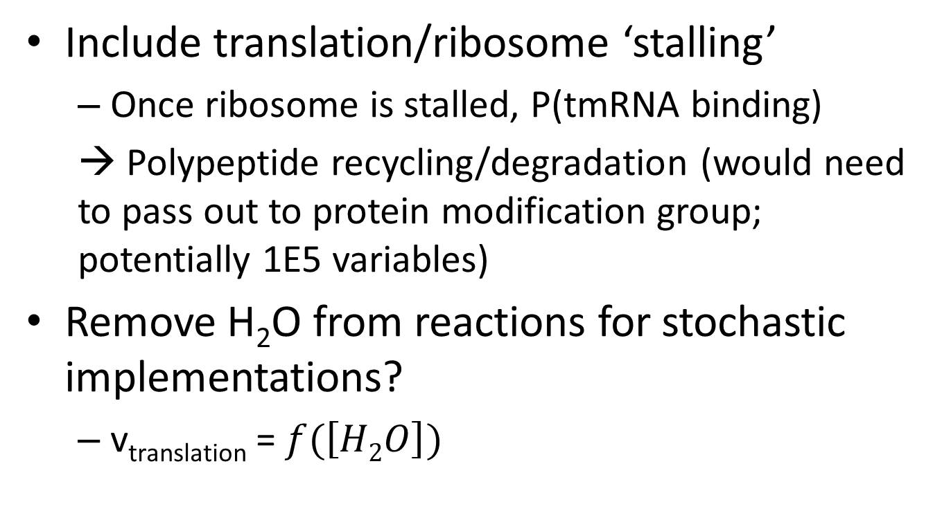
Things to fix/change - Translation
Include translation/ribosome ‘stalling’
Once ribosome is stalled, P(tmRNA binding)
→ Polypeptide recycling/degradation (would need to pass out to protein modification group; potentially 1E5 variables)
Remove H₂O from reactions for stochastic implementations?
v_{translation} = $f(\left[H2O\right])$

Slide 11
Things to fix/change - Translation
Antibiotic effects: drive ribosome disassembly/block ribsome assembly?
Currently in protein activation submodule
Translation reactions should be built from mRNA sequence (rather than protein sequence) to allow for mutations
EF-P: catalyses attachment of fMET to 2nd amino acid

Slide 12
Things to fix/change - Translation
Limit maximum extension within a single model iteration
Unlikely, but possible with Gillespie algorithm that a single amino acid + ribosome extends more than possible
Could maybe reduce number of reactions (e.g. add blocks of amino acids), or single reaction with slower reaction
Define module requirements for integration
Jonathan’s talk:
Translation: 29% of ATP
tRNA aminoacylation: 15.1% of ATP
Unknown: ~40%(?) of ATP

Slide 13
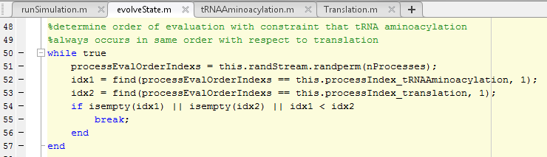
Things to fix/change
Combine/integrate tRNA aminoacylation and translation into a single SBML model?
Annotation and further documentation
SED-ML representation?

