Slide 1
Data Science Jobs
Team 7: Kristin Castaneda, Shineka Barnett, Dahmane Skendraoui, & Mer Arnel Manahan

Slide 2
It is why most of us are here
Genuine interests in prospects during and after bootcamp
Layout who, where, what and how much
Who is hiring?
Where are the jobs?
What skills/technology are they looking for?
What kind of salary can we expect?
What we found
The top industries hiring, companies in those industries and company rating
The states that have the most job openings, positions by company
The top skills the job postings require
The break down of salary ranges per job type (Analyst, Engineer, Scientist)
Why Data Science Jobs?

Slide 3

The Data
Kaggle provided 2018 dataset from Indeed
Who is Hiring?
Company, Industry, Rating
What Skills are needed?
Skills, Top Skills for each position
Where are the Data Science Jobs
Location(State), Job Type
Salary to expect?
Job Title, Job Type, Salary Bins

Slide 4
Who is Hiring-Industry Overview
Questions:
What are the top five industries that have the most job postings?
Within those industries, what are the top five companies with the most postings?
What are the ratings for the companies?
Exploration:
Focused on select columns from dataset→
Company Industry
Company
No of Stars
No of Reviews
Excluding company size (10,000+ parameter)
Excluding company revenue (significant # of null)
5715 entries, 43 columns

Slide 5
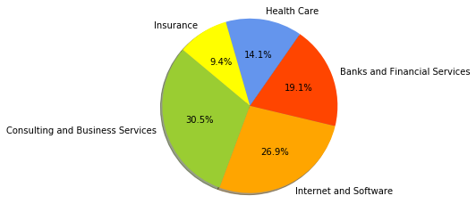
Top Five Industries:

Slide 6
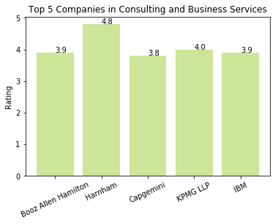
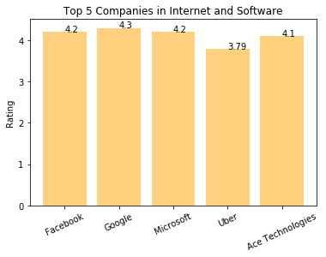
Top Five Companies With Rating :
Notes:
Harnham
Google
Capital One
Kaiser Permanente
USAA

Slide 7

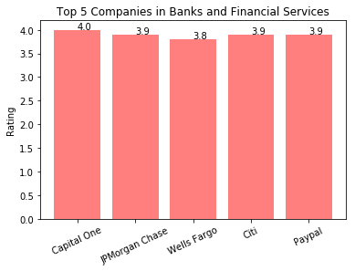
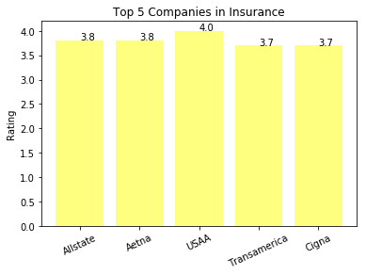

Slide 8
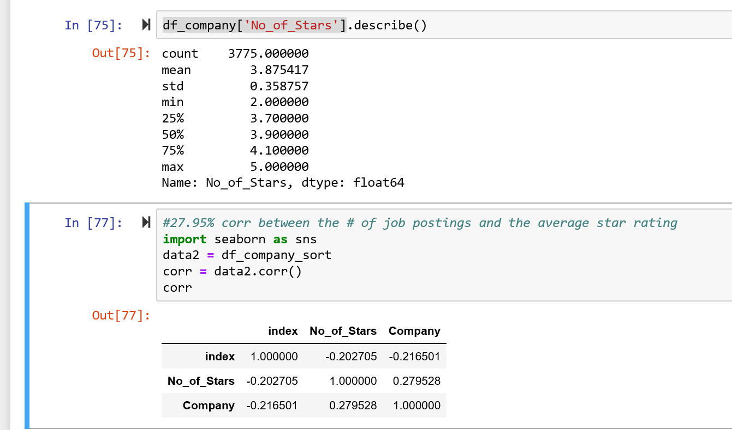
27.95% correlation between company job posting and number of star ratings!
Notes:
A positive correlation indicates the extent to which those variables increase or decrease in parallel

Slide 9

Where are the Jobs?
Where are the jobs located?
Where are top data science companies located?

Slide 10
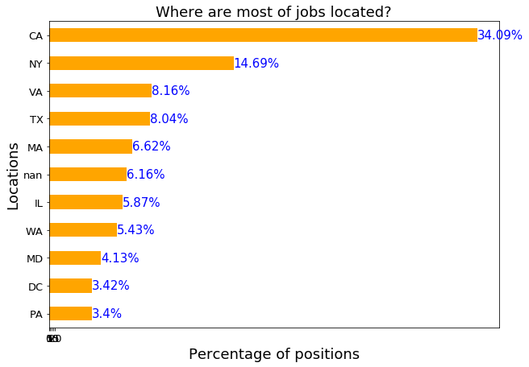
CA 1395
NY 601
VA 334
TX 329
MA 271
nan 252
IL 240
WA 222
MD 169
DC 140
PA 139

Slide 11
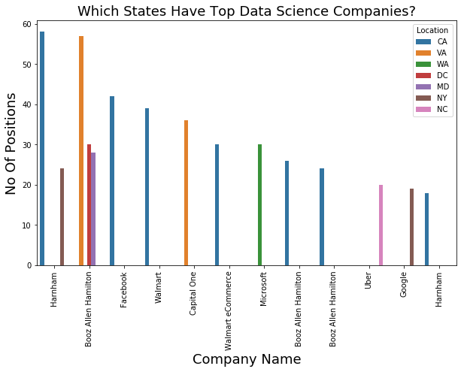
Where are top data science companies located?

Slide 12

What kind of skills are companies looking for?
Top Skills for Each Type
Top Skills for All Types

Slide 13
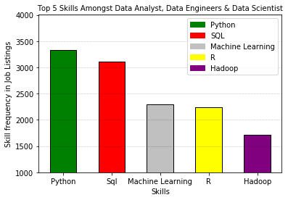
Top 5 Skills Amongst All Job Types:
3325
3104
2297
2234
1714

Slide 14
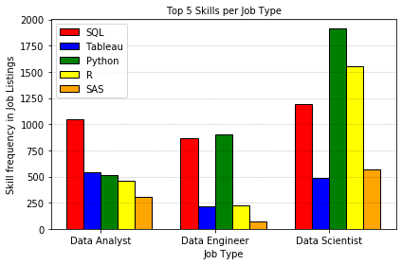
Top 5 Skills Per Job Type

Slide 15


What Salary Can We Expect?
Job Type
Distribution
Skills
Day 2

Slide 16
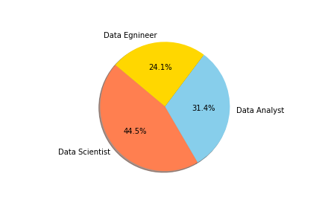
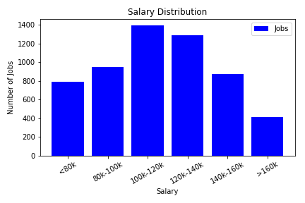
What Salary to Expect?

Slide 17
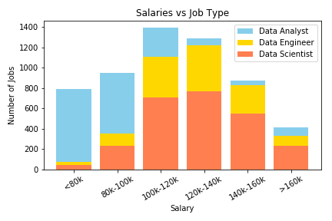
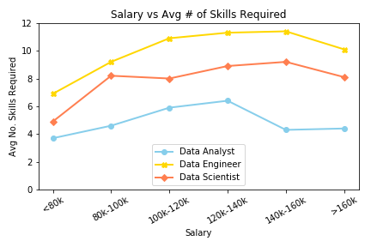
Who Gets Paid the Most? Why?

Slide 18

Post Mortem
Company Size.
Company Revenue
Skills/Tools utilized can vary by industry/company
Include housing data(median listing price of houses). Compare salary vs median listing price by state to see how far the salary will go.
Many more factors that affect compensation strength

Slide 19

Questions?

