Slide 1
VAEs for TRPases
Exploring latent space patterns for TRPases

Slide 2
VAE Training Procedure
MUSCLE3.8 alignment based on Trim 400/600
Consensus sequence (Hidden Markov Model) using HMMER
Alignment to consensus sequence
VAE training for 6000 epochs

Slide 3
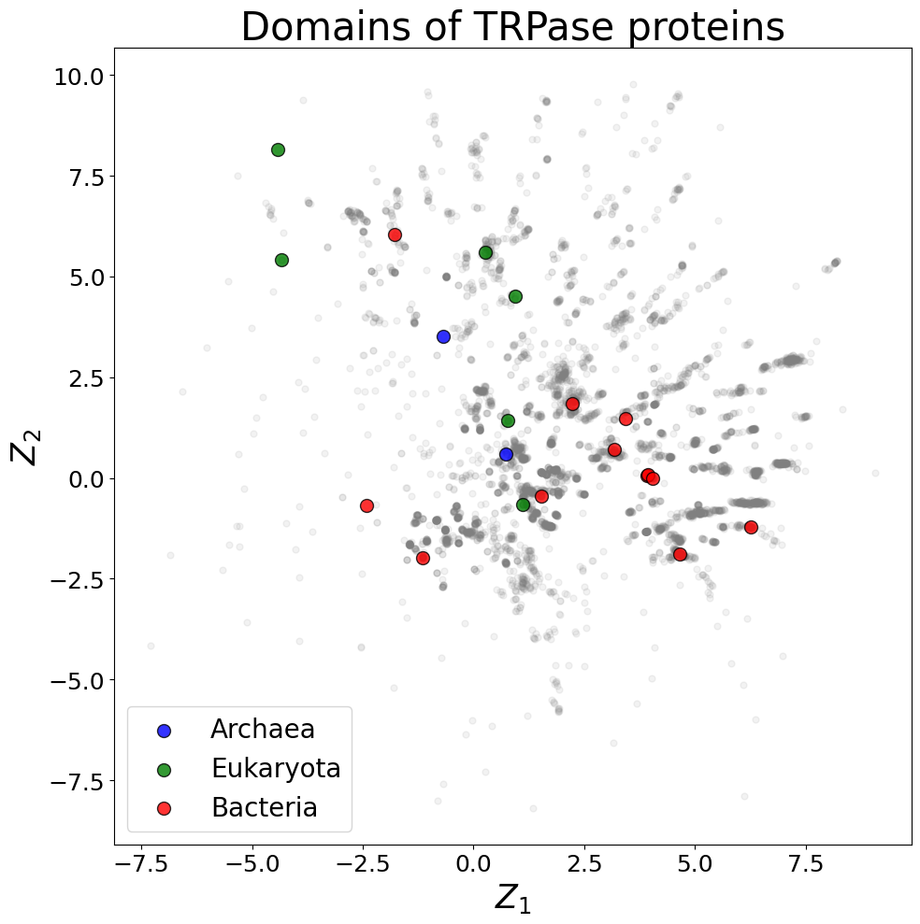
Latent Space

Slide 4
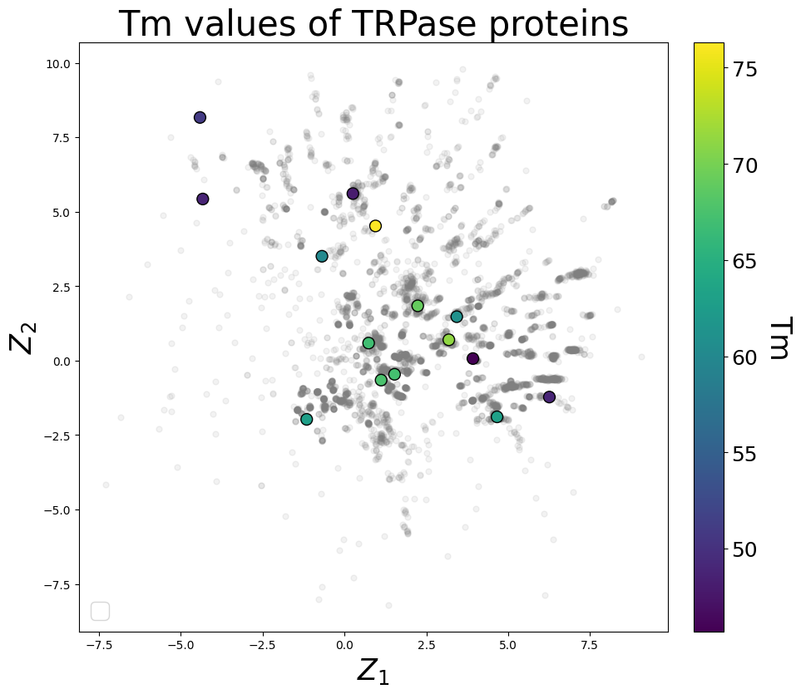
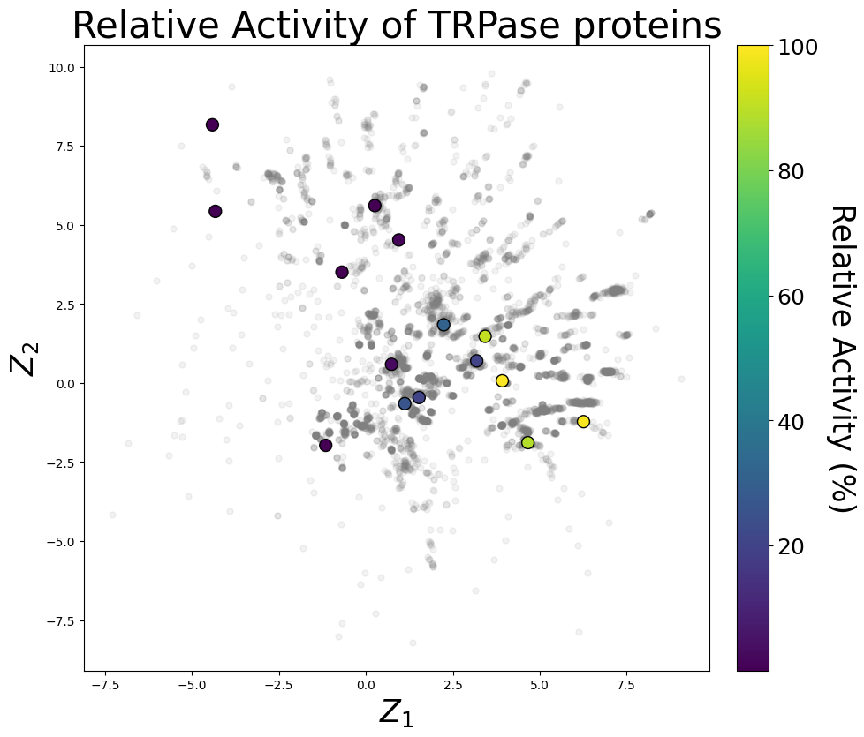
Latent Space – Experimental Analysis

Slide 5
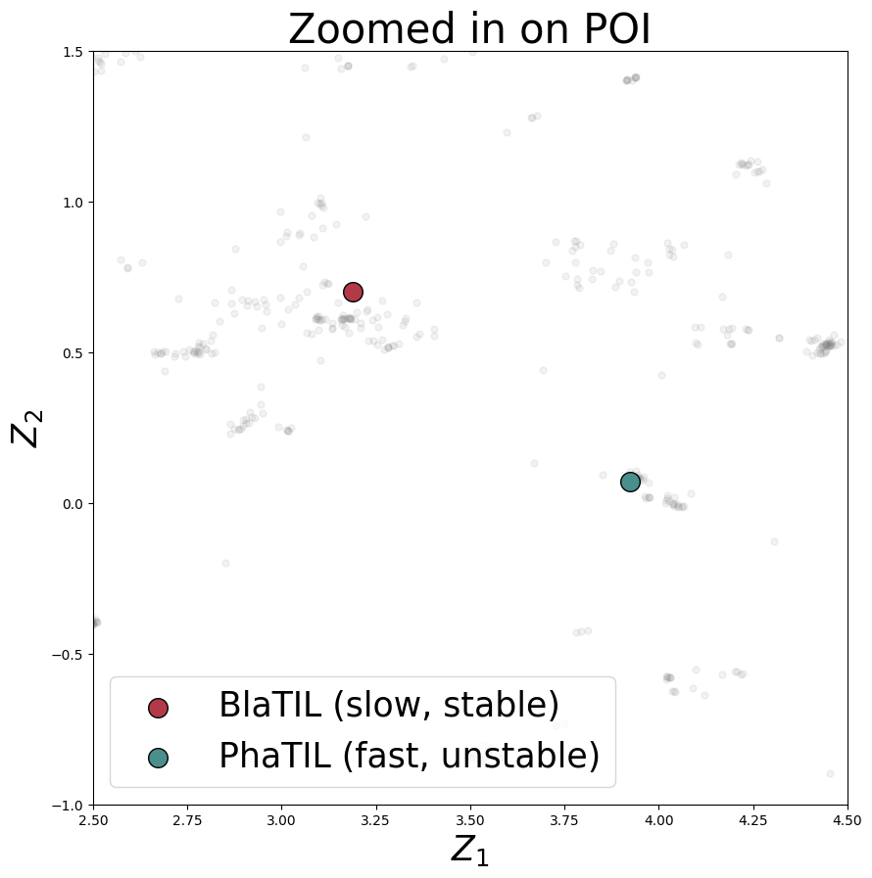
Latent Space – Zoom

Slide 6
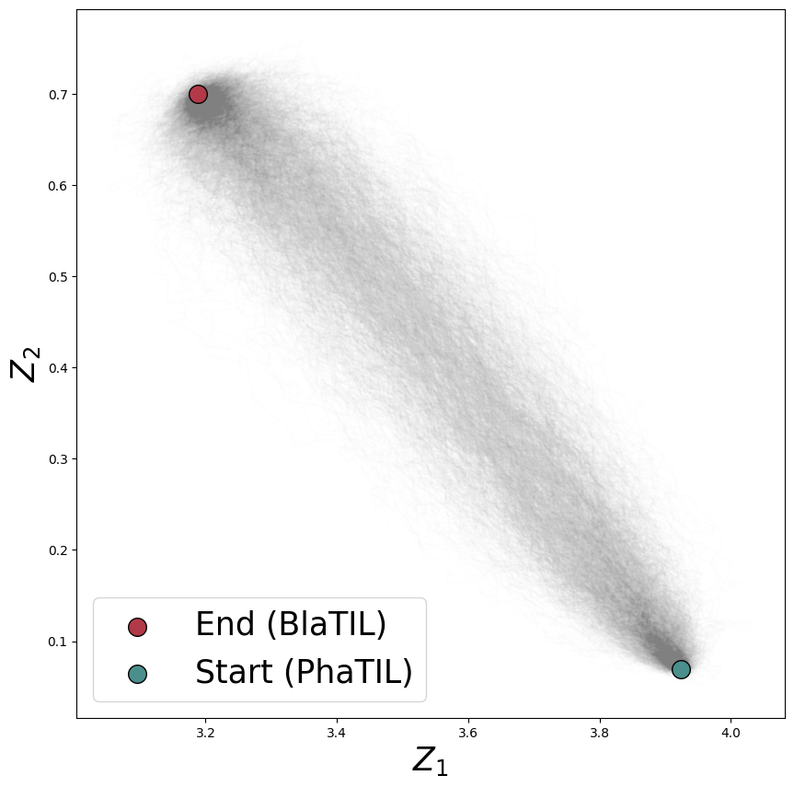
Morphing of Pha into Bha

Slide 7
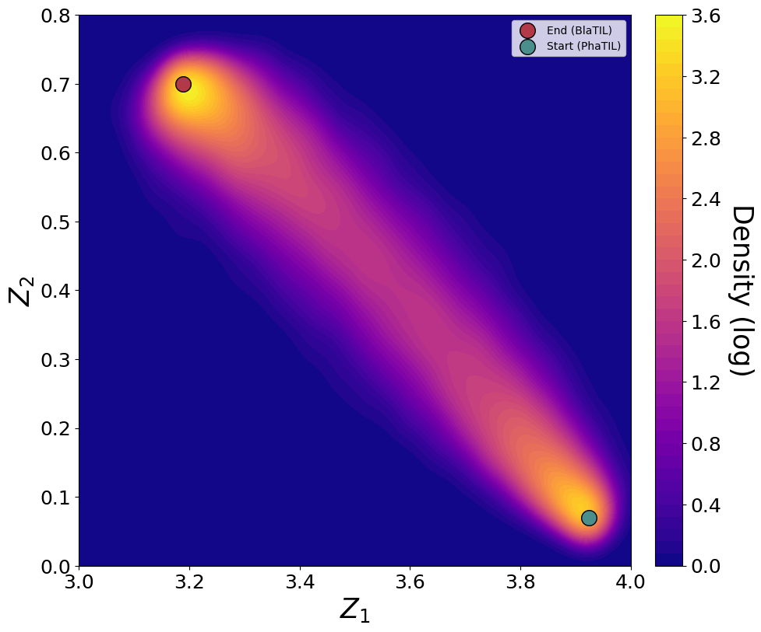
Morphing of Pha into Bha - Density

Slide 8
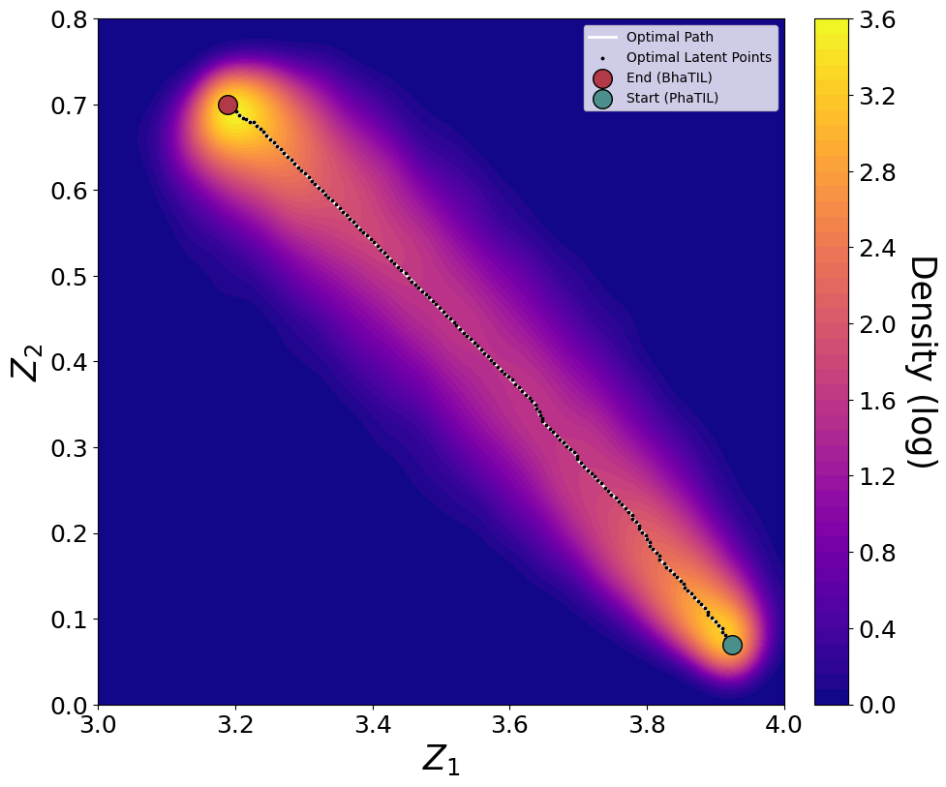
Morphing of Pha into Bha - Density - Optimal Path

Slide 9
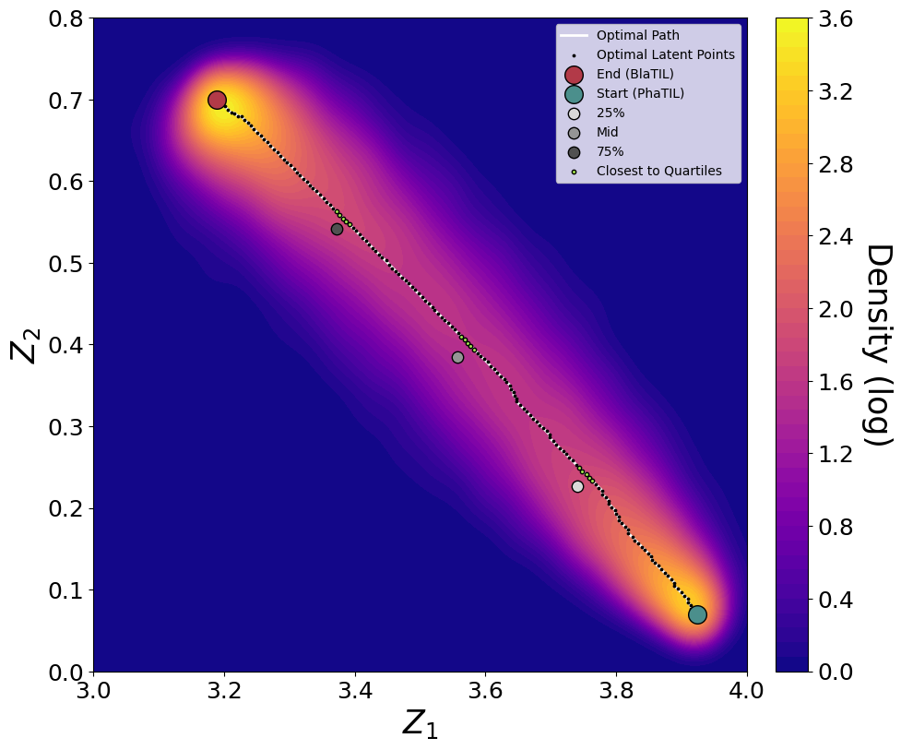
Morphing of Pha into Bha - Density - Optimal Path - Quartiles

Slide 10
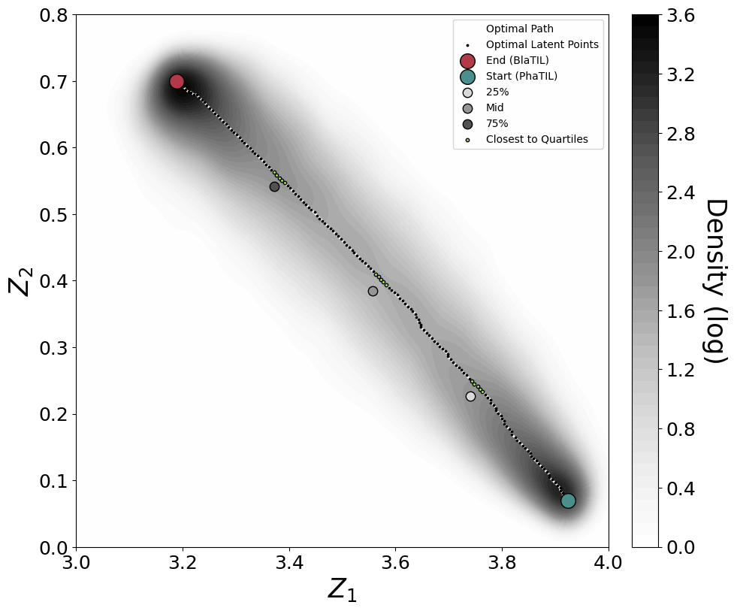
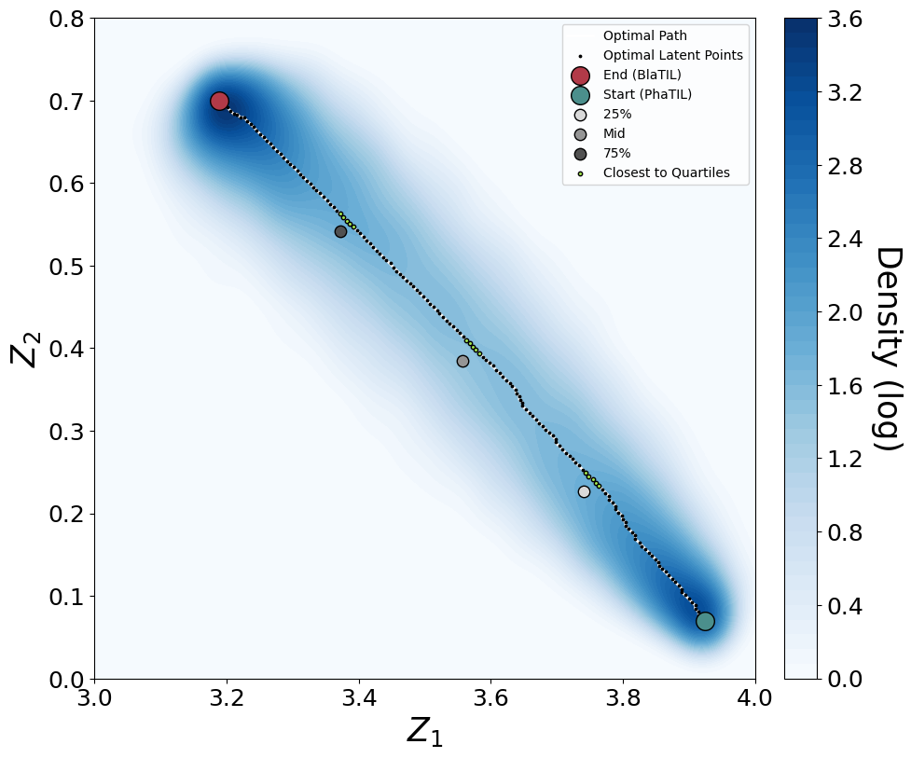
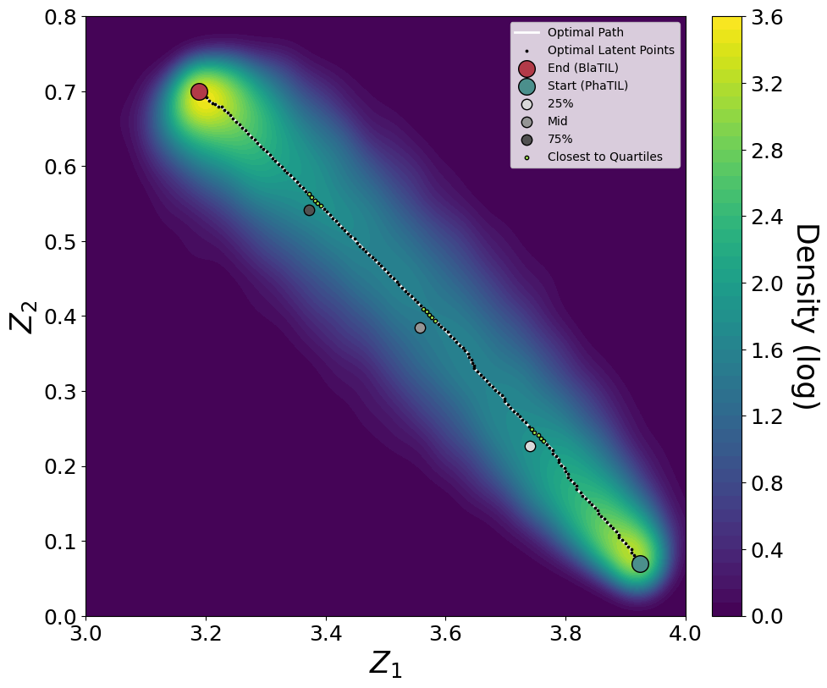

Slide 11
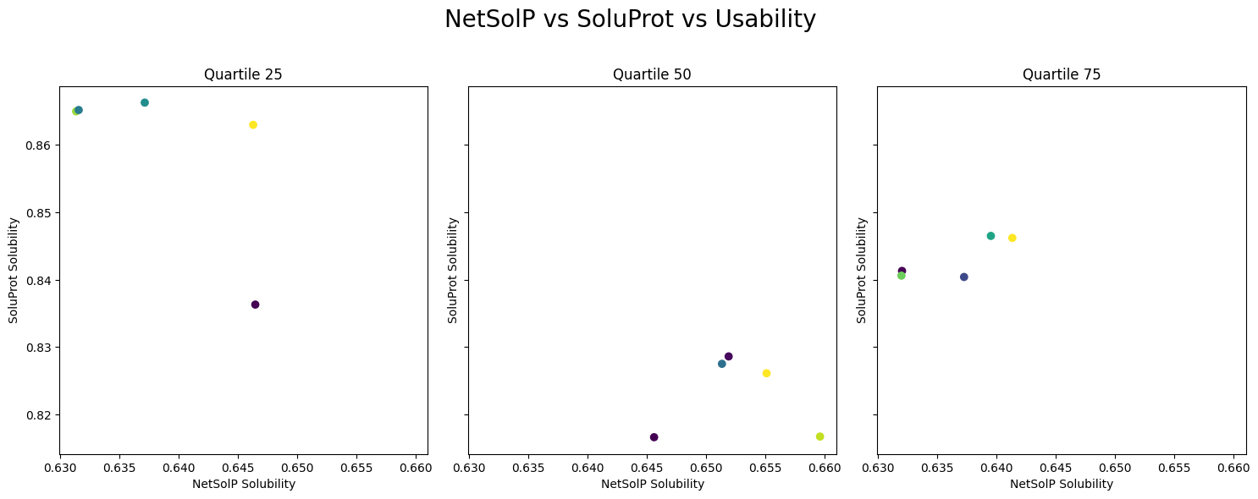
In Silico Characterization

Slide 12
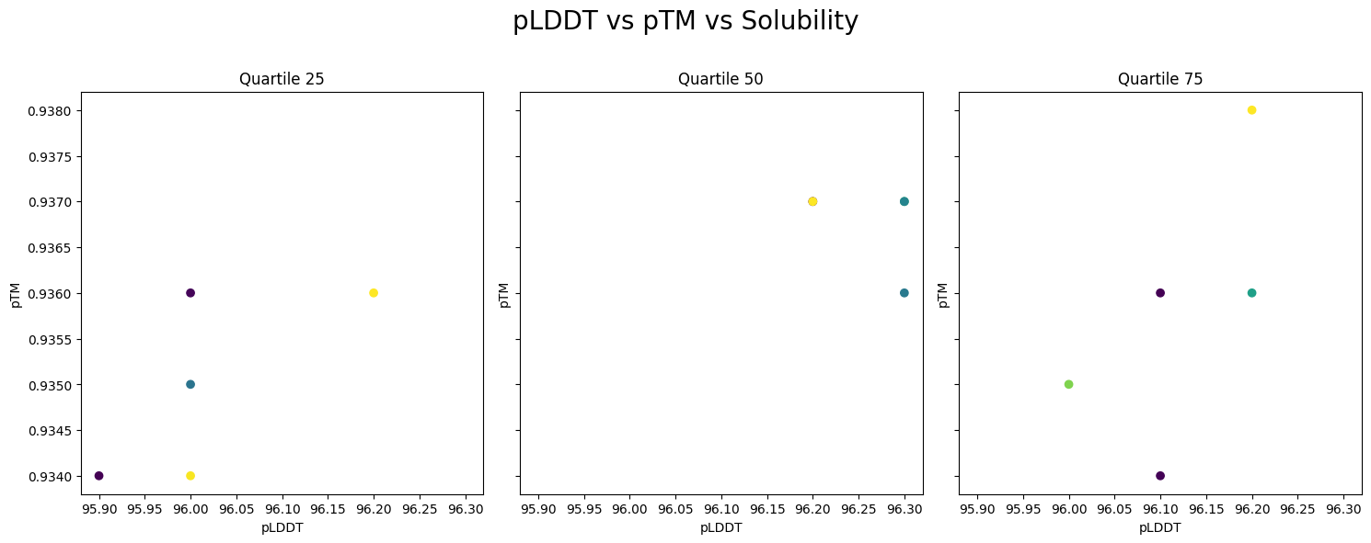
In Silico Characterization

Slide 13
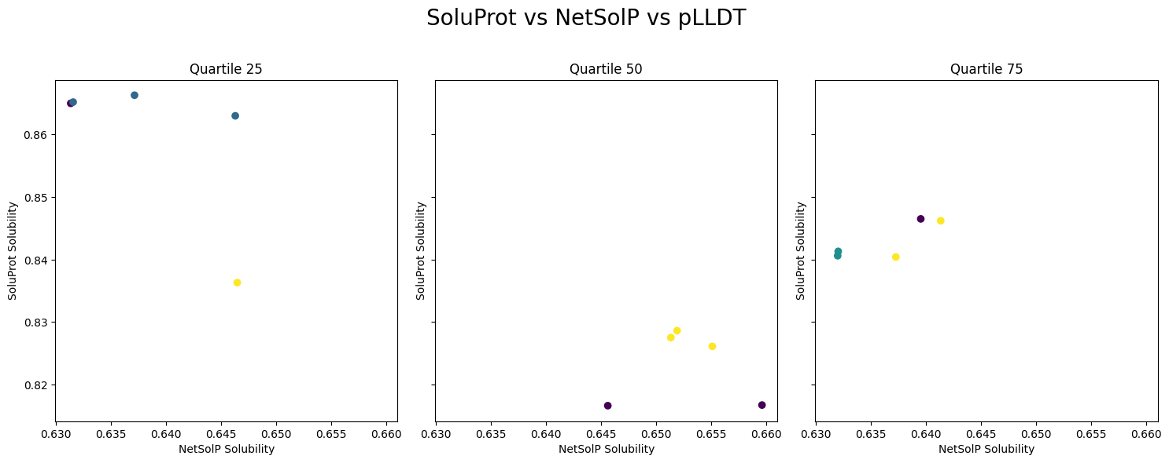
In Silico Characterization

Slide 14
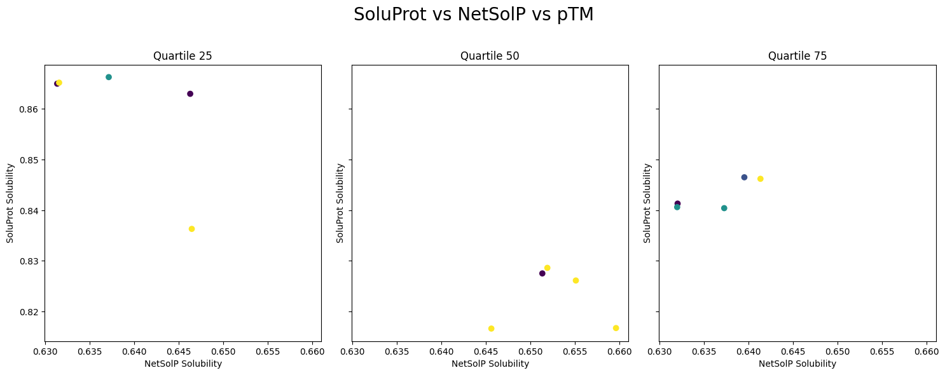
In Silico Characterization

Slide 15
Selection

