Slide 1
Infinia: A realm with infinite stories
Team Caladrius
Bishwambhar Dahal Rajat Dulal
Sirjana Bhatta Suramya Pokharel

Slide 2
Problem Statement:
No adaptability to player interaction
Traditional games rely on fixed narratives and syntax, making it challenging for them to dynamically adapt to individual player needs and preferences.
No real-time procedural content generation
The story of a traditional game is typically crafted during the development phase, often lacking the flexibility to incorporate fresh plot elements as the game evolves.
Traditional game is based on fixed syntax and cant understand player needs. But our game is AI powered and adapts according to situation.
Limited replayability in traditional games
The scenes and narrative of a traditional game can become repetitive, limiting the player's enjoyment as they experience the same story repeatedly.
Need for frequent content updates
Frequent updates become essential for traditional games as the fixed storyline can lead to decreased engagement over time. However, these updates can pose significant financial challenges for developers.
Traditional game is based on fixed syntax and cant understand player needs. But our game is AI powered and adapts according to situation.

Slide 3
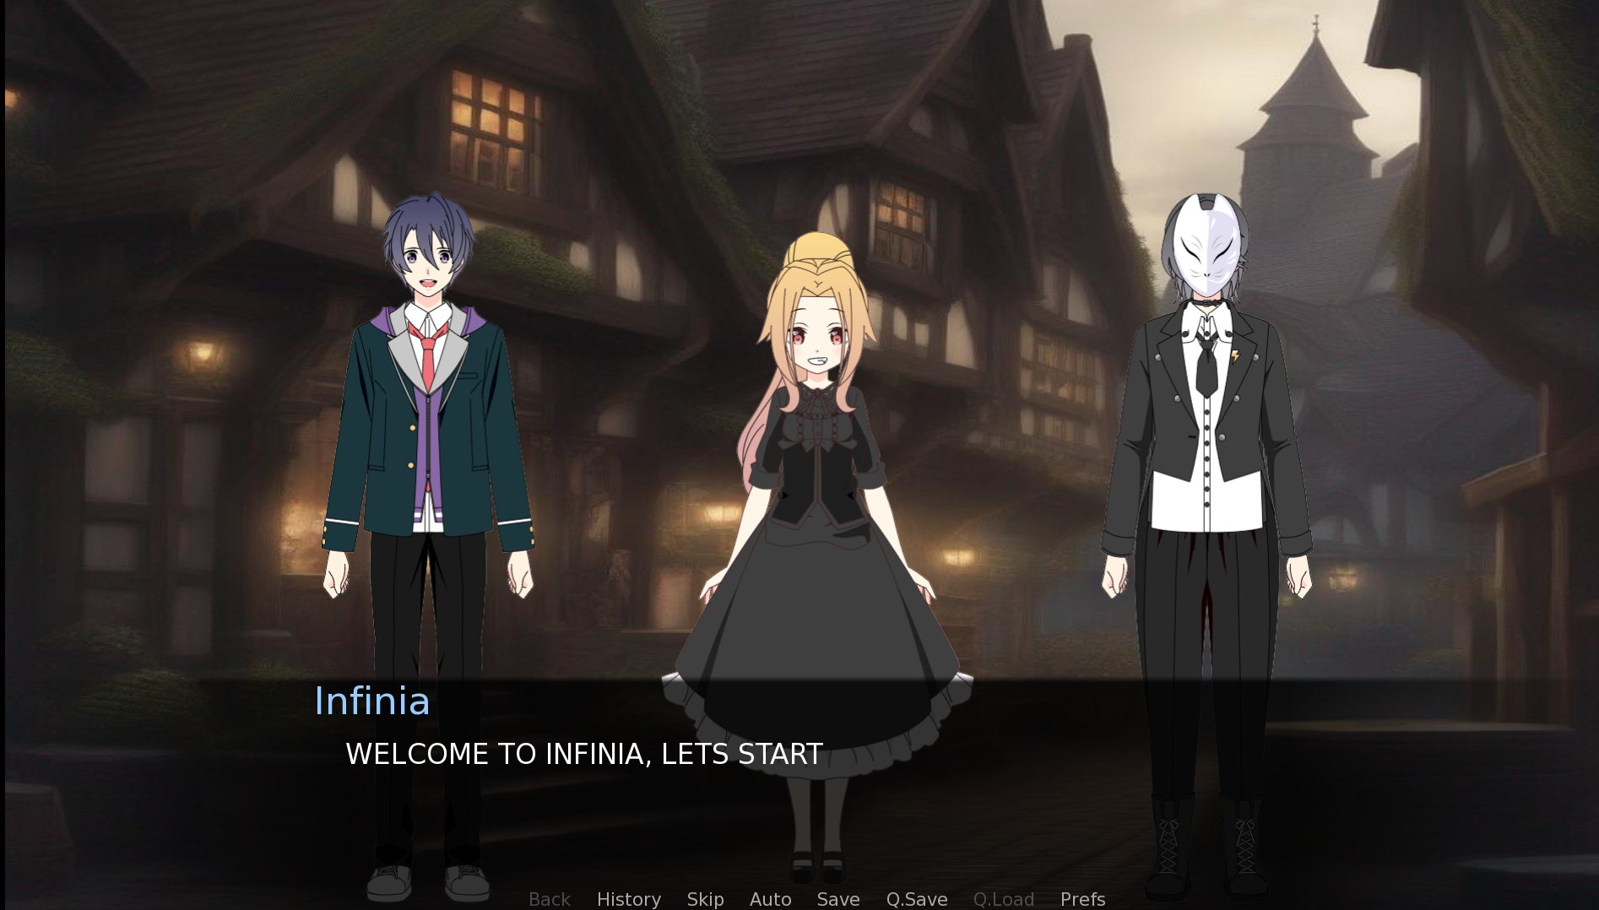
Solution Overview:
AI-Powered Dynamic Content Generation.
Adaptive Player-Centric Experience.
Iterative Improvement Loop.
Plot twists make game more interesting.
Interactive and user friendly game experience.

Slide 4
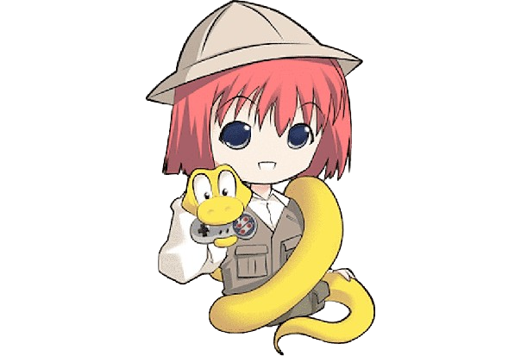

Methodology
Tech Stacks Used
Python
Ren’py Visual Novel Engine
Gemini API
Stable Diffusion API
Musicgen-small API
Google Verex AI Gemini API
For game plot and theme creation.
Generation of dynamic dialogues for characters involved.
Implementation of adaptive storylines that evolve based on the player's actions and decisions.

Slide 5


Stable diffusion API
Leonardo AI Style Illustration
To facilitate game background creation.
To adaptively generate images based on the current story sequence.
Leonardo AI Style API from HuggingFace
musicgen-small API
Model created by FAIR team of Meta AI
For high quality music generation
Generation of background music required
Implementation of adaptive background music based on story

Slide 6
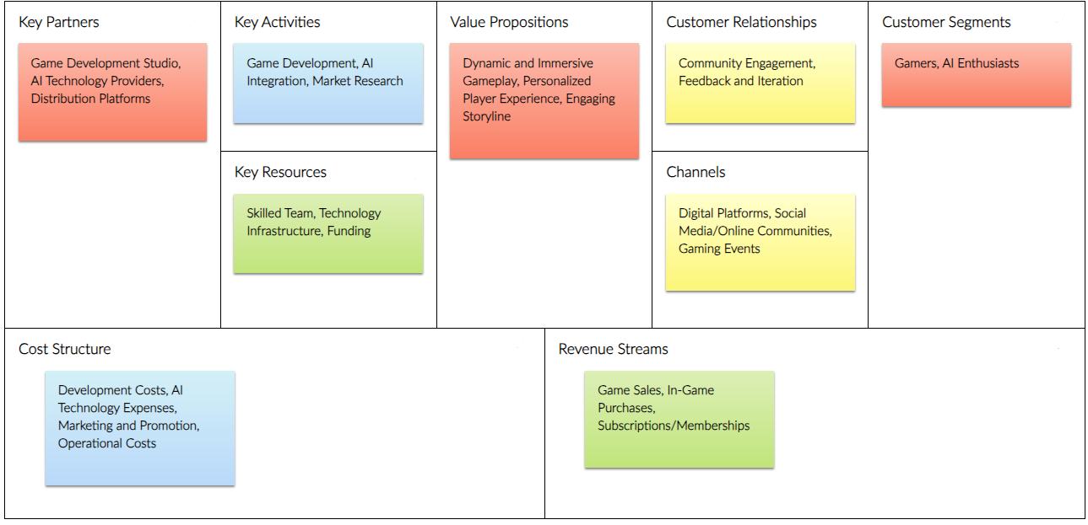
Business Model Canvas

Slide 7


ATTENTION

