Slide 1
BRITISH AIRWAYS
Customer Review Analysis To Gain Insights

Slide 2
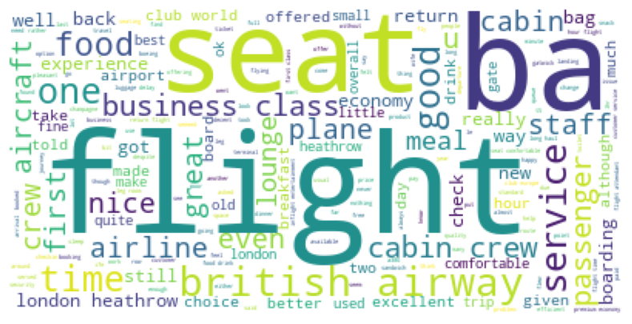
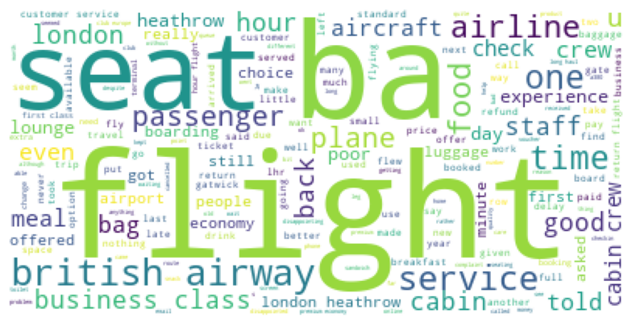
REVIEW ANALYSIS TO GAIN INSIGHTS
Topic Analysis
Key Topics:
Seat and airline
Time and crew
Flight experience
Word Cloud of Positive Sentiment Reviews
Key terms: flight, ba, seat, service, food, time
Key Findings:
Most prevalent topics identified in the analysis are related to seat and airline experiences, considerations of time and crew, and overall impressions of the flight experience
Customers expressed mostly positive sentiment
Overlap in word clouds for positive and negative sentiments is evident, driven by the subjective nature of sentiment analysis
Sentiment Analysis
Word Cloud of Negative Sentiment Reviews
Key terms: flight, ba, seat, airline, service

