Slide 1
BRITISH AIRWAYS
Predictive Modeling of Customer Bookings

Slide 2
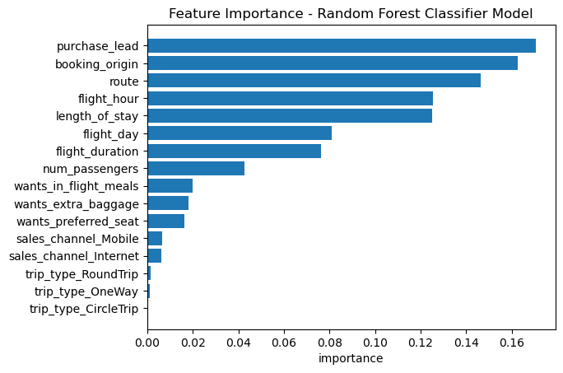
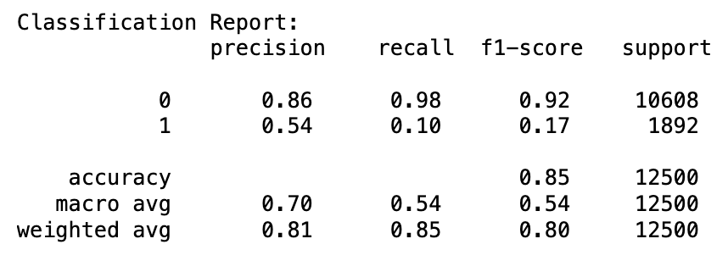
PREDICTIVE MODELING – RANDOM CLASSIFIER MODEL
Top features influencing customer behavior
Purchase lead
Booking origin
Route
Flight hour
Length of stay
Model Evaluation
Accuracy: 85%
Model also performs well for class 0, with a high precision, recall, and F1-score
Room for improvement for class 0, especially in recall for class 1

